Slide 1
greenhouse effect
water heater experiment
PHYSICS
Social and Natural Science Cooperative work
5th grade - 2017-2018 Course
KA2 “Let’s cross the boundaries
of Primary education together”

Slide 2
BUILDing A WATER HEATER- WORK PROCESS
We worked in different teams and each member of the group had a responsibility.
We used a shoe box and we painted it in black. Then we traced with a pencil the size of the tube (in the box) and then we made a hole with the scissors in the box. We stick the tube with electrical tape (because normal zeal was taking off) and we covered the shoe box with a transparent plastic.
We measured the water before (at room temperature- 18 degrees), we wait 20 minutes with the water in the tubes (in the box) and we meausure it again after the activity (21 degrees).

Slide 3
we need
shoe box
black paint
transparent plastic
a plastic tube (2m and 1cm diameter)
clothespins
scissors
thermometer
electrical tape
a bucket

Slide 4
How and why has it happened? What do we want to demonstrate?
Transparent plastic lets the light pass through it (inside the box) but the plastic does not let the heat escape, which stays in the box. For this reason the water temperature increases.
In the atmosphere there are some gases, called "greenhouse effect" that do the same as transparent plastic: they let the light go by but they do not let it get hot and therefore the earth warms up.
Thanks to these gases, the Earth is not frozen, but nowadays the increase in gas emissions causes higher temperatures on Earth (the dangerous "global warming").

Slide 5
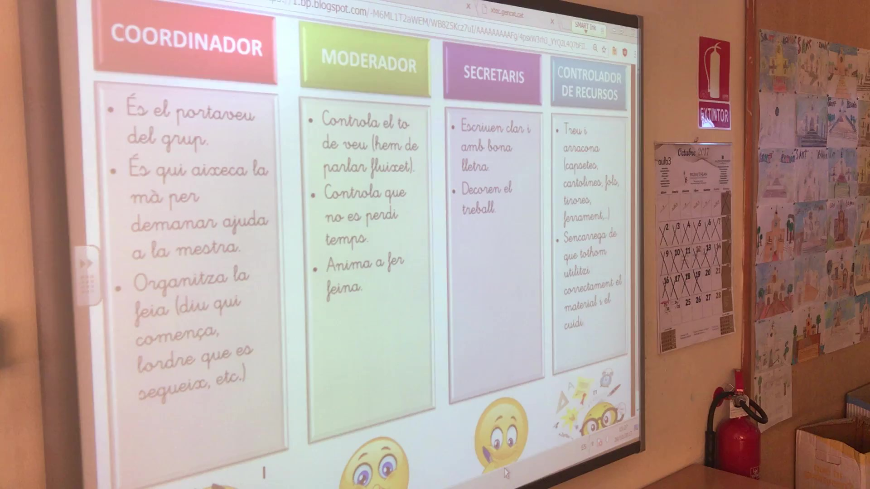
working cooperatively- we work in teams

Slide 6
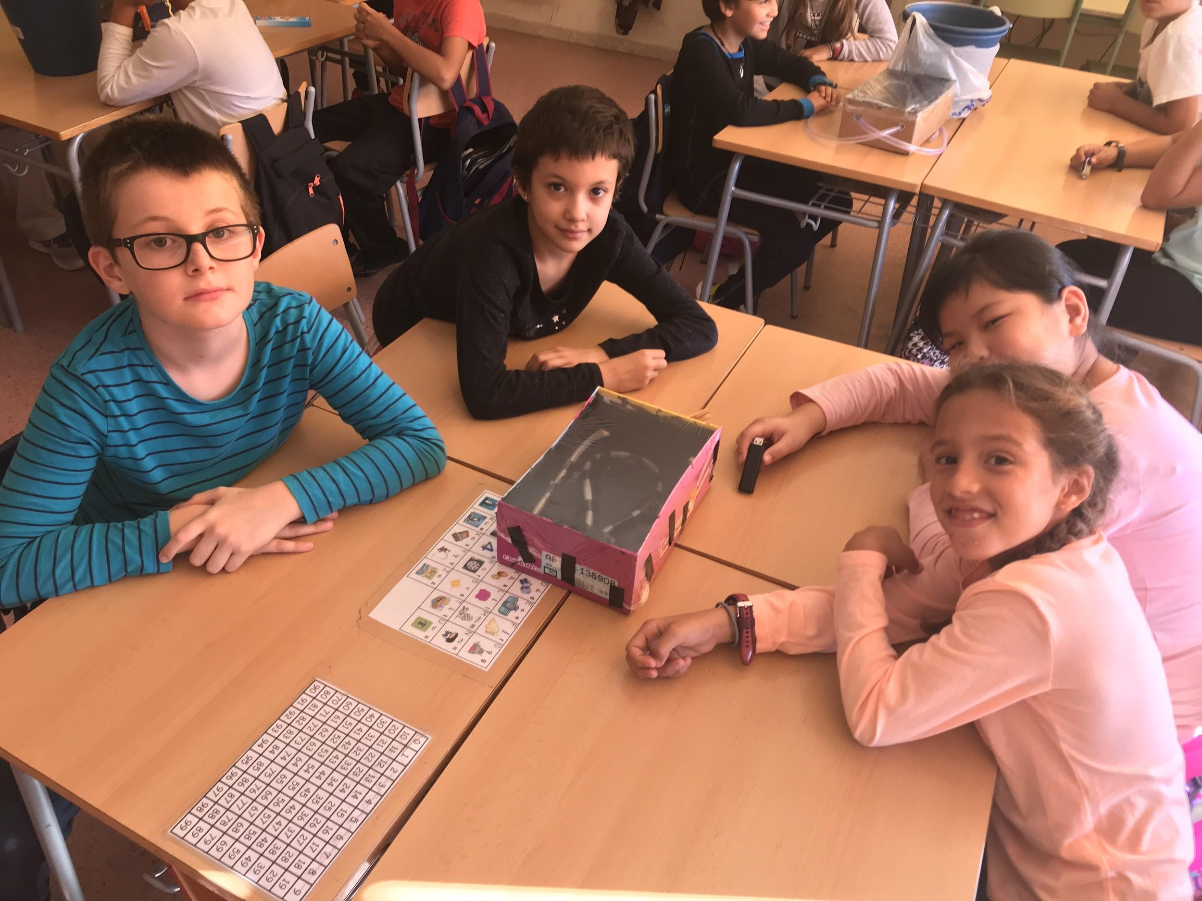

Slide 7
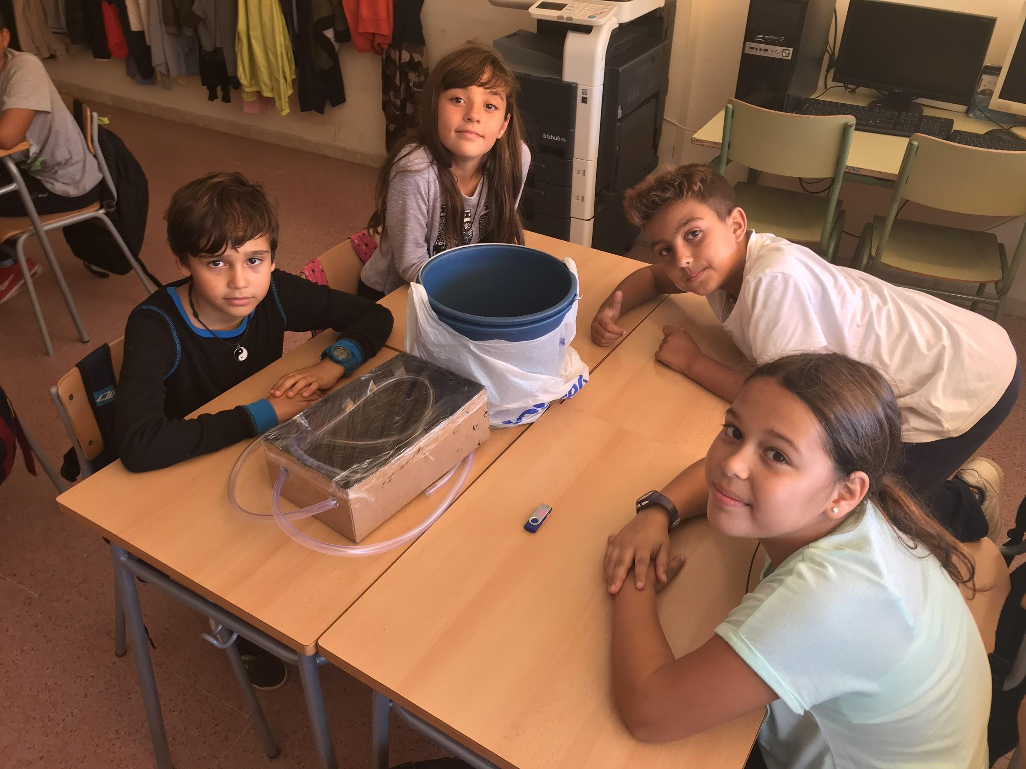

Slide 8
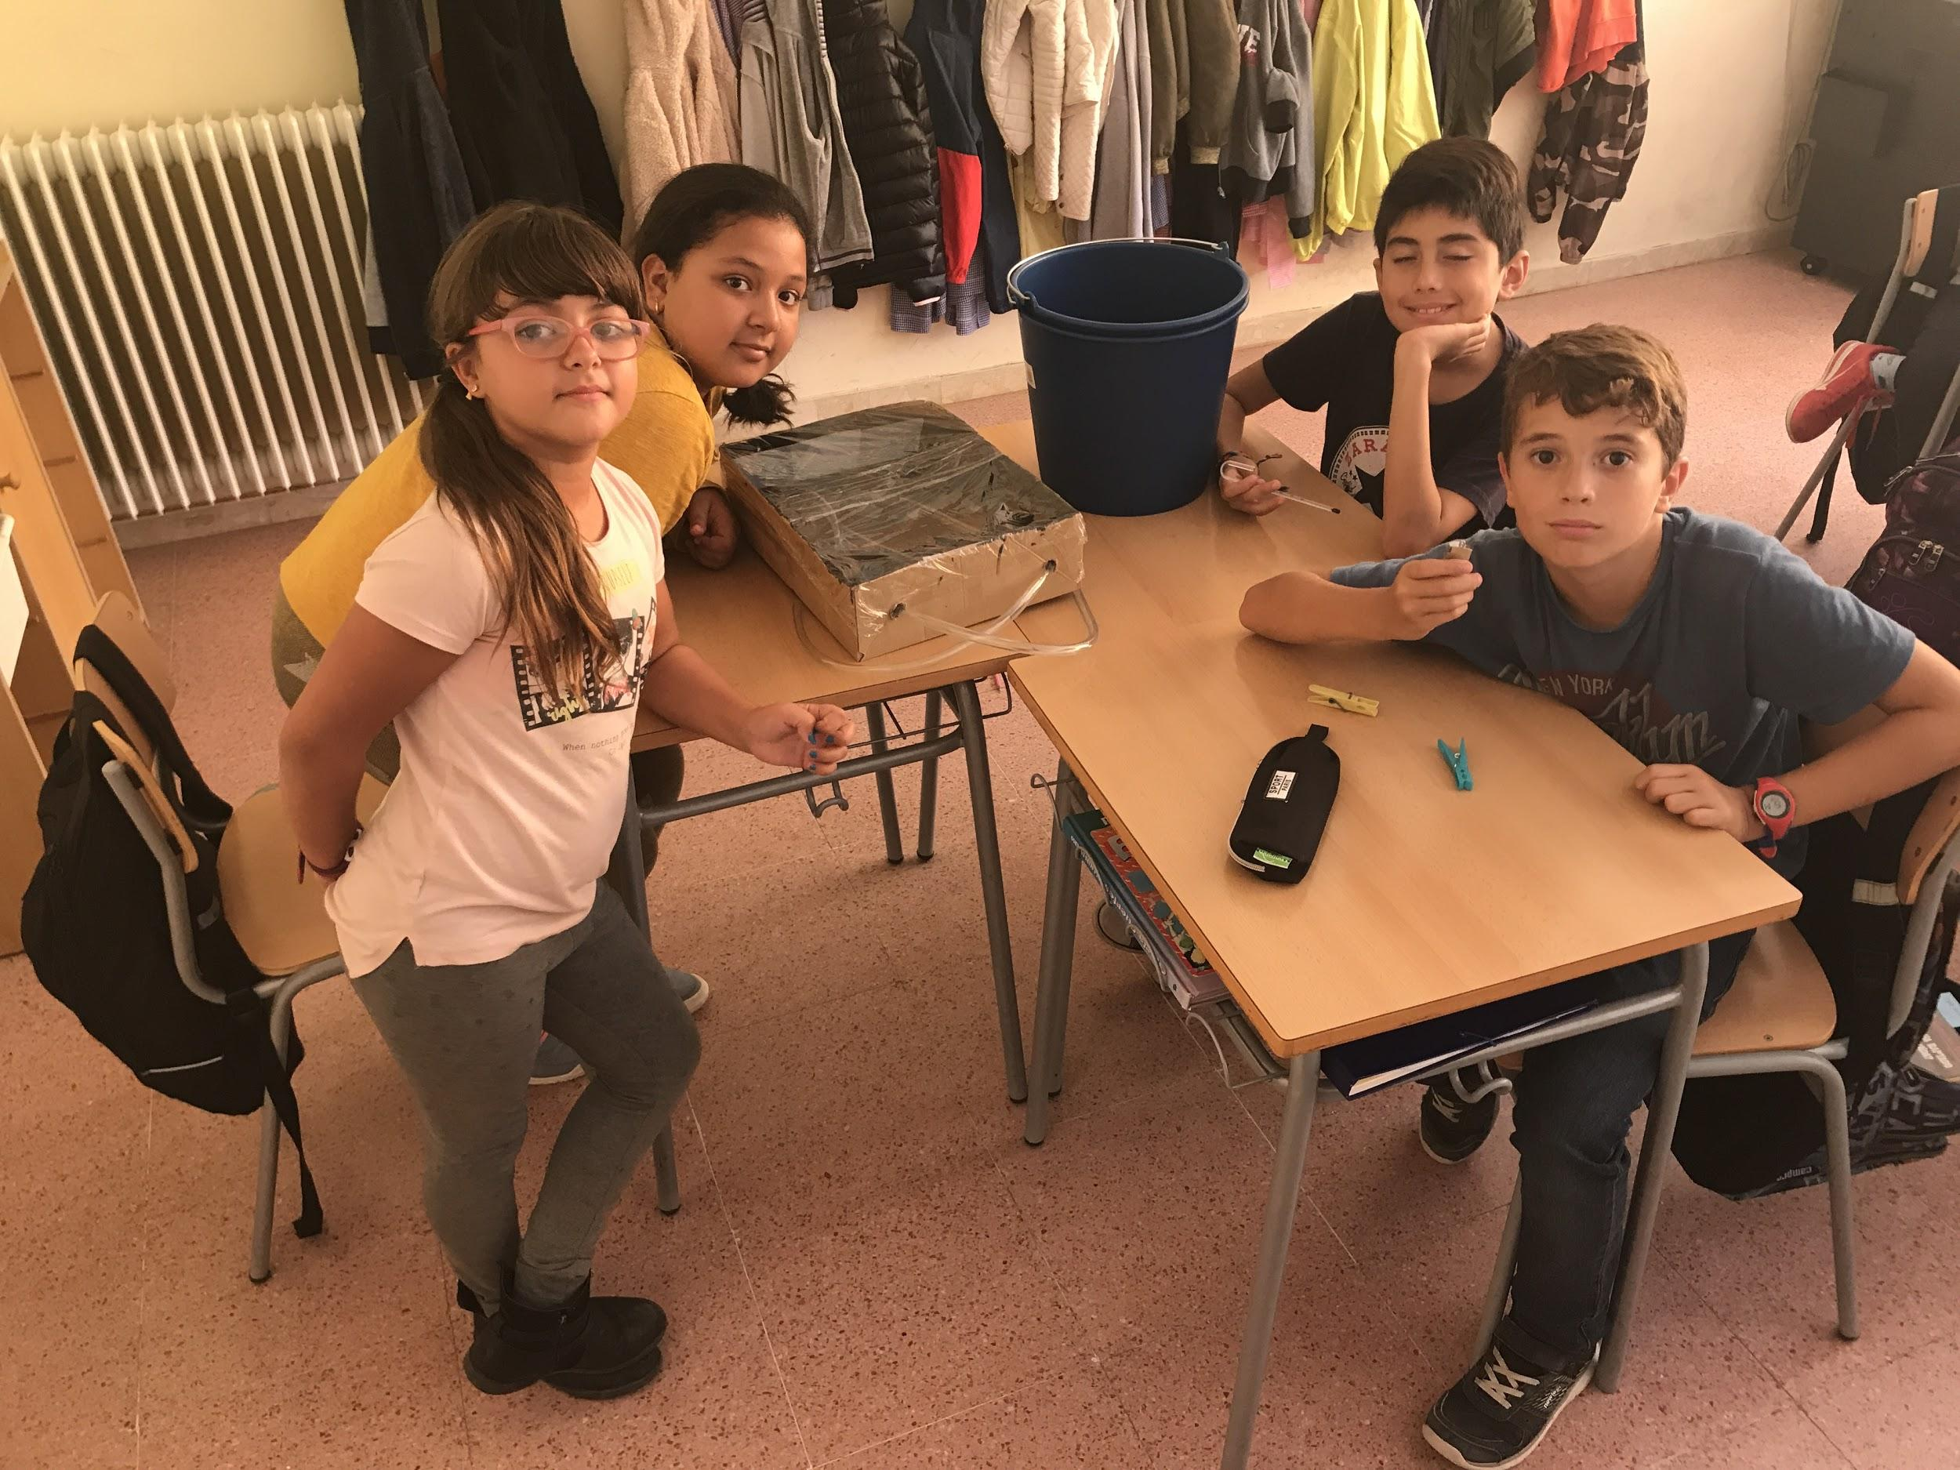

Slide 9
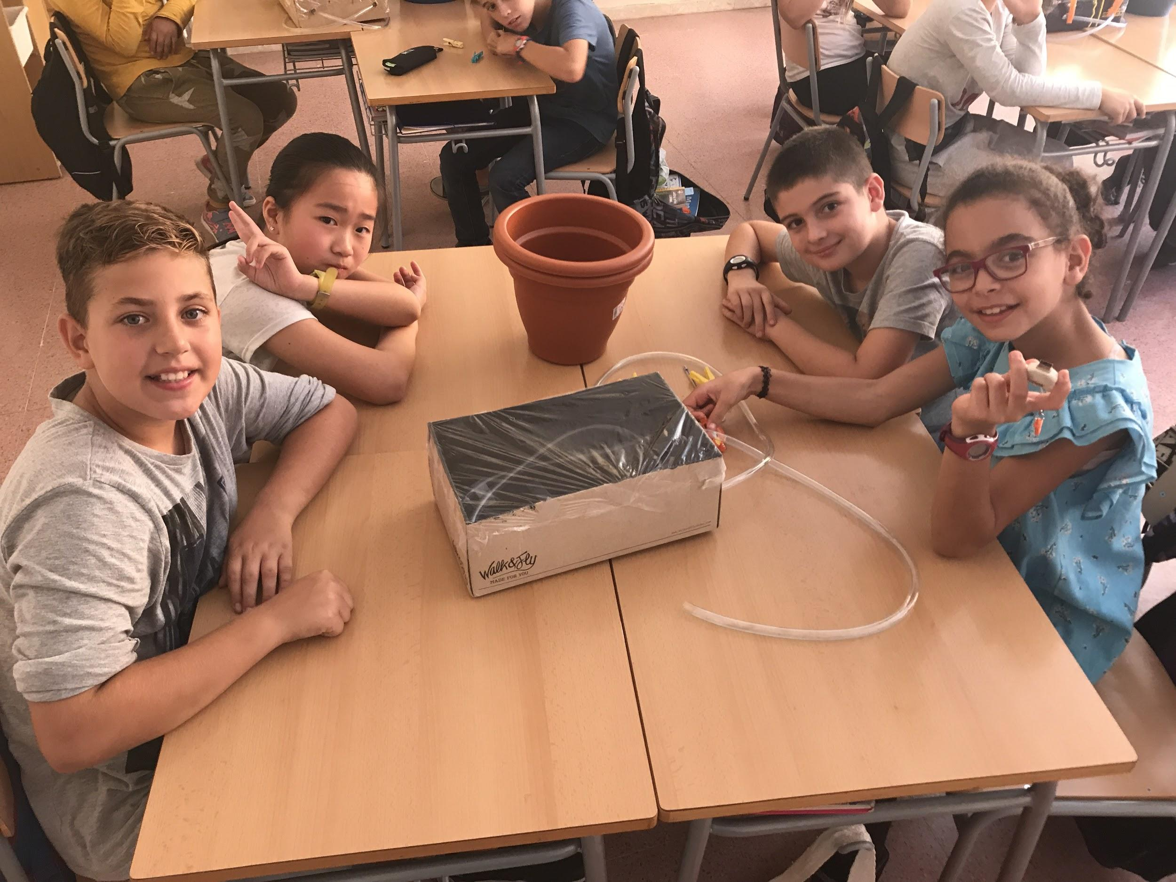

Slide 10
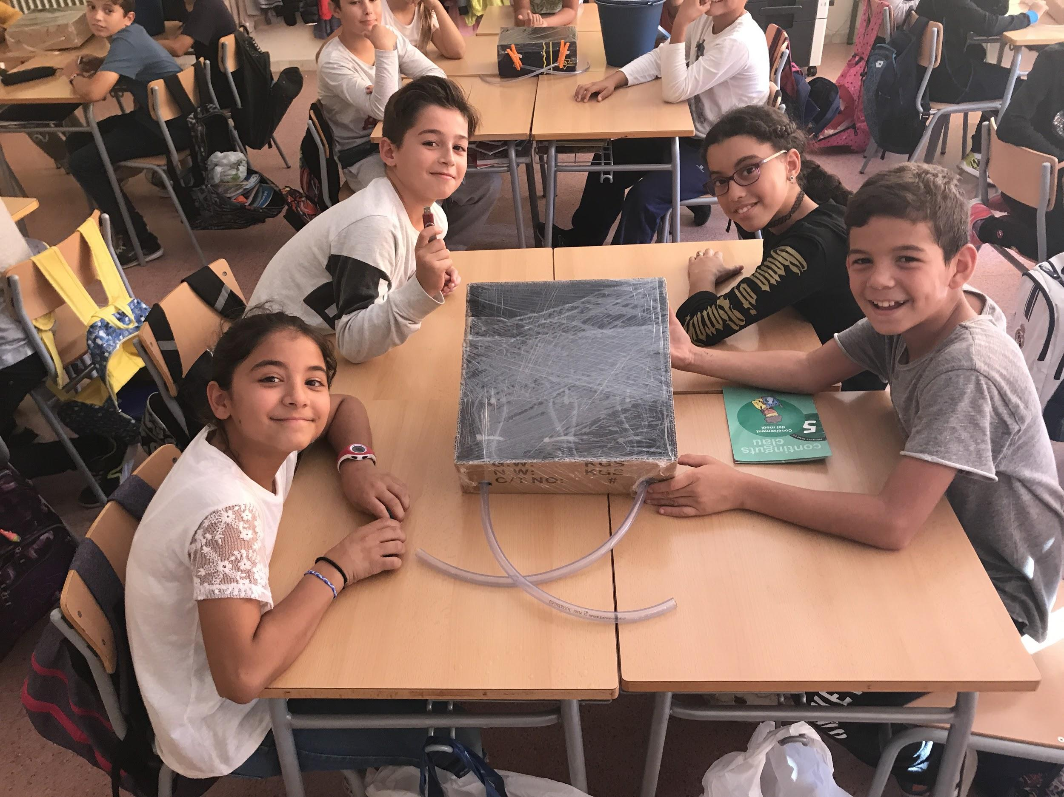

Slide 11
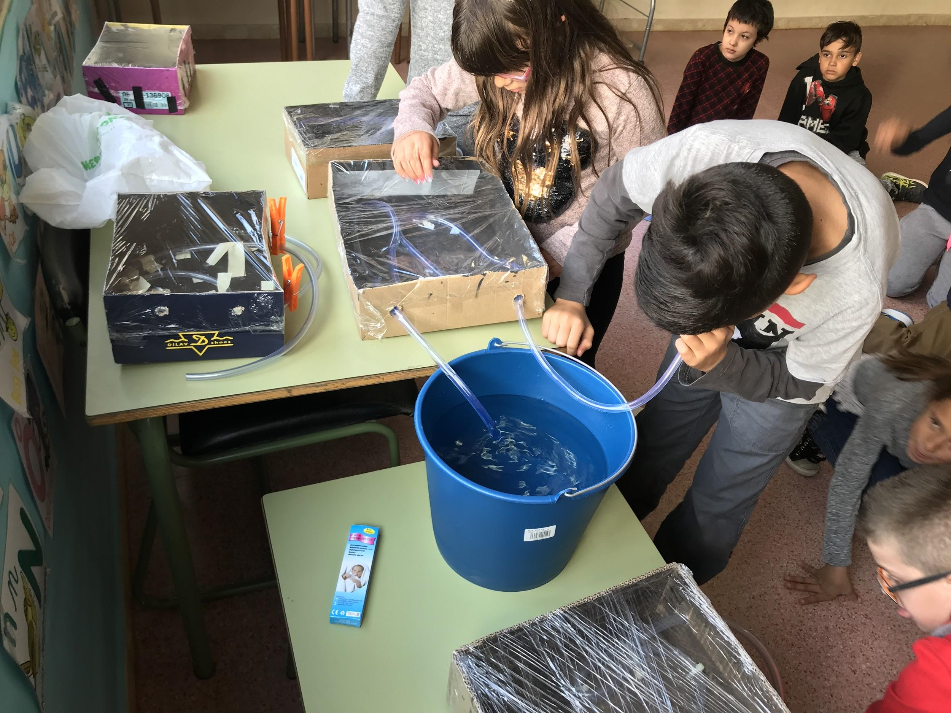

Slide 12
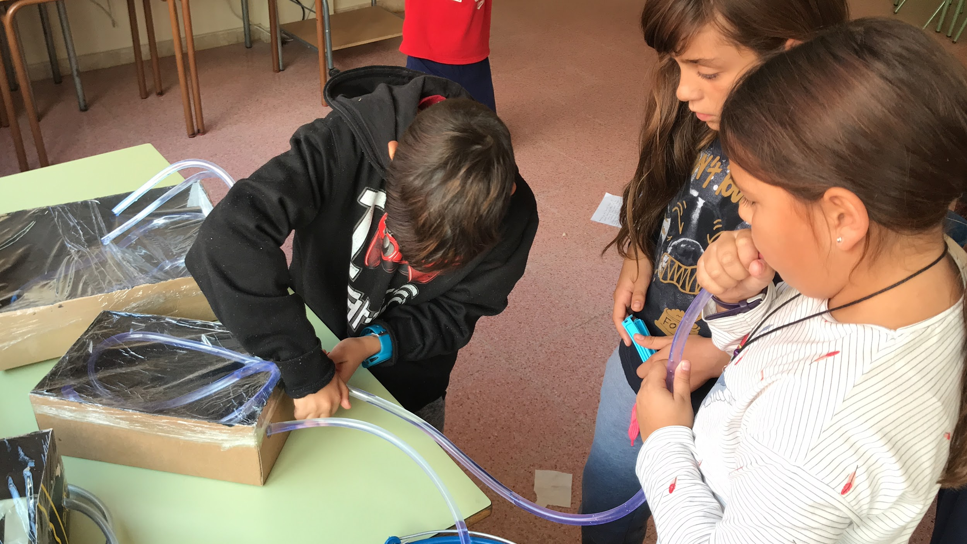

Slide 13
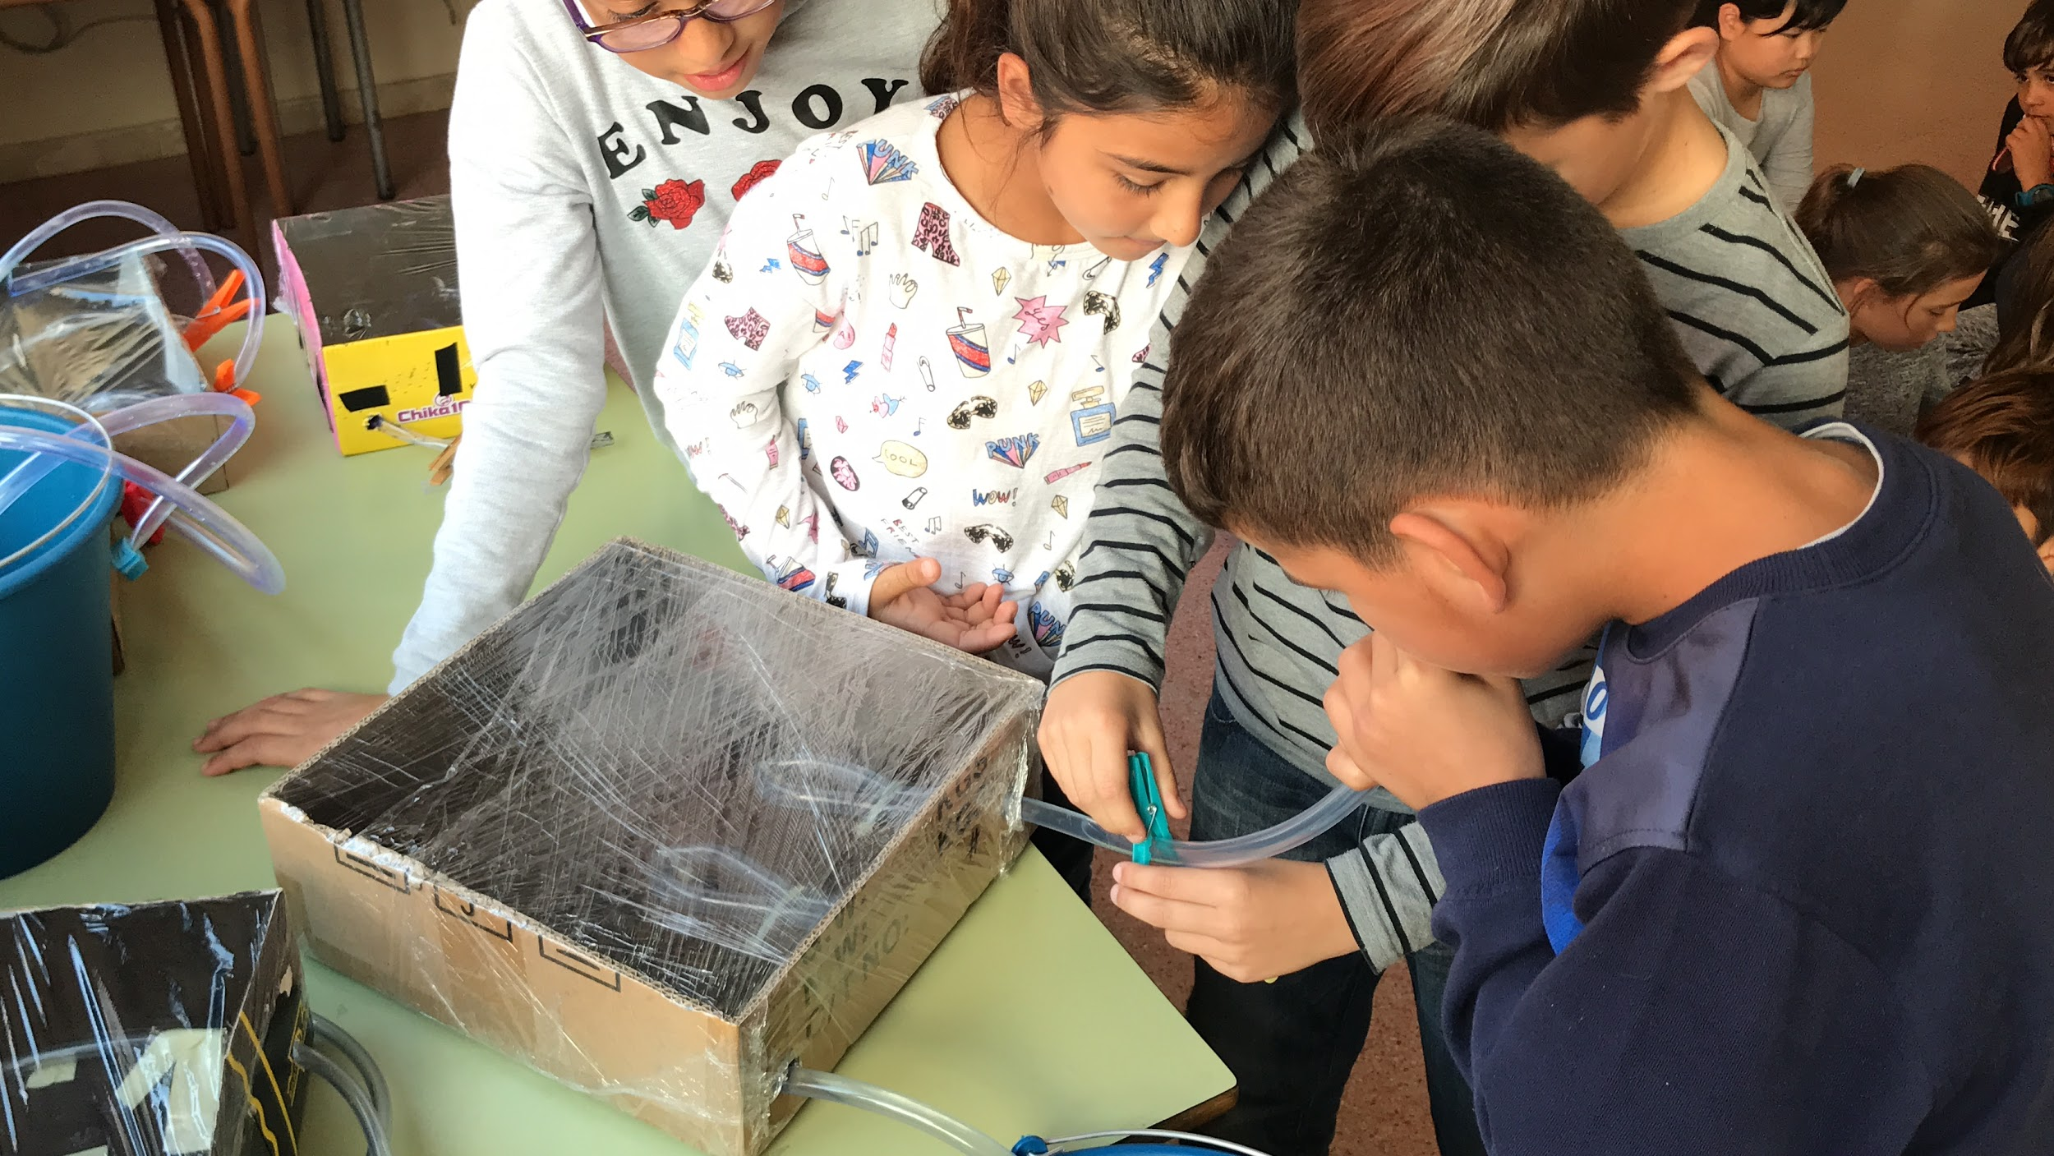

Slide 14
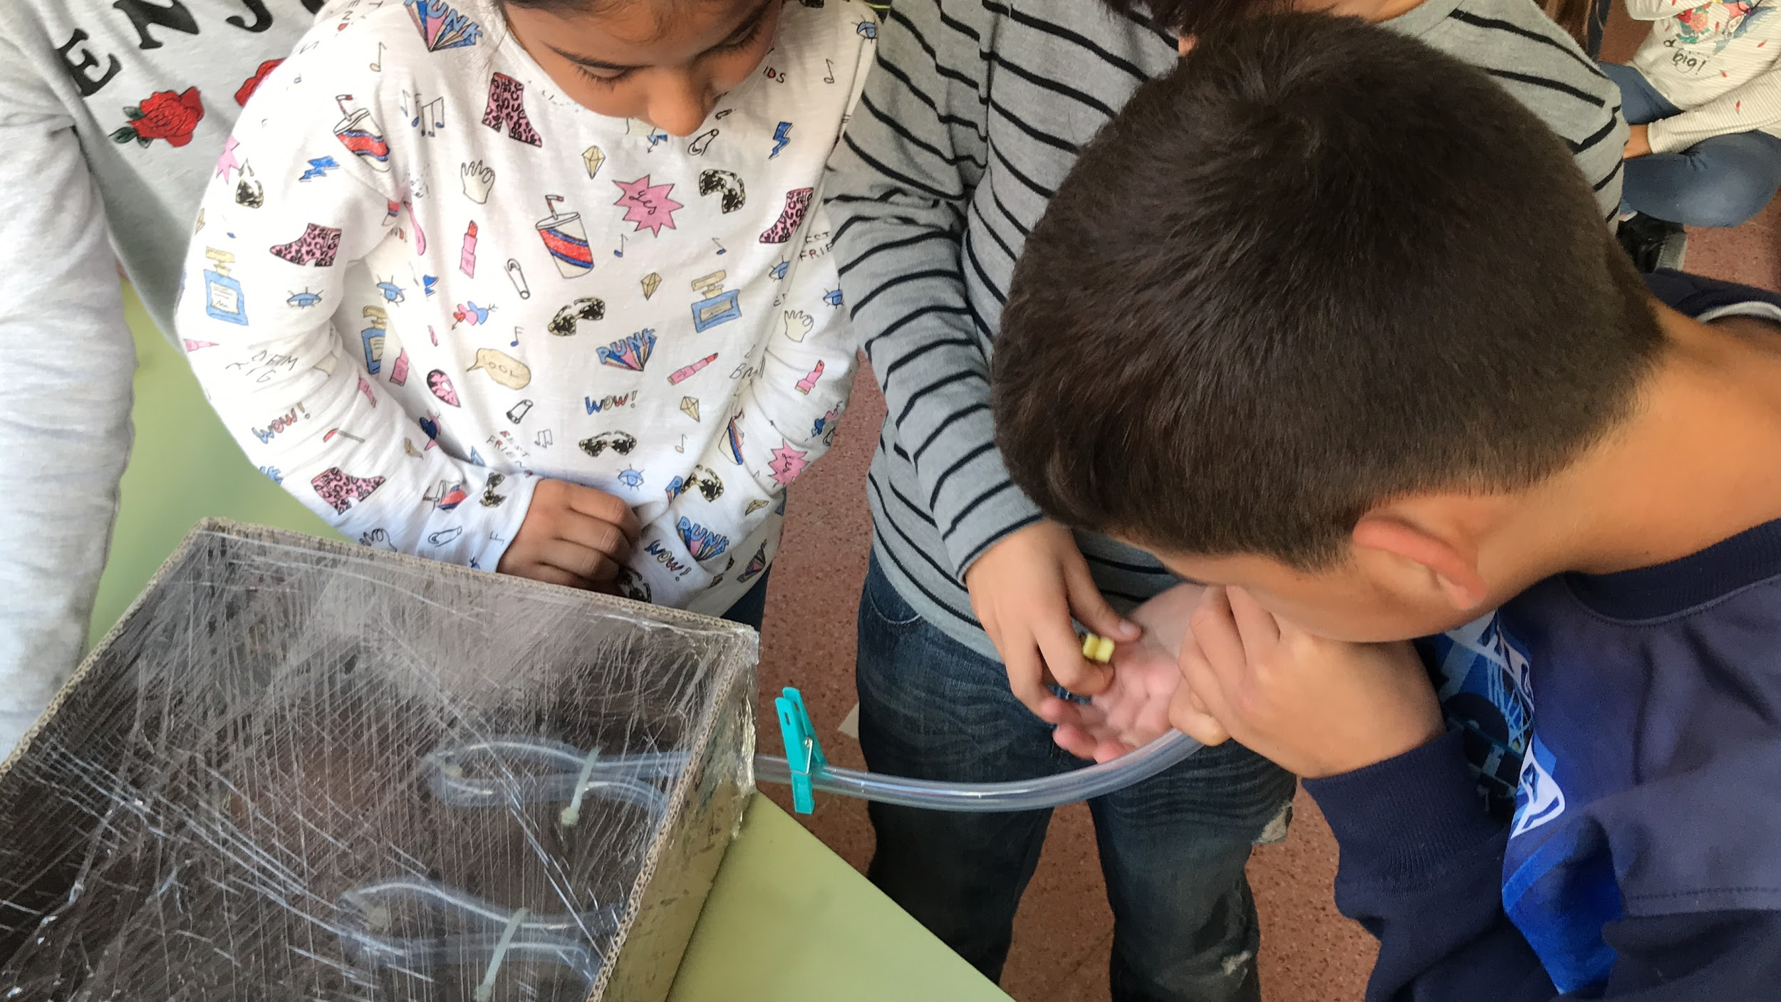

Slide 15
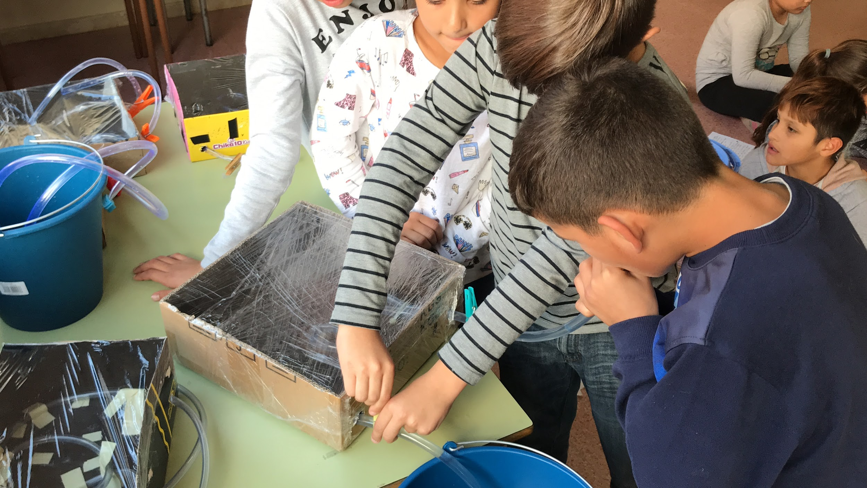

Slide 16
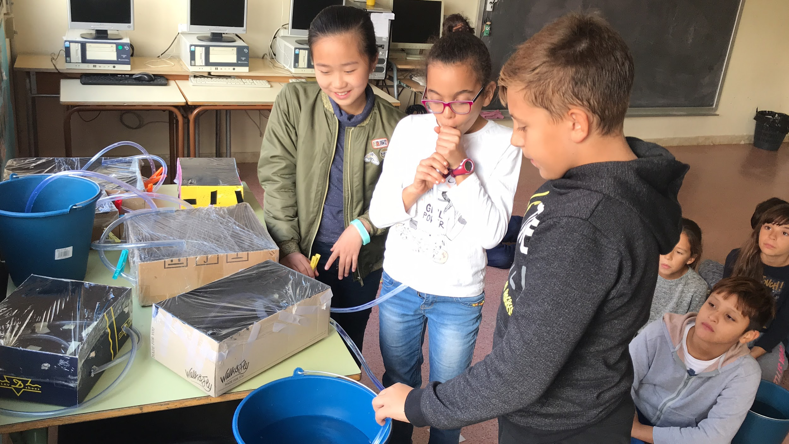

Slide 17
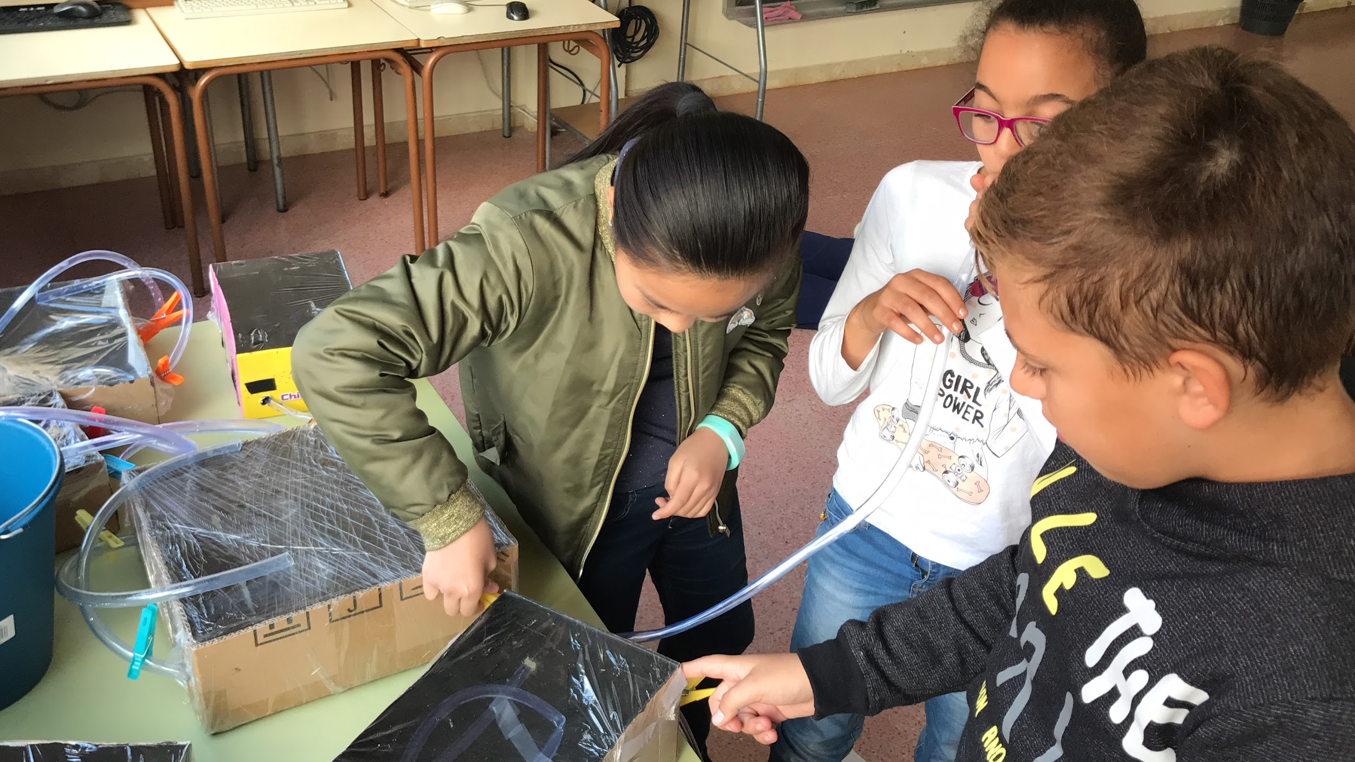

Slide 18
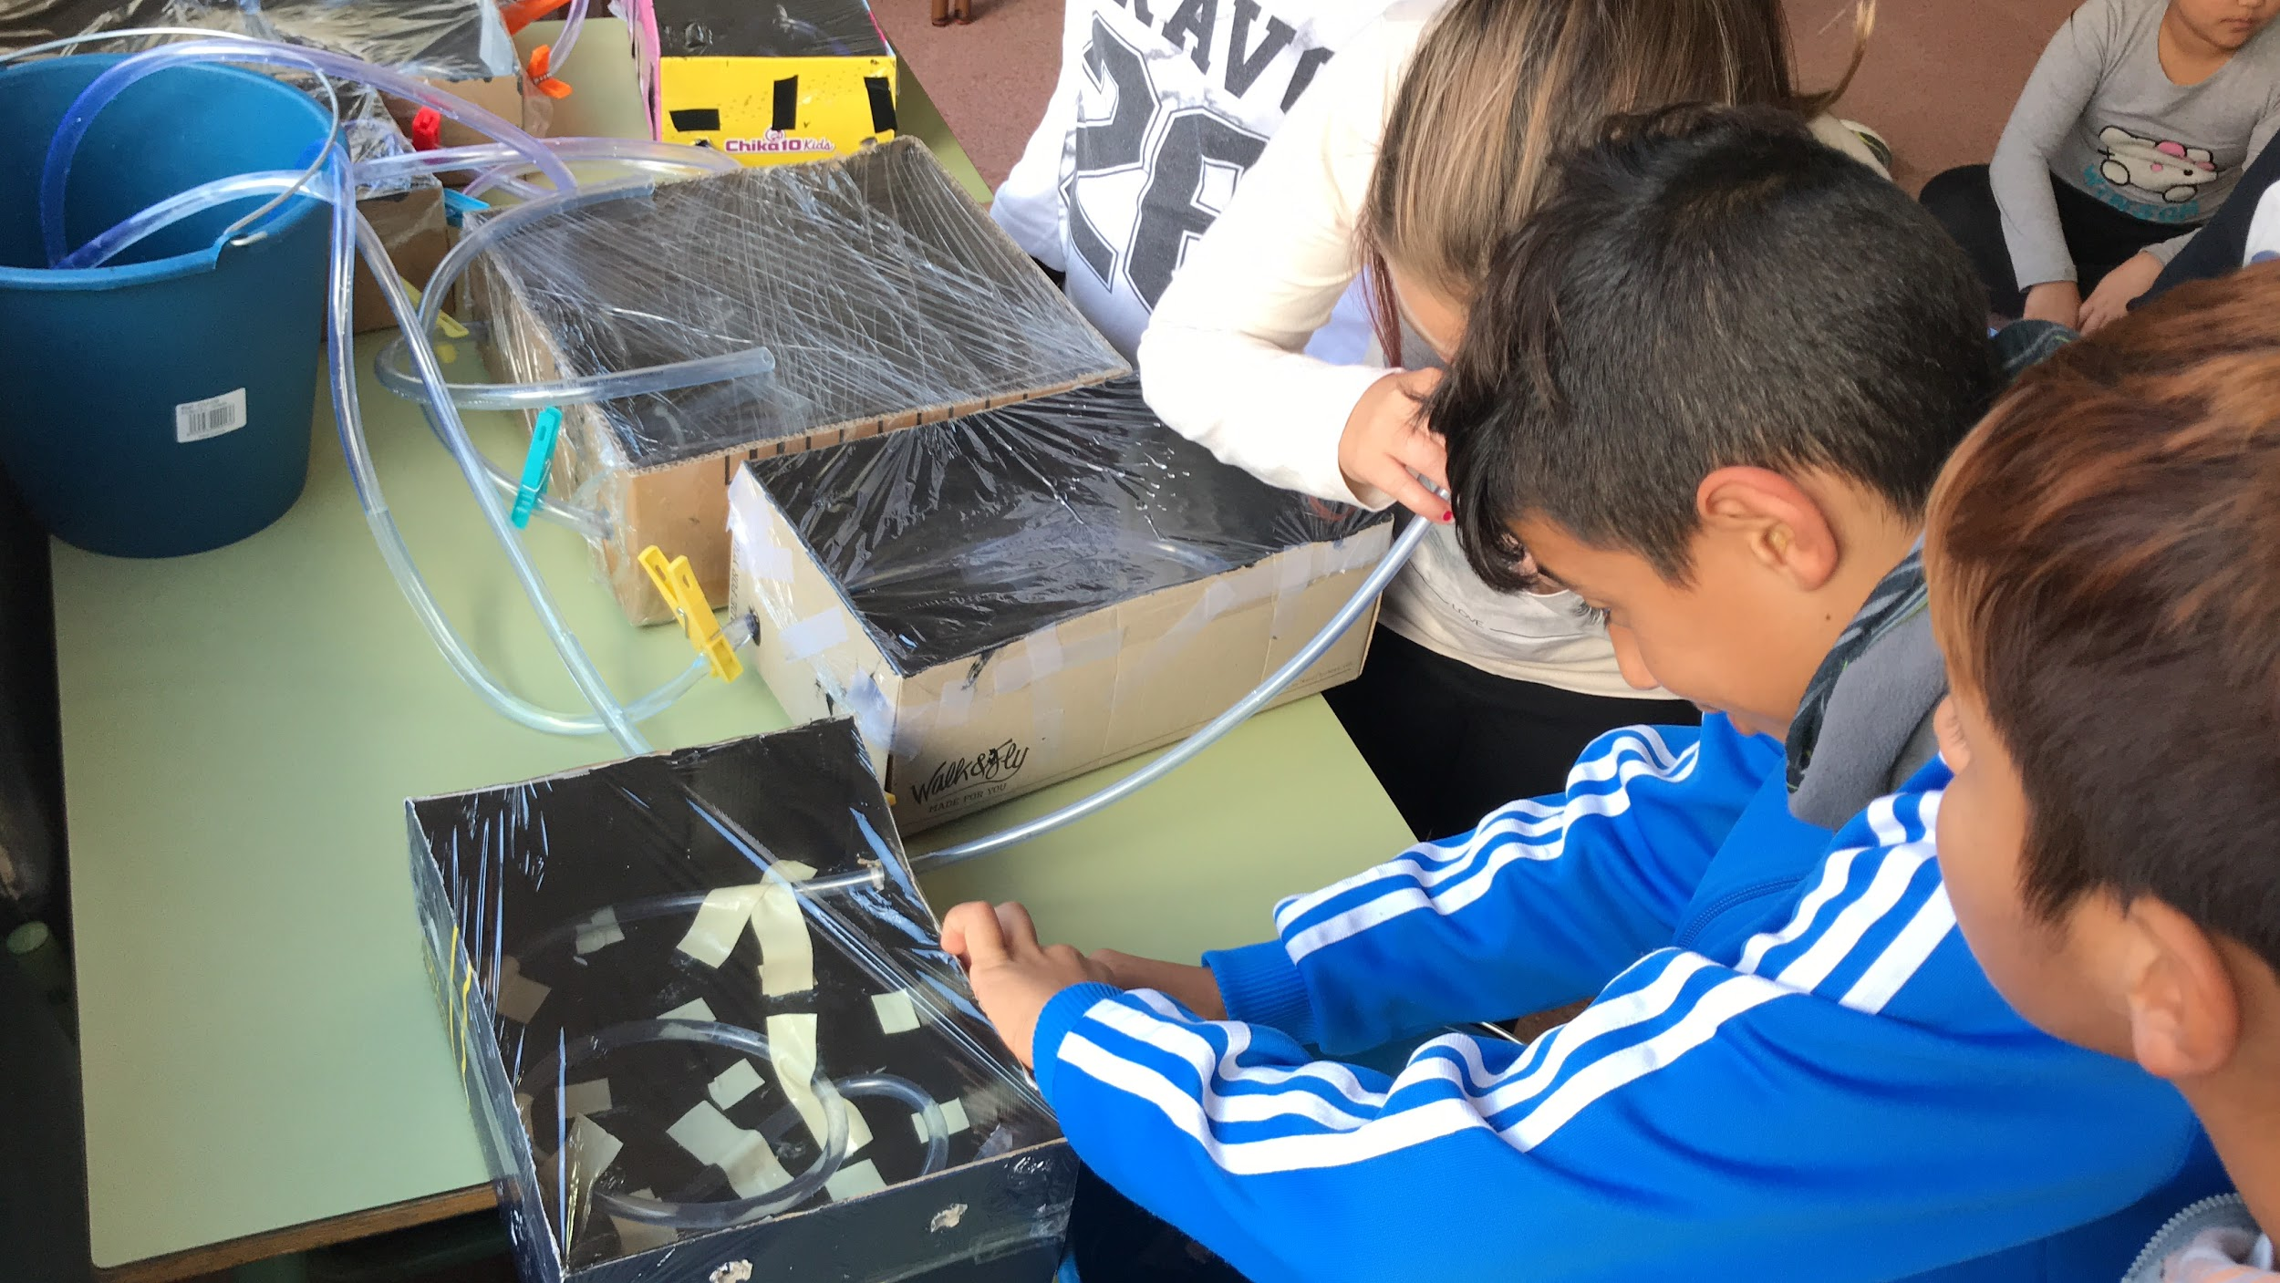

Slide 19
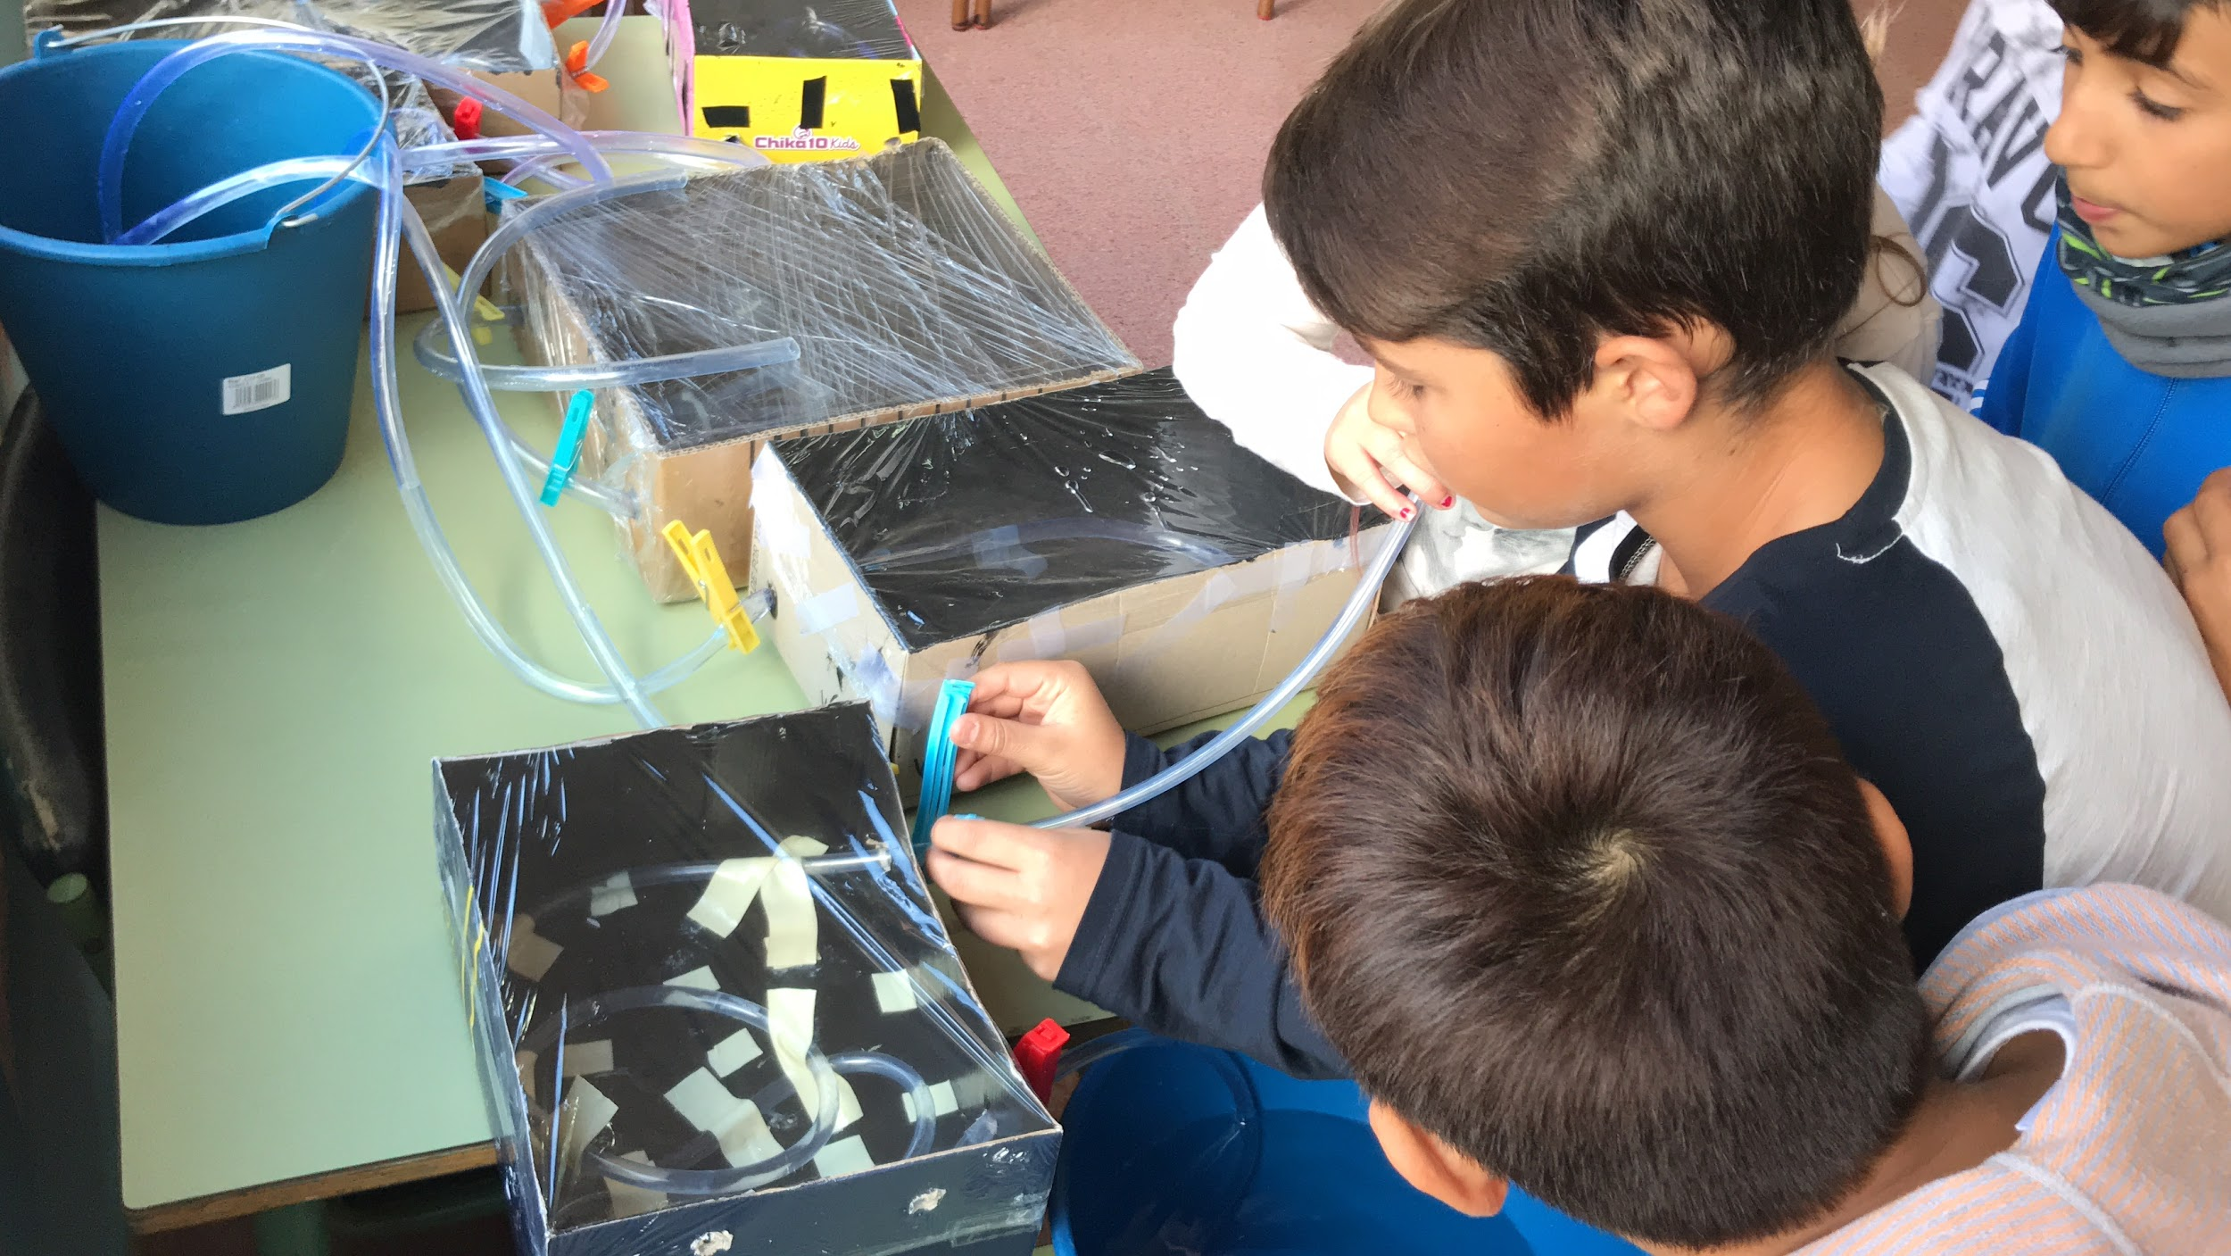

Slide 20
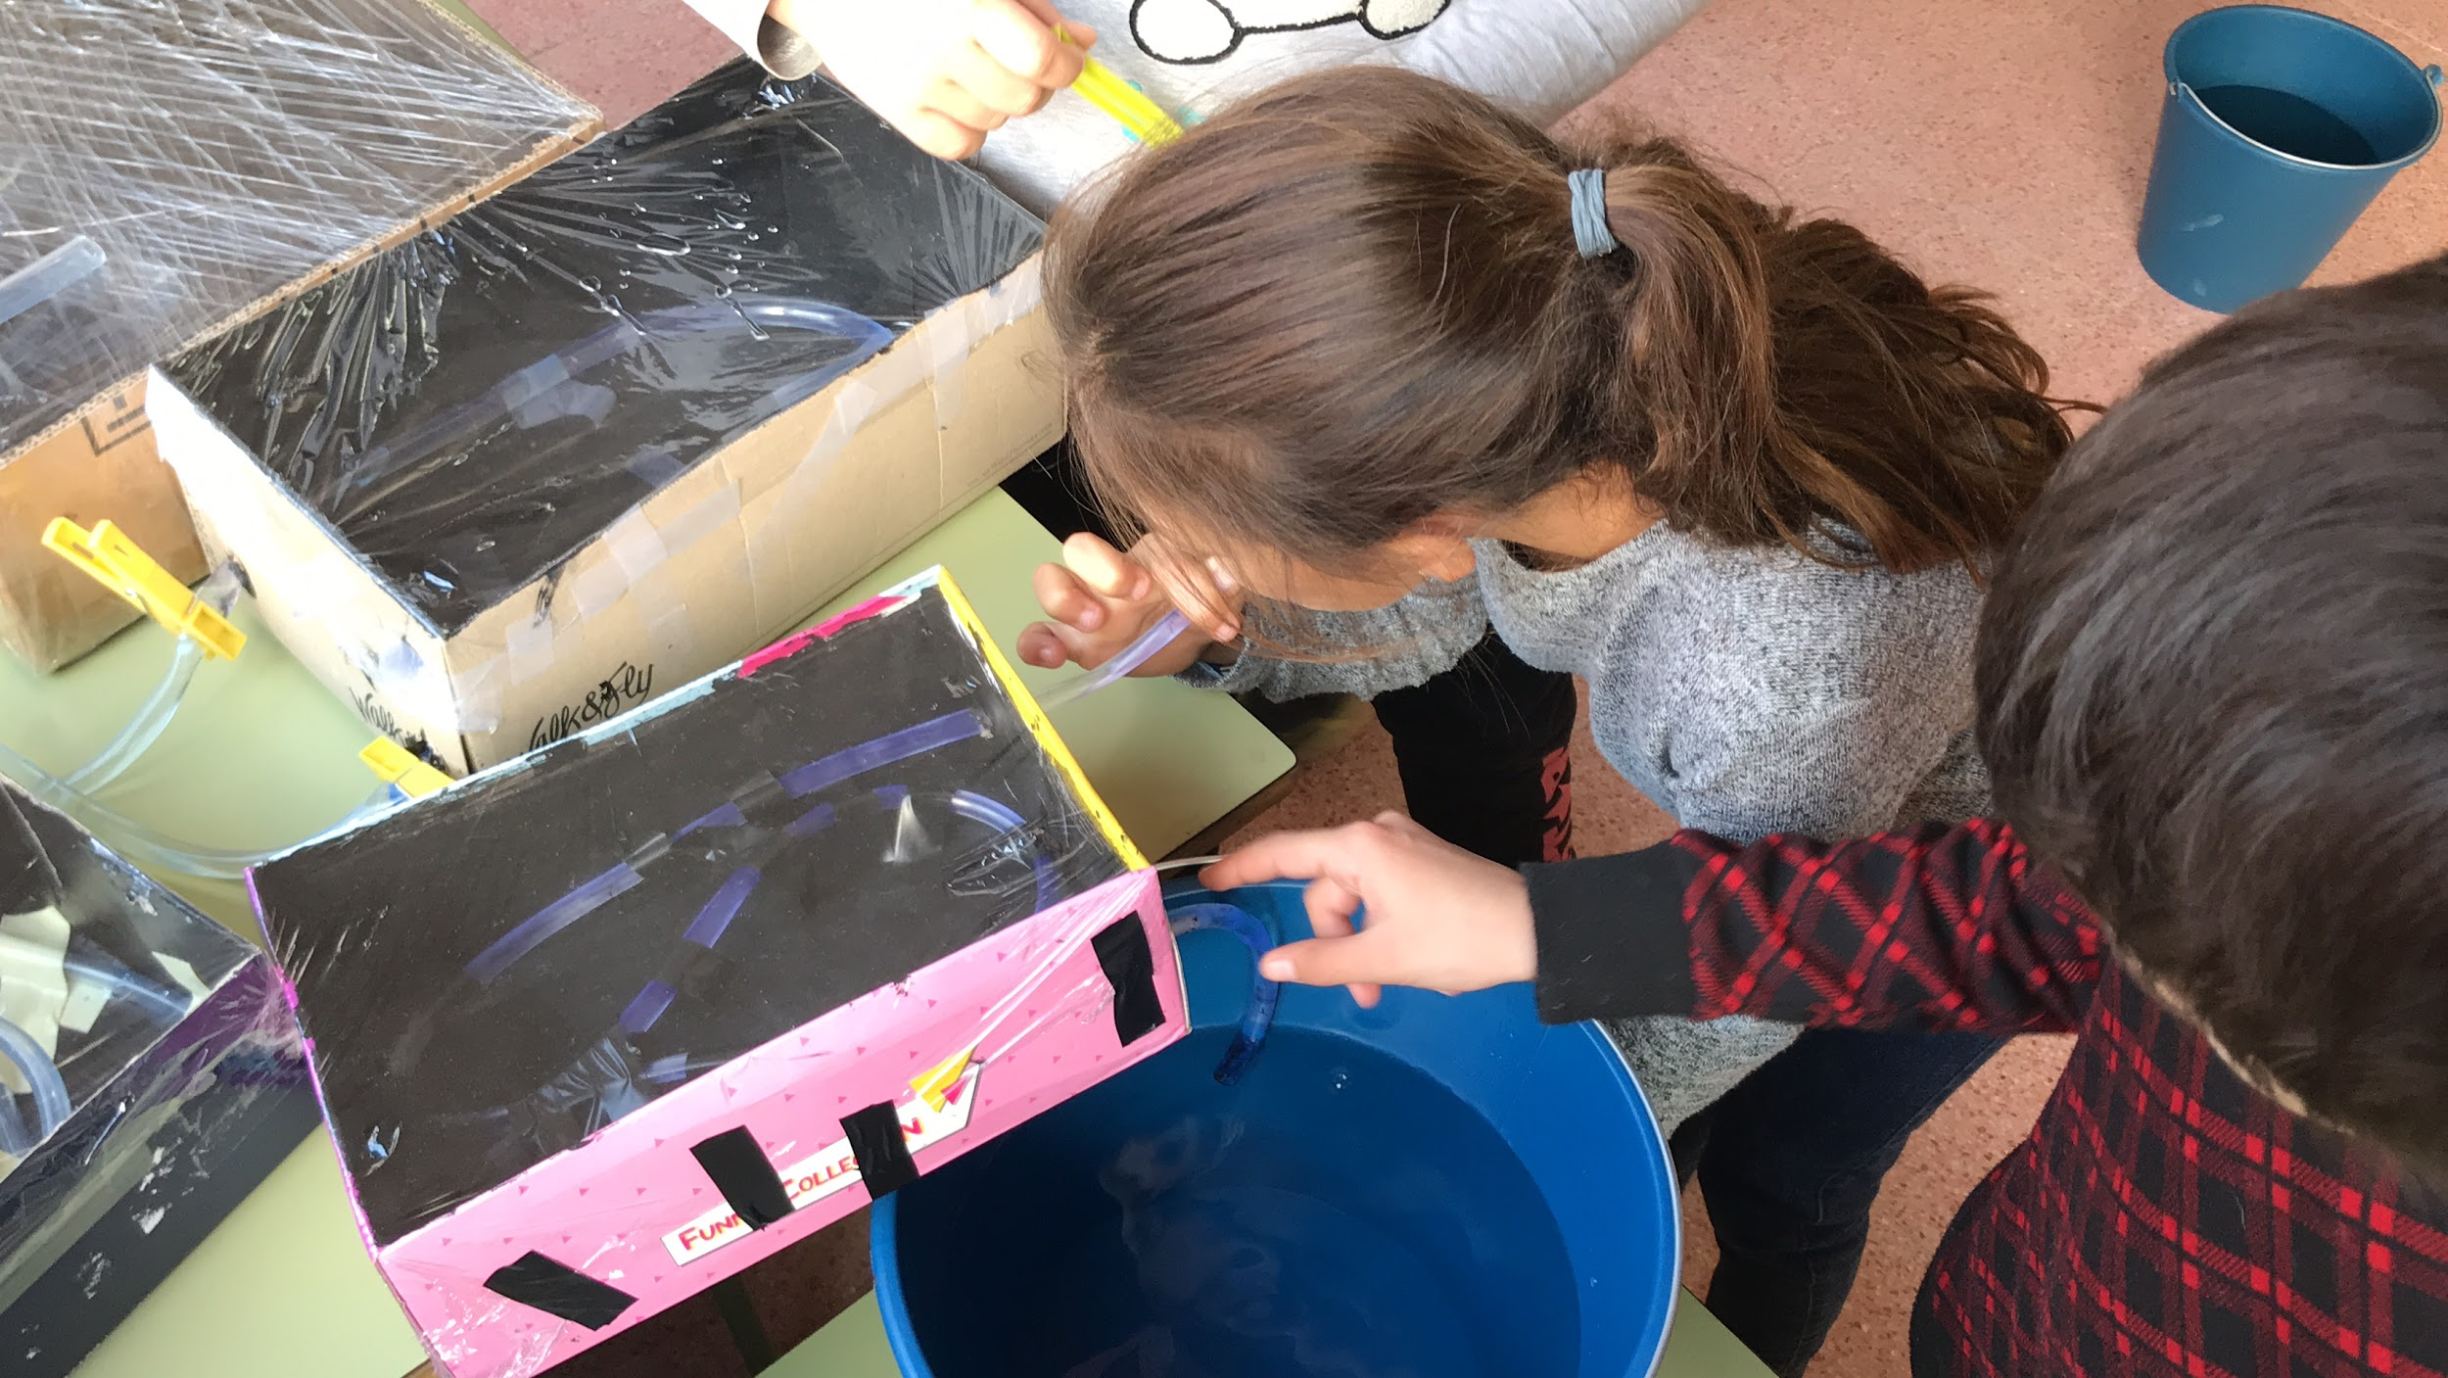

Slide 21
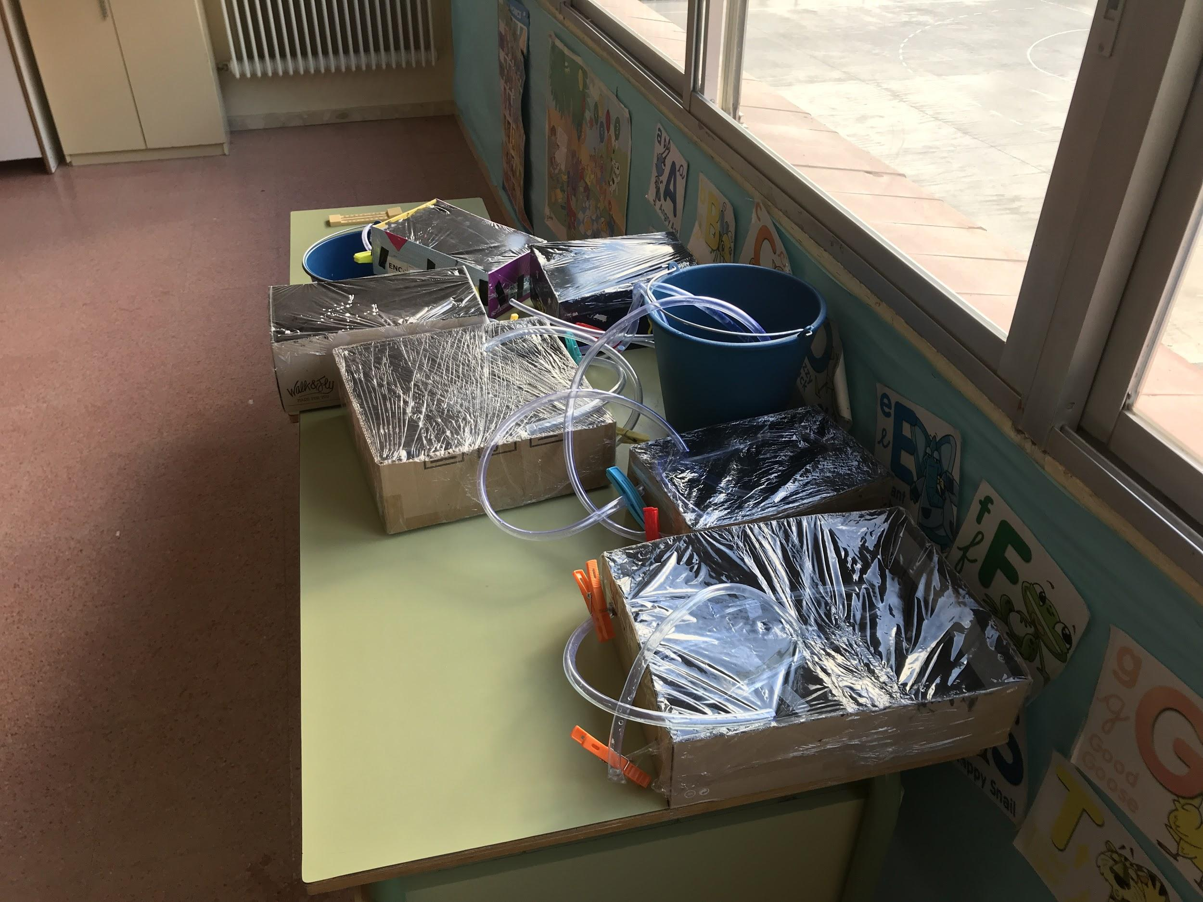
LOOK!!!! our water heaters!

Slide 22
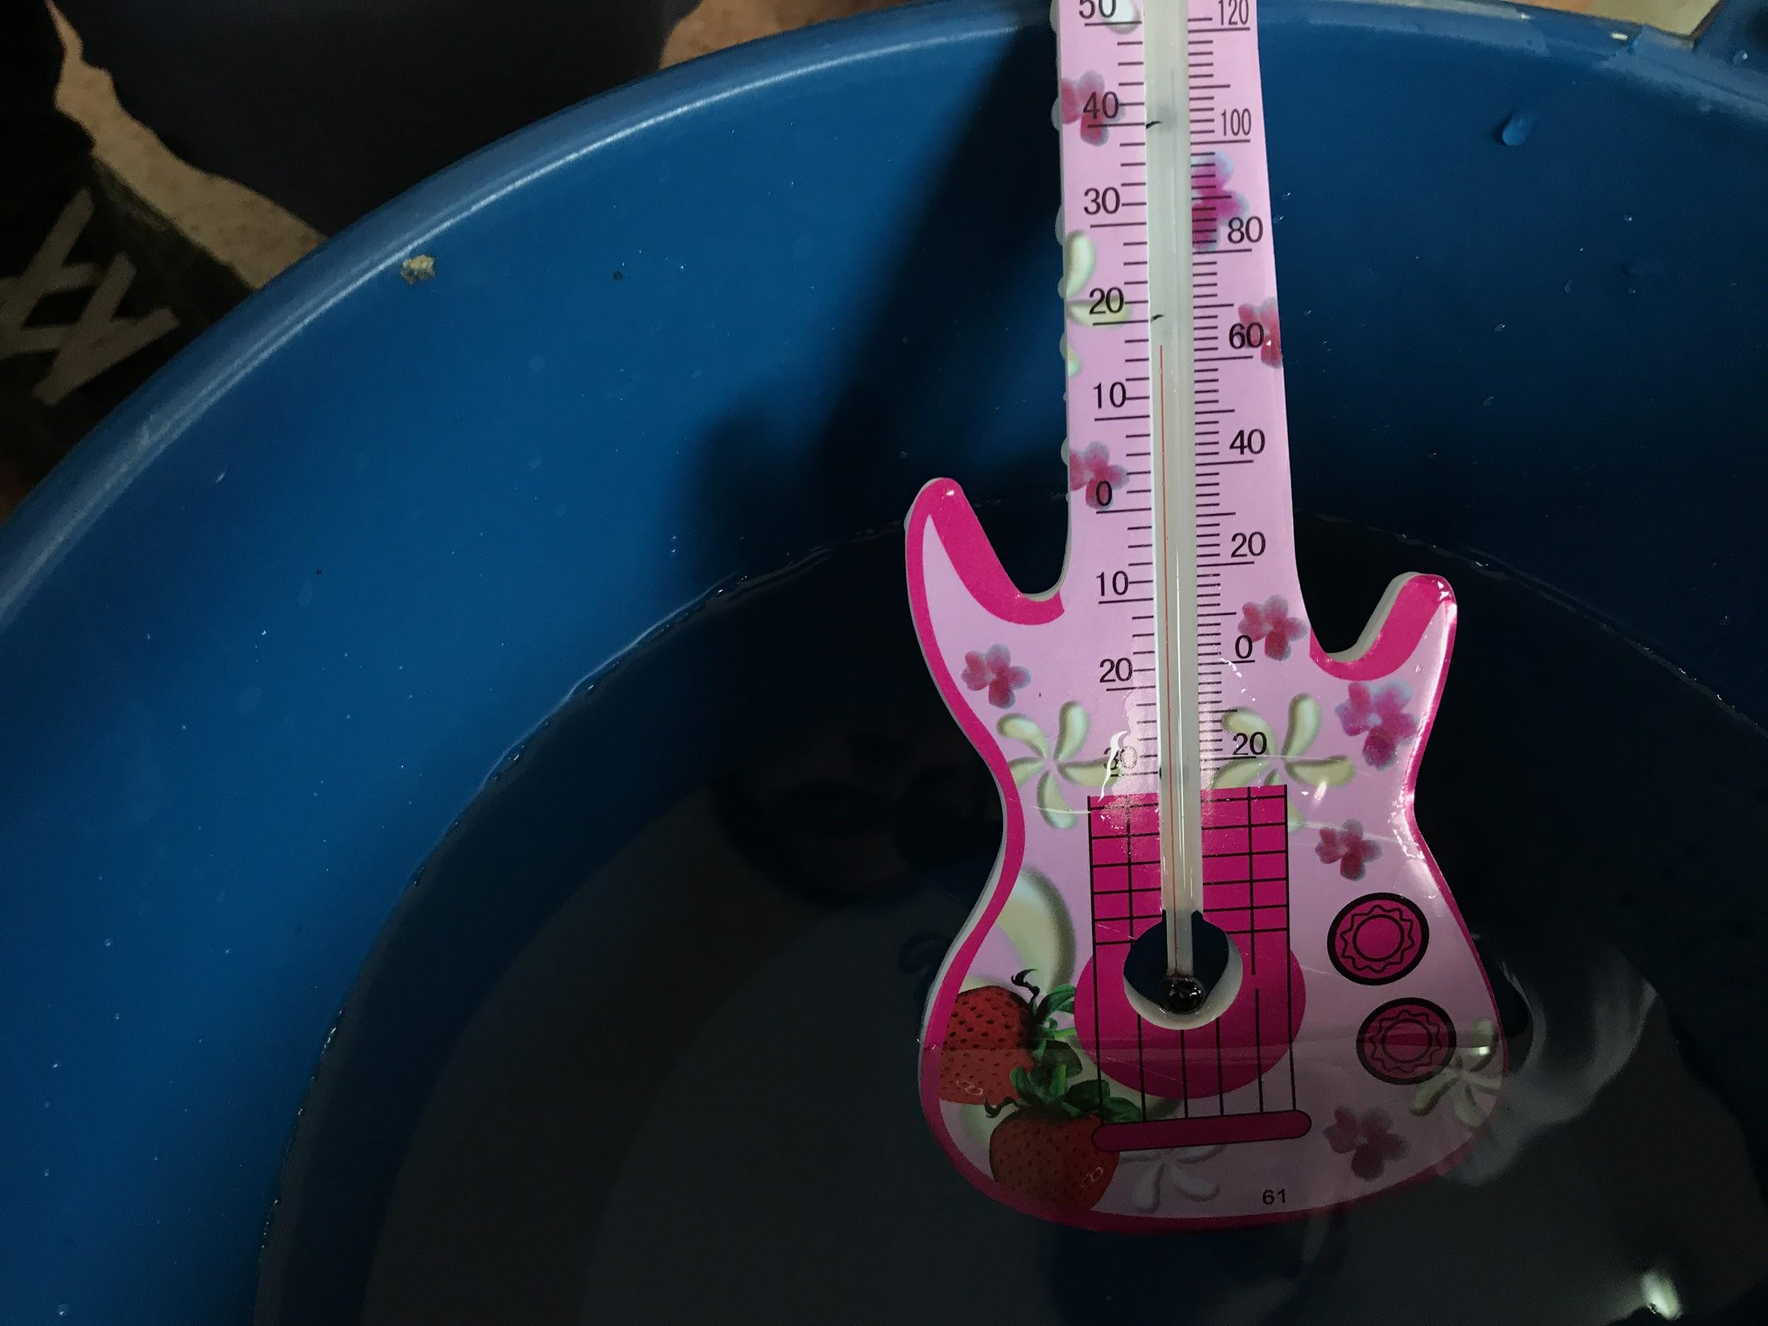
we measured the water temperature with a guitar-shaped thermometer!

Slide 23
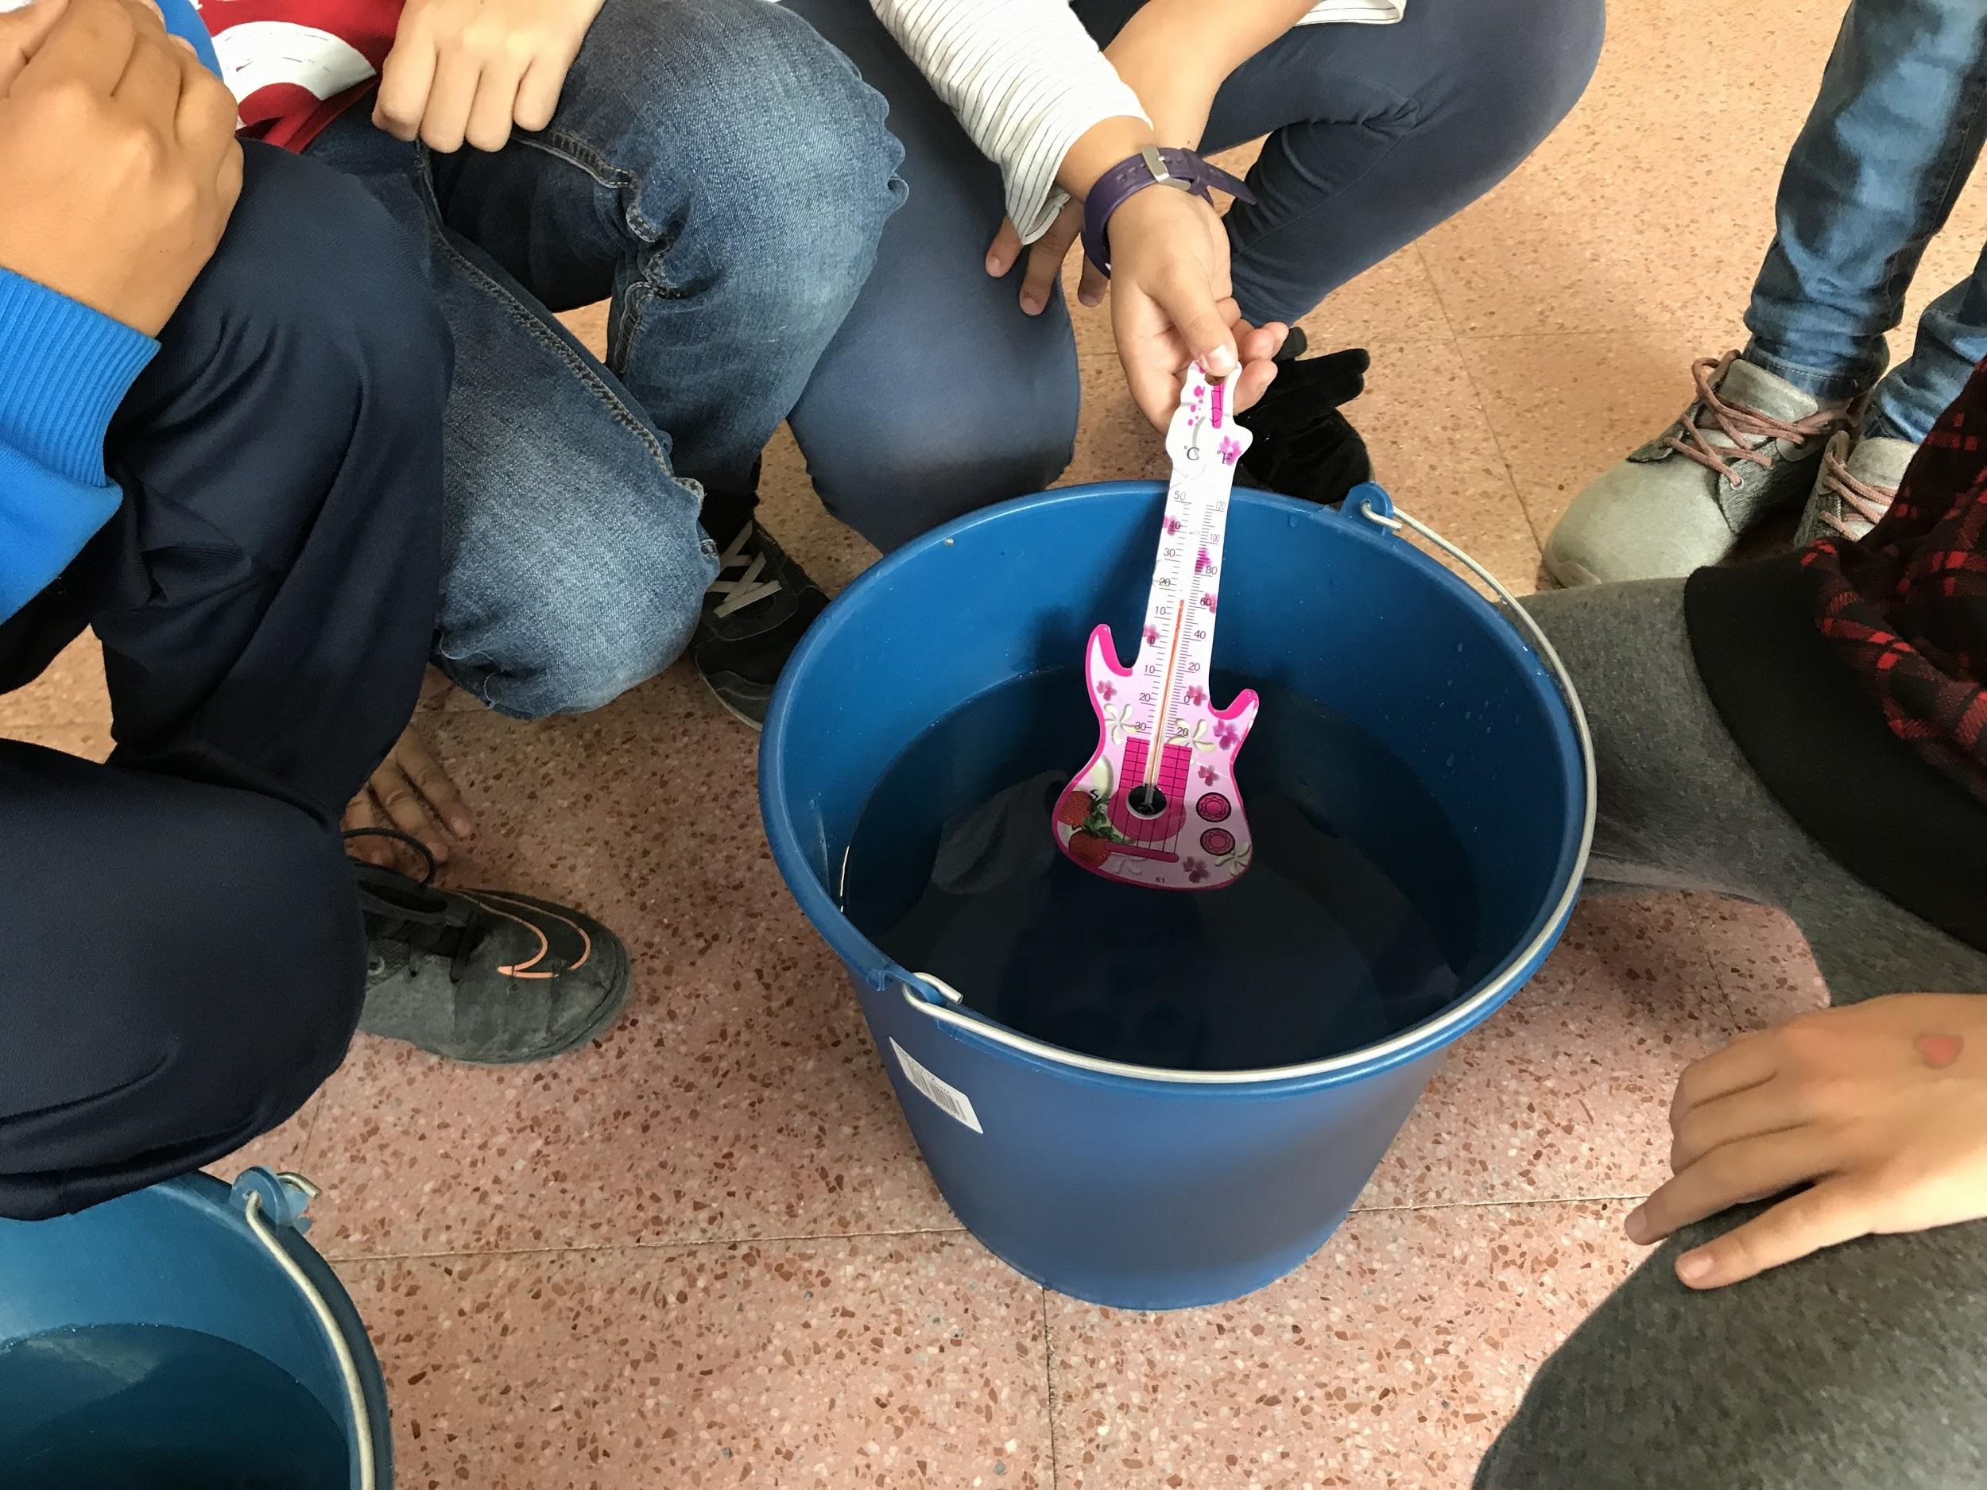
IT WORKED! three degrees of temperature difference!

Slide 24
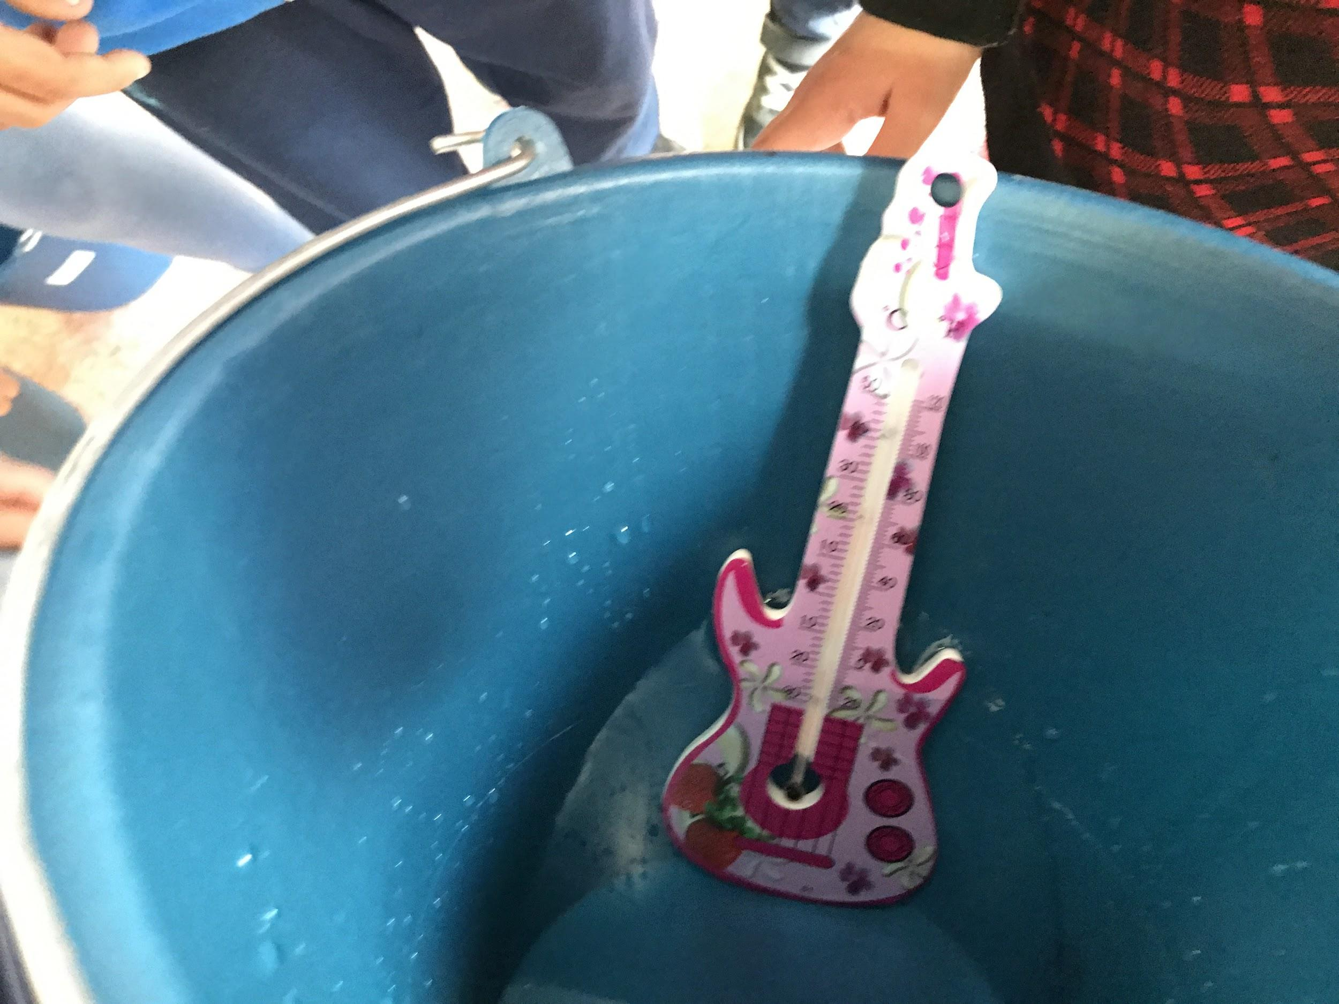

Slide 25
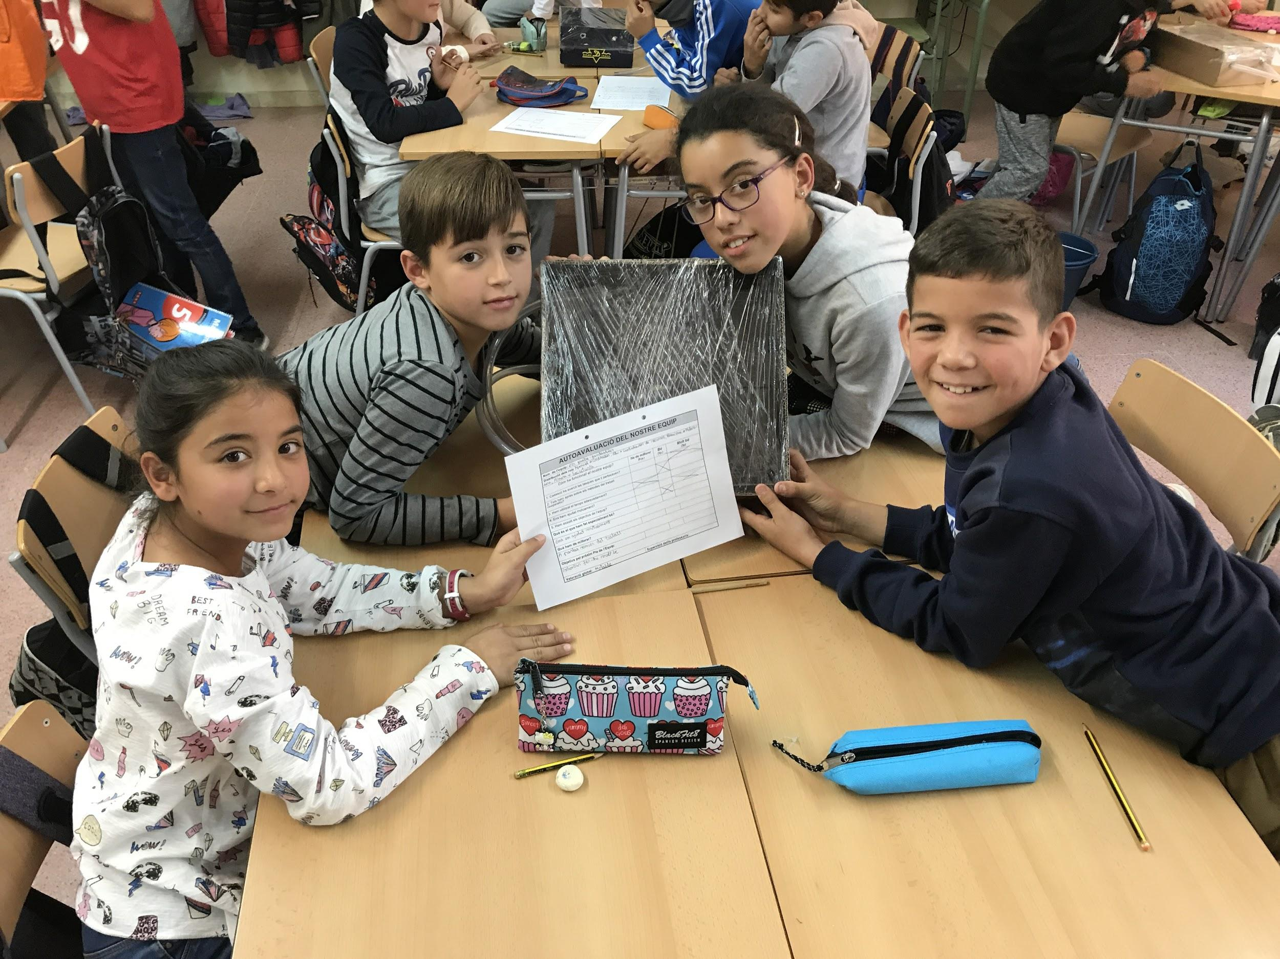
finally we evaluate our project and the team-work

Slide 26
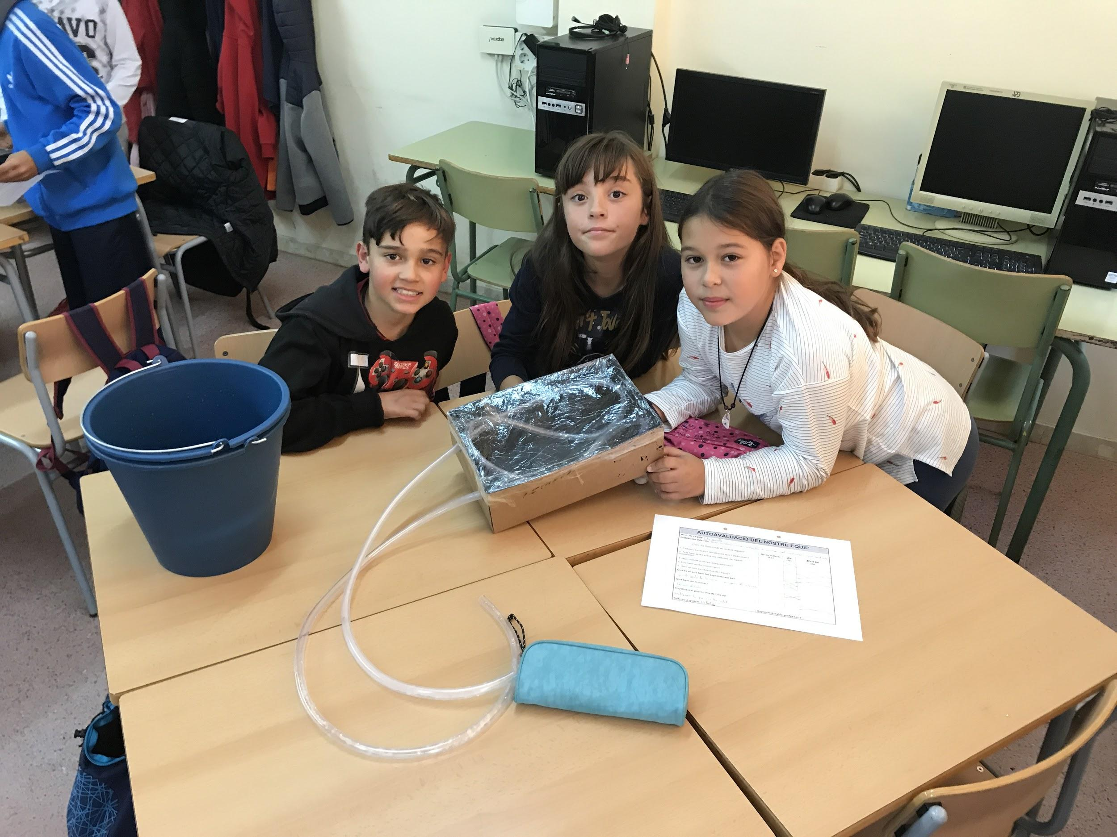

Slide 27
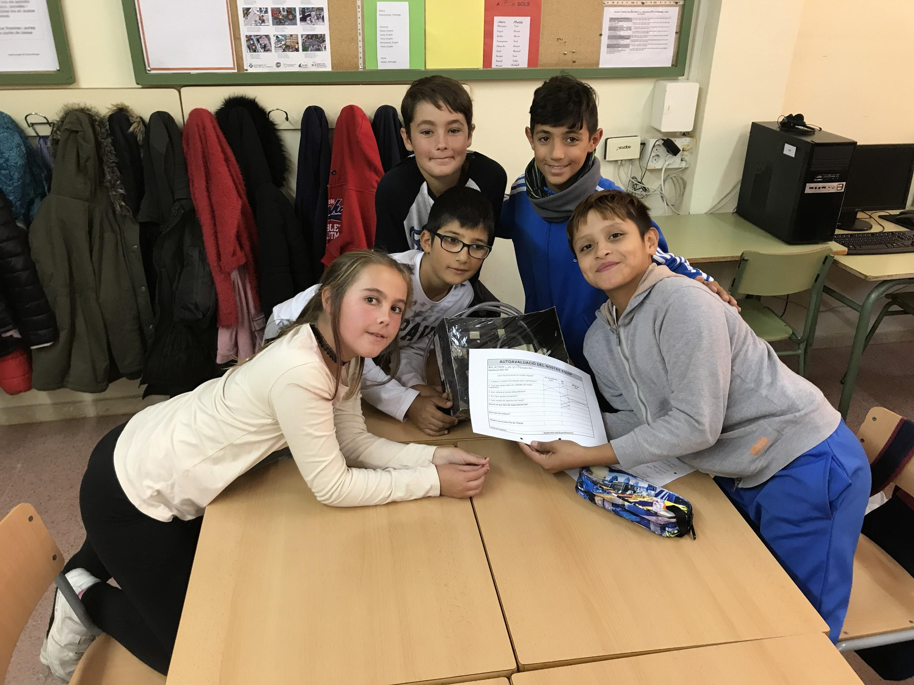

Slide 28
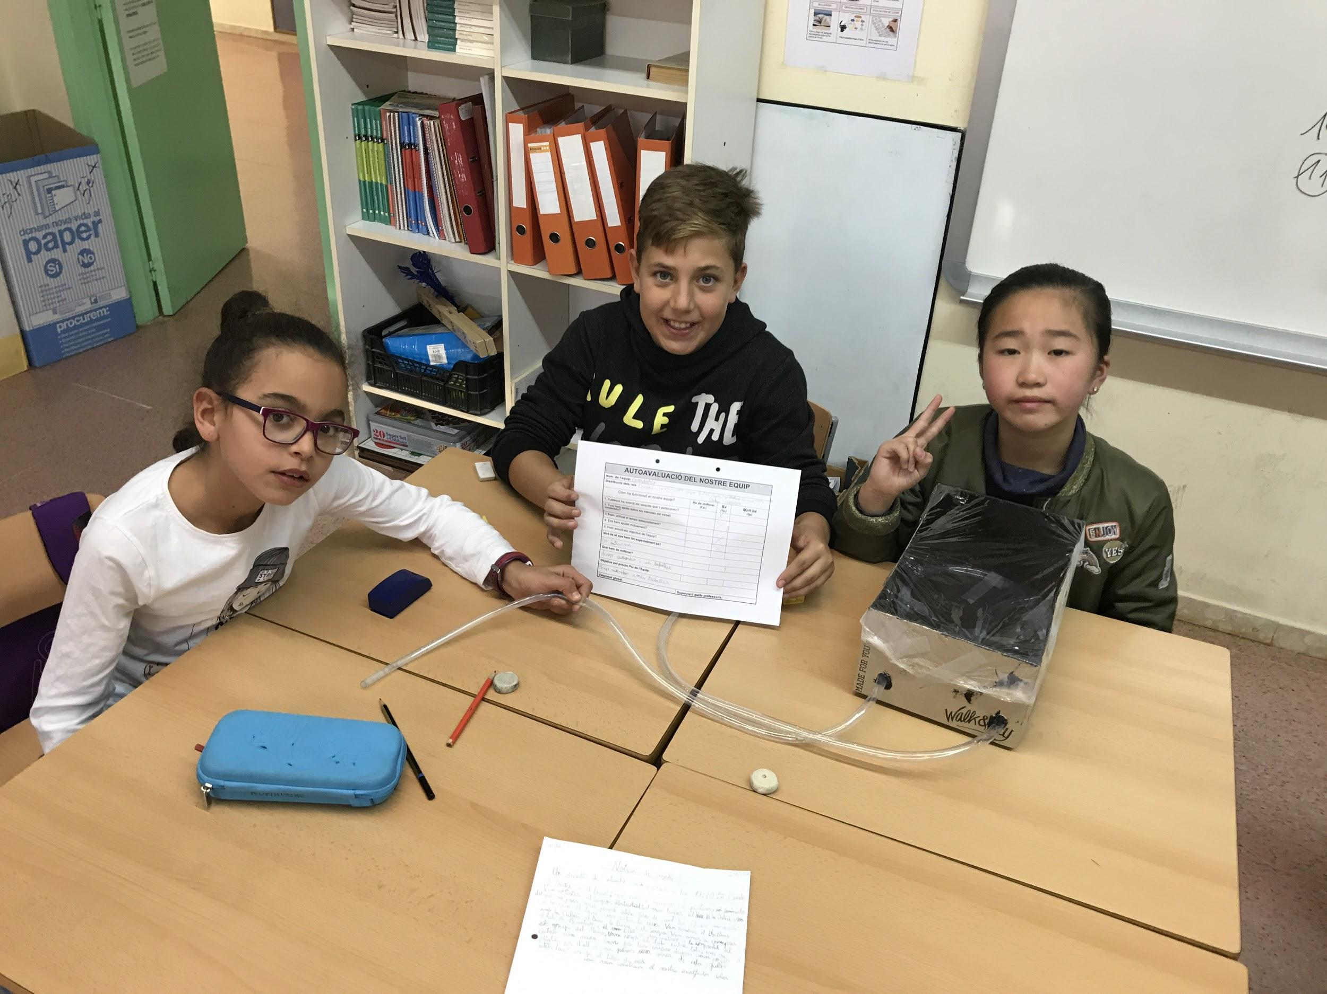

Slide 29
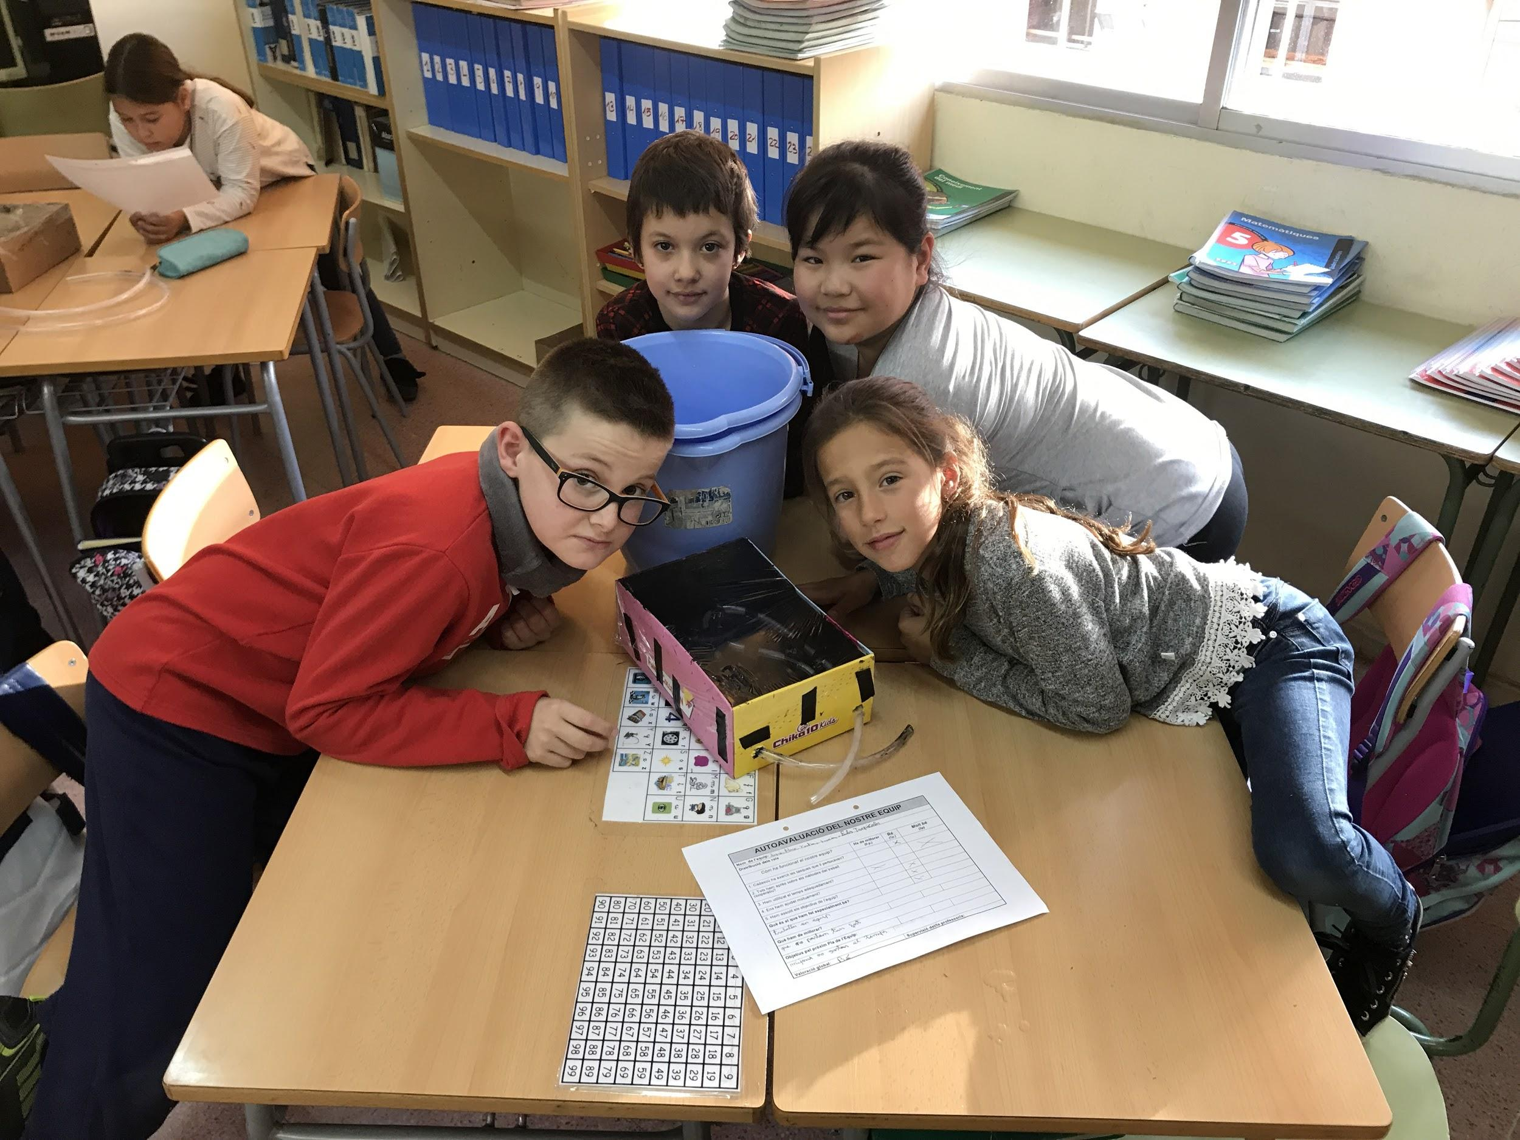

Slide 30
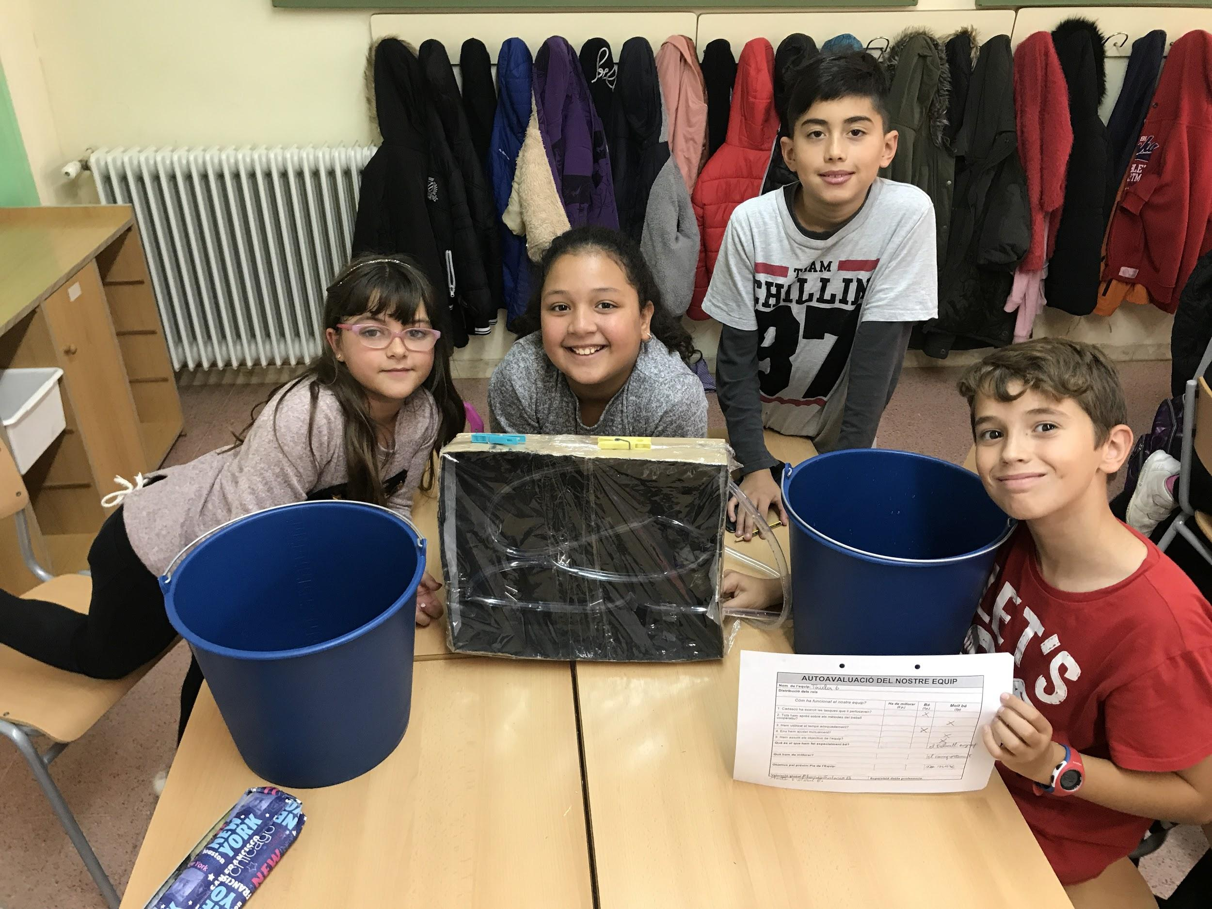

Slide 31
Is THAT “PHYSICS”? WHY?
We think this experiment is “Physics” because it helps to discover why things happen.
We observe the nature to understand the “Greenhouse effect” and “Thermal solar energy” with this experiment, our water heater, we can see how the temperature increases and we can compare what we have done with what happens to Earth.
by Daniel Z. and Alex C.

Slide 32
GOOD BYE FRIENDS
Escola Barrufet Sant Boi
2017-2018
by Daniel Zamudio, Alex Camacho and Leyre Daluz

