Slide 1
PHYSICS
Social and Natural Science Cooperative work
6th grade - 2017-2018 Course
KA2 “Let’s cross the boundaries of Primary education together”

Slide 2
Hello friends!
We are proud because we have participated in this project about a physical phenomenon: electricity.
We really like the experience of knowing how to create an electric circuit.
We hope you like our projects!
6th graders-Barrufet team

Slide 3
1st Step
Cooperative work:
Model construction.

Slide 4
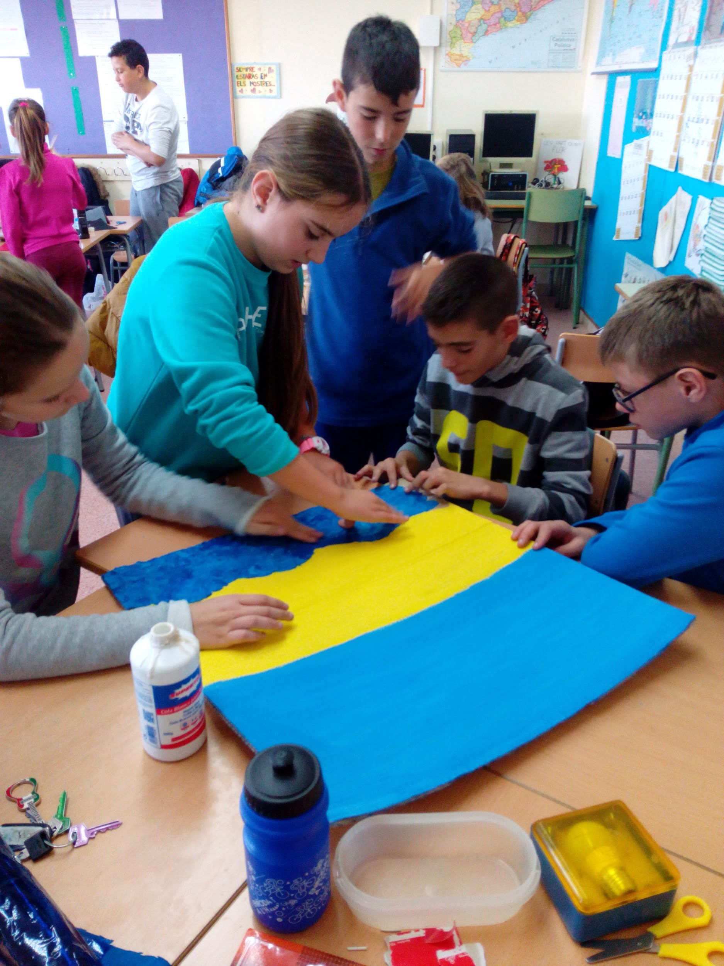
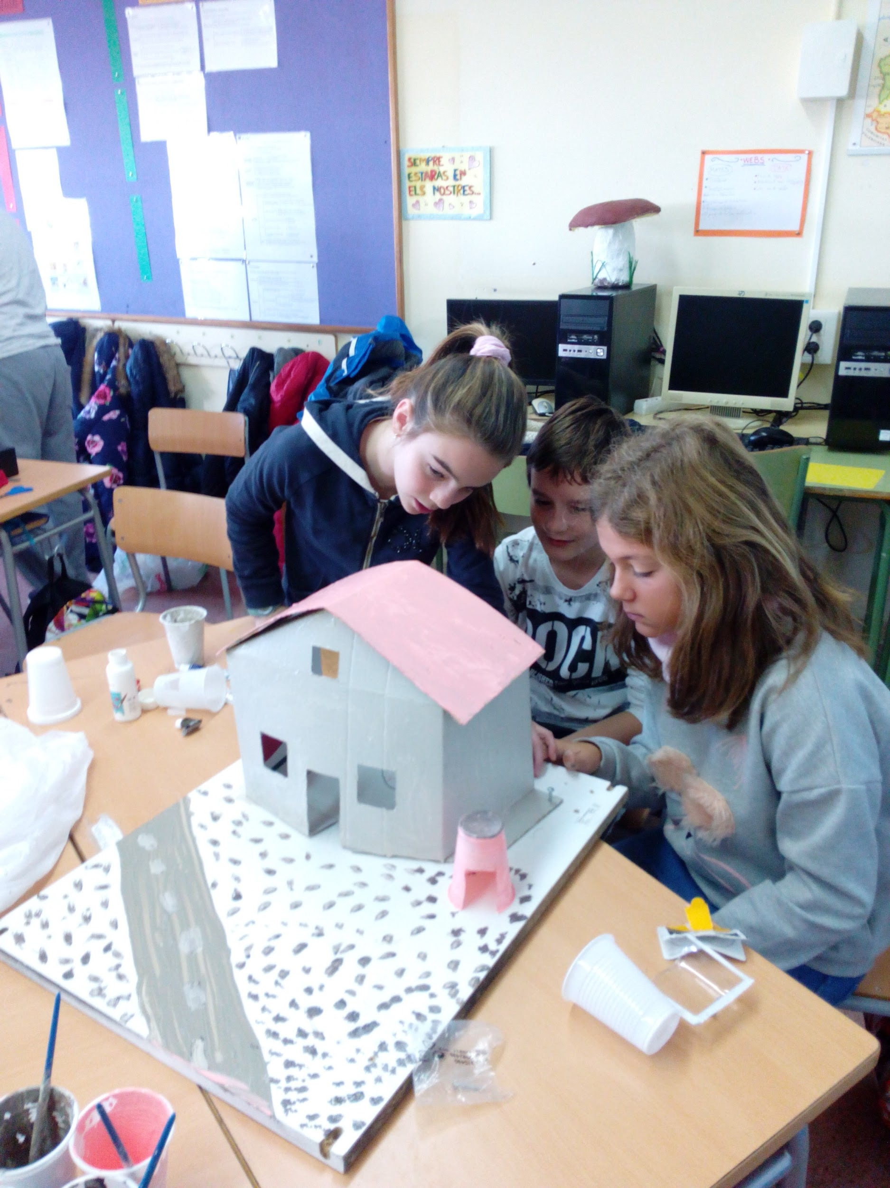

Slide 5
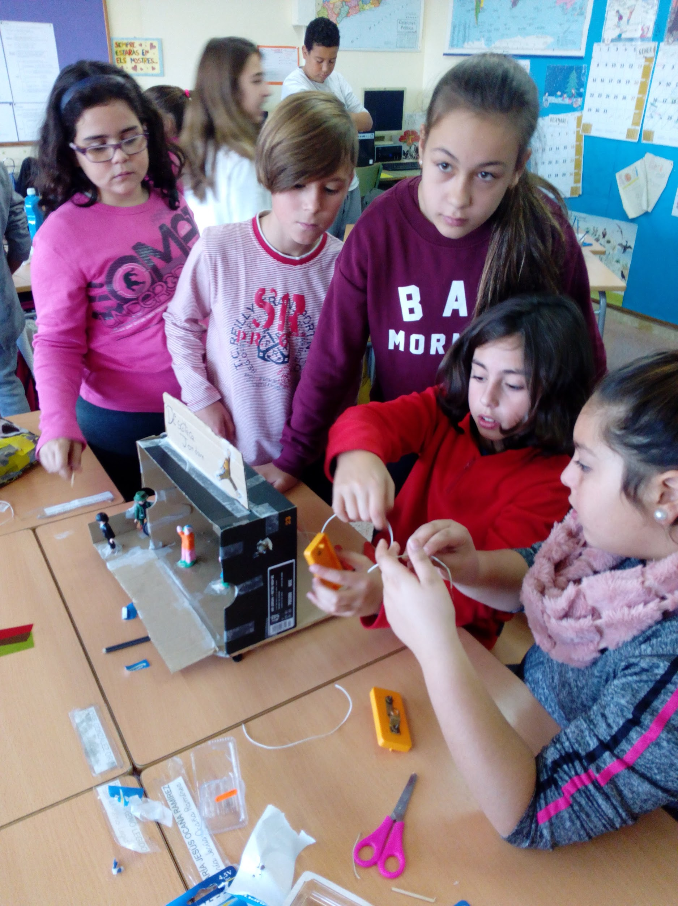
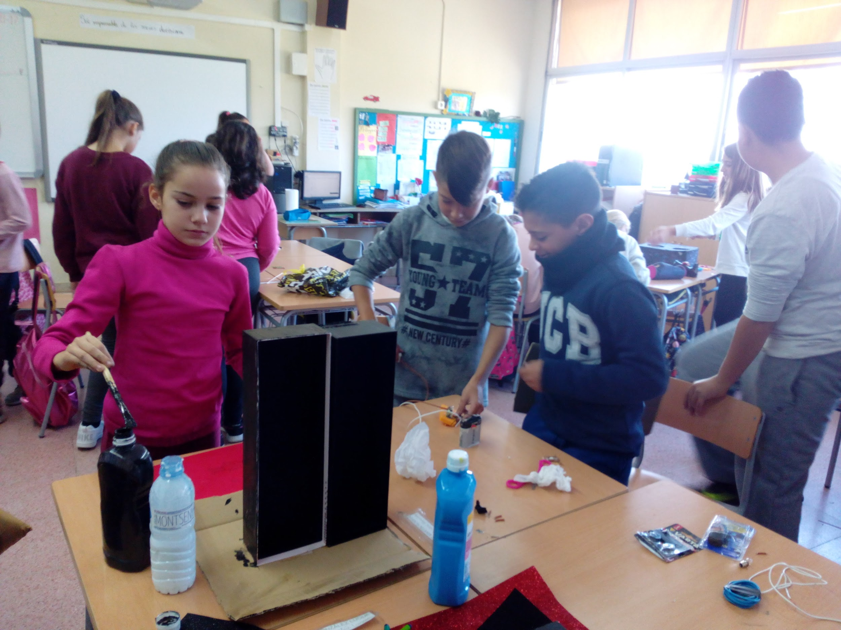

Slide 6
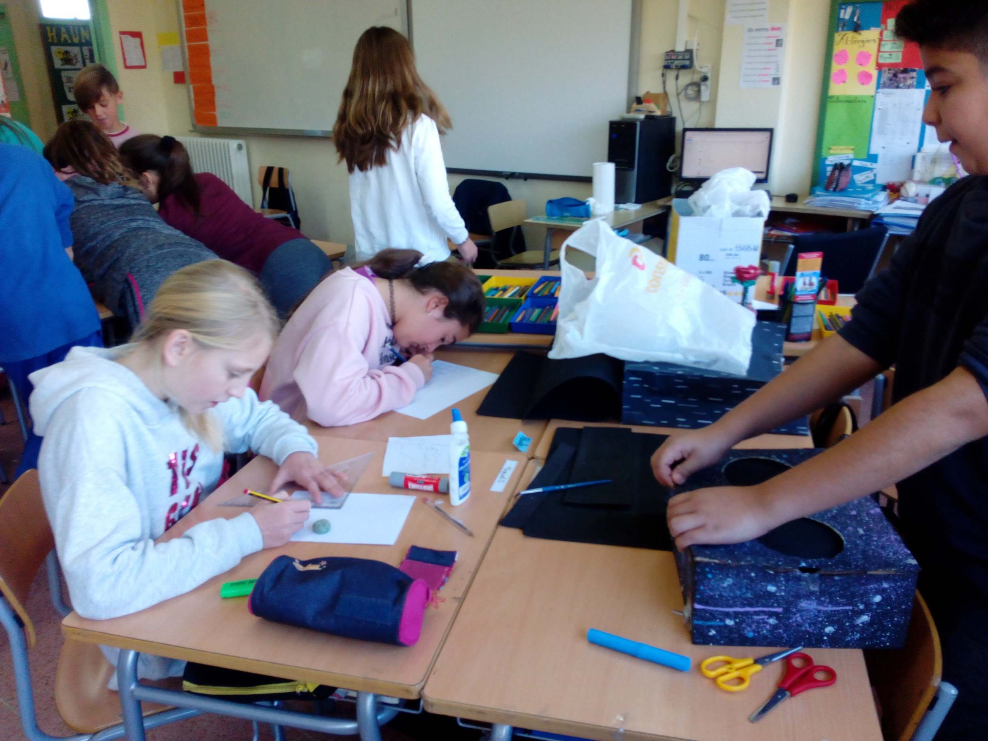

Slide 7
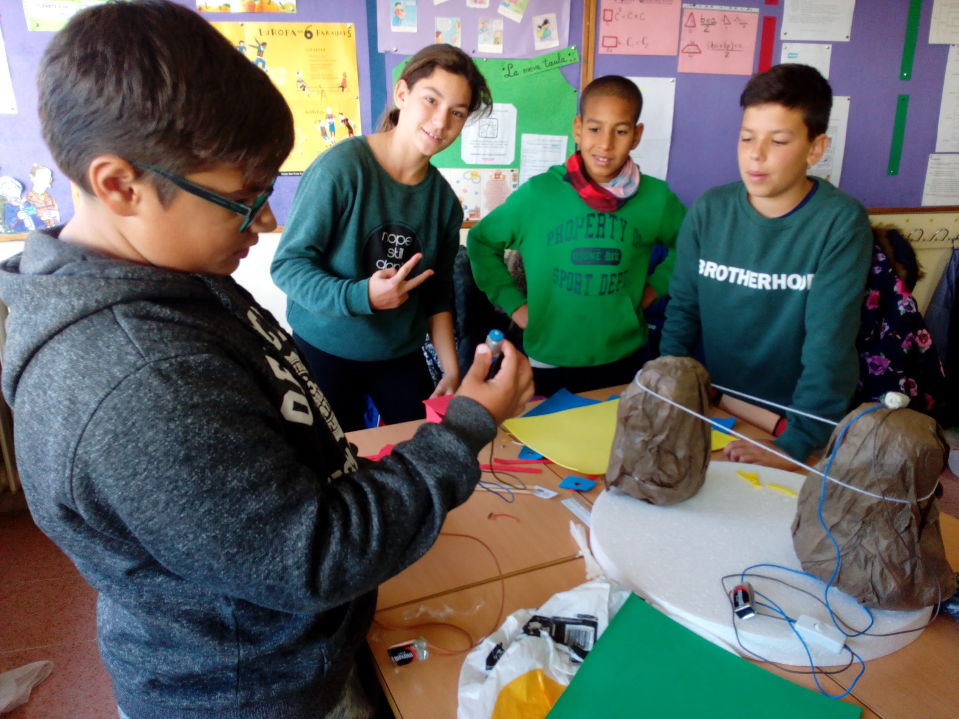

Slide 8
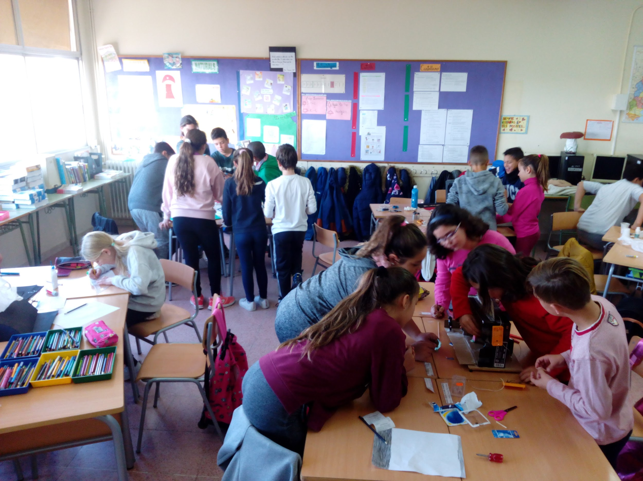

Slide 9
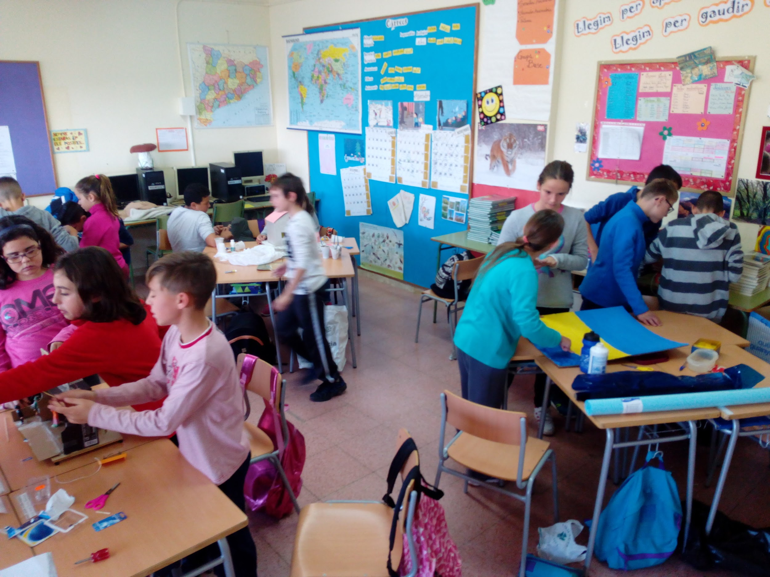

Slide 10
2nd. Step
Exhibition of works

Slide 11
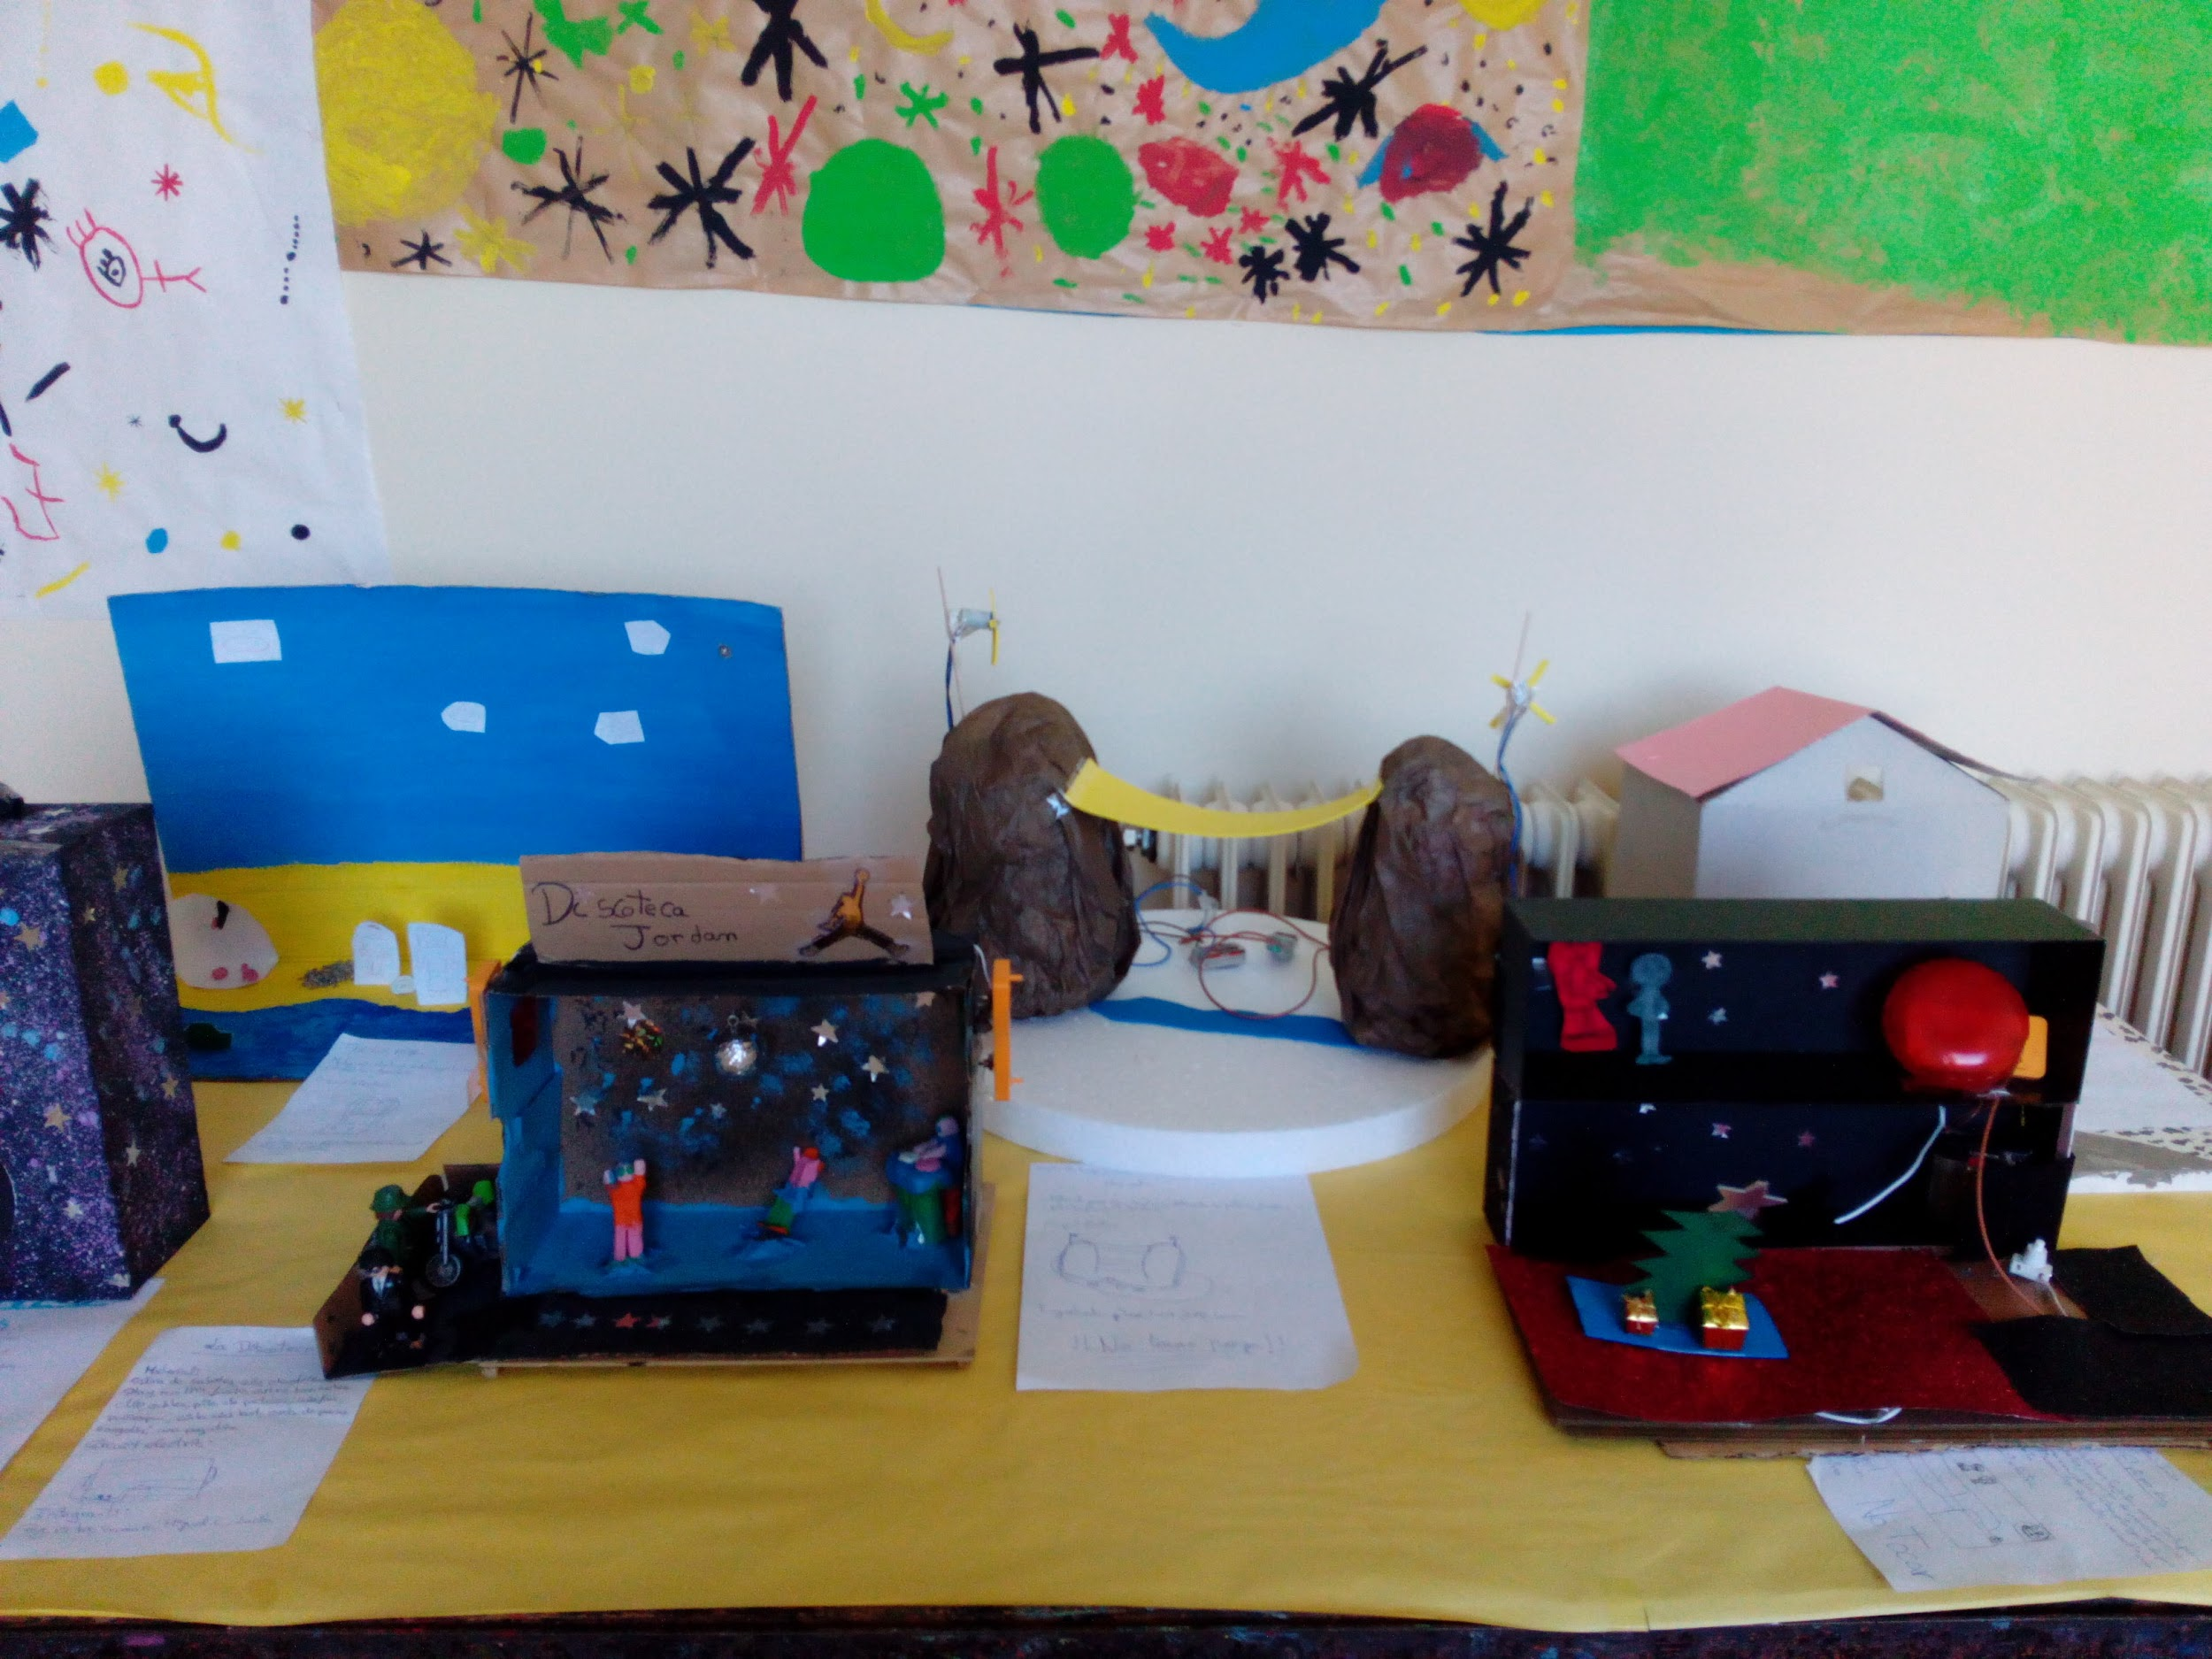

Slide 12
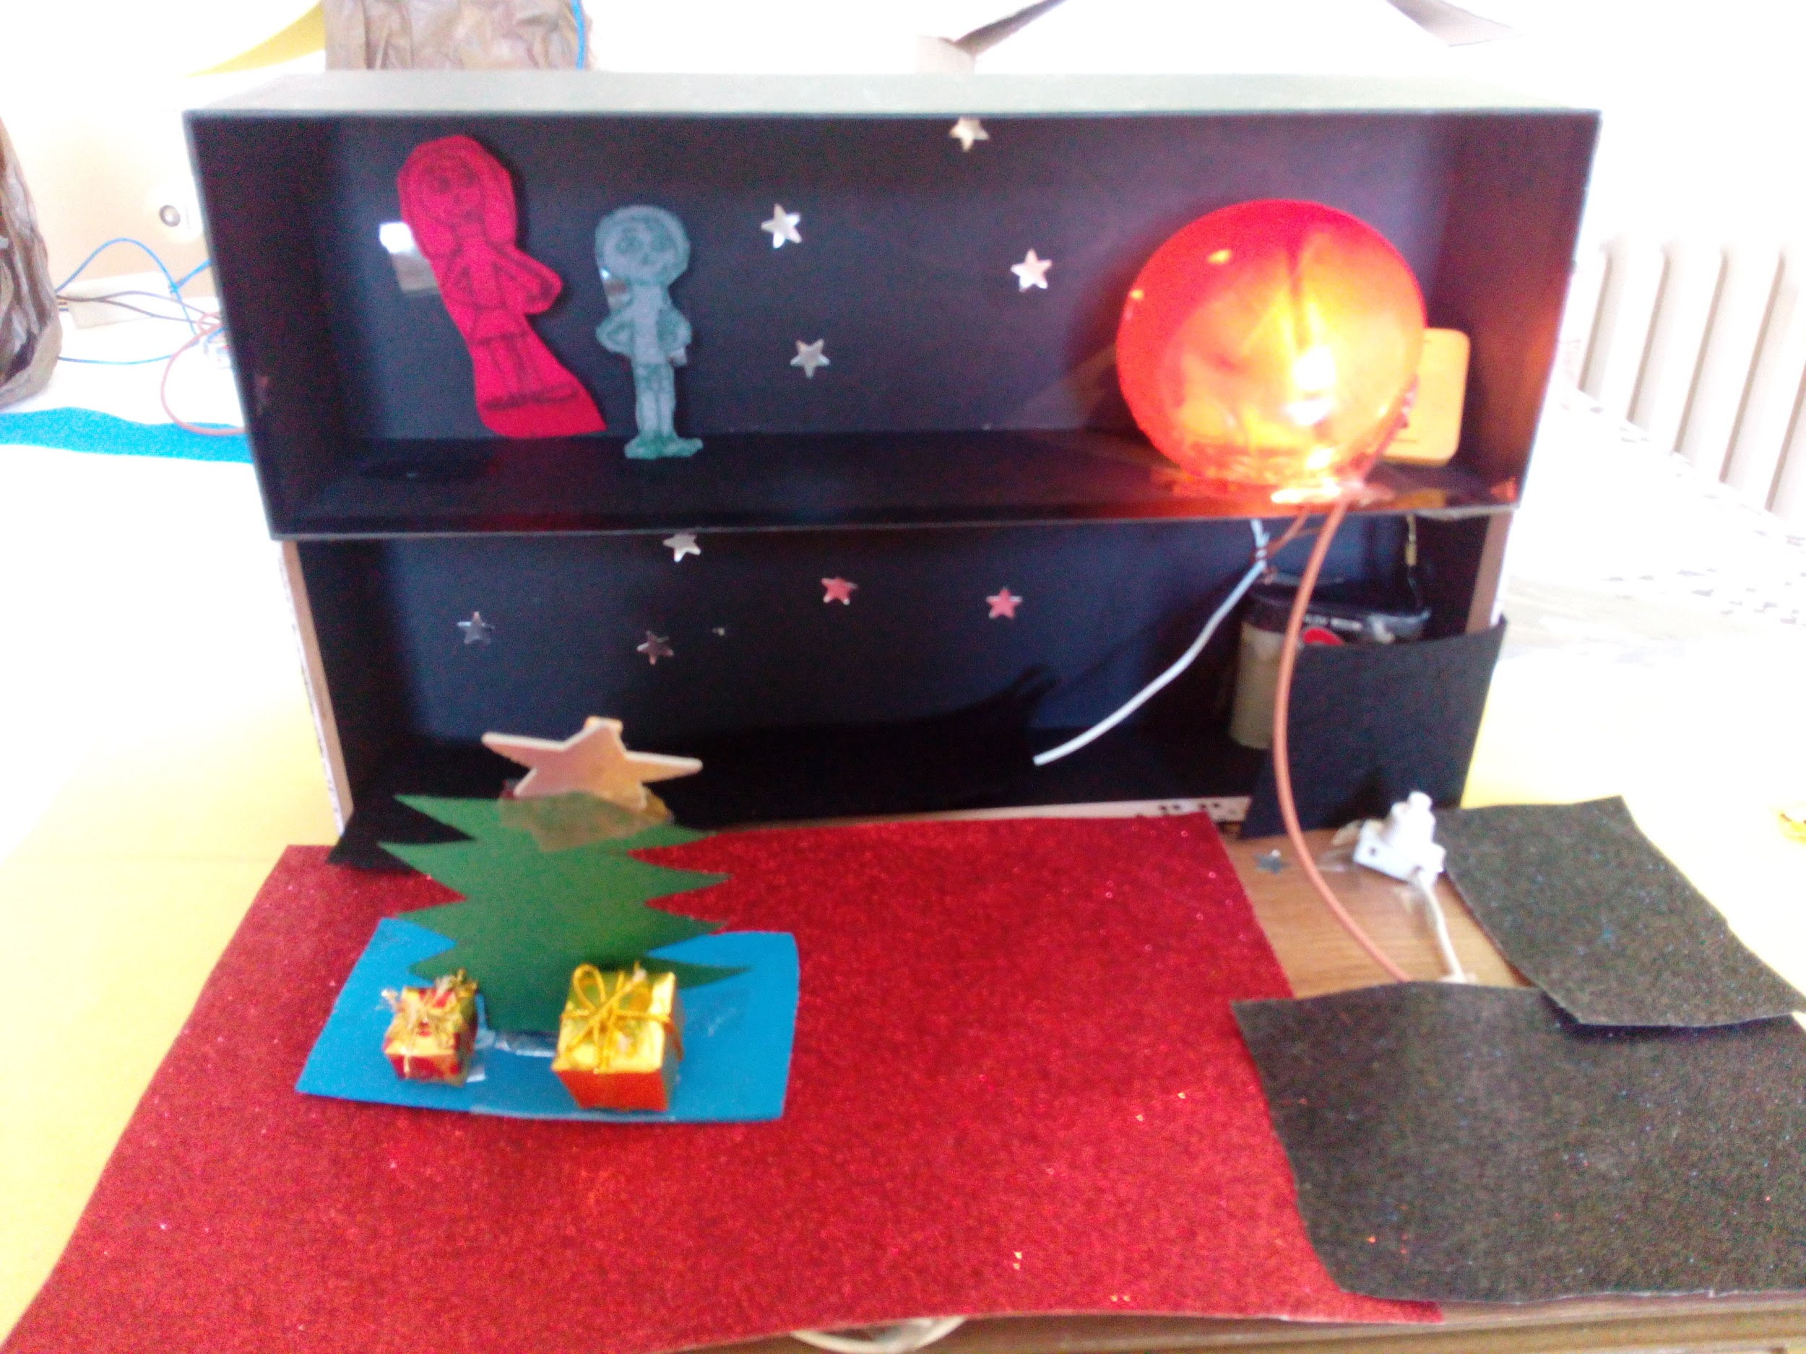
“Christmas decoration”

Slide 13
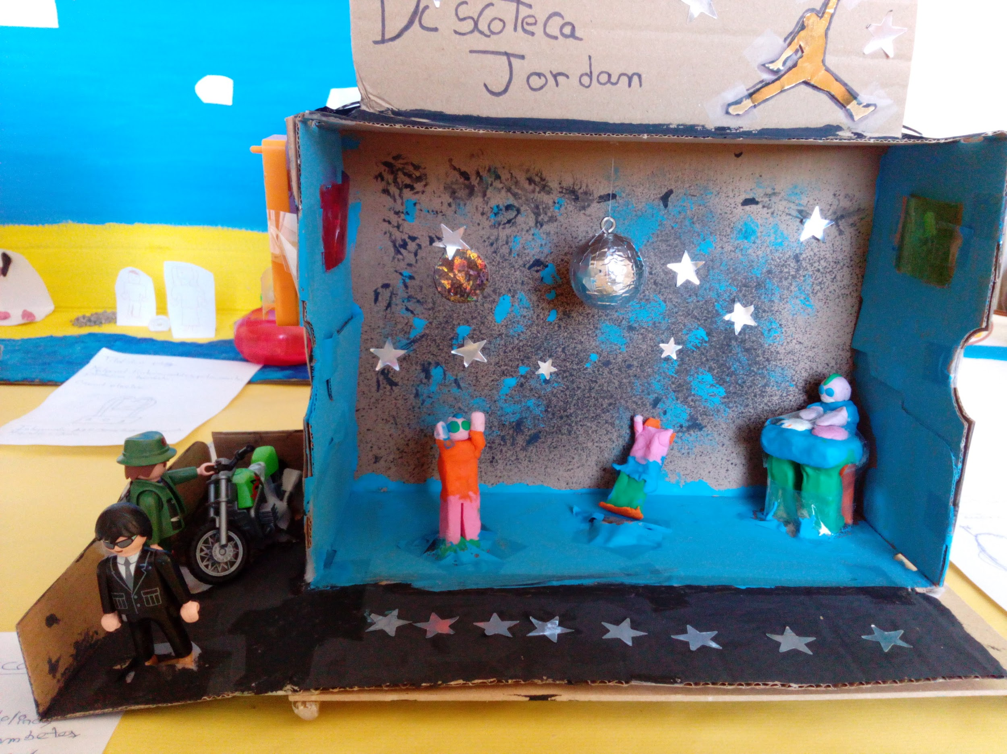
“Discoteque”

Slide 14
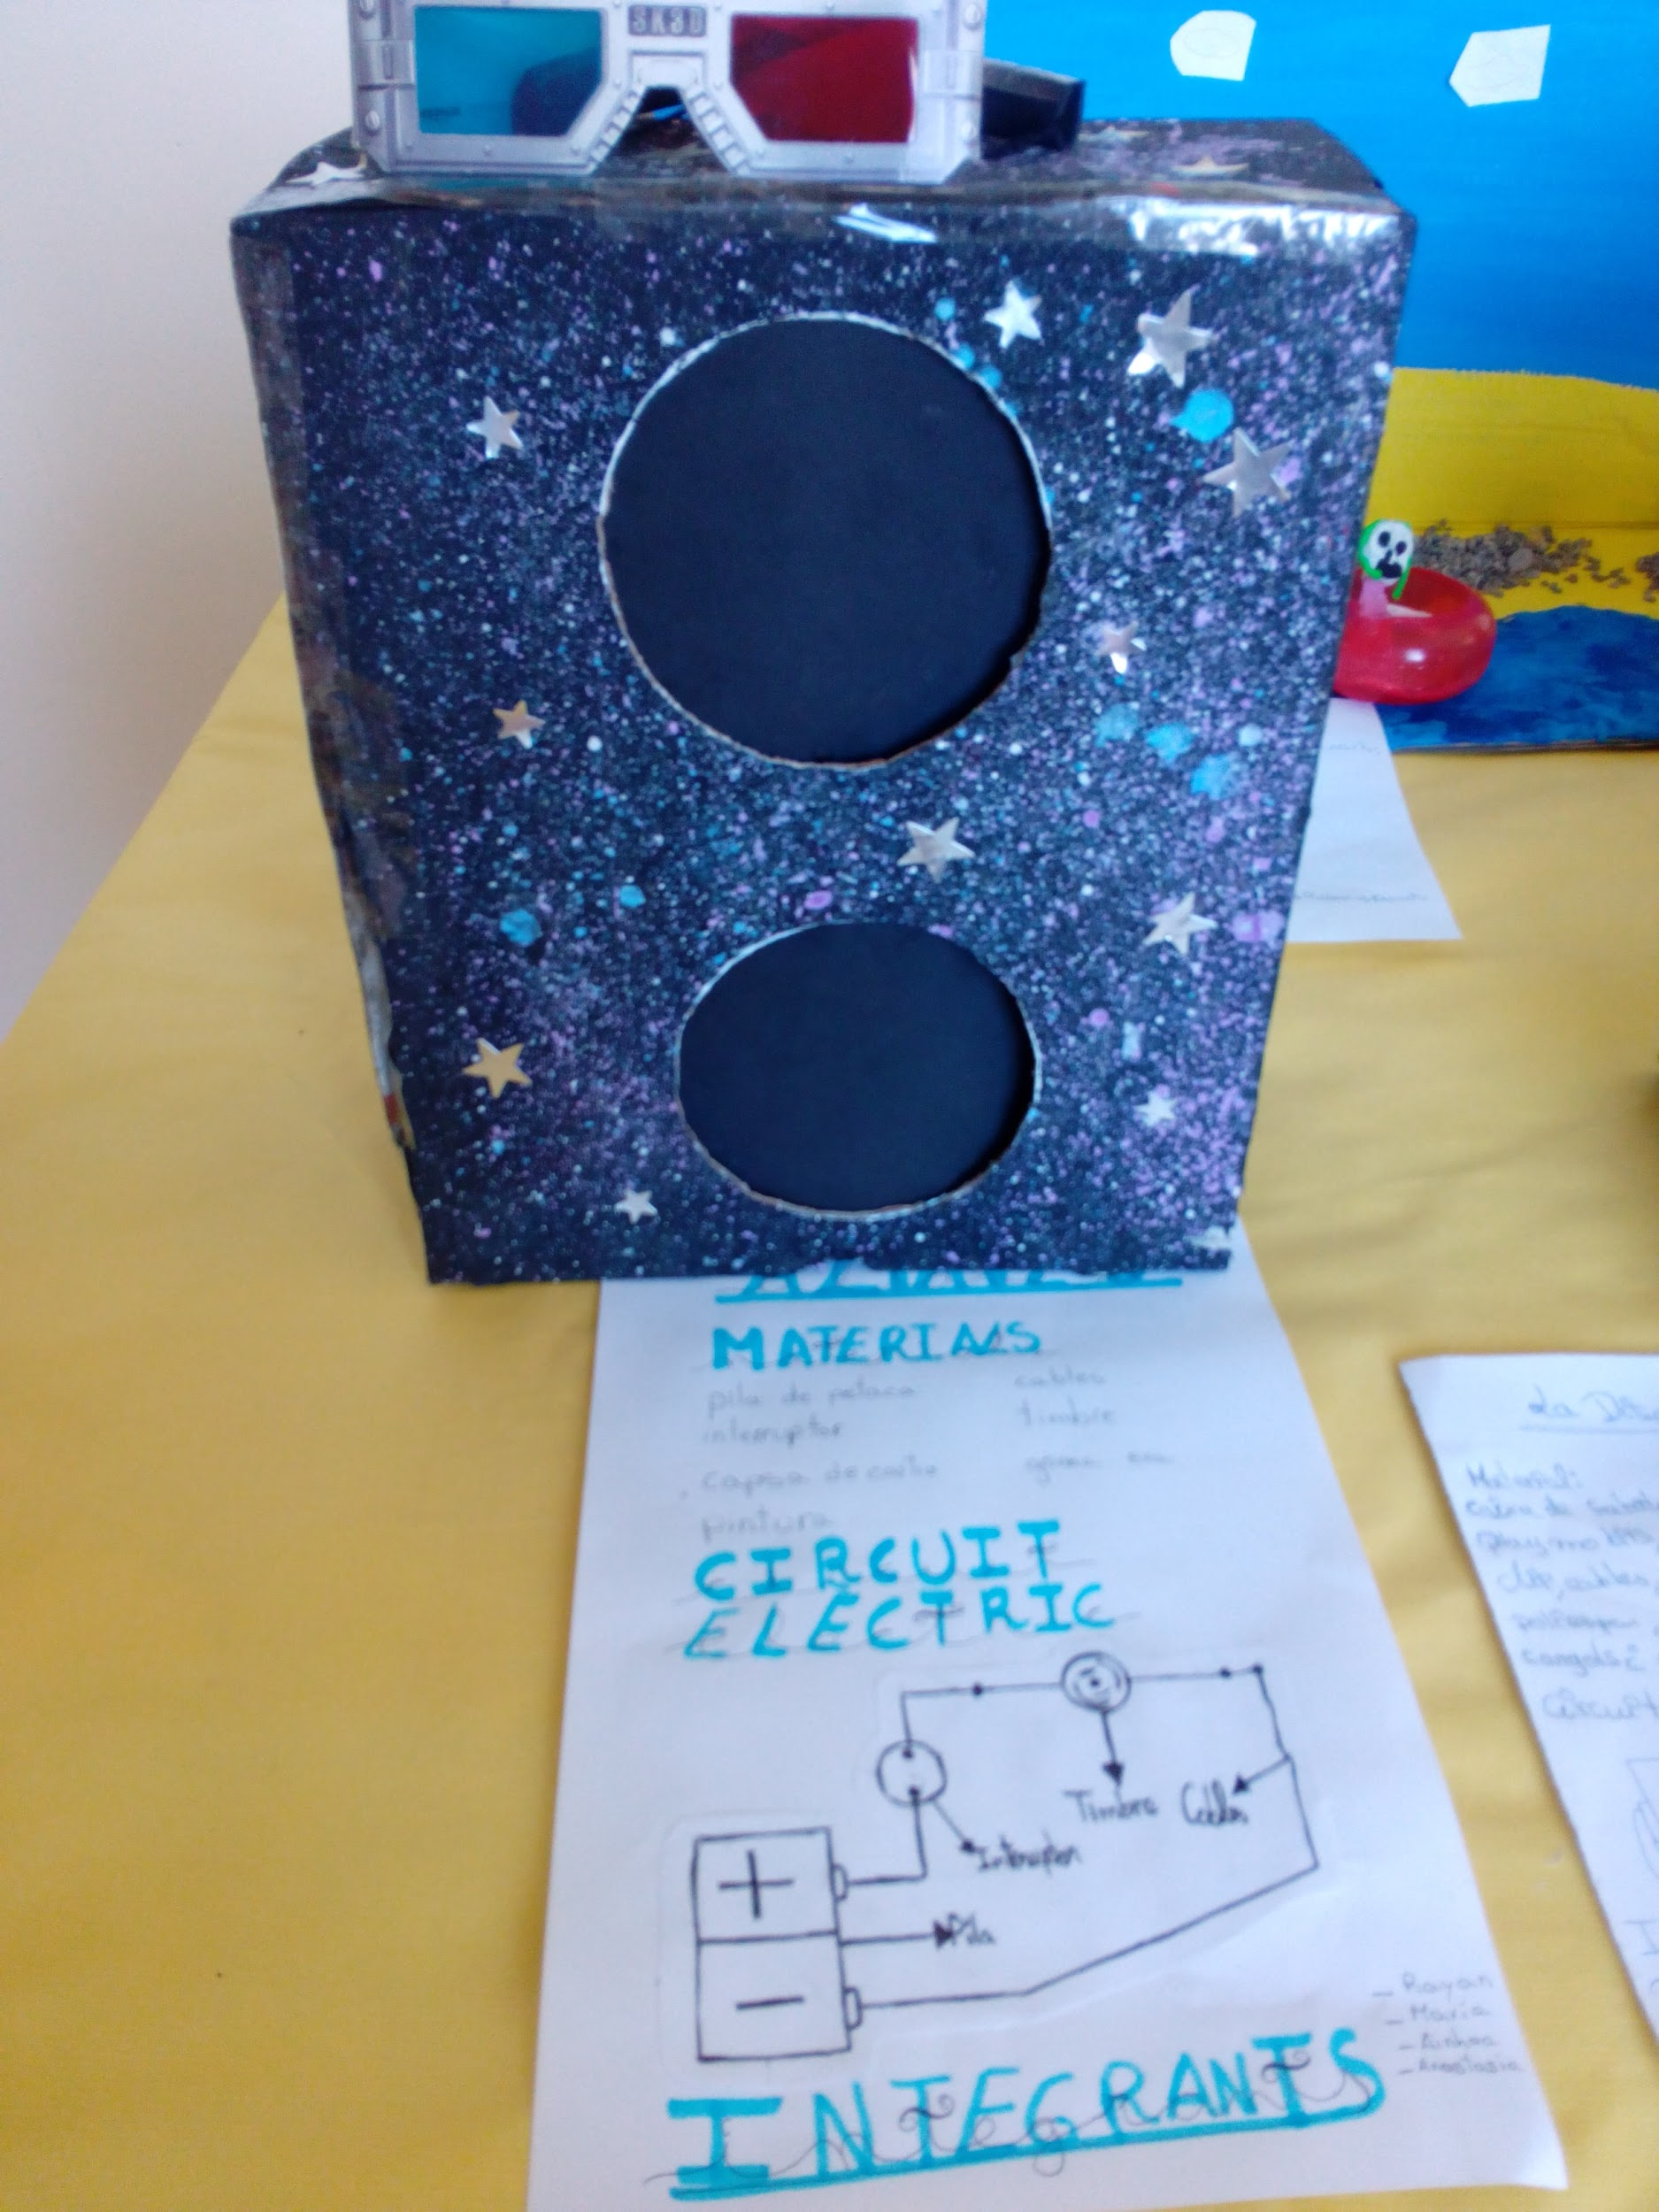
“Party speaker”

Slide 15
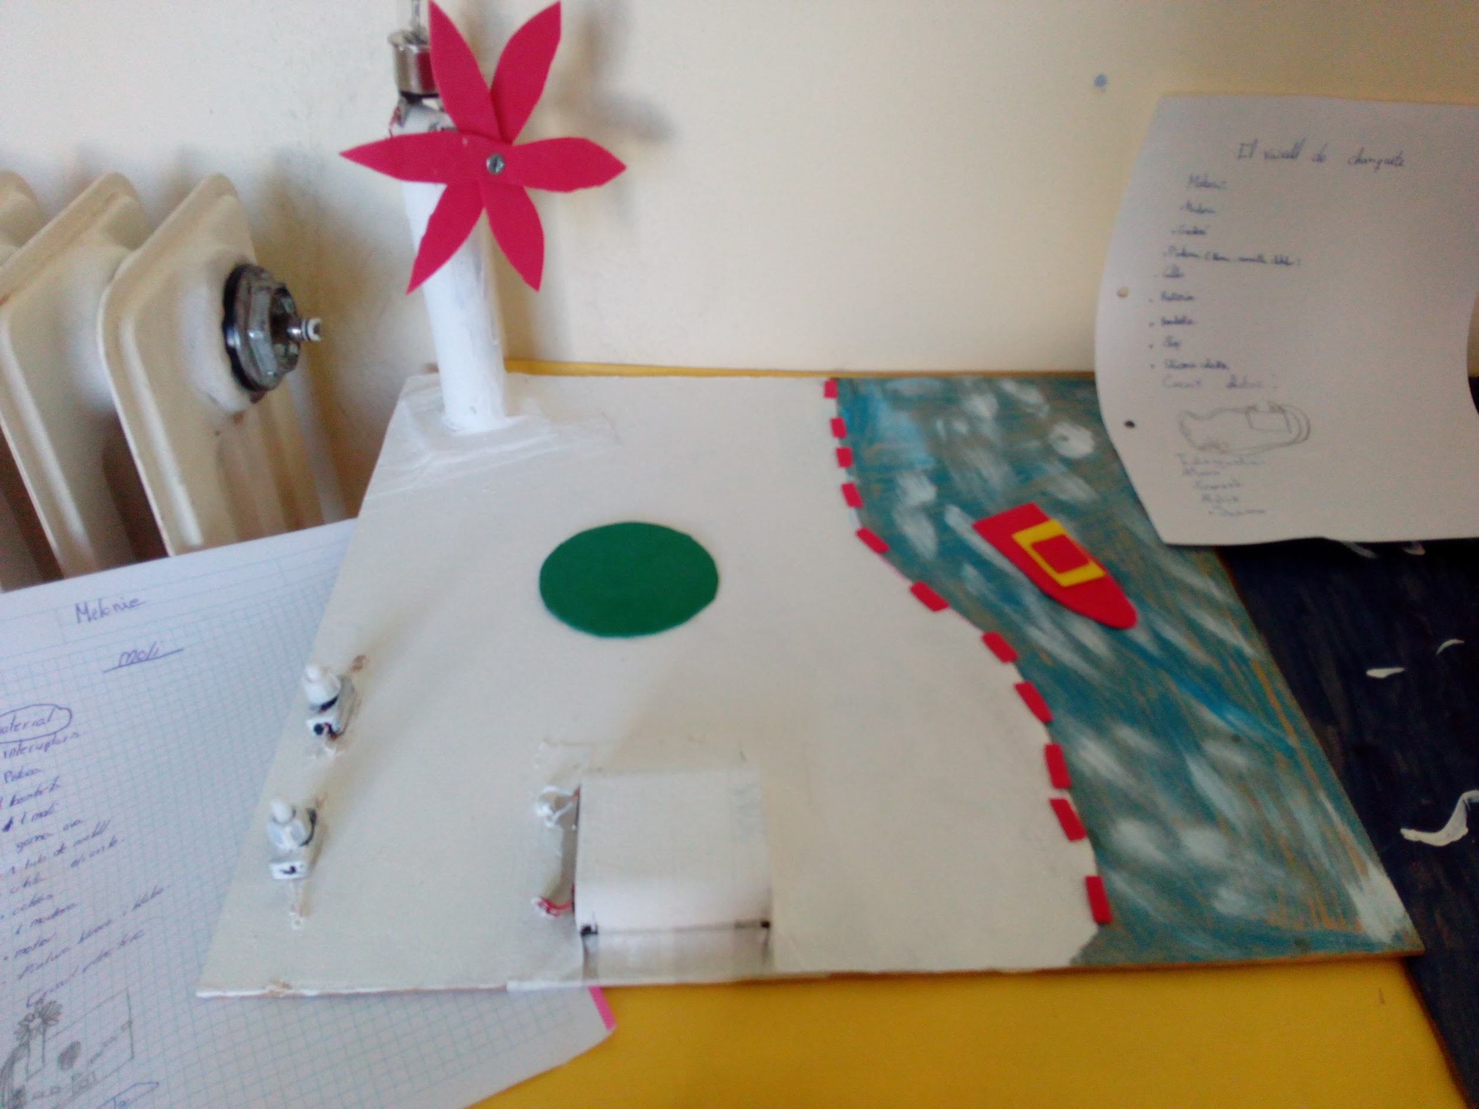
The mill & the lighthouse

Slide 16
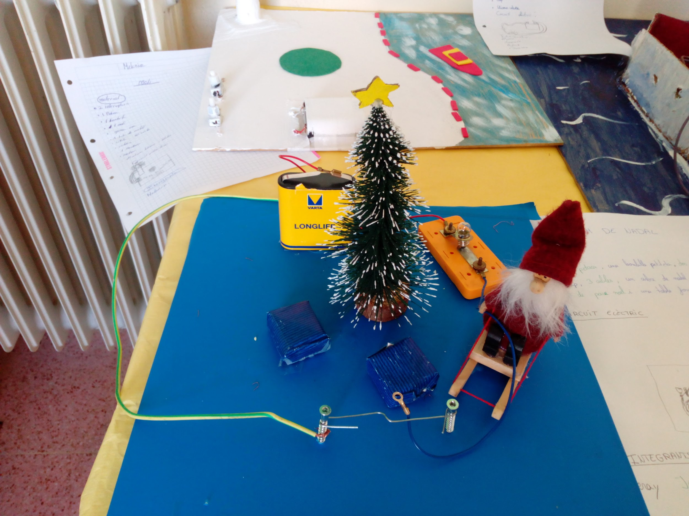
“Christmas party”

Slide 17
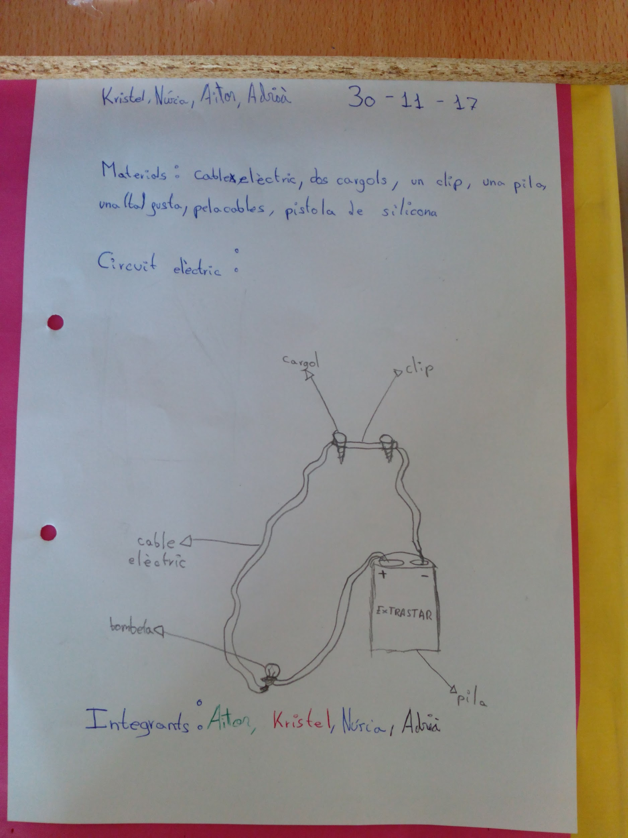
“Circuit Diagram”
(electric circuit scheme)

Slide 18
3rd Step
Work exhibition
&
Oral presentation by 6th graders
How electricity works: Oral explanation and demonstration to young students (1st graders-Primary)

Slide 19
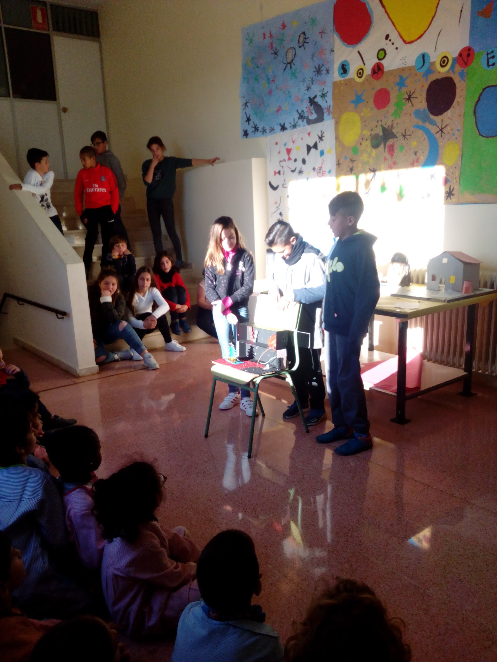
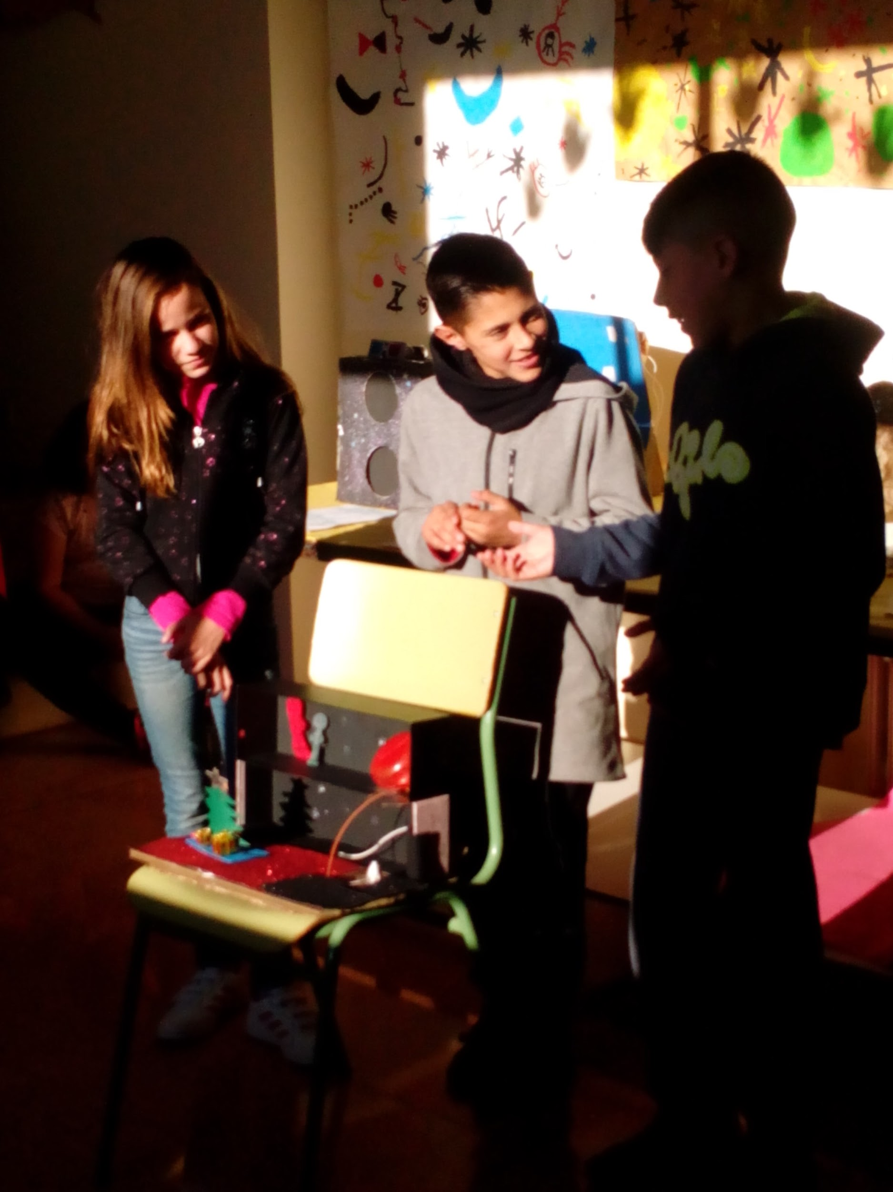

Slide 20
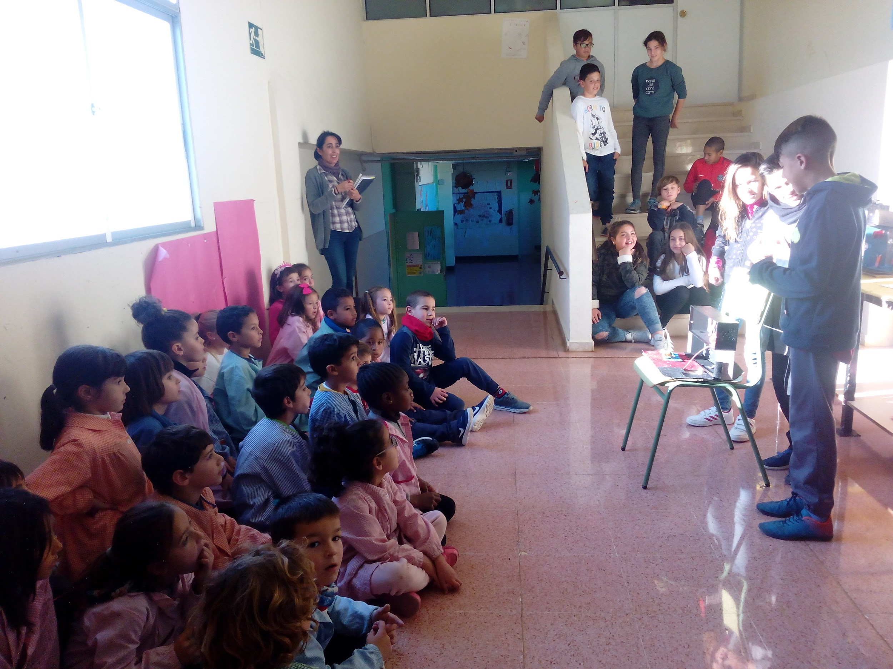

Slide 21
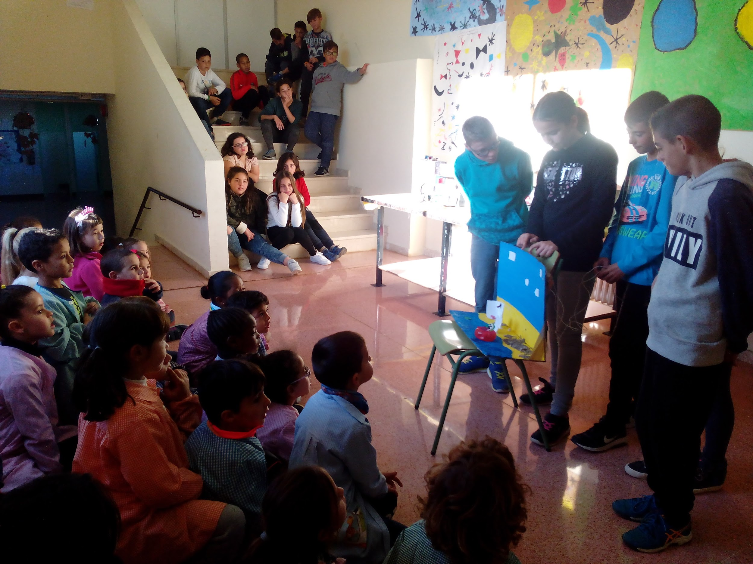

Slide 22
