Slide 1
My Plan(eT)- an eTwinning project for teaching decision-making at young ages
Cornelia Melcu, eTwinning ambassador, Școala Gimnazială Nr. 9 „Nicolae Orghidan” Brașov, Romania
Adriana Lefter, eTwinning ambassador, Școala Gimnazială „Elena Doamna” Tecuci, Galați, Romania

Slide 2
Why?
The students wants to express their voice and being an active part of their (school) life, even they are young
Who?
7 schools from 5 countries (Romania, Cyprus, Moldova, Poland, Portugal)
When?
Starting in October 2018 and finishing in June 2019

Slide 3
About the project:
The students are expected to create the profile of a new planet. They will describe/design the perfect place for them to live in the Universe (a new planet). They will describe the flora, fauna, inhabitants and the main values to share and respect.
Aims:
To empower pupils offering them the opportunity to participate effectively in public life and decision- making processes, making their voices heard
To foster the development of pupils’ 21 Century skills such as collaboration, creativity, critical thinking, ICT use, life skills and logical skills
To practice English as a foreign language in a communicative way

Slide 4
How?
The students are expected to create the profile of a new planet. To achieve that, they will apply their knowledge to carry out their tasks. They will create products related to their imaginary planet’s special features. They will collaborate in order to create joined products.
Expected results:
Public Twinspace, common presentations and e-books

Slide 5
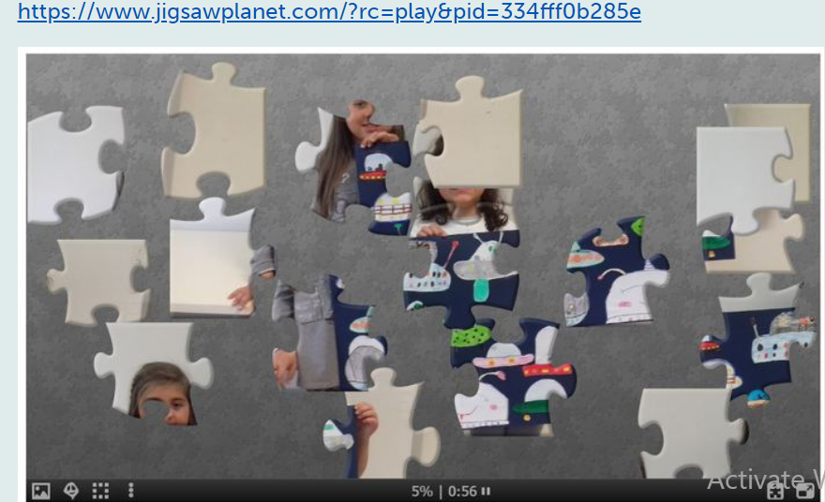
How?
Presentation of the participants in a creative way, chose by the students
Learning with fun ! (outdoor, based on games and inquiry, flipped clasroom
https://www.jigsawplanet.com/?rc=play&pid=334fff0b285e

Slide 6
How?
Children thought about a place where to live and gave arguments why they choose it
STEM activity: describing the main condition of life
Common product: a pool for voting the name/place of the planet

Slide 7
How ?
Who lives on our planet? - describing inhabitants,
In international teams, the participants will describe the living organisms on the planet

Slide 8
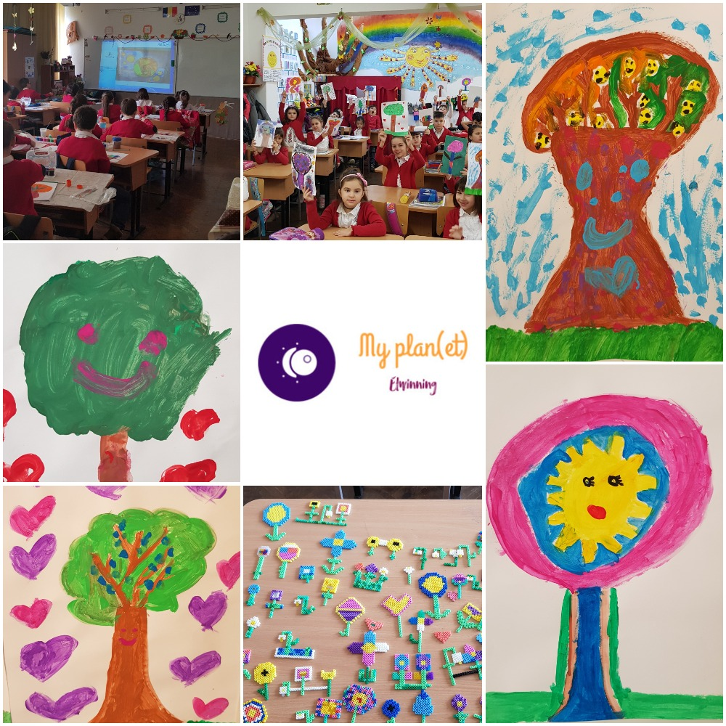
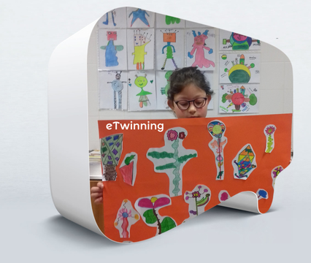
How ?
Who lives on our planet? flora, fauna
In international teams, students discover what are the most appropriate elements to exist on this planet

Slide 9
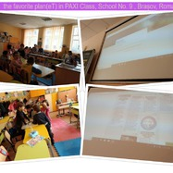
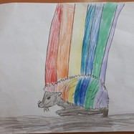
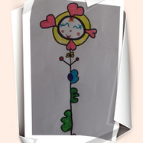
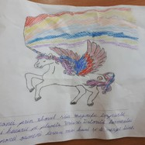
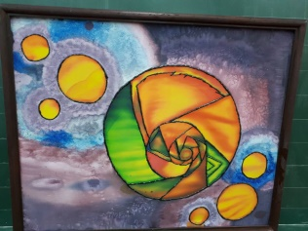
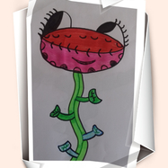
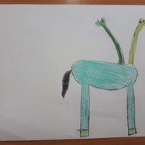
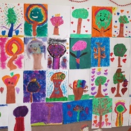
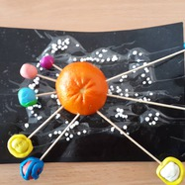
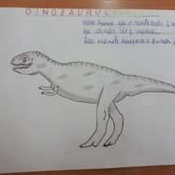
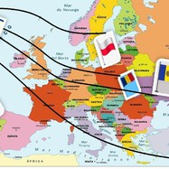
What’s next?
an ebook

Slide 10
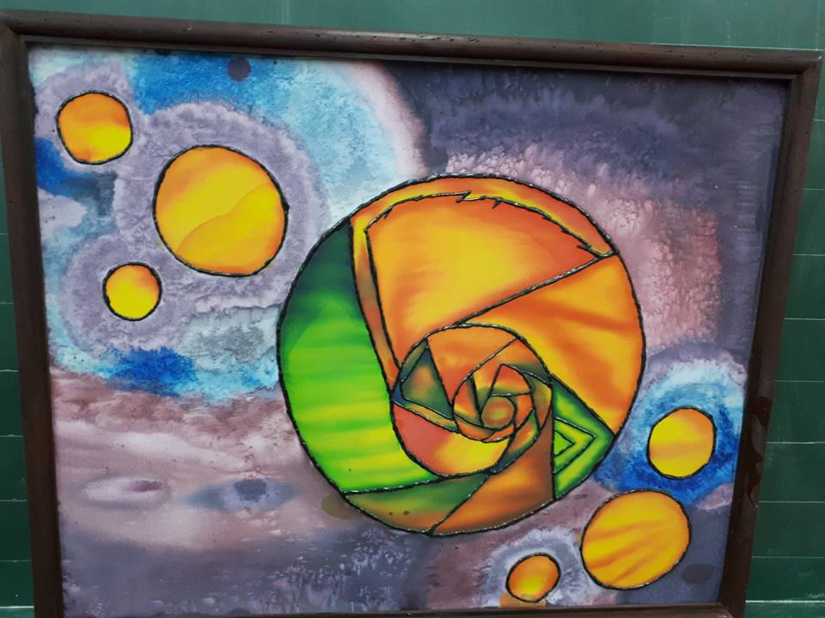
What’s next?
How to cohabit there? What to respect?
Children will identify the main values to be respected

Slide 11
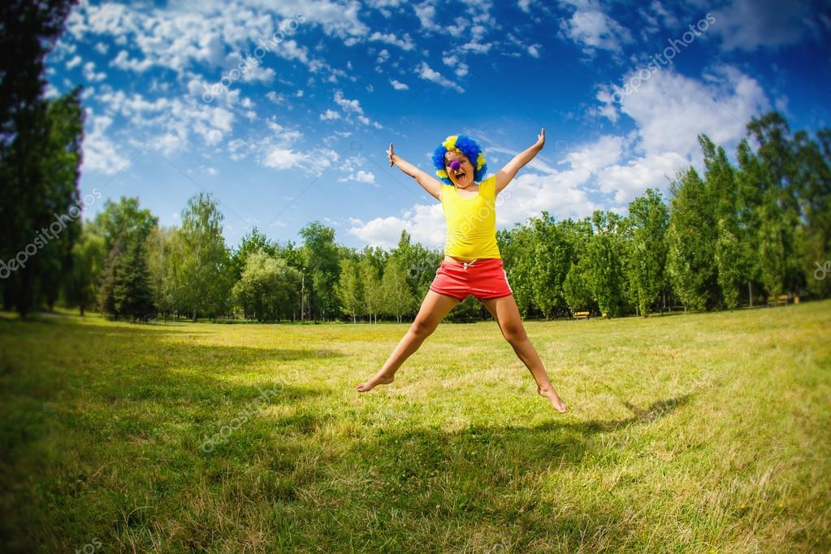
A perfect place for children to live in the Universe can be a new planet or we will try to make ours the happiest of all!

