Slide 1
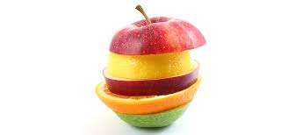
Embracing Differencies

Slide 2
Inclusion - Diversity
Quotes
"Our job is to teach the kids we have.
Not the ones we would like to have.
Not the ones we used to have.
Those we have right now …. all of them."
Dr. Kevin Maxwell

Slide 3
Directions
this slide is for collaborating purposes and is not going to be used in the final outcome: our e-book
Please follow these steps:
write a word/words that come/s to your mind when we are talking about inclusion & diversity. Use this link here
Visit each slide and post your answer. You may search about it in the internet and post your resource at the end of this presentation
Add any photos you think might make our presentation more attractive (use cc free images and don’t forget to pay attribution when necessary
Add slides if there is not enough space or if you think we should have more content
Respect others’ posts and make comments if you think something is really interesting or … the opposite

Slide 4
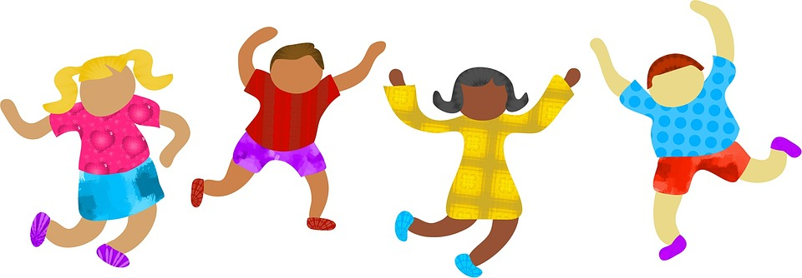
Contents
definition
principles of inclusive education
aims and objectives
how to develope inclusive schools
role of an inclusive teacher
teaching strategies for inclusive education
the inclusive classroom
barriers in inclusive education

Slide 5
What do we mean when we say Inclusion?
The dictionary defines inclusion as ‘the action or state of being included within a group or structure’.
Inclusion of persons with special needs into a regular education system, not a special school (Snezana Kalamkovic, Novi Sad, Serbia)
helping kids with special needs to be integrated in to the society.(Nida Türkelay Burdur,Turkey)
Inclusion entails acceptance and support and integrates everyone (not only special needs people) into a totality without discrimination. (Argiro Spyrogianni, Lesvos, Greece)
Inclusion means removing the obstacles that everyone has in order to be able to offer equally in the society and to develop one’s skills and specific abilities.( Kourtidou Sofia, Thessaloniki,Greece)
Inclusion means that people with special needs or other characteristics has the equal access of participation in the personal, public and political area as everybody else. (Martha Iordanidou, Thessaloniki, Greece)
Treating all equal, everywhere (Bojana Manic, Pirot, Serbia)
Notes:
Ne znam da li sam dobro sve dodala.

Slide 6
2. Are there any principles for inclusive education?
Inclusive education is based on basic concepts:
(1) the right of all children including children with disabilities to education - no matter their speed of learning and their special characteristics regarding education, it is our duty to promote and develop their potential in a holistic way including all aspects: physical, social, linguistic, cognitive.
(2) inclusion means changing the educational system to suit the children - Education does not simply mean reading and writing. It also means providing special learners with the functional skills that enable them to be part of the family and community as well. (Mariga, McConkey and Myezwa, 2014)
(3) In Serbia a little.
(4) acceptance for diversity is the most important part of inclusion, in my opinion, and of course providing differentiated help to the ones who need it

Slide 7
3. What are the aims and objectives of Inclusive Education?
1.Developing awareness of equal rights to life (Snezana Kalamkovic, Novi Sad, Serbia)
2.developing social abilities og special needs kids. ( Nida Türkelay, Burdur, Turkey)
3.Inclusive education should aim at the opportunity of everyone involved to feel confident and accepted by a smaller or larger group depending on occasion. (Argiro Spyrogianni, Lesvos, Greece)
4. Assimilation of creating a sense of belonging, recognising and engaging the student voice. ( Natavan Badalova, Azerbaijan)
Inclusive education is based on the following basic concepts:(1) the right of ALL children to education - no matter if a child has any disabilities or learns at a different speed it is our duty to develop their potential in a holistic way: physical, linguistic, social, cognitive and sensory.(2) inclusion means changing the educational system to suit the children - People will often argue that children with severe disabilities cannot be taught in ordinary classrooms. This is an example of how education systems need to change to be more accommodating. Education in its true sense does not mean only reading and writing. For learners with severe multiple disabilities, it may mean being equipped with functional skills that enable them to be part of the family and community. (Mariga, McConkey and Myezwa, 2014)

Slide 8
4.How can we develop an inclusive school? 1/2
The school is the heart of inclusive education. The main key stakeholders (parents, educators, learners, the principals, the school governing body and the whole community where the school is located) have to coordinate their efforts in order to turn schools into a warm welcoming and enabling place where all children can learn.
Adjust school access, teaching tools… (Snezana Kalamkovic, Novi Sad, Serbia)
more flexible programs
involving the whole community
equipped with technological devices according to needs of pupils ( Nida Türkelay,Burdur. Turkey)
Drastic curriculums’ changes, insert technological aid in classrooms, engaging families and local communities into the learning process. (Argiro Spyrogianni, Lesvos, Greece)
4. Inclusive school should be “equipeed “ with inclusion teachers ,changed from typical into diversive environment ( Natavan Badalova, Azerbaijan)

Slide 9
2/2
-Support more child-centred teaching practices
-Develop mentoring for teachers based on observation and training
-introduce full service schools to every district with the training programe for principles
-increase the number of full service schools in all districts
-provide training for local parents
-community leaders and disabled people
-Accessible school buildings
- support special schools as resource bases
-develop inclusive education practices in all high schools

Slide 10
5. What is the role of teacher in an inclusive school?
Hey teachers!
If you have a child with a learning disability in your class, how do you adapt the learning environment to suit the child?
changing classroom practice
Teachers need to
identify the difficulties and barriers that children experience in learning and do their best to reduce or remove any obstacles to learning
discover and emphasize the student’s talents
respects dos and donts of pupils
be the co-ordinator of every attemp and innovation happening in class
lead the way to acceptance and communication through the whole group
create pure environment of belonging rather than separating or grouping.
changing existing practices
https://www.youtube.com/watch?time_continue=7&v=lnFCpvTetro Mara, Italy

Slide 11
6. Suggest shortly some teaching strategies for an inclusive education
should be tolerant
differentiated teaching
project based learning
emphasis on teamwork
new tecnologies/STEAM in class
pair and small group work because talking and making questions (social interaction) can improve learning.
activate their prior learning
create a good relationship with the child and understand how he/she learns

Slide 12
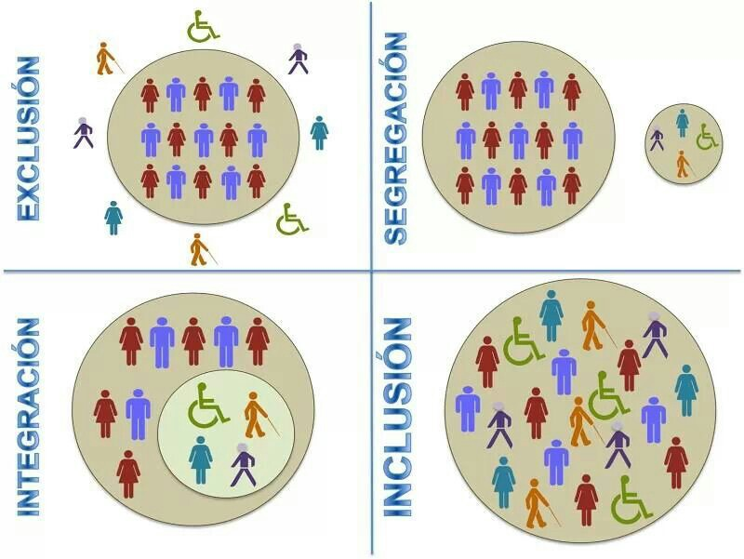
7. How do you visualise the inclusive classroom?

Slide 13
inclusive classroom
practical tips to meet the children’’s needs
Classroom layout
Access
Movement to desk/mat
Seating arrangement
Lighting and Acoustics
also focusing on content, teaching methods and assessment
Visual learning is enhanced through diagrams, video clips, Powerpoint presentations or images. Encouraging learners to read from the board/screen while the teacher explains the content increases reading fluency. Print-outs could be made for learners who like to make notes, while increasing the font size or changing the background of these print-outs could accommodate learners with visual disabilities.
Auditory learners could benefit from the class reading out loud what is written on the board, or by allowing learners to describe the images that are shown. These methods do not only accommodate auditory learners, but also learners with learning disabilities like dyslexia.
Multiple types of assessment are encouraged. Some learners prefer oral instead of written assignments, while others might like to type their assignments. Changing the colour of the paper on which learners do their tasks could be preferred by some, while others need to have their tasks printed in enlarged font. Learners with hearing disabilities might need their tasks to be adapted from written text to sign language, while children with seeing disabilities might need to be supplied with braille versions.

Slide 14
8. What are the potential barriers in inclusive education?
existing popular beliefs concerning “the different person”
lack of teamwork
lack of economical mean
being short of sufficient social encouragemnt

Slide 15
8.b How to overcome these barriers
Consistency of the procedures used to gain trust in the group of people that are involved.
Finding like-minded people who can assist the targeted goal, inclusion and acceptance.
Change assumptions into actions

Slide 16
Useful Resources
Add any useful resources you have found and used
http://www.inclusionbc.org/our-priority-areas/inclusive-education/what-inclusive-education
Inclusion by Design - Inclusion strategies for NGO's https://www.salto-youth.net/tools/toolbox/tool/toolbox-tackling-intolerance-and-discrimination.2038/
https://www.google.gr/url?sa=t&rct=j&q=&esrc=s&source=web&cd=4&cad=rja&uact=8&ved=0ahUKEwiroM7K2MrWAhWOLVAKHQPqA9sQFghFMAM&url=http%3A%2F%2Fen.unesco.org%2Fthemes%2Finclusion-in-education&usg=AFQjCNHqbD7mxjxWIBBhRkt1PD3pPtlo-Q
A guide from Unesco http://unesdoc.unesco.org/images/0024/002482/248254e.pdf
https://www.google.gr/url?sa=t&rct=j&q=&esrc=s&source=web&cd=3&cad=rja&uact=8&ved=0ahUKEwiroM7K2MrWAhWOLVAKHQPqA9sQFgg9MAI&url=http%3A%2F%2Funesdoc.unesco.org%2Fimages%2F0017%2F001778%2F177849e.pdf&usg=AFQjCNGnc0TOAC9L_VymlPawgHx9tWe9Kw
https://www.youtube.com/watch?time_continue=5&v=8HPh4RoV63s
https://www.google.gr/url?sa=t&rct=j&q=&esrc=s&source=web&cd=14&cad=rja&uact=8&ved=0ahUKEwiroM7K2MrWAhWOLVAKHQPqA9sQFgh7MA0&url=http%3A%2F%2Finclusiveschools.org%2Ftogether-we-learn-better-inclusive-schools-benefit-all-children%2F&usg=AFQjCNHji6TdRw8gUsrJpXzohIp3LniQDQ

Slide 17
The co-creators
Add your name and surname for attribution
Nida Türkelay
Argiro Spyrogianni
Natavan Badalova ( Azerbaijan)
Bojana Msnic, Pirot, Serbia

Slide 18
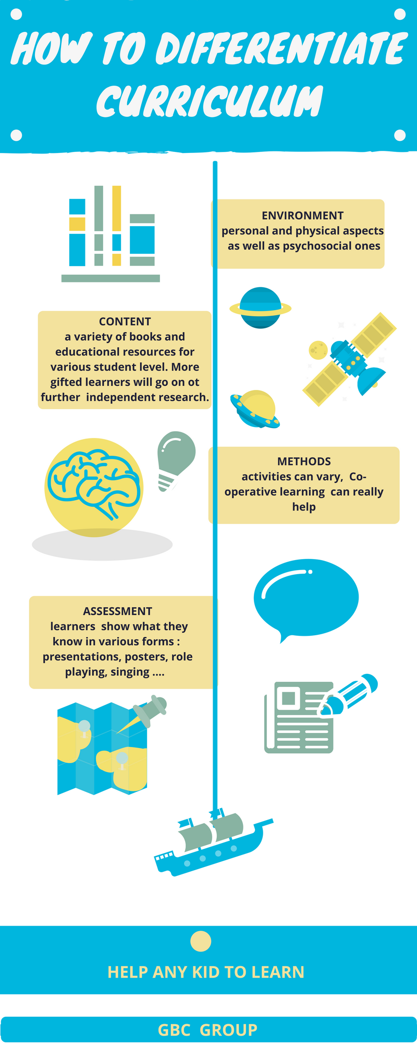
Maria Antonietta Caravelli

Slide 19
We need you to complete our puzzle!
( Antonella Montalbano)

Slide 20
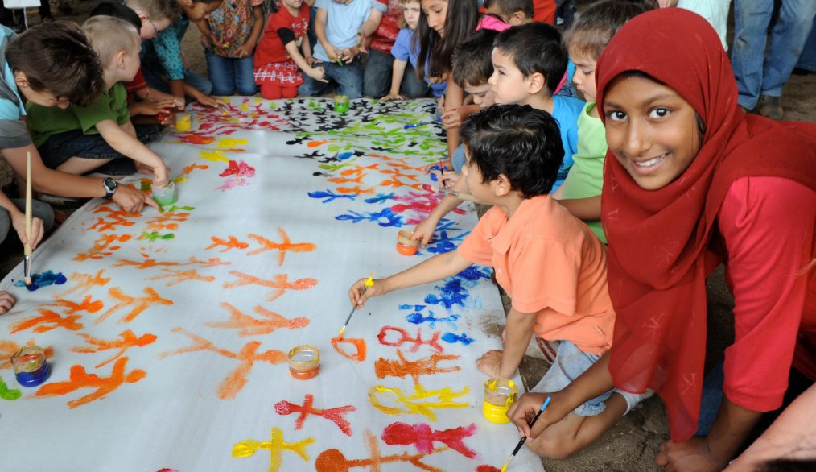
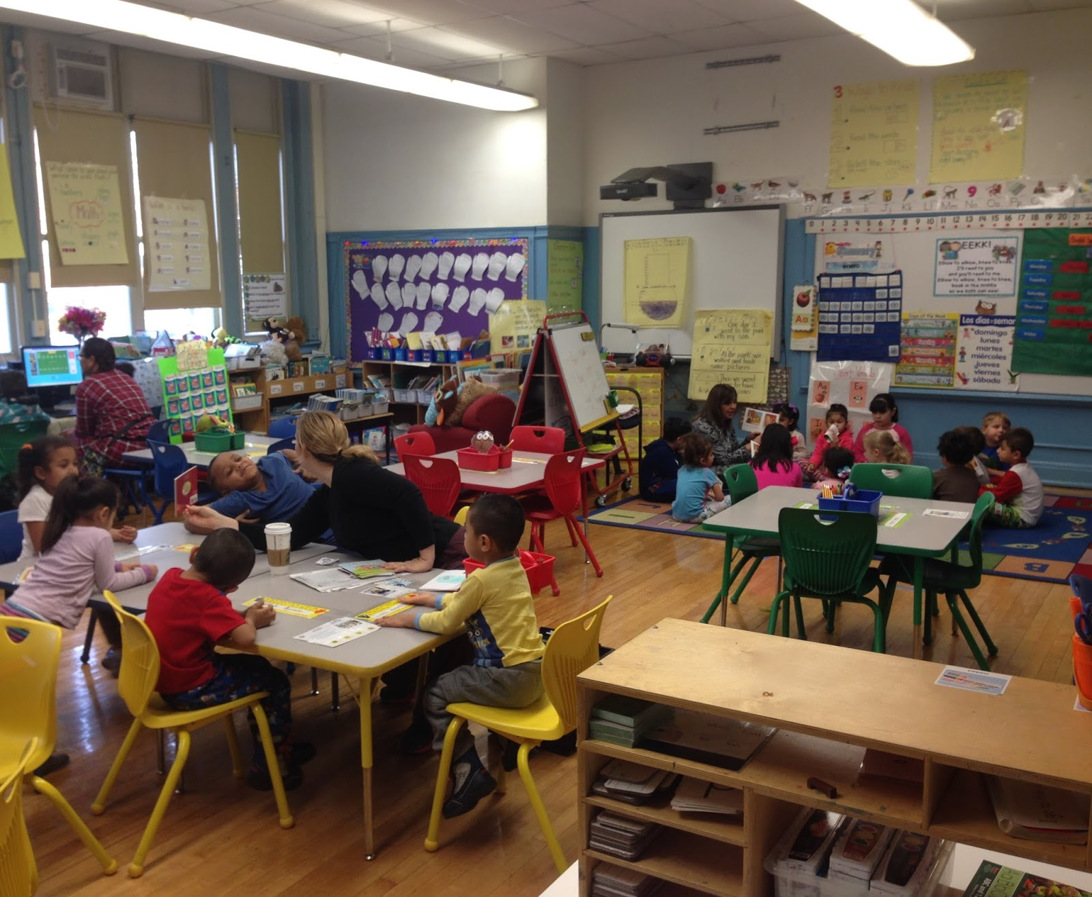
Environment for inclusive learning

