Slide 1
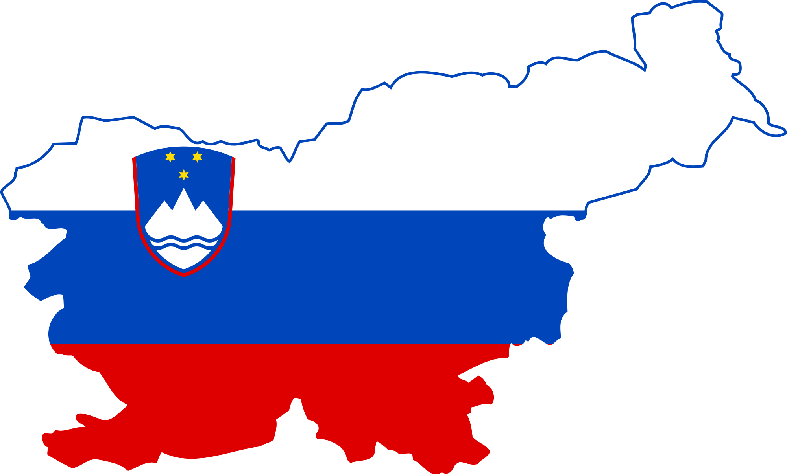
Slovenia
Notes:
ČRTOMIR: Hello everybody, we are very happy to meet you again. This time in Turkey. We are 8th and 9th graders from Primary school 1. Our school is in the small town Murska Sobota, which is located in the north-east of Slovenia (Pokaži na zemljevidu). We are hoping to spend another great time with you. But first at all let us tell you something about our small but beautiful country Slovenia.

Slide 2
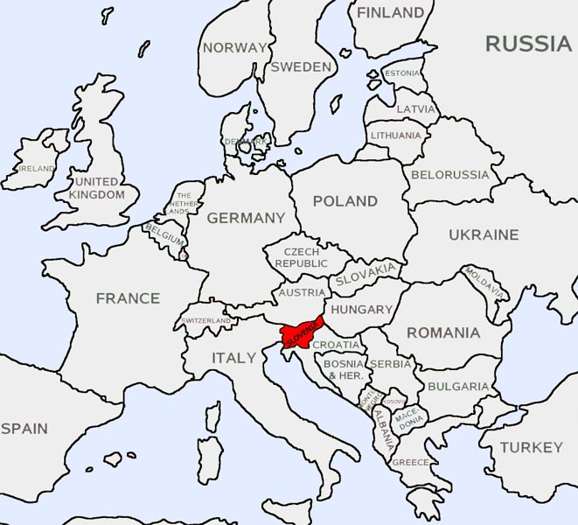
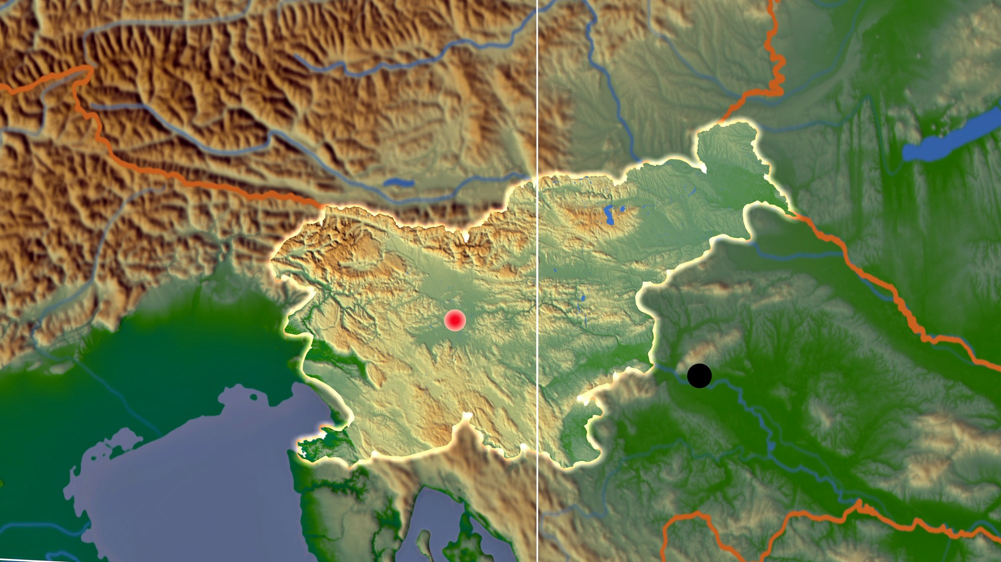
Location
Notes:
ALJAŽ: Slovenia is a small country in central Europe. It borders Italy in the west, Austria in the north, Hungary in the northeast and Croatia in the southeast. It also has a bit of access to the Adriatic sea. According to its geographical relief it's got many mountains in the northwest, while the eastern part of the country is more flat with some hills.
VPRAŠANJE:
Which of these countries does Slovenia border?

Slide 3
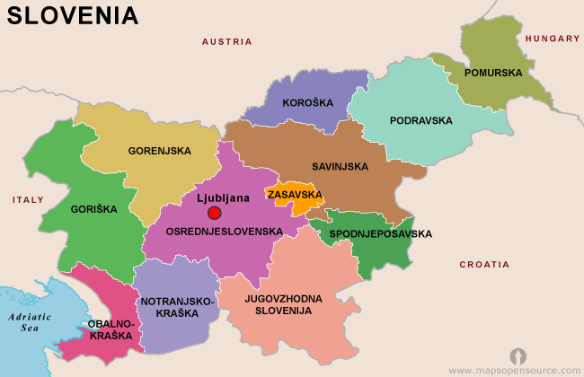
REGIONS
Notes:
DENIS: There are 12 regions in Slovenia. The capital Ljubljana is in the central region. We live in the Pomurska region, the biggest mountain is in the Gorenjska region and the Slovenian coast is in the Obalnokraška region. Slovenia is in the shape of a chicken and we live in the "head" of the chicken, that’s why we joke about being the smartest in the country.
Vprašanje:
Which part of the chicken is the Pomurska region in?

Slide 4
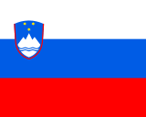
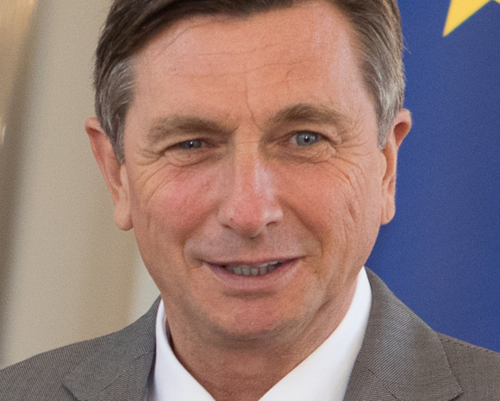
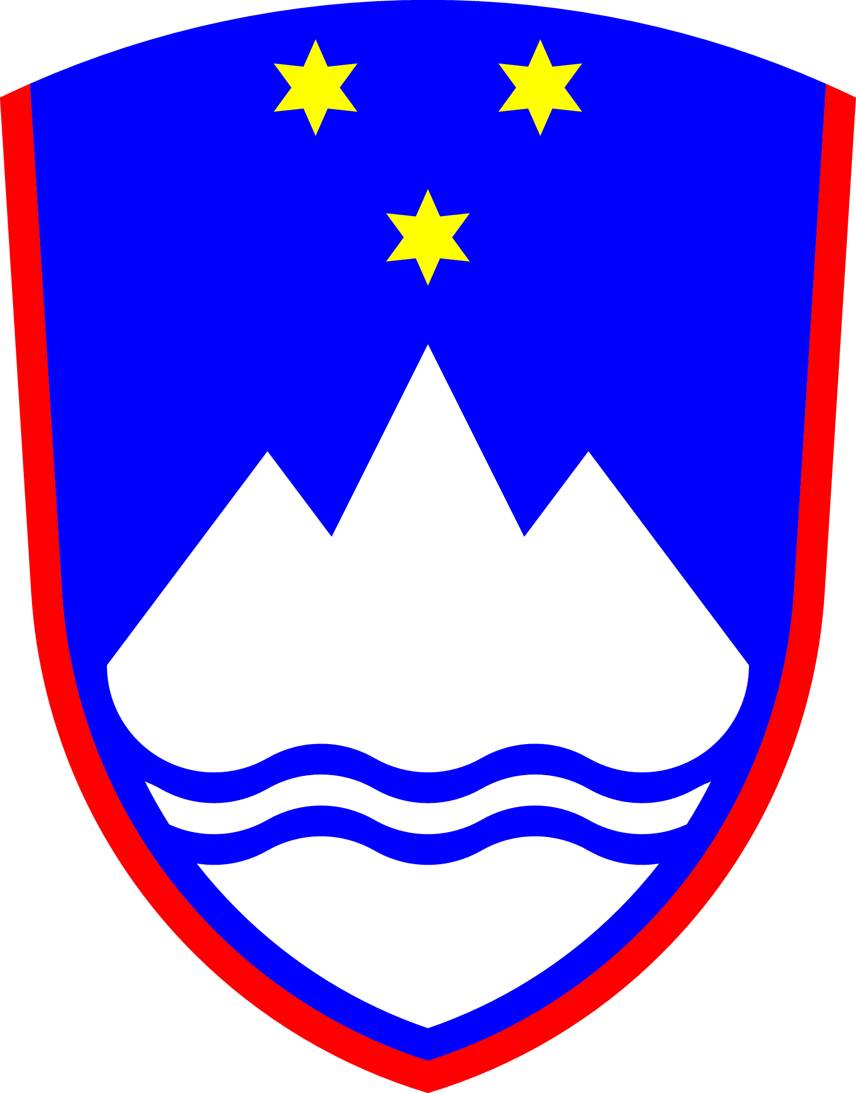
Notes:
MAJ:In this slide you can see our flag which has 3 colors white on the top, blue in the middle and red at the bottom. The president of Slovenia is Borut Pahor. Parts of our coat of arms are the Celje stars, mountain Triglav and all the rivers in Slovenia. Slovenia became independed in 1991. Our national anthem is a part of the poem written by the greatest Slovene poet France Prešeren in 1844.
Vprašanja:
Whats the correct order of colors on the Slovenian flag from top to bottom.
Iz katerih komponentov je sestavljen slovenski grb ALI katerega leta se je slovenija osamosvojila
Gdo je predsednik države
https://www.youtube.com/shorts/NDSiRvVLt9g

Slide 5
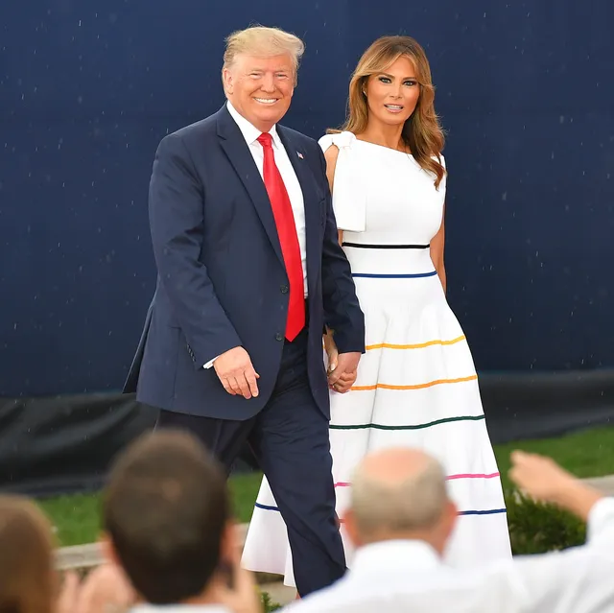
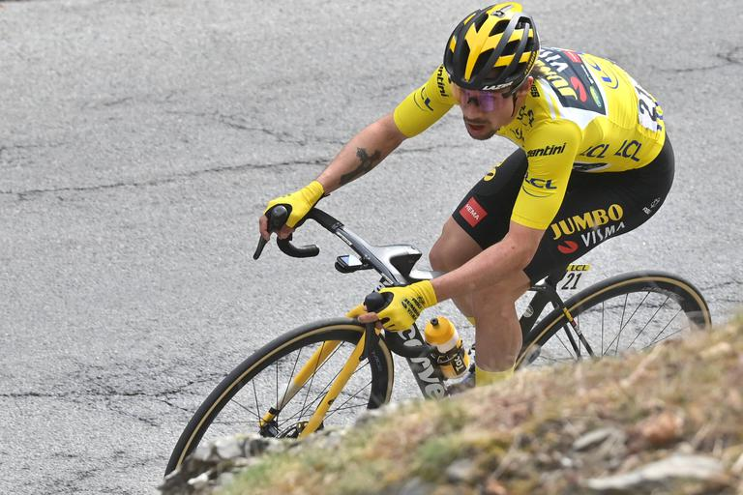
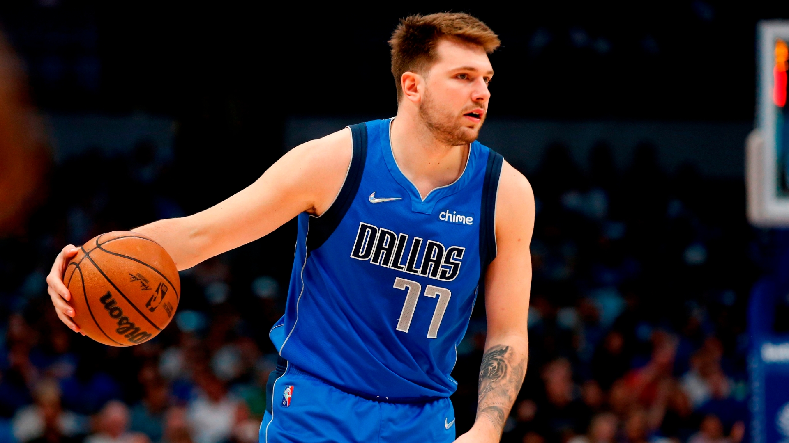
Famous people
Notes:
Sašo: Slovenia is relatively small, but there are quite a few world-known people from here. Most of them are famous because at sports, for example, Luka Dončić, a 22-year-old Slovenian basketball player currently playing for the Dallas Mavericks team in the USA. Other famous sport personalities are Peter Prevc, the best Slovenian ski jumper and Primož Roglič, who also started his sports career with ski jumping, but later became a professional cyclist. Although, the most known Slovenian is probably Melania Trump, the wife of the former president of the USA, Donald Trump.
Vprašanje: What sport is Primož Roglič known for?

Slide 6
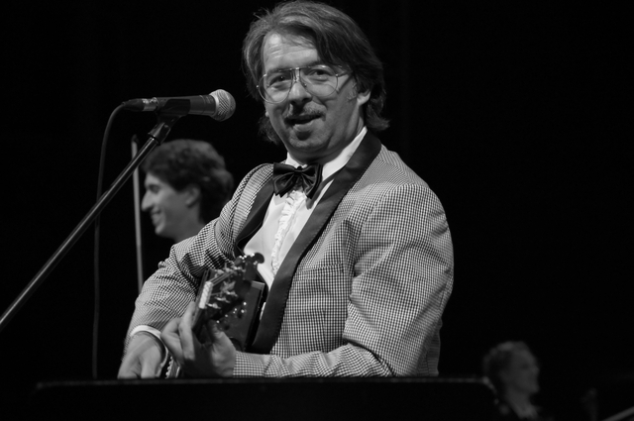
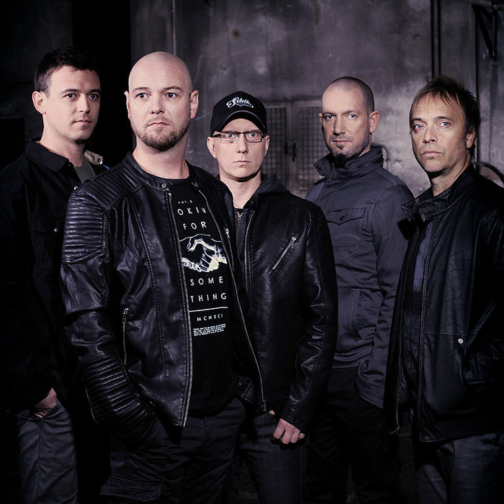
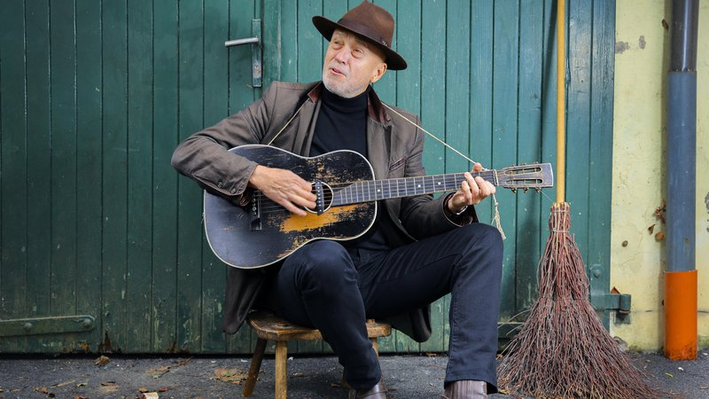
Famous musicians
Notes:
MATIC: There are many famous Slovenian musicians, but they are less known outside the country. Most famous of them are Robert Pešut, also known as Magnifico, the rock band Siddharta, Vlado Kreslin and folk music band The Avsenik brothers that held concerts in several European countries and created the most known Slovenian folk song, Na Golici.
Vprašanje: Who wrote the most famous Slovenian folk song Na Golici

Slide 7
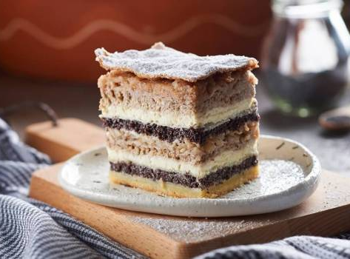
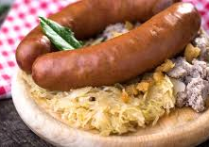
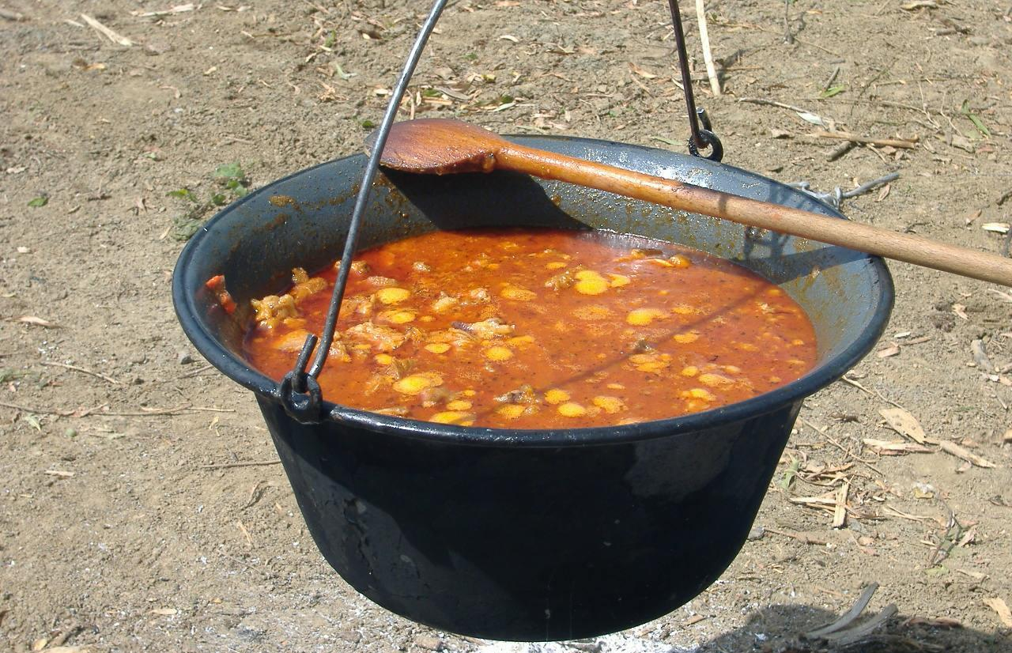
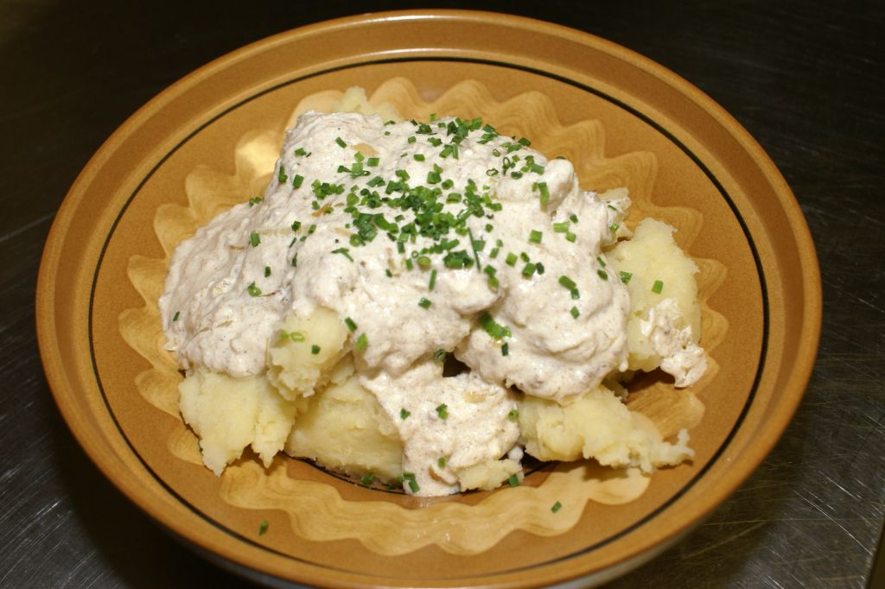
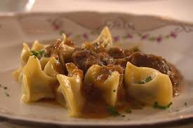
Slovenian cousine
Notes:
MAJ: In Slovenia we have some really delicious food. Each region has its own specialities, for example: Kranjska klobasa from Gorenjska region, Bograč, Prekmurska gibanica and dodoli from our region Prekmurje, Idrijski žlikrofi from Central region and some more… When you were at Slovenia i am sure you tried Prekmurska gibanica. It's a very good desert that is typical for our region Prekmurje.
VPRAŠANJE:
Which dish isn't from Prekmurska region? Odg: Kranjsak klobasa

Slide 8
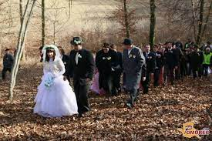
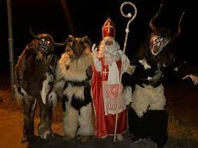
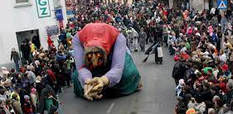
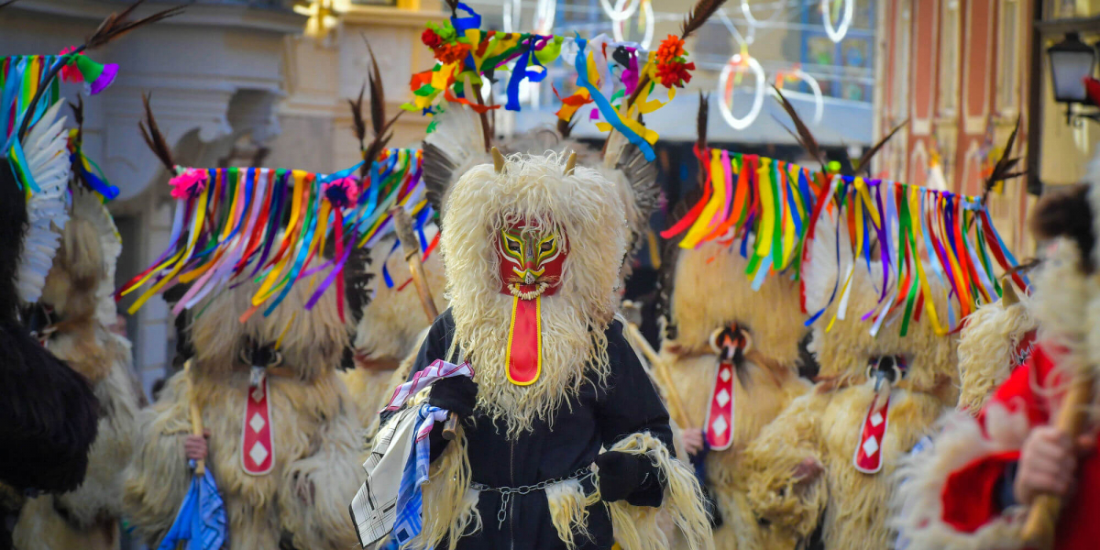
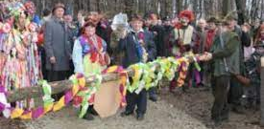
FOlk customs or typical celebrations
Notes:
c

Slide 9
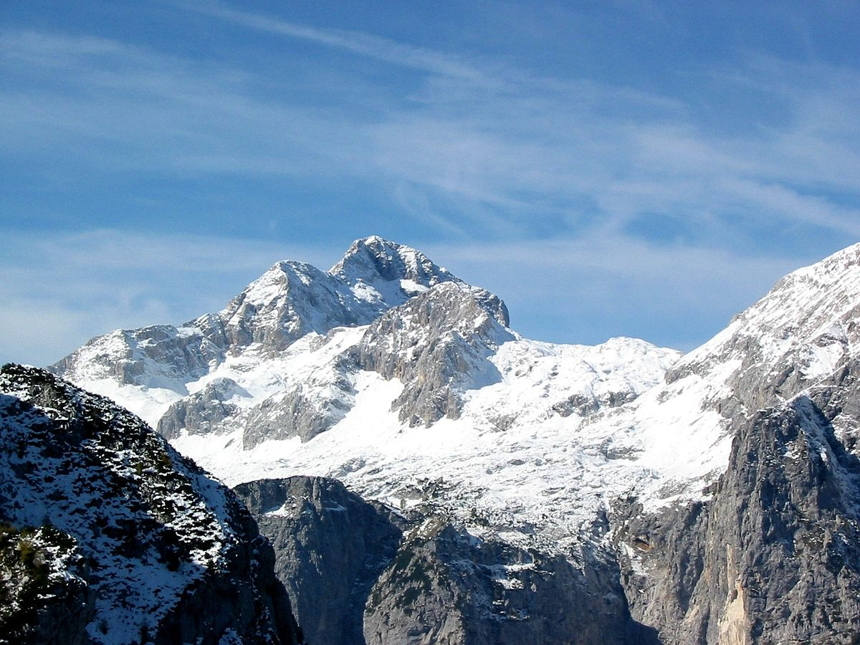
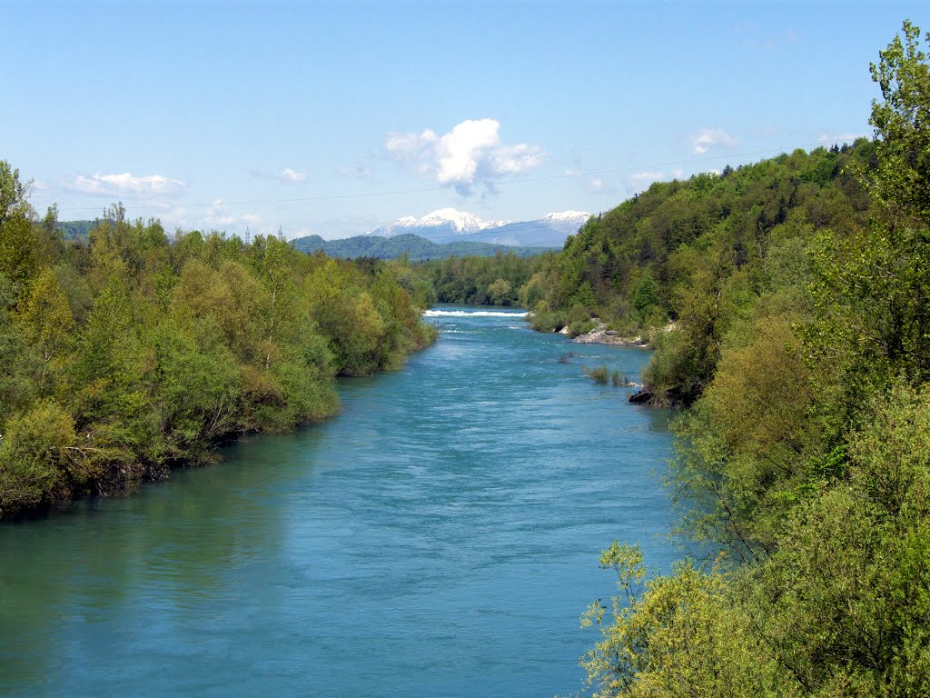
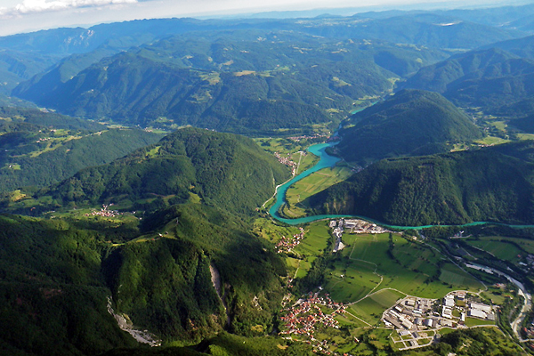
Geographical features
Notes:
ALJAŽ: In slovenia we have mountains and sea, hills and valleys, rivers and lakes, plains and forests, but we don't have a desert. Our coast line is 47km long. Our biggest mountain is Triglav with 2864m. The longest river is Sava with 990km.
VPRAŠANJA:
How long is our coast line?

Slide 10
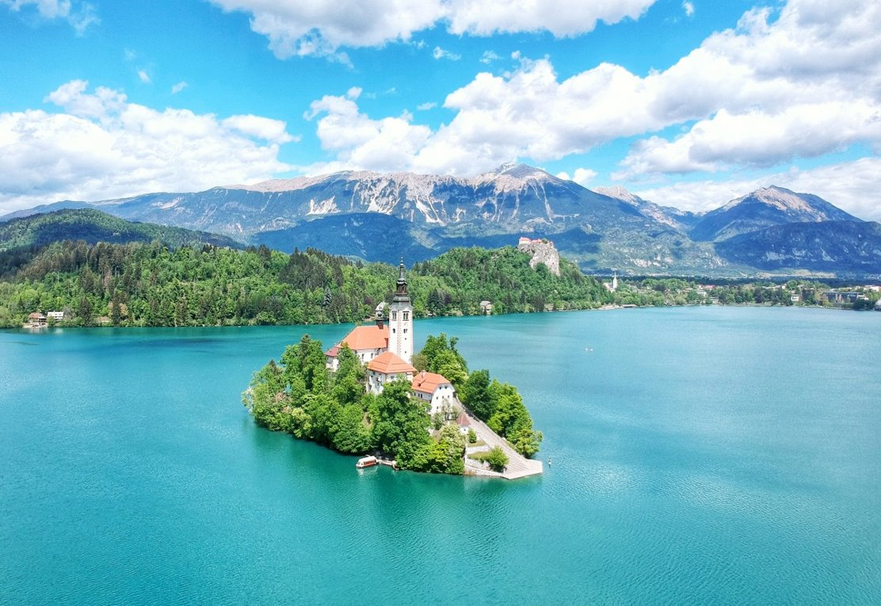
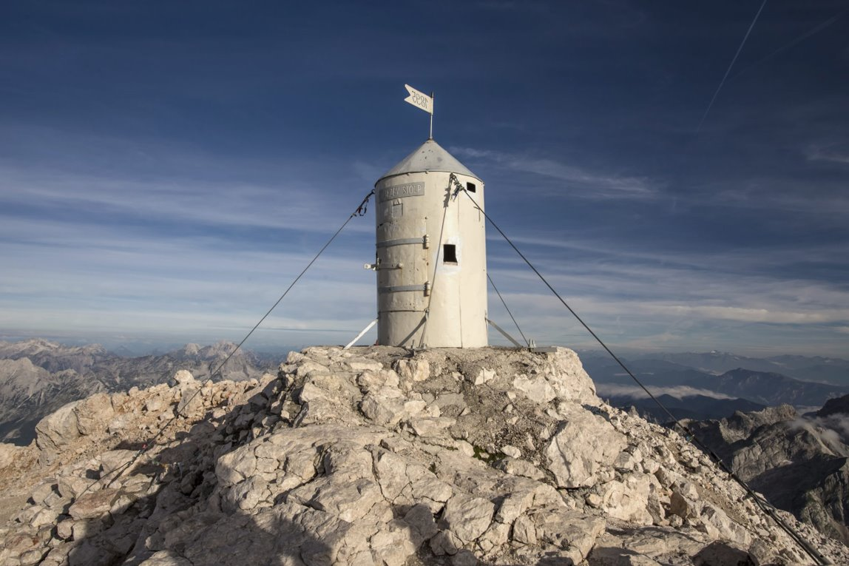
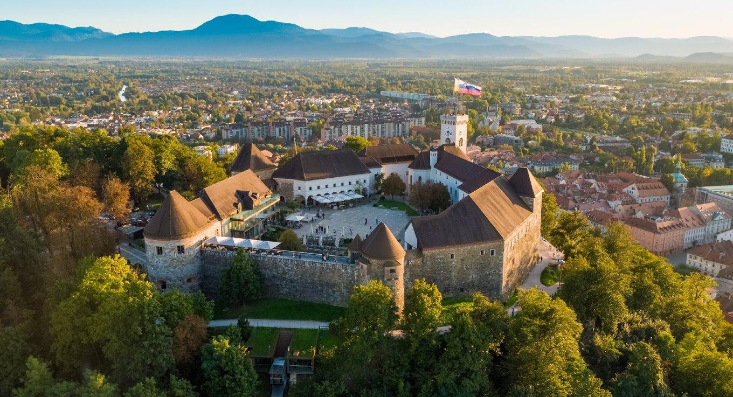
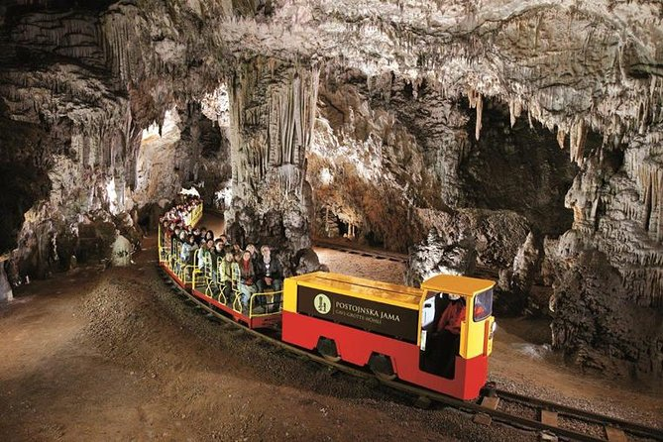
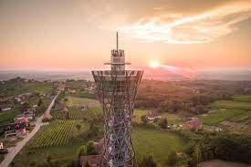
tourist attractions
Notes:
Denis: Slovenia is full of interesting attractions . The Aljaž tower is a small tower on top of our biggest mountain Triglav. The Vinarium tower is a big tower in a town called Lendava. It has a beautiful look over the whole Pomurje region. Bled is a touristic town with a beautiful castle beside the lake which has got a small Island in the middle. The Ljubljana castle is a big castle on top of a Hill in the centre of the capital city. Near the town of Postojna there is a famous cave called the Postojna Cave with a fun train ride in it.
Question: In which town is the famous cave with the fun ride located?
Lendava, Bled, Postojna, Ljubljana

Slide 11
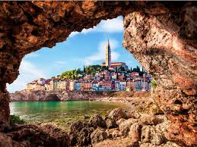
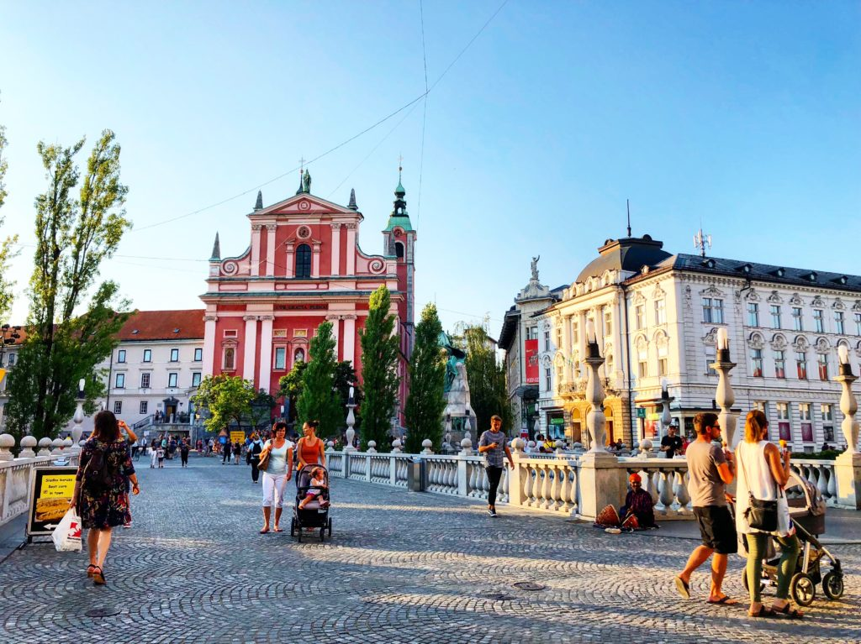
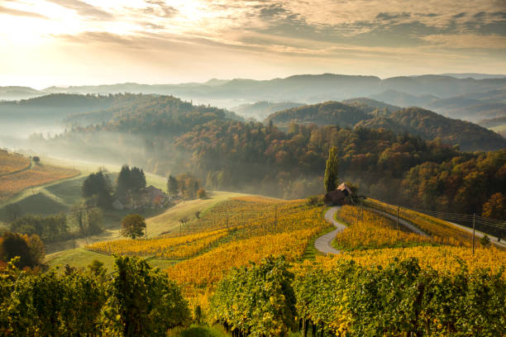
Thank you for your attention ☺
Notes:
That was just a little piece of our country. We hope you liked it. There are many more attractions and gorgeous sights to see and visit in Slovenia. So, if you have a chance, come and visit us.Welcome.

Slide 12
Sašo, Črtomir, Maj, Denis, Aljaž, Matic

