Slide 1
Moving sensor
Ema L, Ema M, Matic

Slide 2
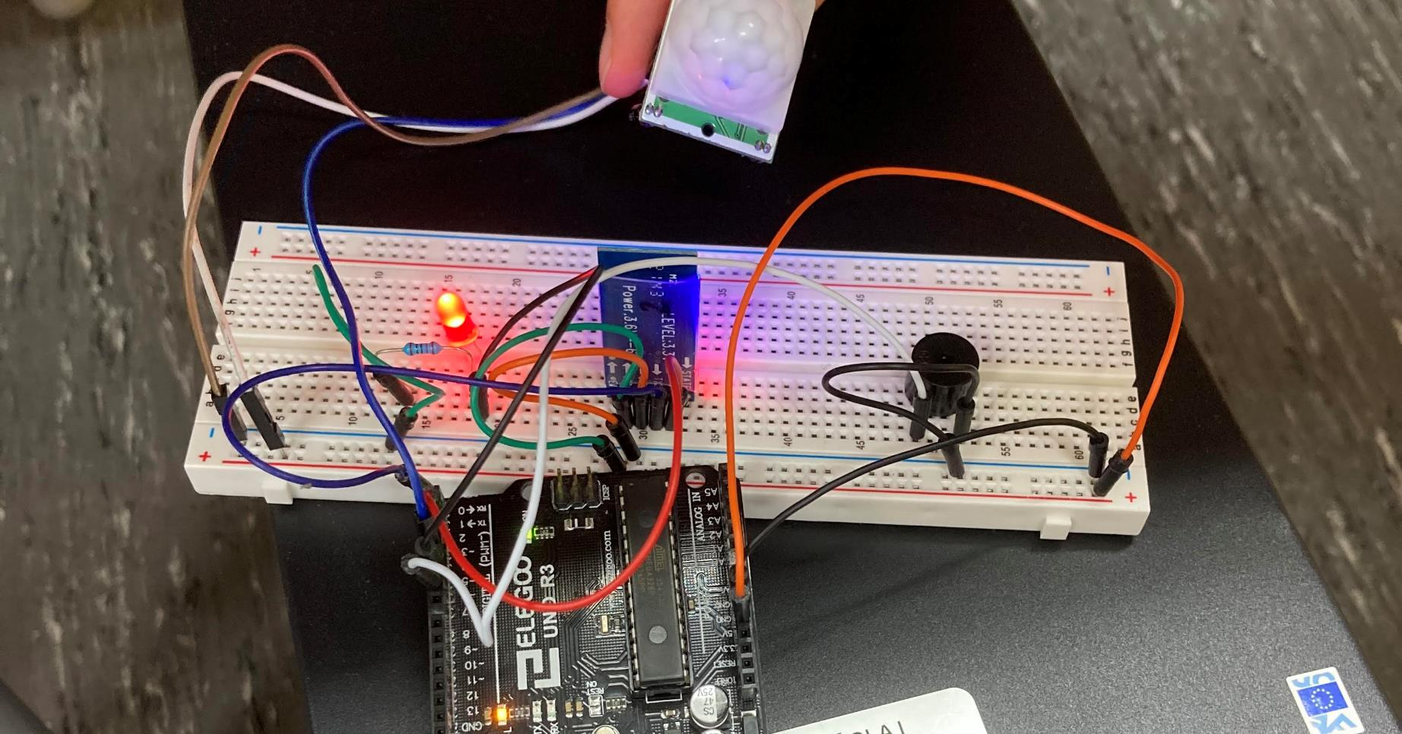

Slide 4
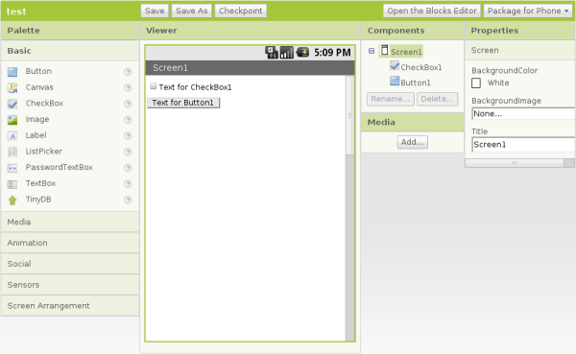
App Inventor

