Slide 1
OUR COUNTRY: SPAIN

Slide 2
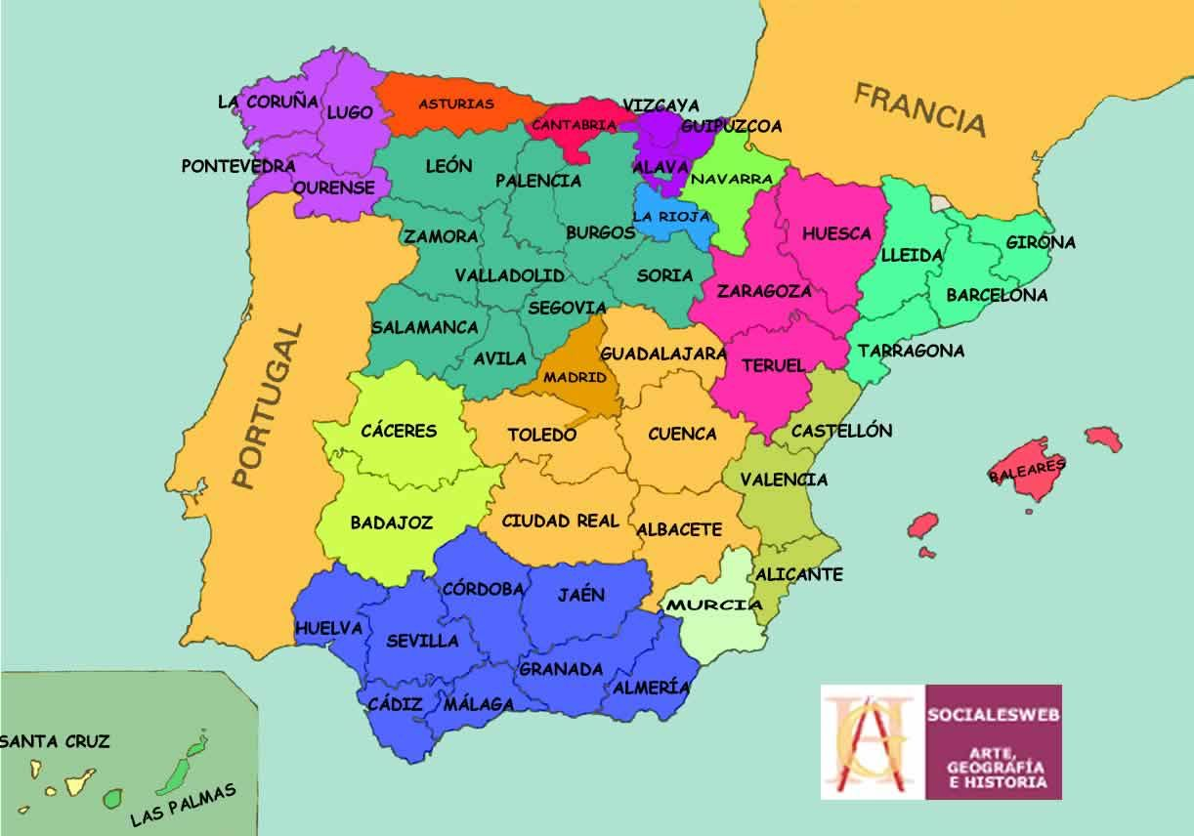
POLITICAL ORGANIZATION
17 Autonomous communities (our autonomous community is Castilla La Mancha).
50 provinces.
Castilla La Mancha has 5 provinces: Toledo, Albacete, Cuenca, Guadalajara and Ciudad Real.
The capital city of Spain is Madrid.
The King of Spain is Felipe VI.
The president is Pedro Sánchez.

Slide 3
IMPORTANT MONUMENTS
The Holy family This is located in the city of Barcelona. It is one of the most important monument, designed by the architect Antoni Gaudí. Started in 1882, it is still under construction and is the greatest exponent of catalan modernist architecture.
Royal Palace: It is located in the capital, Madrid, and it is the largest Royal Palace in western Europe and on the largest in the world.
Alhambra :The Alhambra is a fortress that housed the monarch and the court of the kingdom of Granada. Composed of places with incredible gardens, it has stupendous Andalucía interior decoration and its unbeatable location makes the Alhambra one of the most important monuments of Spain.
Mosque of Córdoba: It is one of the most important monuments with islamic architecture in Spain , It was declared cultural patrimony of humanity as part of the most historical centre of the city.

Slide 4
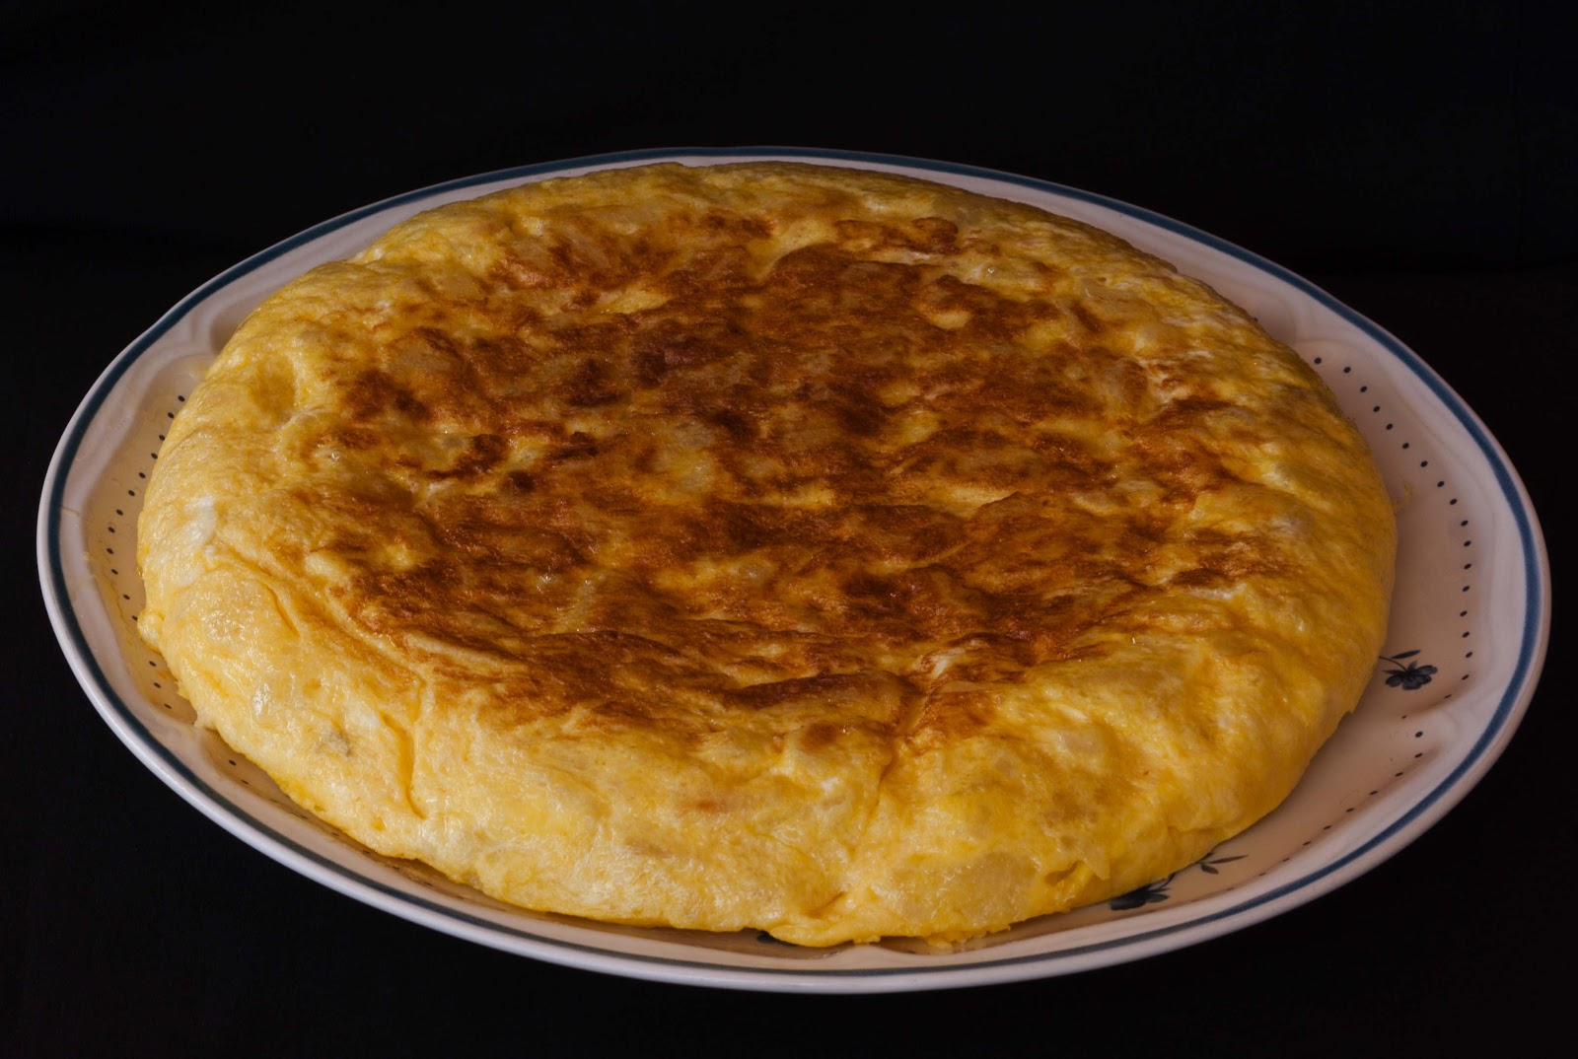
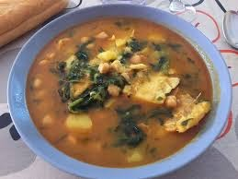
TYPICAL FOOD
One of the characteristics and why Spain is known is because the food, some of the most famous foods in Spain are paella, crumbs, stew or potato omelette.

Slide 5
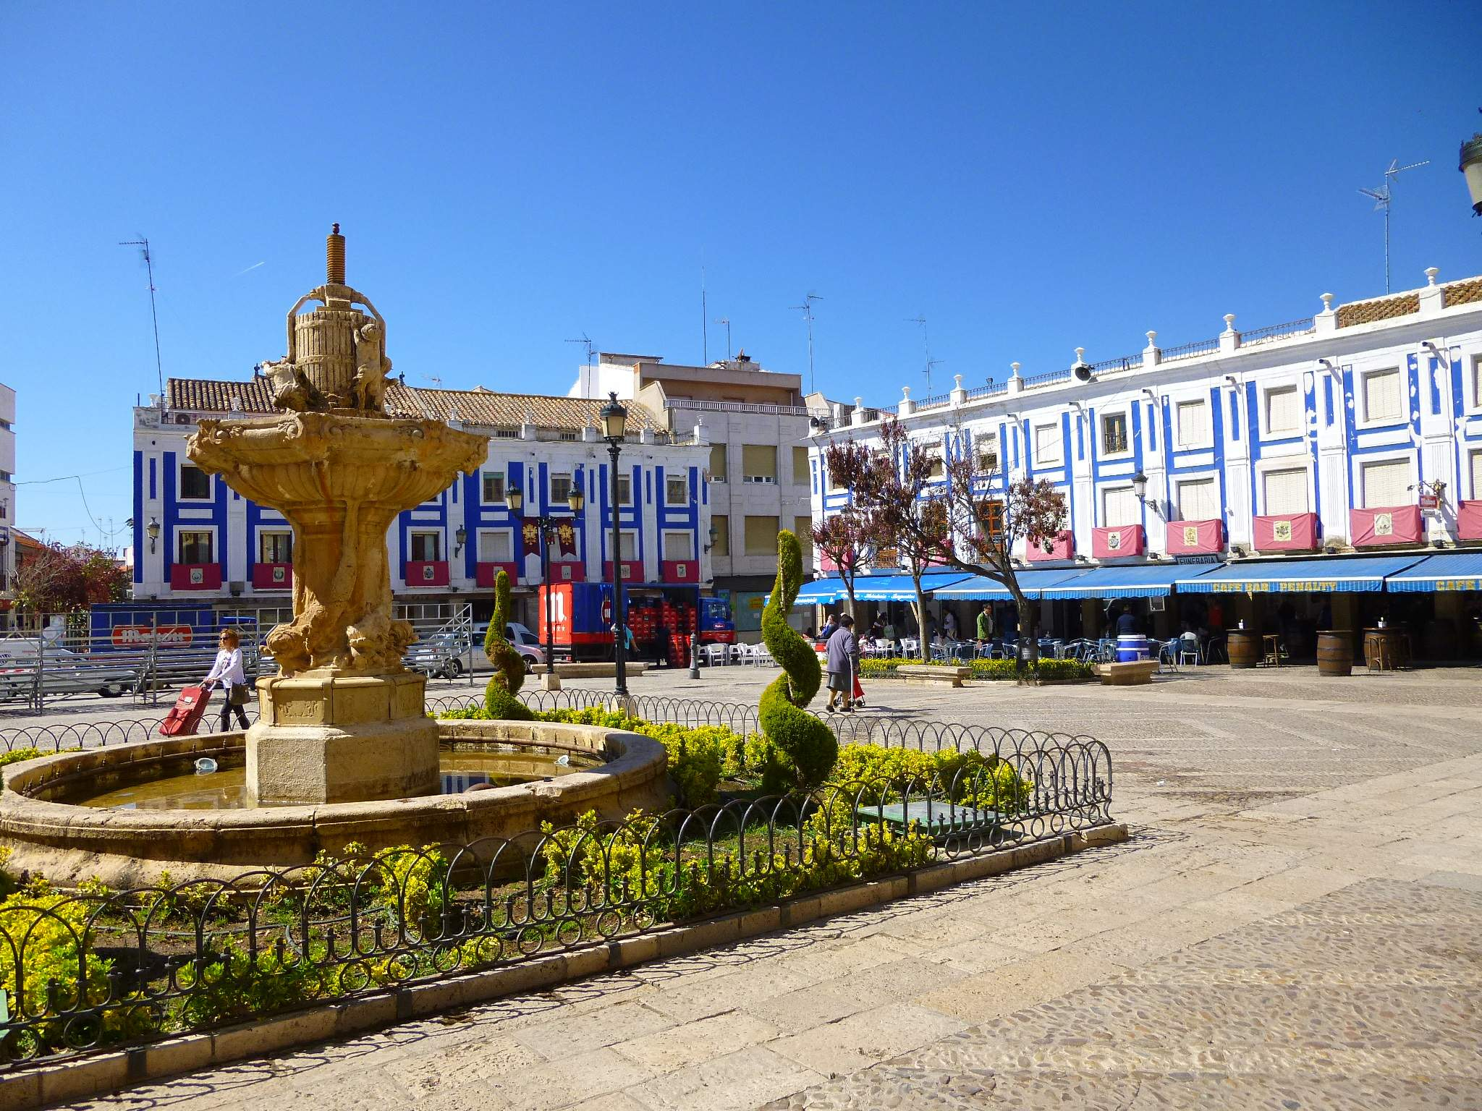
VALDEPEÑAS

Slide 6
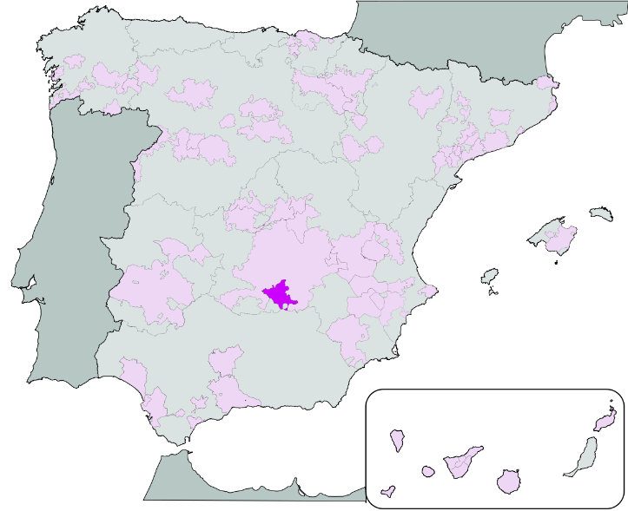
GEOGRAPHY
Its name means "Valley of Rocks", because it is located in a wide hilly area surrounded by a meander of the Jabalón River, just bordering on the plain south of La Mancha, and the subsoil is rich in limestone rock.
It is located in the Campo de Calatrava, an extensive plain north of the Sierra Morena and lies on the left bank of Jabalón River a tributary of the Guadiana.

Slide 7
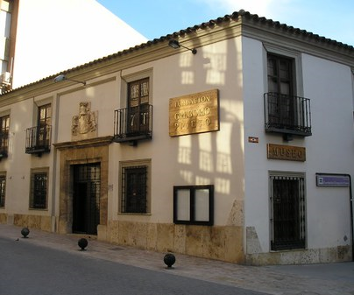
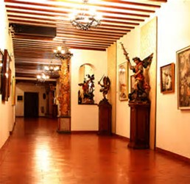
GREGORIO PRIETO MUSEUM
Gregorio Prieto, painter, poet and illustrator well known for his portraits, kitch collages and also rural landscapes of England, Greece and La Mancha.
He worked for the BBC in London while in exile after the Spanish Civil War. A foundation named after him exhibits most of his work in Valdepeñas.

Slide 8
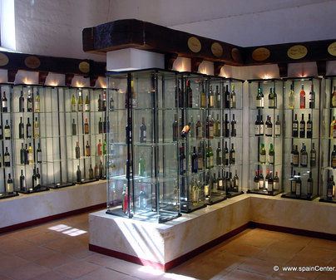
THE WINE MUSEUM
It was founded in 1901 and at full capacity until the 70 of the last century. We will see secrets, culture and folklore around wine from Valdepeñas: crushers, copper filters... Tools of tillage and carriages.
We will also see the winery indeed, its docks of download, scales, jars, well... And a collection of photographs of Harry Gordon of the harvest of 1959.

Slide 9
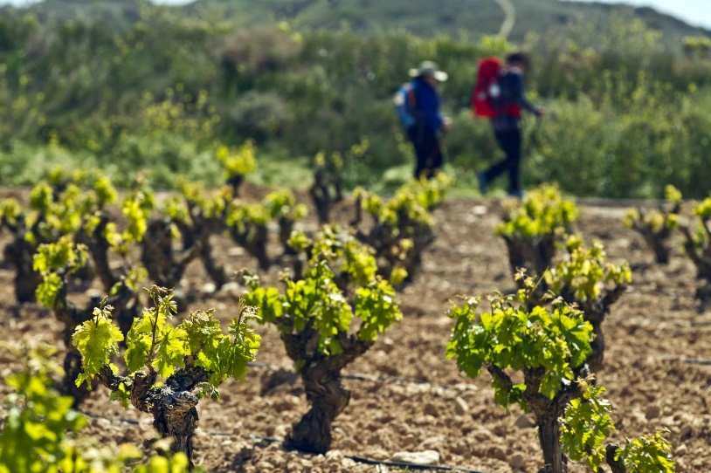
ECONOMY
After rapid growth in the late 19th century the town became home to a lot of factories, as well as hot mineral springs.
However, its chief trade was in red wines. The city continues to be famous for its wines and is the center of a grape-growing district.

Slide 10
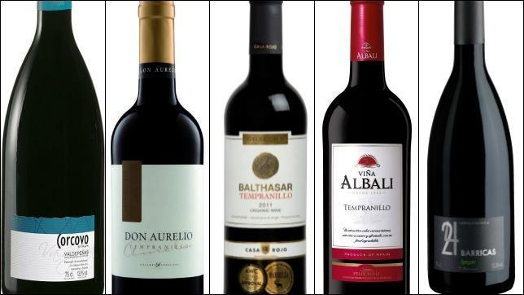
ECONOMY
Valdepeñas wines are among the most popular in Spain and recently in EU countries. In addition to the food and wine industry, there are small and medium industries located in several industrial parks.

Slide 11
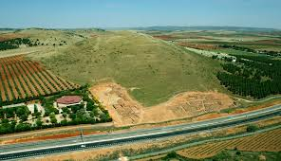
CLIMATE
Valdepeñas is almost completely surrounded by mountains and hills, although the main wine-growing area of Valdepeñas is situated on a plain.
The mountains protect Valdepeñas from the effects of the Mediterranean Sea, but also ensure that the DO's climate is completely continental.

Slide 12
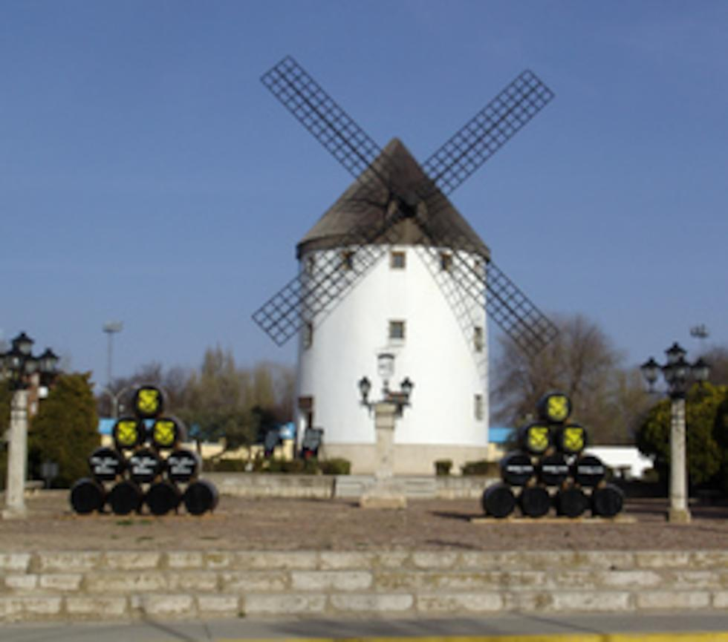
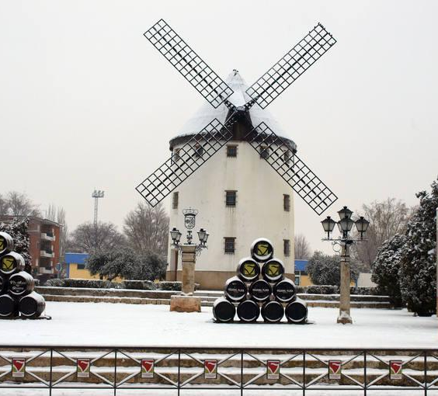
CLIMATE
Winters in Valdepeñas are cold – temperatures can drop as low as -5 Celsius degrees. Summers are hot and dry. Maximum temperatures can reach over 40 Celsius degrees. Droughts are fairly common.
Although hailstorms and high winds are rare, they do occur, sometimes with devastating effects. Rainfall is scarce, and mainly happens during the spring and autumn months.

Slide 13
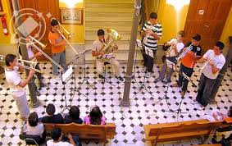
MUSIC
Valdepeñas has a music school called ‘Conservatorio Ignacio Morales Nieva’
Every year there is a concert where people of the academy perform, and you can go there and watch how they play their instruments, both in collective and individual performances
In addition, Spanish
artists are invited every
year to perform in
Wine Festival

Slide 14
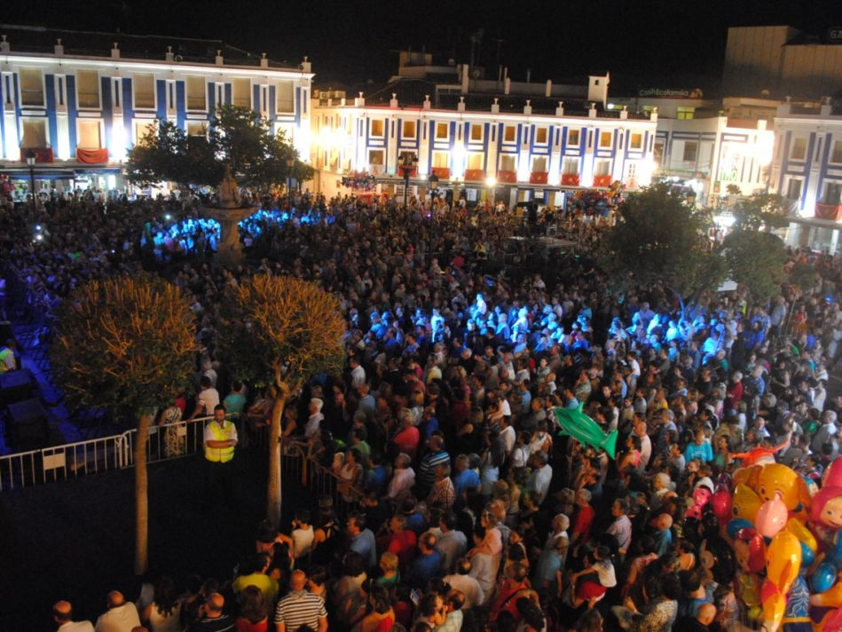
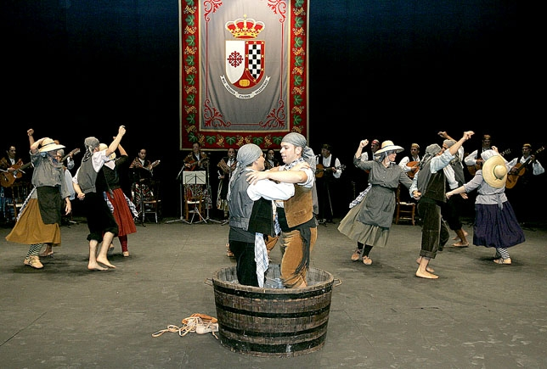
FESTIVALS
Valdepeñas is known because of its Wine Festival that is celebrated in september. Some popular music groups visit us and perform in the main square.
People gather in the square dancing and enjoying the music.
Other activities related to the wine culture take place during this week.

Slide 15
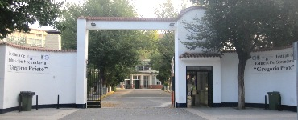
I.E.S GREGORIO PRIETO
This high school has its origins in 1929 as a Vocational Training School. It is the biggest high school in our community (Castilla La-Mancha)
Nowadays it has around 1500 students and 150 teachers. The students can be between 12 and 30 years old

Slide 16
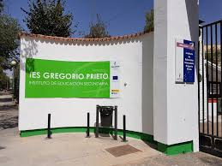
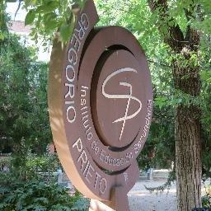
I.E.S GREGORIO PRIETO
Our high school offers the opportunity to attend Compulsory Secondary Education and Bachillerato studies in Humanities-Social Science, Health Science and Technology. It also has the exclusiveness of studying Vocational Training and degrees such as commerce, mechanics, cooking, electricity…

Slide 17
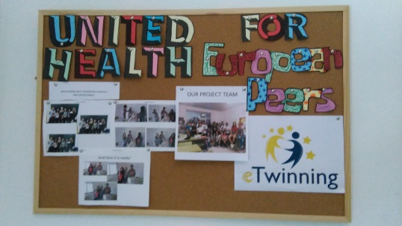
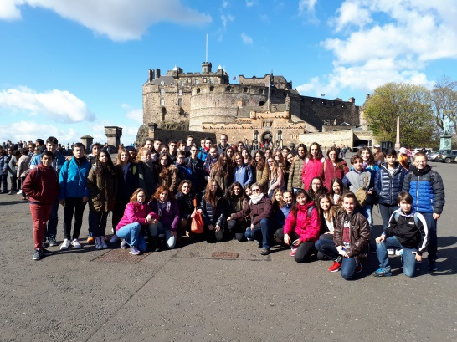
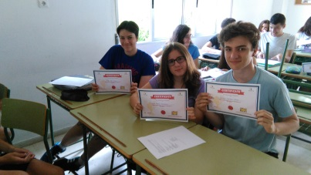
INTERNATIONAL PROJECTS
Linguistic Inmersion trips: Dublin, Edinburgh, York, Oxford.
Erasmus projects: 7 for this course.
Exchange with Belgium.
eTwinning projects.

Slide 18
THE END

