Slide 1
SUPR TXTR
MAJ, NINA AND LUŠA

Slide 2
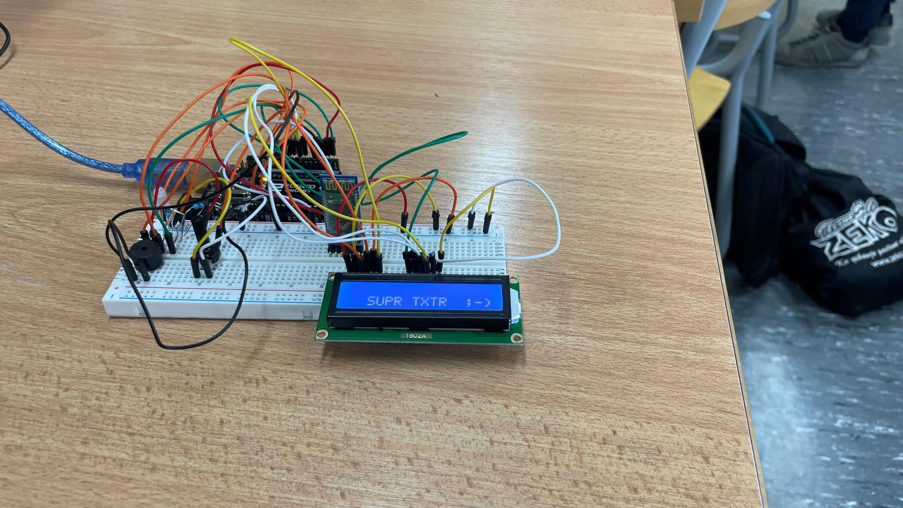
OUR PROJECT

Slide 3
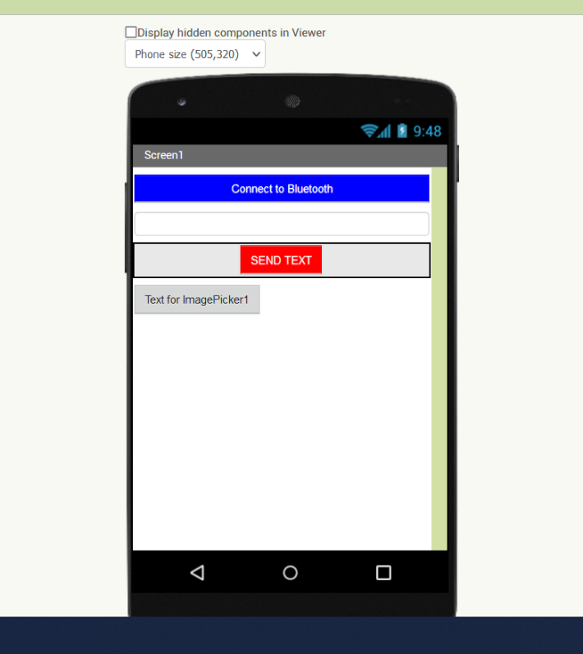
APP INVENTOR

Slide 4
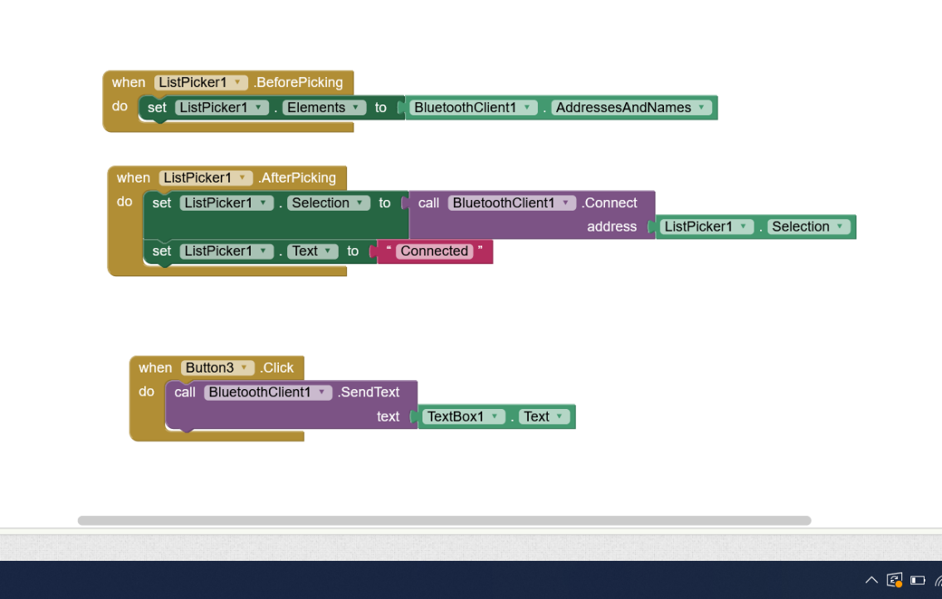
APP INVENTOR-CODE

Slide 5
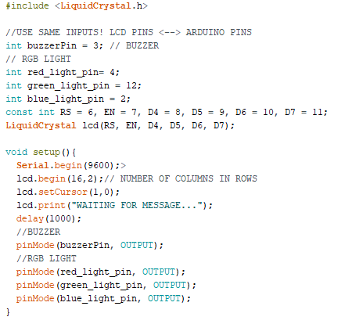
THE CODE #1

Slide 6
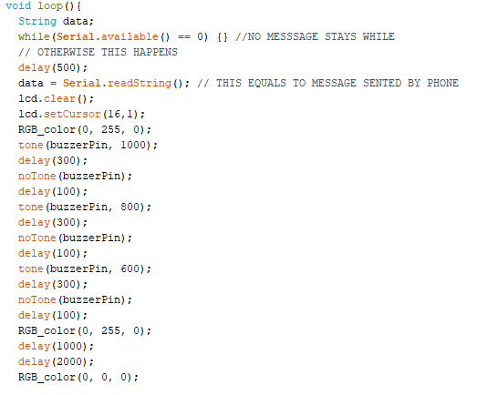
THE CODE #2

Slide 7
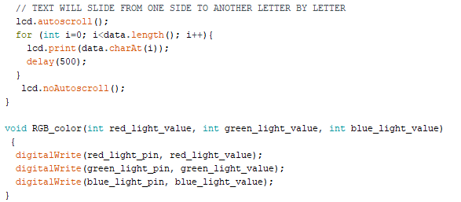
THE CODE #3

