Slide 1
Christmas Lights - Arduino
Christmas Light
OPEN YOUR DOORS TO DIGITAL AGE

Slide 2
How to make Christmas Lights show with Arduino
In this project we are going to show how to make Christmas light using Arduino and leds

Slide 3
How to make Christmas Lights
In this project we are going to show how to make Christmas lights using Arduino and leds

Slide 4
Components List
1 Arduino Uno R3 board
1 Breadboard
10 Leds
10 220 Ohm resistors
cables and jumper

Slide 5
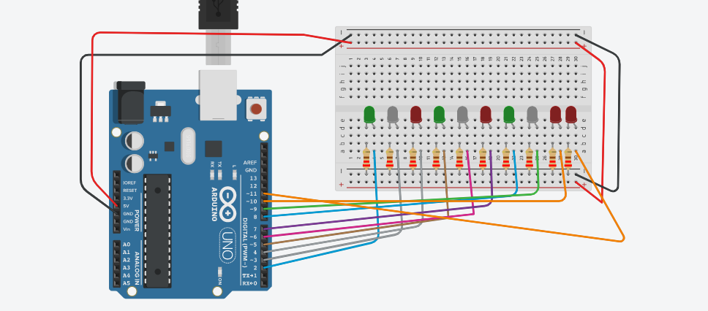
The Sketch

Slide 6
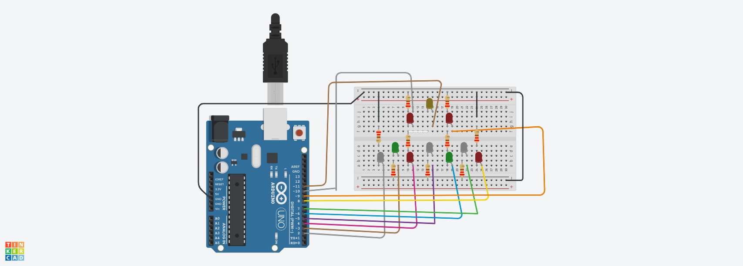
If you like you can give to the leds a Christmas tree shape

Slide 7
The Code
https://www.tinkercad.com/embed/7vXcjm5DOS5?
// Christmas Light simulation
//
void setup() {
}
// the loop function runs over and over again until power down or reset
void loop() {
}

Slide 8
int arrLED[10] = { 2, 3, 4, 5, 6, 7, 8, 9, 10, 11 };
// define 10 Pin. One for each Led
//arrLED[10] define an array of 10 delements
To avoid to repeat every time the same code to setup the leds and turn them on and off.
Arrays are groups of the same kind of data that are placed consecutively in memory. For example, we can have an array of integers (type int) which is two or more integer numbers occurring one after the other.
The key here is that each element in an array is placed directly after the previous element which allows us to access each element in turn using a loop.
Note that the element numbering starts from zero [0] and not one [1], so the first element in the array is element 0.

Slide 9
Accessing an Array in a Loop
A for loop is used to get the contents of each element in the array in turn and print the values to the Serial Monitor window.
for (int i = 0; i<10; i++)
{
pinMode(arrLED[i], OUTPUT);
// set up PIN from 2 to 11 in OUTPUT mode
}

Slide 10
/*
Name: Christmas Light simulation
Created: 23/11/2021 15:00:00
Author: I.C. Camera Sala Consilina
Open Your Doors to Digital Age Project
*/
// define 10 Pin. One for each Led
int arrLED[10] = { 2, 3, 4, 5, 6, 7, 8, 9, 10,11 };
/* x, y, z are three variable to count the number
of loops the leds are turned on and of in the same way
*/
int x = 1;
int y = 1;
int z = 1;
void setup() {
for (int i = 0; i<11; i++)
{
pinMode(arrLED[i], OUTPUT); // set up PIN from 2 to 10 in OUTPUT mode
}
}

Slide 11
void loop() {
//Turn on and off LEDs for 5 times
if (x <= 5) {
int j;
for (j = 0; j < 10; j++)
{
digitalWrite(arrLED[j], HIGH); // switch on PIN from 2 to 10
}
delay(400);
int k;
for (k = 0; k < 10; k++)
{
digitalWrite(arrLED[k], LOW); //switch on PIN from 2 to 10
}
delay(400);
x++; //increase x by 1
}

Slide 12
/*
x > 5 let's turn on LEDs in ascending and descending order for 3 times.
it will run until y less than 3
*/
if(x>5 && y<=3) {
// switch on and off LEDs from the first to last
for (int i = 0; i<10; i++)
{
digitalWrite(arrLED[i], HIGH);
delay(50);
digitalWrite(arrLED[i], LOW);
delay(100);
}
// switch on and off LEDs from the last to first
for (int j = 10; j >= 0; j--)
{
digitalWrite(arrLED[j], HIGH);
delay(50);
digitalWrite(arrLED[j], LOW);
delay(100);
}
y++; //increase y by 1
}

Slide 13
/*
x > 5 , Y > 3: LEDs odd - even LEDs flashes for 5 times.
the variabe z is controlling this sequence
*/
if(x>5 && y>3 && z<=5) {
for (int j = 0; j<10; j = j + 2)
{
digitalWrite(arrLED[j], HIGH);
digitalWrite(arrLED[j + 1], LOW);
}
delay(400);
for (int k = 0; k<10; k = k + 2)
{
digitalWrite(arrLED[k], LOW);
digitalWrite(arrLED[k + 1], HIGH);
}
delay(400);
z++; // increase z by 1
}

Slide 14
if (x > 5 && y > 3 && z > 5)
{
int t;
for (t = 0; t < 10; t++)
{
digitalWrite(arrLED[t], HIGH);
}
delay(400);
//int t;
for (t = 0; t < 10; t++)
{
digitalWrite(arrLED[t], LOW);
}
delay(400);
// x > 5 , y > 3, z > 3 let's start the sequence again from the beginning
x =1; y=1; z=1
}
}

Slide 15
Next Step
Every time you push the button the sequence that the lights switch on and off change.
Try to change the code to accomplish that.
Insert a button to choose the sequence of the lights that you like more

Slide 16
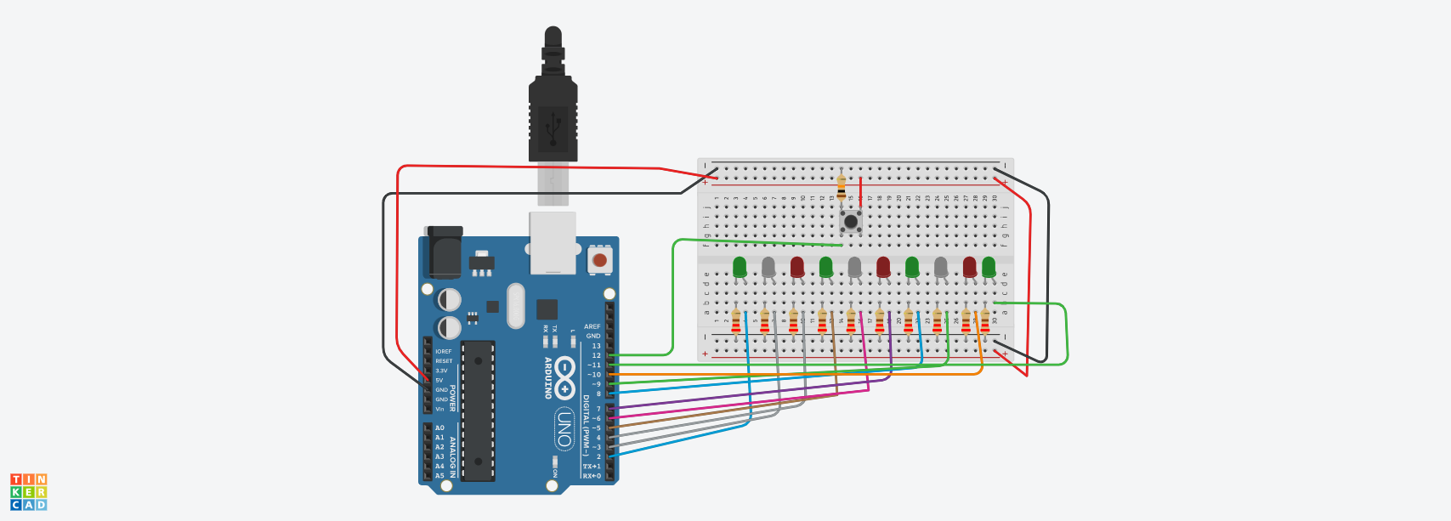

Slide 17
Components List
1 Arduino Uno R3 board
1 Breadboard
10 Leds
10 Resistors 220 Ohm
1 Button
1 Resistor 10 kOhm
cables and jumper

Slide 18
The code
https://www.tinkercad.com/embed/dax3nXvRYiP?

Slide 19
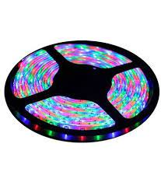
Eureka! I can try to build on my own Christmas lights for my home with Arduino

