Slide 1
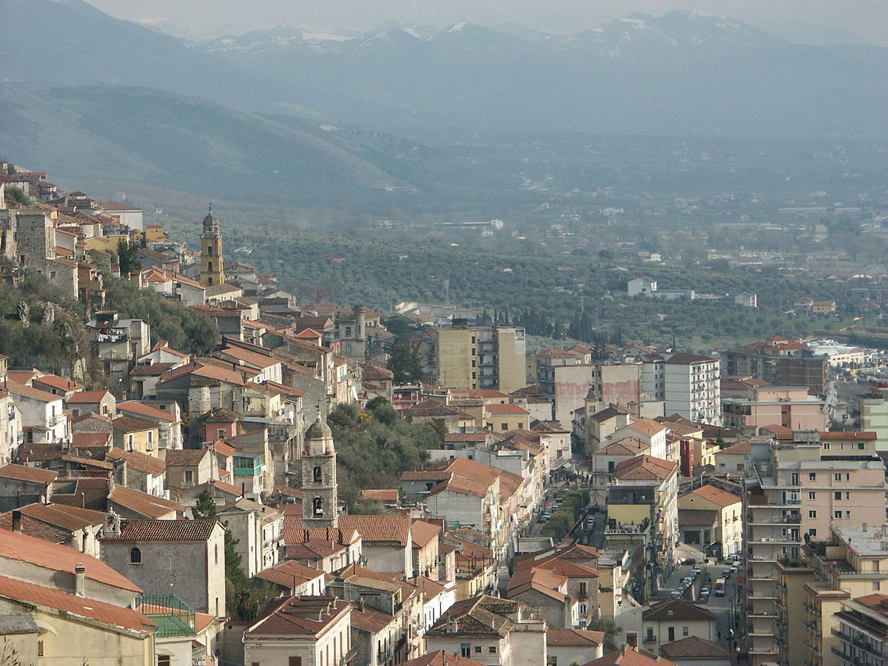
SALA CONSILINA
Sala Consilina is a town in the province of Salerno, in the Campania region. It is located in the southwestern Italy and is part of Vallo Di Diano area.
The Vallo di Diano is part of the ‘Cilento and Vallo di Diano and Alburni’ National Park that is the second largest national park in Italy. In 1998 it became a World Heritage Site of UNESCO

Slide 2
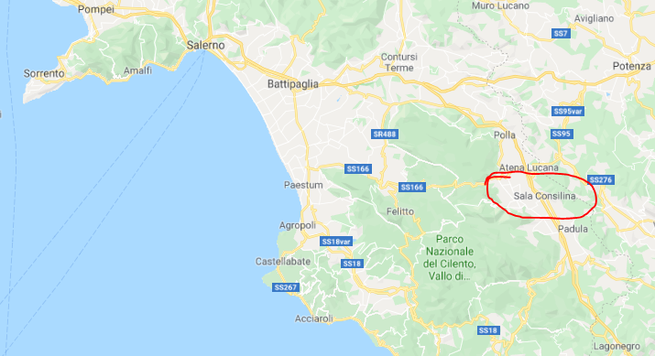

Slide 3
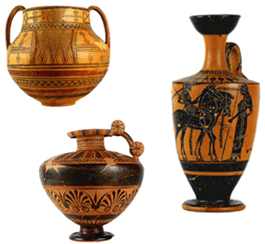
SALA CONSILINA- HISTORY
Sala Consilina is the largest center of the Vallo di Diano. It was populated since the ninth century BC. The news about the center of Consilinum dates back to Roman times, from which the today's Sala Consilina originated, erected during the Longobard colonization.

Slide 4
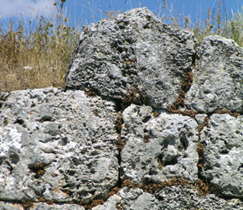
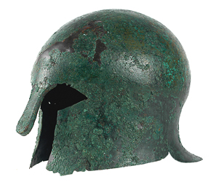
SALA CONSILINA- HISTORY
The Greek origin became predominant in Sala Consilina in the second part of the 6th century – first decennia of the 5th century B.C.

Slide 5
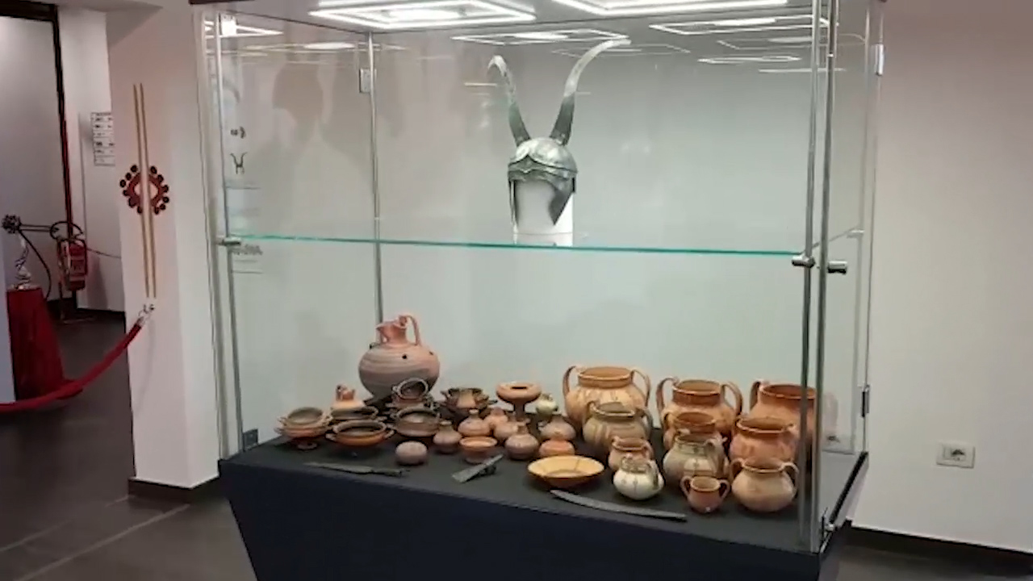
MASC- ARCHAEOLOGICAL MUSEUM OF SALA CONSILINA
In this museum there is the history of the ancient settlements of Sala Consilina.

Slide 6
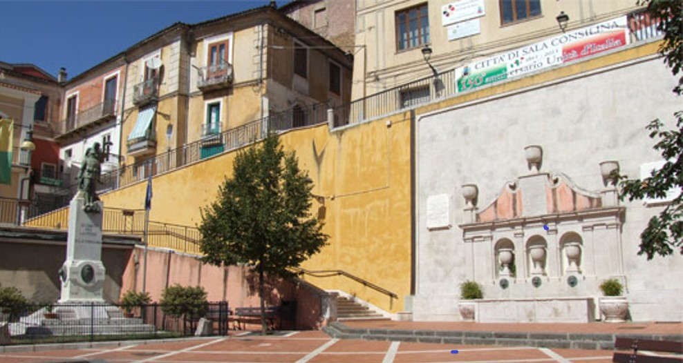
VISITING SALA CONSILINA
Piazza Umberto I
The main square

Slide 7
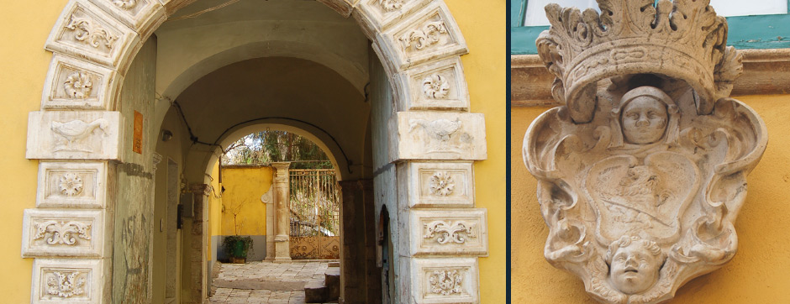
VISITING SALA CONSILINA
The Portal of the Grammatico Palace (1772)

Slide 8
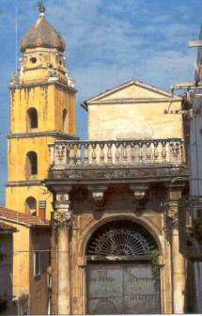
VISITING SALA CONSILINA
Acciari Palace (1704)
Bell tower of Saint Peter Church

Slide 9
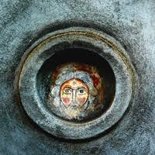
VISITING SALA CONSILINA
Fresco from the church of St.Stephen Protomartyr (XII century)

Slide 10
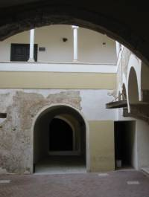
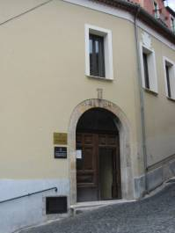
VISITING SALA CONSILINA
Courtyard and open gallery in the Grancia of Saint Lorenzo

Slide 11
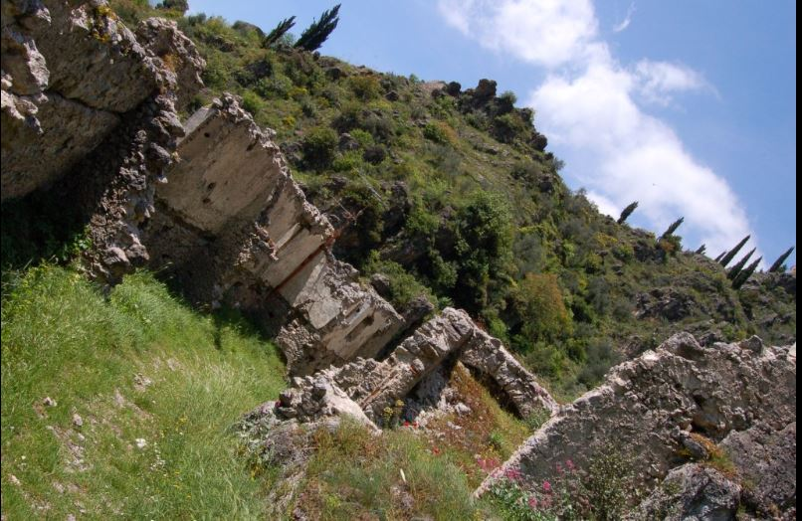
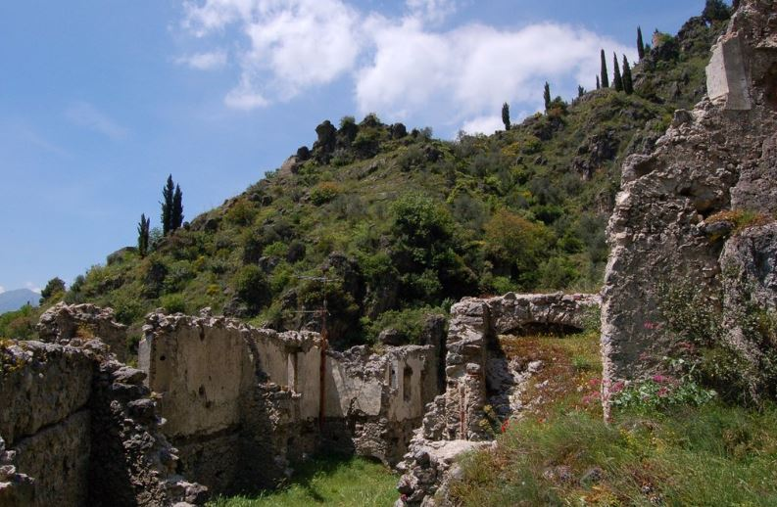
VISITING SALA CONSILINA
Norman castle and its walls (around 1250)

Slide 12
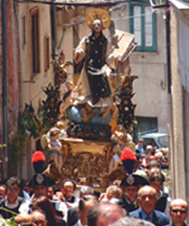
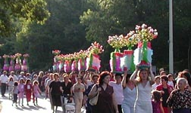
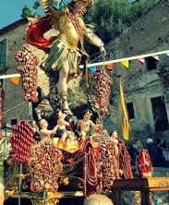
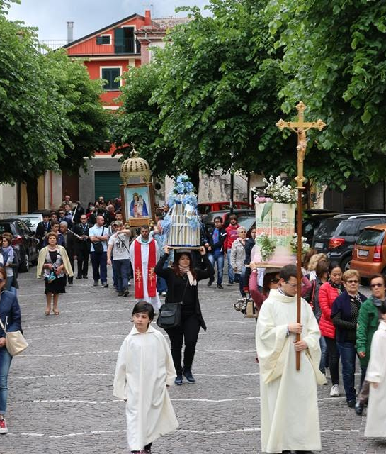
TRADITIONS
The people of the Vallo di Diano are faithful to the tradition of the “festival” connected to the region’s folk religion.

Slide 13
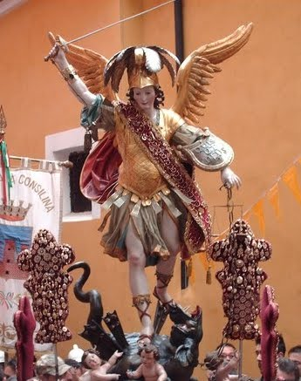
TRADITIONS - THE ARCHANGEL MICHAEL BETWEEN BYZANTINES AND LONGOBARDS
The celebration of the patron of Sala Consilina, St Michael Archangel, takes palce from September 28 to 30, following an old, complex and really spectacular ritual.The devotion to St. Michael was brought to Italy by the Byzantines in the 6th century

Slide 14
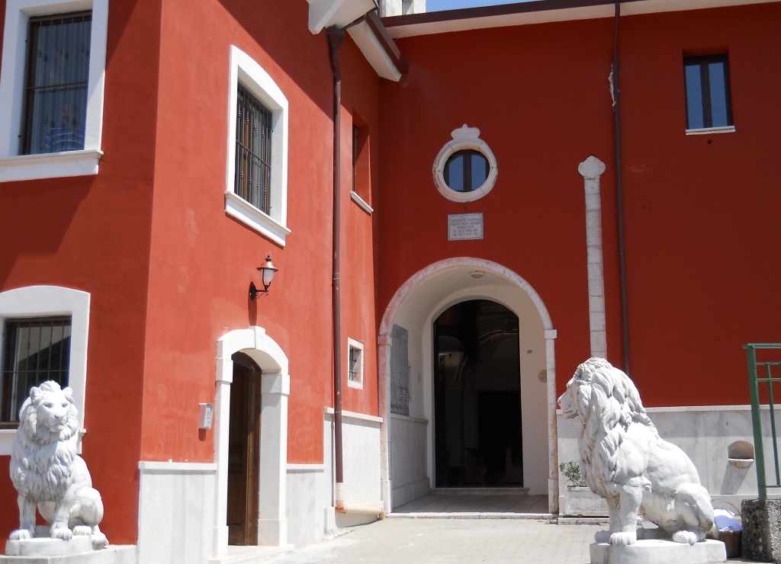
TRADITIONS - THE ARCHANGEL MICHAEL BETWEEN BYZANTINES AND LONGOBARDS
May 8th - the ascent: ascending procession from the city to the Sanctuary at the top of the mountain;
May 17th - the belt;
July 4th - the appearance;
September 27th - 29th, the party and the descent: return ritual, when people return to the city from the mountain.
December 16th - Saint Michael and the earthquake.
Sanctuary

Slide 15
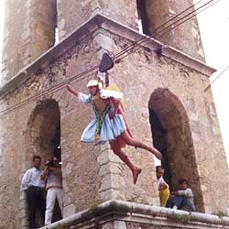
TRADITIONS - THE ARCHANGEL MICHAEL BETWEEN BYZANTINES AND LONGOBARDS
The protagonist is a child that plays the role of the saint.
The festivities begin in the evening of the 28 of September in the district of S.Eustace. A ship with a child on board, dressed as St. Michael, is carried on the shoulders of the men in the procession, preceded by boys with torches singing the saint’s praises.
The next day there is the ‘Flight of the Angel’ : the child-angel is hooked to a wire, suspended at a height of 10 meters, thanks to a system of pulleys and cables, steered by two men, the child angel flies three times to the statue of St. Michael, offering the ritual presents to the saint in exchange for his protection of the citizens of Sala.

Slide 16
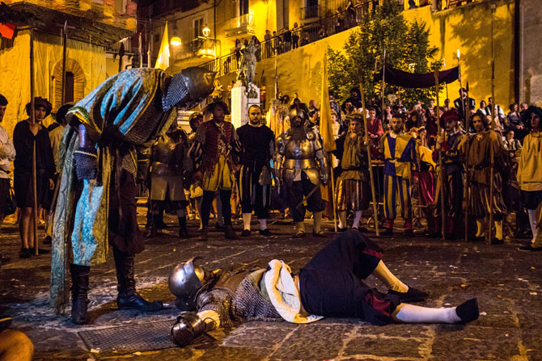
CARLO V NE LA TERRA DE LA SALA
This is the historical re-enactment, which relives the sumptuous reception organized in Sala Consilina in 1535, on the occasion of the passage of Emperor Charles V returning from the Tunis expedition. Scenario of the event are the characteristic streets and squares of the districts of Saint Stephan and Saint Eustace.

