Slide 1
How to make music with Arduino
OPEN YOUR DOORS TO DIGITAL AGE

Slide 2
INTRODUCTION
In this tutorial we are going to explain how make music with Arduino using just a buzzer.
This activity is certainly a lot of fun, and will allow music fans (and not only) to give vent to all their imagination and creativity.

Slide 3
COMPONENT LIST

Slide 4
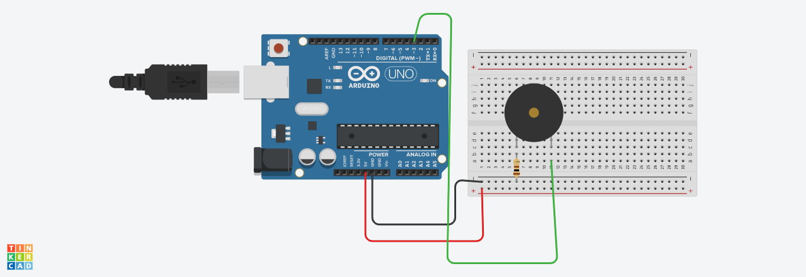
THE SKETCH

Slide 5
PASSIVE BUZZER
It does not emit any pre-set sound, but require a specific waveform to make the internal membrane vibrate. They can produce different tones depending on the power signal used.
The use of a passive buzzer allows you to create customized melodies or, in a different way, to reproduce small famous songs.
This is because the passive buzzer, unlike the active buzzer, can generate different tones (notes)

Slide 6
CONTROL A BUZZER WITH ARDUINO
One of the most functional methods to control a buzzer is the use of the native arduino tone () function. This function uses 2 or 3 parameters with the following syntax: tone(pin, frequency, duration);
pin, is the digital/PWM connected with the buzzer,
frequency, is the frequency in Hz, of the pitch to reproduce,
duration, is the duration durata in milliseconds of the pitch.
N.B. Once the function has been called up, it starts playing the sound and immediately passes to the next part of the code without waiting for the reproduction to be completed. tone, so that the notes do not overlap.

Slide 7
Only one tone can be generated at a time. If a tone is already playing on a different pin, calling tone () will have no effect. If the tone is playing on the same pin, the call will set its frequency.
The noTone () function stops the generation of the square wave caused by tone (). Using noTone () has no effect if no tone is being generated.
Sintassi:
noTone(pin);

Slide 8
THE CODE
Multiline comment start with /* and ends with */ all the line in the middle are not read by cmpiler
/*
Let's play some music with Arduino
Author: Istituto Comprensivo Camera
Open Your Doors To Digital Age
*/
// label to define the buzzer Pin.
#define buzzerPin 3

Slide 9
Pitches
// define the notes frequency. This are the pitches to play
#define NOTE_C5 523
#define NOTE_CS5 554
#define NOTE_D5 587
#define NOTE_DS5 622
#define NOTE_E5 659
#define NOTE_F5 698
#define NOTE_FS5 740
#define NOTE_G5 784
#define NOTE_GS5 831
#define NOTE_A5 880
#define NOTE_AS5 932
#define NOTE_B5 988

Slide 10
THE Song
To play the melody we have used two arrays.
The first one to store the notes of the song, the second one to store the speed of each note .
To iterate over the notes and type of notes of the melody we use a for loop.

Slide 11
Notes Array
Type of notes Array
int tempo[] = {
8, 8, 4,
8, 8, 4,
8, 8, 8, 8,
2,
8, 8, 8, 8,
8, 8, 8, 16, 16,
8, 8, 8, 8,
4, 4
};
int notes[] = {
NOTE_E5, NOTE_E5, NOTE_E5,
NOTE_E5, NOTE_E5, NOTE_E5,
NOTE_E5, NOTE_G5, NOTE_C5, NOTE_D5,
NOTE_E5,
NOTE_F5, NOTE_F5, NOTE_F5, NOTE_F5,
NOTE_F5, NOTE_E5, NOTE_E5, NOTE_E5, NOTE_E5,
NOTE_E5, NOTE_D5, NOTE_D5, NOTE_E5,
NOTE_D5, NOTE_G5
};

Slide 12
SETUP (CODE)
// the double / define one line comment
void setup() {
pinMode(buzzPin,OUTPUT); // buzzer is an OUTPUT pin
}

Slide 13
LOOP
To play the melody over and over copy the following code inside the void loop() function.
To run it only one copy the code inside the setup and leave the void loop() function empty

Slide 14
// iterate over the notes of the melody:
for(int i = 0; i < sizeof(notes)/sizeof(int); i++) {
// to calculate the note duration, take one second divided by the note type.
//e.g. quarter note = 1000 / 4, eighth note = 1000/8, etc.
// to distinguish the notes, set a minimum time between them.
// the note's duration + 50% seems to work well:
int duration = (1000/tempo[i])* 1.50;
tone(buzzerPin, notes[i], duration);
delay(duration);
// stop playing before playing the next one
noTone(buzzerPin);
}

Slide 15
Improvement
To improve the rhythm , change inside the the array that holds the type of notes the duration.
For example; instead of put inside type of note (quarter note = 4, eighth note = 8) put the duration (1000/4 , 1000/8). This will help in case of melody with dotted notes to better set the duration.

Slide 16
Notes Array
Type of notes Array
int tempo[] = {
125, 125, 250,
125, 125, 250,
125, 125, 125, 125,
500,
125, 125, 125, 125,
125, 125, 125, 63, 63,
125, 125, 125, 125,
250, 250
};
int notes[] = {
NOTE_E5, NOTE_E5, NOTE_E5,
NOTE_E5, NOTE_E5, NOTE_E5,
NOTE_E5, NOTE_G5, NOTE_C5, NOTE_D5,
NOTE_E5,
NOTE_F5, NOTE_F5, NOTE_F5, NOTE_F5,
NOTE_F5, NOTE_E5, NOTE_E5, NOTE_E5, NOTE_E5,
NOTE_E5, NOTE_D5, NOTE_D5, NOTE_E5,
NOTE_D5, NOTE_G5
};

Slide 17
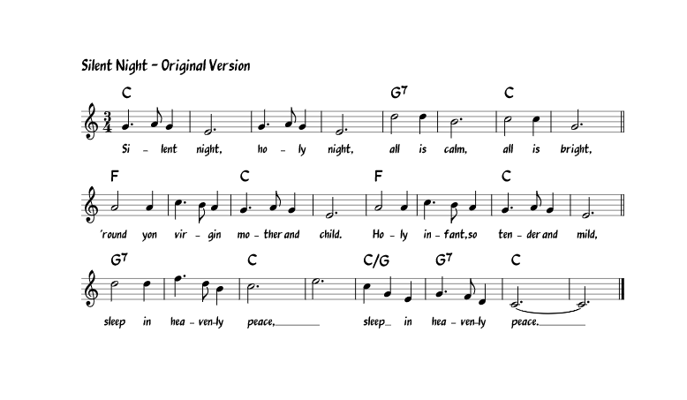
How to read music sheet
A melody consists of notes played in a sequence, and rests between the note. Each note and rest has its own particular duration.

Slide 18
Basic Simbols
There are two main clefs
The staff consists of five lines and four spaces. Each of those lines and each of those spaces represents a different letter, which in turn represents a note. Those lines and spaces represent notes named A-G, and the note sequence moves alphabetically up the staff.

Slide 19
Notes and Rest values
Notes placed on the staff tell us which note letter to play on our instrument and how long to play it. There are three parts of each note, the note head, the stem, and the flag.

Slide 20
Note Duration
How can you use the durations to play notes? Well, imagine that a quarter note is one quarter of a second, and eighth note is one eighth of a second, and so forth. In that case, the actual duration for each note is 1000 milliseconds divided by the value for it in the durations array. For example, the first note is 1000/4, the second is 1000/8, and so forth.

Slide 21
Dots and Ties - Extend note duration
There are other ways to extend the length of a note. A dot after the note head, for example, adds another half of that note’s duration to it. So, a half note with a dot would equal a half note and a quarter note; a quarter note with a dot equals a quarter plus an eighth note. A tie may also be used to extend a note. Two notes tied together should be held as long as the value of both of those notes together.

Slide 22
Beam - Shorten note duration
The opposite may also happen, we can shorten the amount of time a note should be held, relative to the quarter note. Each flag halves the value of a note, so a single flag signifies 1/2 of a quarter note, a double flag halves that to 1/4 of a quarter note, et cetera.

Slide 23
Now it’s time for you to make Arduino playing your favourite melody

