Slide 1
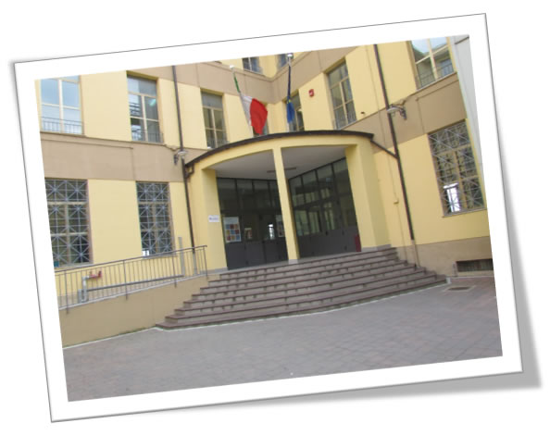
Istituto Comprensivo GIOVANNI CAMERA

Slide 2
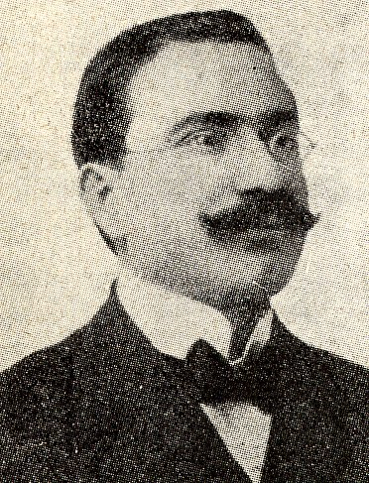
The Origins
Our school was founded in honor of Giovanni Camera.
He was an Italian politician and lawyer. He turned his efforts towards the education of his people.

Slide 3
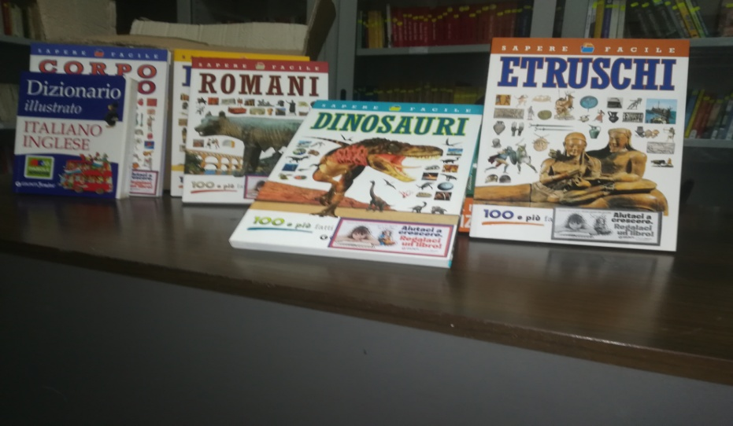
Library
This is our library
It’s open to everybody
These are some new books ----->

Slide 4
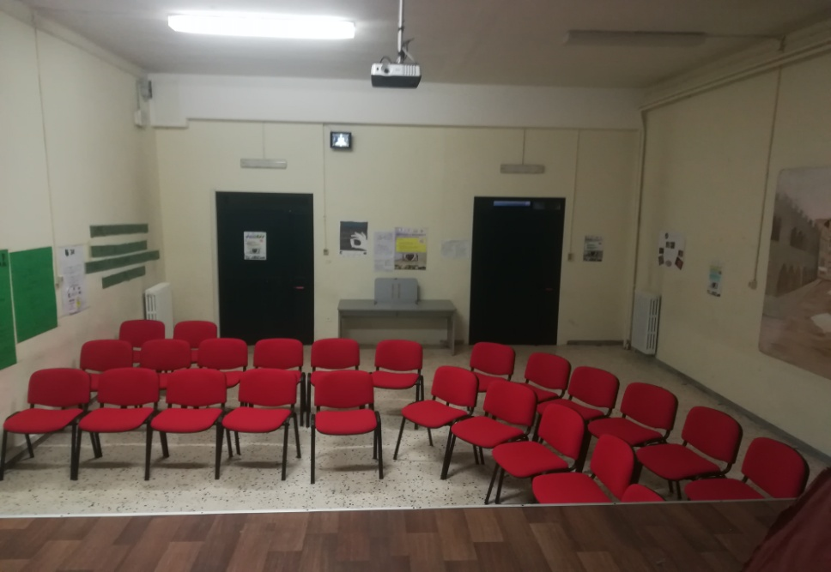
Theater
This is our theater. Here we do some performances and drama labs
<----- These are some objects we use for our performances

Slide 5
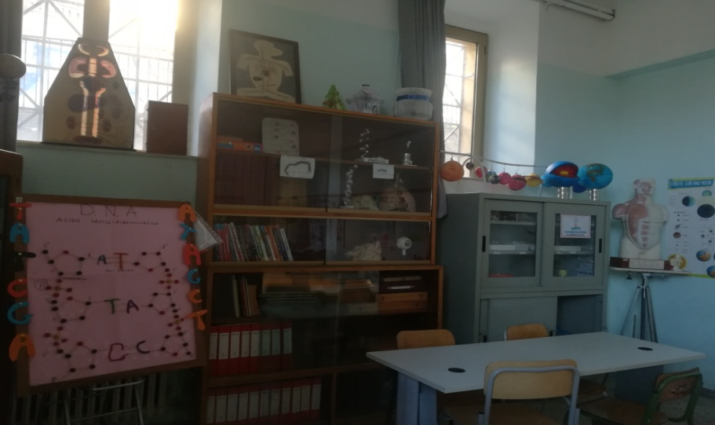
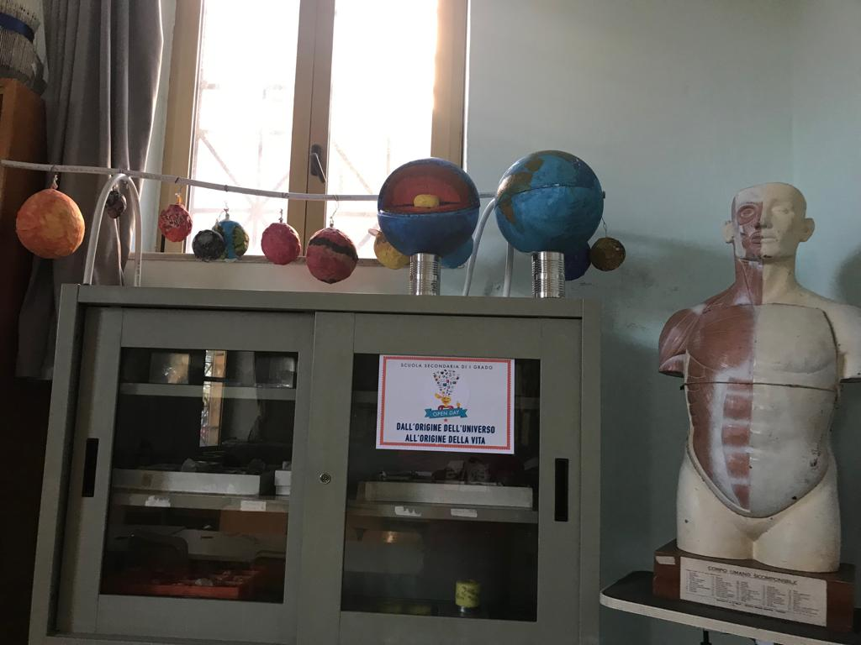
This is the science lab
This is our science lab where we work to make various experiments

Slide 6
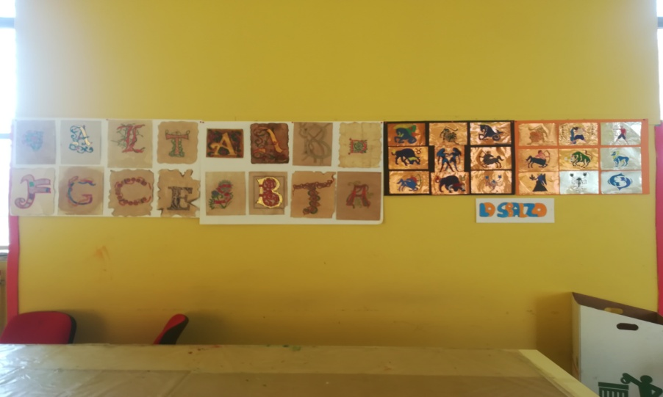
Art lab
This is our art lab, where we draw and create different artworks
These are some works that we have done →

Slide 7
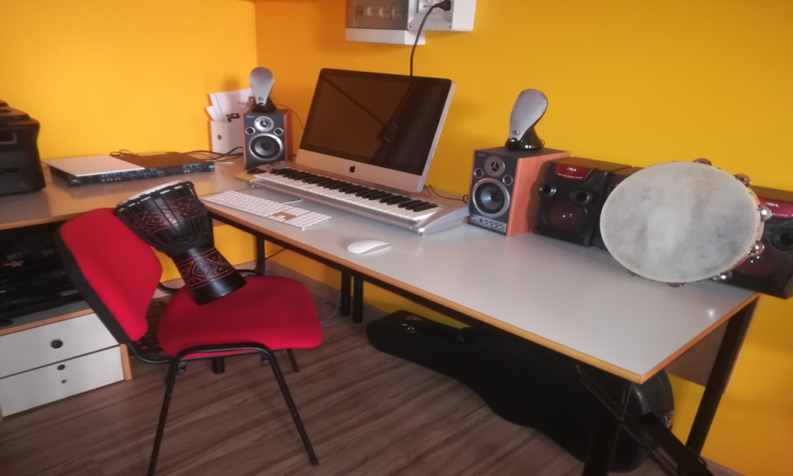
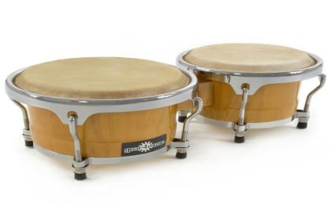
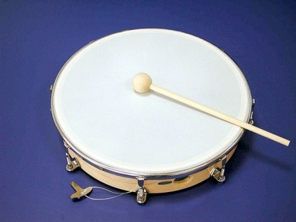
Music lab
Here we study music and play different instruments such as tambourine

Slide 8
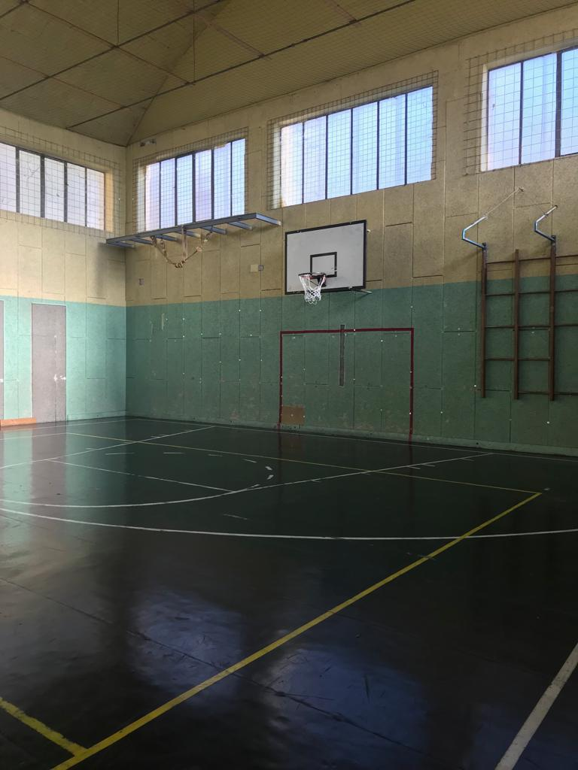
This is our gym
This is our gym and in this place we play volleyball, basketball, football and we practice P.E.

Slide 9
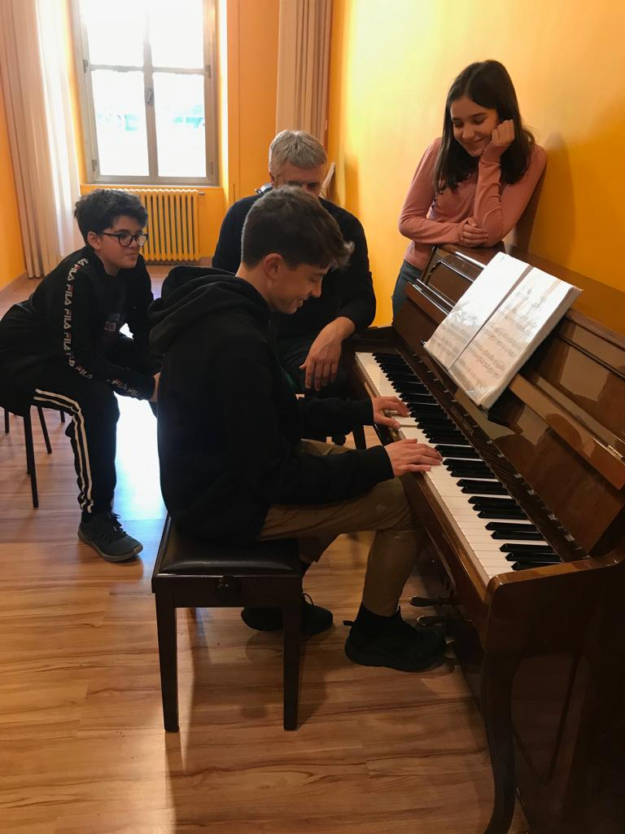
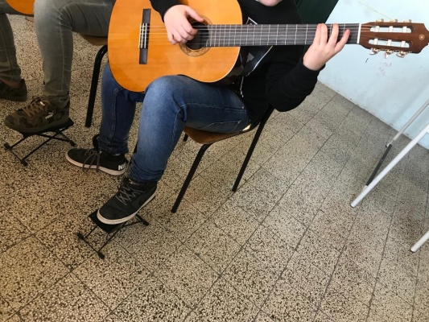
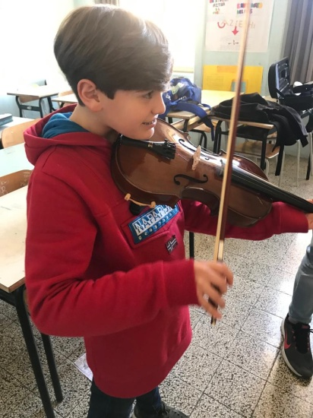
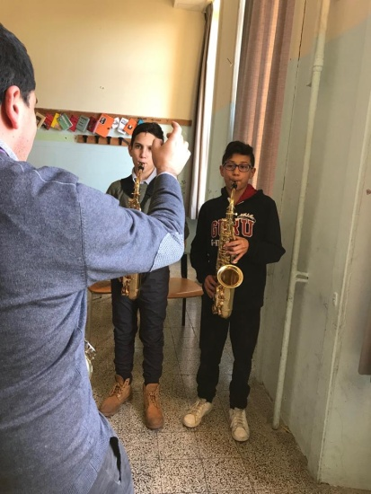
afternoon activities
In the afternoon, we do some activities just like playing some instruments and we do some courses to increase our competences.
These are some activities that we do in the afternoon. For example: playing the violin, the saxophone, the piano and the guitar.

Slide 10
Saxophone
This instrument is the saxophone. IT is a brass instrument. There are many types of saxophone, for example: the soprano. It is a wind instrument

Slide 11
Violin
This instrument is the violin. It has four strings, you can play it with a bow that makes the strings vibrate

Slide 12
Guitar
This is the guitar. It has six strings, you can play it by making the strings vibrate with the pled

Slide 13
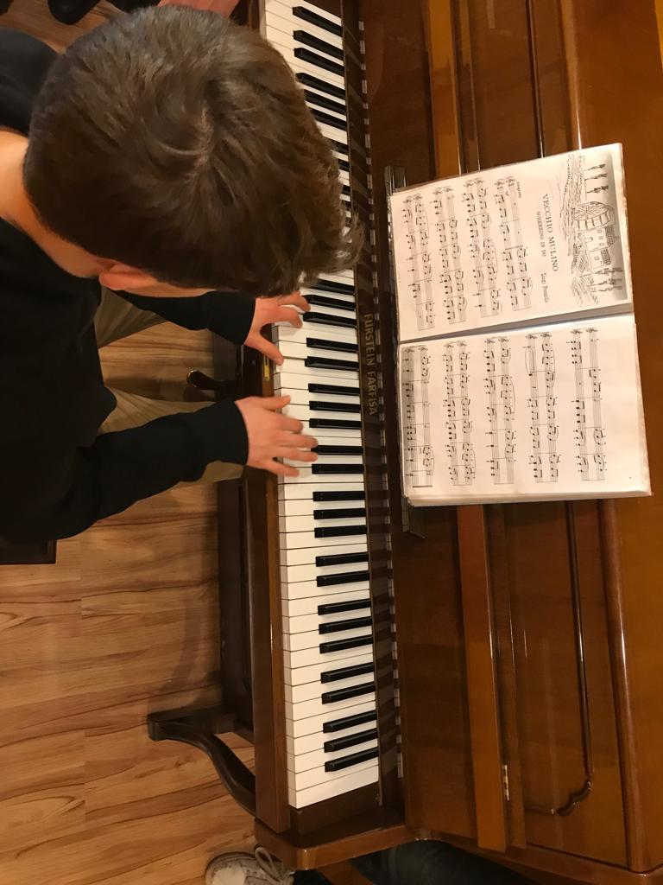
Piano
This instrument is the piano. A is a stringed instrument made up of 88 keys, 52 white and 36 black. Some famous pianists are Beethoven and Chopin

Slide 14
The Italian Education system
It is divided into five stages:
kindergarten (scuola dell'infanzia), from 3 to 5/6 years
primary school (scuola primaria or scuola elementare), from 6 to 11 years
lower secondary school – middle school (scuola secondaria di primo grado or scuola media inferiore), from 11 to 14 years
upper secondary school – high school (scuola secondaria di secondo grado or scuola media superiore), from 14 to 19 years
university (università)

