Slide 1
Temperatur Meter/Converter with Arduino
OPEN YOUR DOORS TO DIGITAL AGE

Slide 2
INTRODUCTION
This is a very simple project that takes the temperature from a TMP36 sensor and displays it in Celsius, Kelvin and Fahrenheit on a 16x2 (16 columns and 2 rows) LCD display.
On the first line it’s printed the temperature in °C on the second line the temperature converted in °K and °F.

Slide 3
COMPONENT LIST
Quantity | Component
1 | Arduino Uno R3
1 | Breadboard
1 | LCD 16 x 2
1 | 220 Ω Resistor
1 | Temperature Sensor [TMP36]
1 | 330 Ω Resistor
n | jumper wires

Slide 4
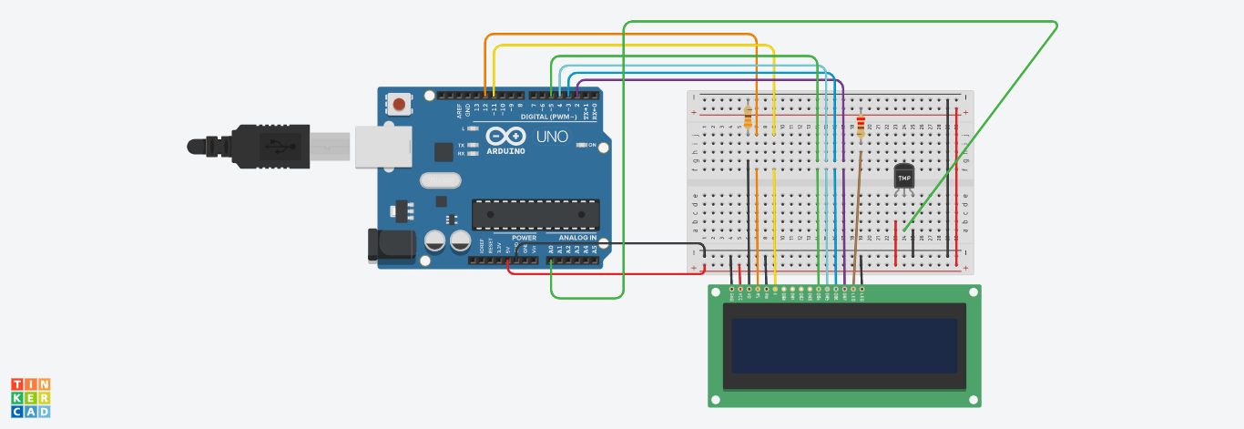
THE SKETCH

Slide 5
LCD DISPLAY 16x2
LCD has up to 16 pins. In the most common uses, we do NOT use all pins.
With the support of ‘LiquidCrystal library’, we even can use LCD without knowing the meaning of these pins.
#import <LiquidCrystal.h>

Slide 6
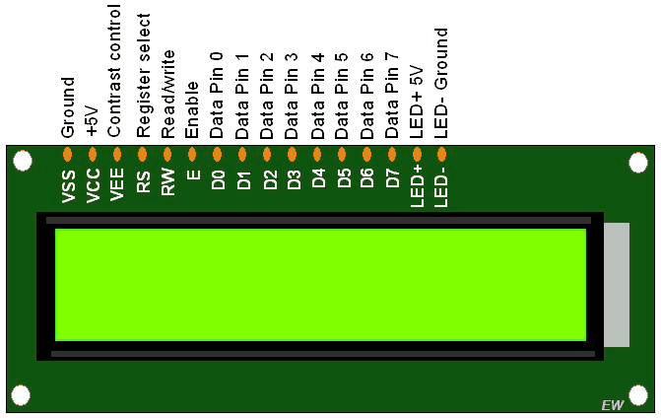
LCD Display Pins

Slide 7
LCD Pins Functionality
The interface consists of the following pins:
GND pin, need to be connected to GND (0 V)
VCC pin, the power supply, need to be connected to VCC (5 V)
V0 (LCD contrast) pin, can be connected to the 5 V for the highest contrast and brightness or a potentiometer to control the brightness and contrast.
RS pin, tells the LCD whether the data on the data bus is the commands or the data.
R/W (Read/Write ) pin, that selects reading mode or writing mode.
EN (Enable) pin, is used to enable the LCD.
D0 - D7 (Data bus) pins, carries data and commands with Arduino and LCD.
A-K (Anode - Cathode) pins, are used to power the LCD backlight. A pin - 5V, K pin - GND

Slide 8
HOOK UP LCD Display
The Hitachi-compatible LCDs can be controlled in two modes: 4-bit or 8-bit. The 4-bit mode requires seven I/O pins from the Arduino, while the 8-bit mode requires 11 pins. For displaying text on the screen, you can do most everything in 4-bit mode, so example shows how to control a 16x2 LCD in 4-bit mode.
Use the picture of the circuit in the next side as a reference to build the basic connection to the LCD. Please make sure you put the wires into the correct spot/port. At this point you are all set for programming the LCD!

Slide 9
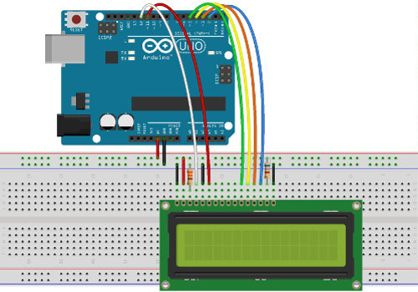
LCD CONNECTION
SKETCH

Slide 10
How to connect the LCD to Arduino UNO
 | PIN DISPLAY LCD | PIN Arduino
1 | GND | GND
2 | VCC | 5V
3 | V0 | 5V
4 | RS | Pin 12
5 | R/W | GND
6 | EN | Pin 11
7 | D0 | Not connected
8 | D1 | Not connected
9 | D2 | Not connected

Slide 11
 | PIN DISPLAY LCD | PIN Arduino
10 | D3 | Not Connected
11 | D4 | Pin 5
12 | D5 | Pin 4
13 | D6 | Pin 3
14 | D7 | Pin 2
15 | A (Led +) | 5 V
16 | K (Led -) | GND

Slide 12
Temperature sensore TMP36 - How it Works
The TMP36 temperature sensor is an easy way to measure temperature using an Arduino! The sensor can measure a fairly wide range of temperature (-50°C to 125°C), is fairly precise (0.1°C resolution). In this project we have chosen to use TMP36 temperature sensor because of it’s included inside Arduino starter kit. We will go over the basics of hooking the TMP36 up and writing some basic code to read the analog input it is connected to.
The TMP36 allows you to acquire temperatures in the range between -50 ° C and + 125 ° C, returning linear voltage values between about 0.1Vdc and 1.7Vdc at the output.
1°C degree variation produces a variation of the output voltage equal to 10mV;
at a temperature of 0 ° C the sensor supplies a voltage of 500mV.

Slide 13
Temperature sensore TMP36 - How it Works
The circuit is very trivial, it just connects the sensor directly to Arduino UNO via the analog port A0:
The analog input gives us a value between 0 and 1023,
0 being no voltage and 1023 being 5V.
To figure out what this voltage converts to in degrees Celsius we will need to first find the percentage of 5V on the input. This can be done by dividing the sensor Input by 1024.
As we know from the datasheet, the sensor will output 0 – 1.75V over a range of 175 degrees (-50°C to 125°C) so that means every 0.01V equals 1 degree.
We will need to convert the percentage of input to voltage by multiplying by 5V.
Since we are not measuring 0° – 175° we will need to shift the output value so that the minimum reading of -50° equals a voltage reading of 0. We do this by subtracting 0.5 from the output voltage. Our new value now ranges from -0.5 to 1.25 (which looks remarkably similar to our temperature range!)
To convert from millivolts to degrees Celsius we will need to multiply by 100.

Slide 14
Voltage To temperature in °C
To get the temperature from the voltage we are going to use the following steps
// convert the ADC reading to voltage
voltage = (readTMP36Value / 1024.0 ) * 5.0 ;
// convert the voltage to temperature in degrees celsius
// the sensor changes 10 mV per degree
// the datasheet says there's a 500 mV offset
// ((volatge - 500mV) times 100)
tempCelsius = (voltage - 0.5) * 100.0;

Slide 15
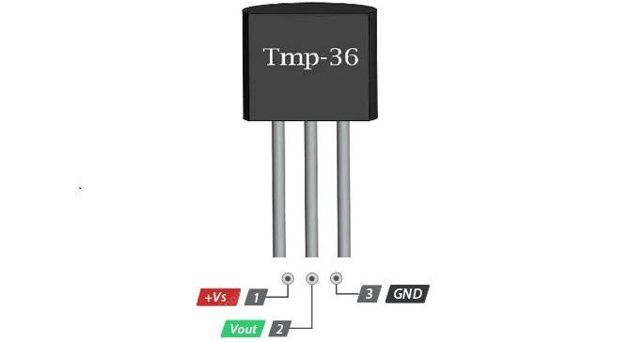
How to Connect the Temperature Sensor (TMP36) to Arduino
TMP-36 | Arduino
VIN (pin1) | 5V
VOUT (2) | A0 (Analog Pin)
GND (3) | GND

Slide 16
The Code
// include the library code:
#include <LiquidCrystal.h>
// initialize the library with the numbers of the interface pins
LiquidCrystal lcd(12, 11, 5, 4, 3, 2);

Slide 17
// variable definition
float voltage = 0.0;
float tempCelsius = 0.0;
int readTMP36Value = 0.0;
int tmpPin = A0;
float tempFahrenheit = 0.0;
float tempKelvin = 0.0;

Slide 18
void setup() {
// set up the LCD's number of columns and rows:
lcd.begin(16, 2);
// Print a message to the LCD.
lcd.setCursor(0,0);
lcd.print("Temperature");
lcd.setCursor(0,1);
lcd.print("meter!");
delay(2000);
// initialize serial the serial port
Serial.begin(9600);
}

Slide 19
void loop() {
//
lcd.clear();
// read the value from anolg pin A0
readTMP36Value = analogRead(tmpPin);
// convert the ADC reading to voltage
voltage = (readTMP36Value / 1024.0 ) * 5.0 ;
// convert the voltage to temperature in degrees celsius
// the sensor changes 10 mV per degree
// the datasheet says there's a 500 mV offset
// ((volatge - 500mV) times 100)
//round(tempCelsius = (voltage - 0.5) * 100.0);
tempCelsius = (voltage - 0.5) * 100.0;
// temperature in Fahrenheit
tempFahrenheit = ((tempCelsius * 9)/5) + 32.0;
tempKelvin = tempCelsius + 273.15;
Serial.print("Temperature: °C = ");
Serial.print(tempCelsius);
Serial.print(" --> ");
Serial.print("°F: ");
Serial.print(tempFahrenheit);
Serial.print(" --> ");
Serial.print("°K: ");
Serial.println(tempKelvin);
// set the cursor to column 0, line 0
// (note: line 0 is the first row, since counting begins with 0):
lcd.setCursor(0, 0);
lcd.print("Temp°C: ");
lcd.print(tempCelsius);

Slide 20
//round(tempCelsius = (voltage - 0.5) * 100.0);
tempCelsius = (voltage - 0.5) * 100.0;
// temperature in Fahrenheit
tempFahrenheit = ((tempCelsius * 9)/5) + 32.0;
tempKelvin = tempCelsius + 273.15;
Serial.print("Temperature: °C = ");
Serial.print(tempCelsius);
Serial.print(" --> ");
Serial.print("°F: ");
Serial.print(tempFahrenheit);
Serial.print(" --> ");
Serial.print("°K: ");
Serial.println(tempKelvin);
// set the cursor to column 0, line 0
// (note: line 0 is the first row, since counting begins with 0):
lcd.setCursor(0, 0);
lcd.print("Temp°C: ");
lcd.print(tempCelsius);

Slide 21
// set the cursor to column 0, line 1
// (note: line 1 is the second row, since counting begins with 0):
lcd.setCursor(0, 1);
lcd.print("Temp°F: ");
lcd.print(tempFahrenheit);
delay(2000);
lcd.clear();
// write conversion in °K
lcd.setCursor(0, 0);
lcd.print("Temp°C: ");
lcd.print(tempCelsius);
lcd.setCursor(0, 1);
lcd.print("Temp°K: ");
lcd.print(tempKelvin);
// wait 2 seconds before new measure
delay(2000);
}

Slide 22
Upload The Code And Test
Now that all of the code has been written it can be uploaded to your Arduino! Click “Upload” button in the top left corner of the Arduino IDE and it should upload without any issues. Next, click the “Serial Monitor” button in the top right corner (it looks like a magnifying glass). After a few seconds you should start to see a stream of data appear in the window – that is your temperature in degrees Celsius.

