Slide 1
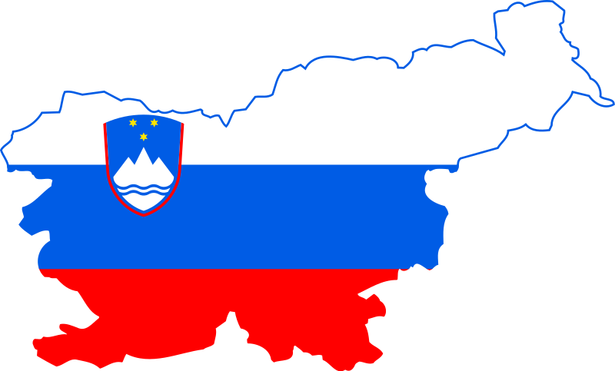
SLOVENIA

Slide 2
EMA L.
14 years old
Černelavci
Hobbies: chess, read, cycle, paint
Free time: bake and dance

Slide 3
EMA M.
14 years old
Free time: music, reading books
Martjanci

Slide 4
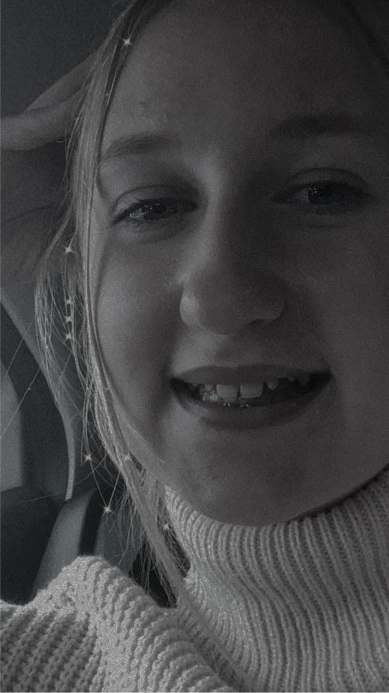
NINA
13 years old
Hobbies: volleyball, violin
Free time: watching football, singing

Slide 5
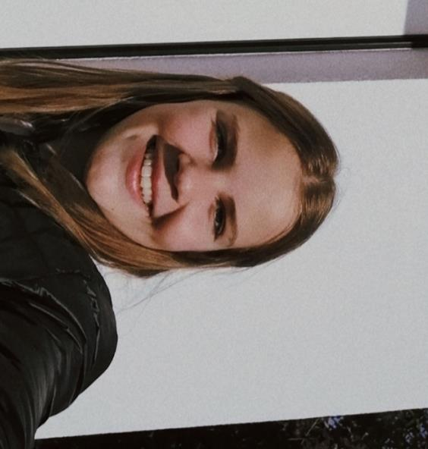
LUŠA
13 years old
Hobbies: volleyball, volunteer firefighter
Free time: cooking, watching Turkish series

Slide 6
ALJAŽ
13 years old
Hobbies: basketball, football
Free time: playing videogames

Slide 7
DENIS
13 years old
Free time: programming, playing video games, making video games

Slide 8
Murska Sobota
Nice small town in the east of Slovenia
2 shopping centers
4 schools
Swimming pool near the city stadium Fazanerija
Nice park with a castle
Recreation park Fazanerija
Stadium Fazanerija
Football team Mura

Slide 9
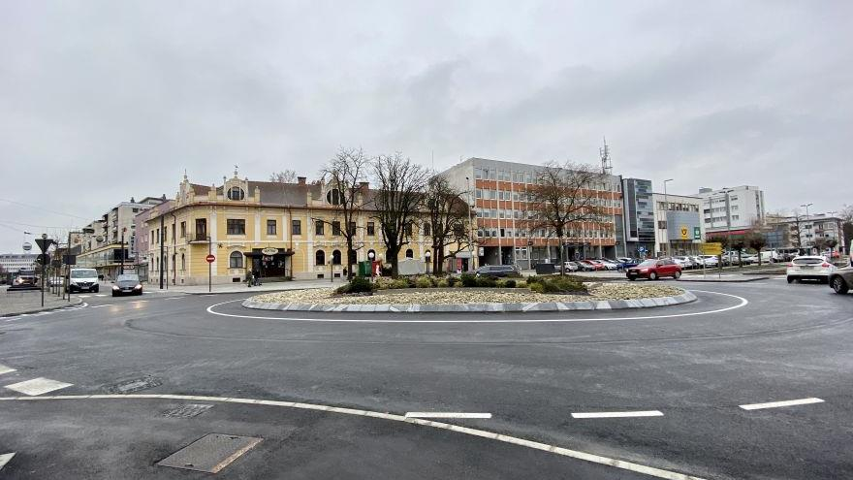

Slide 10
Murska Sobota
Theater
Statue of Štefan Kovač
Ice cream place
Best ice cream
City center
Stores with interesting items
Restaurant and hotel Zvezda
Bank, post office

Slide 11
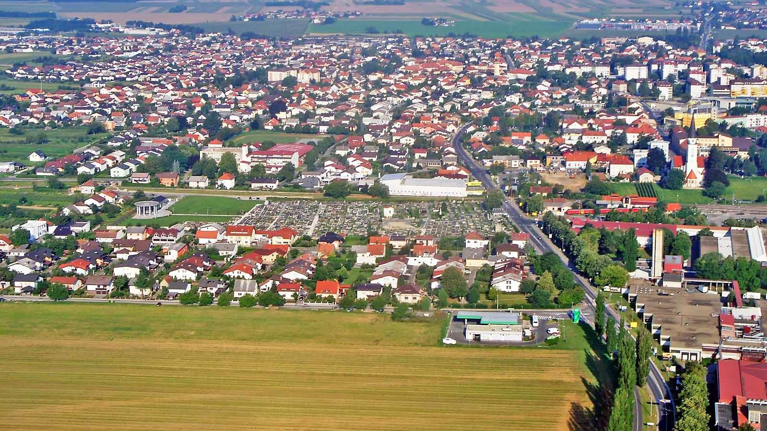

Slide 12
Murska Sobota
Expano
Exercise park
Expano lake called Kamešnica

Slide 13
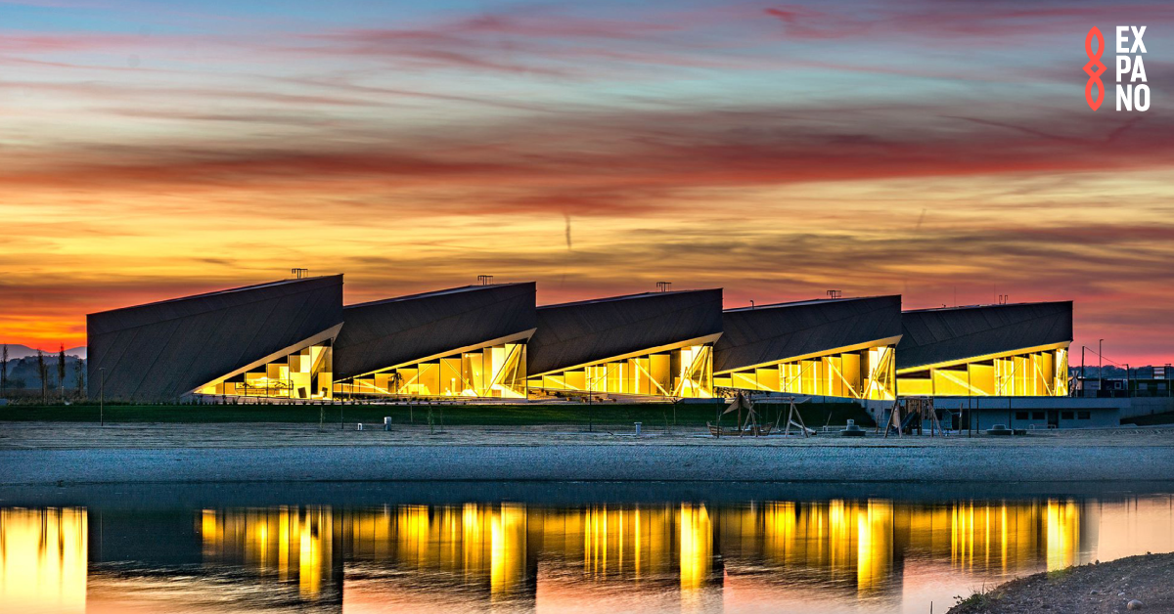

Slide 14
MARTJANCI
Small village
Prekmurje region of Slovenia
Between M. Sobota and Moravske Toplice
Church Saint Martin
Population: 500 people

Slide 15
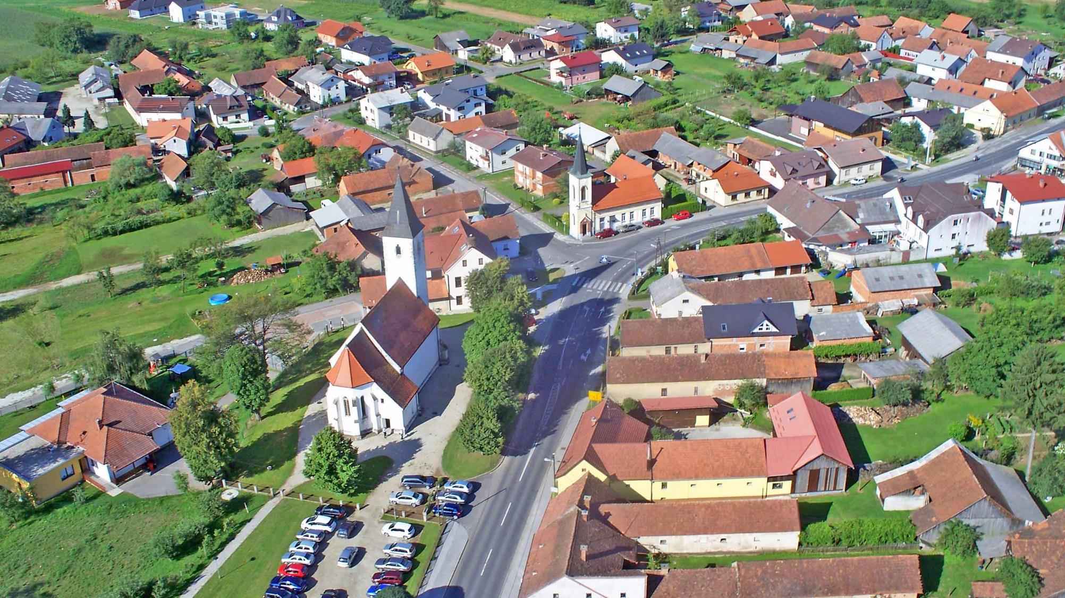

Slide 16
ABOUT OUR SCHOOL:
Primary school I Murska Sobota
Architect Feri Novak
4 floors
63 years old
638 students
80 teachers and workers
Aleš Benko
Notes:
We go to Primary school I in Murska Sobota. The school was made by an architect named Feri Novak. It's pretty big. It has 4 floors. The school is 63 years old. It has 638 student and 80 teachers and workers. Our principal is Aleš Benko.

Slide 17
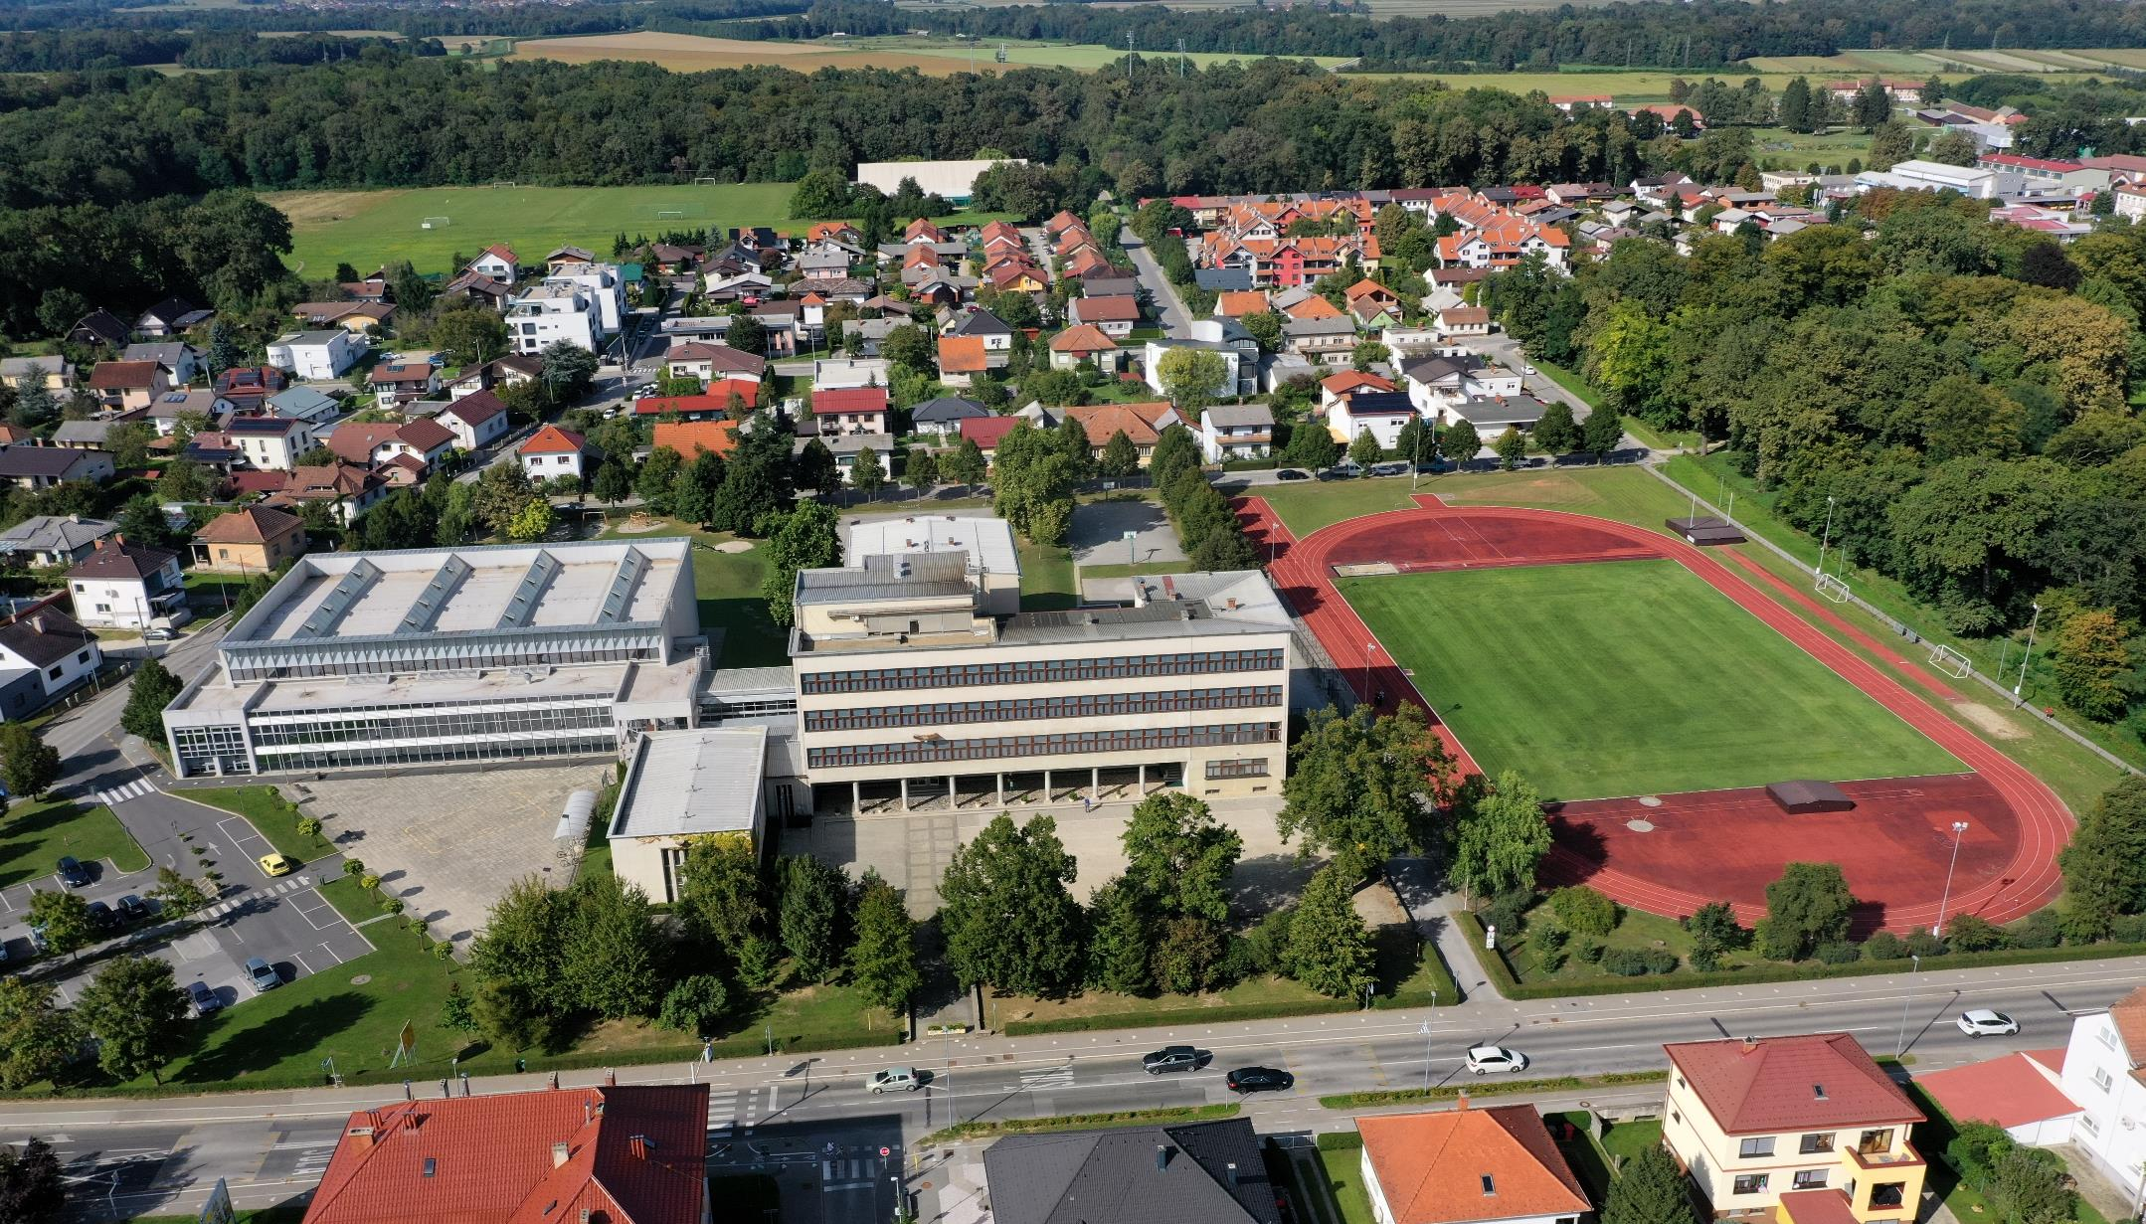

Slide 18
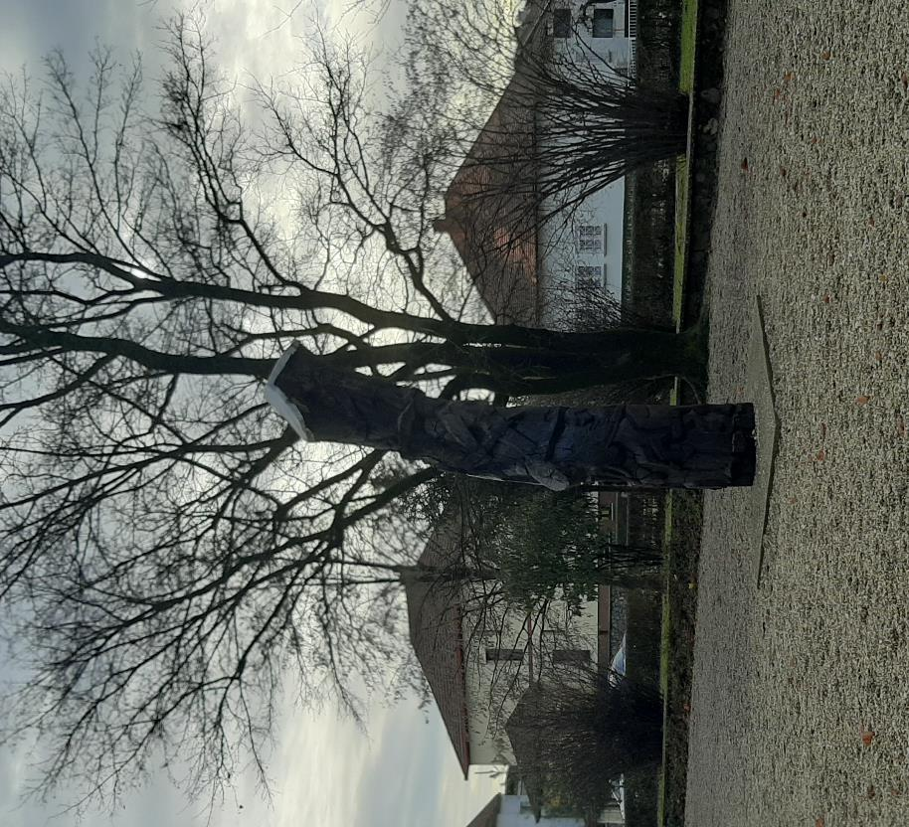

Slide 19
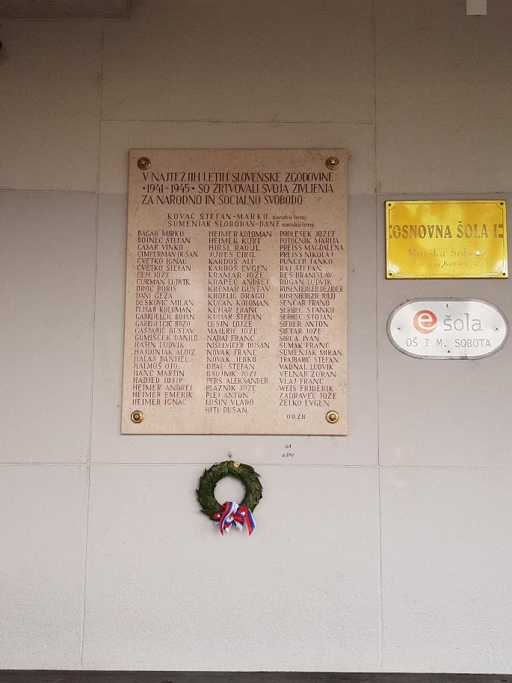

Slide 20
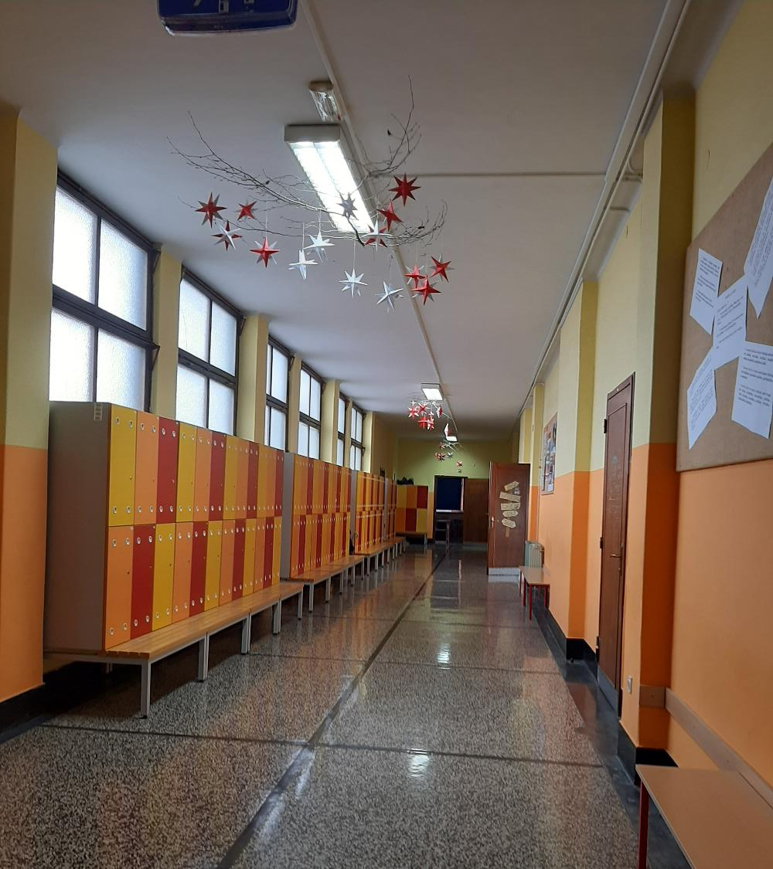
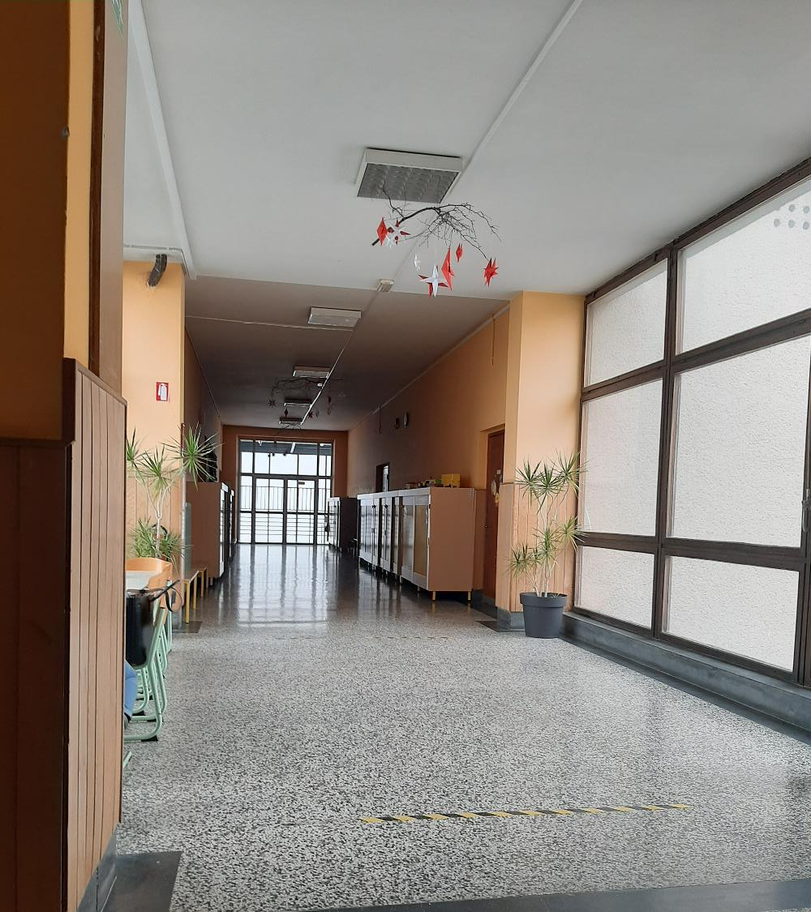

Slide 21
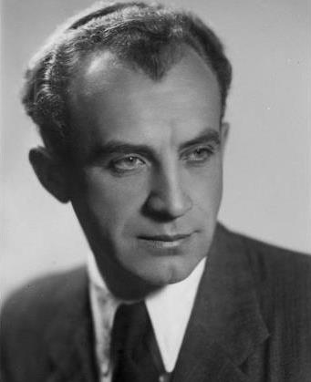

Slide 22
POPULAR SPORTS IN OUR SCHOOL:
Basketball
Football
Volleyball
Good at sports
Notes:
Popular sports in our school are basketball, football and volleyball. We are very good at sports, we have a lot of certificate for sports.

Slide 23
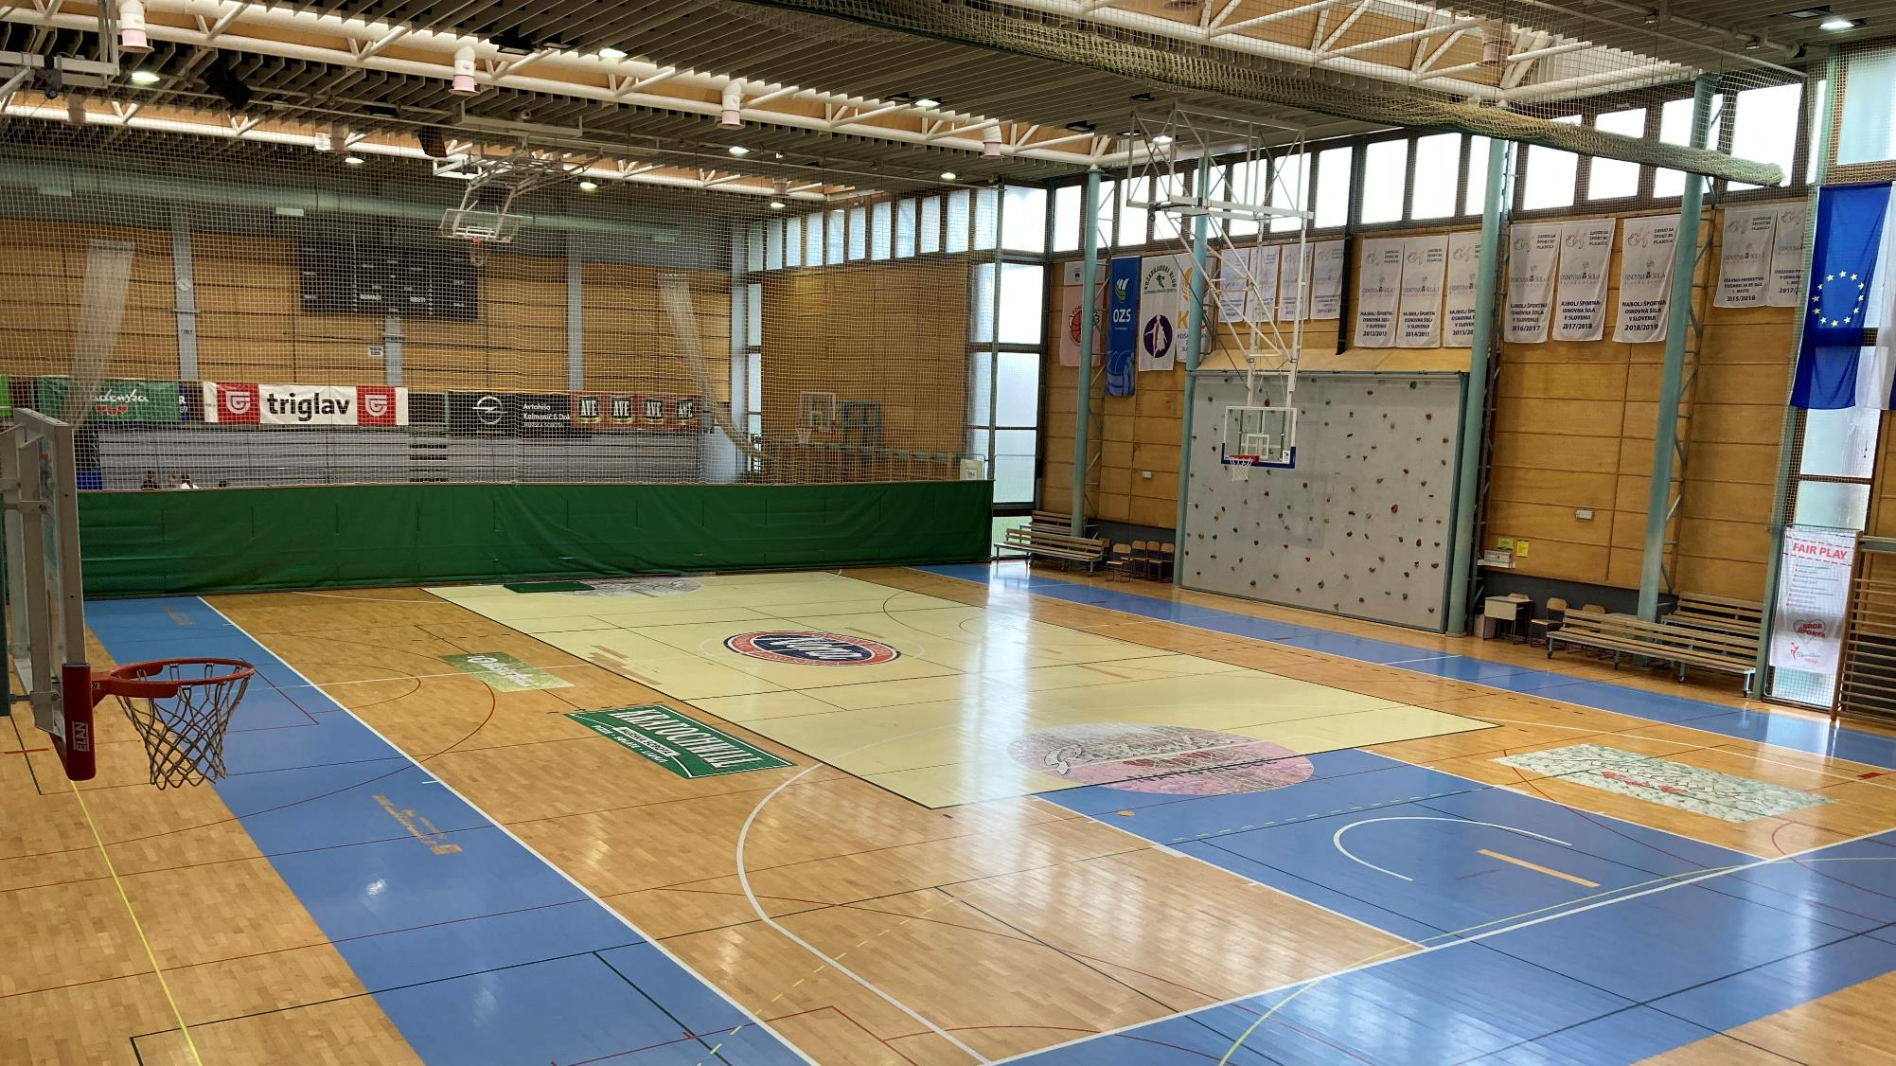

Slide 24
AWARDS:
Eco school
Sports school
Cultural school
Notes:
Our school is an eco school and has been the most sporty school for many times.

Slide 25
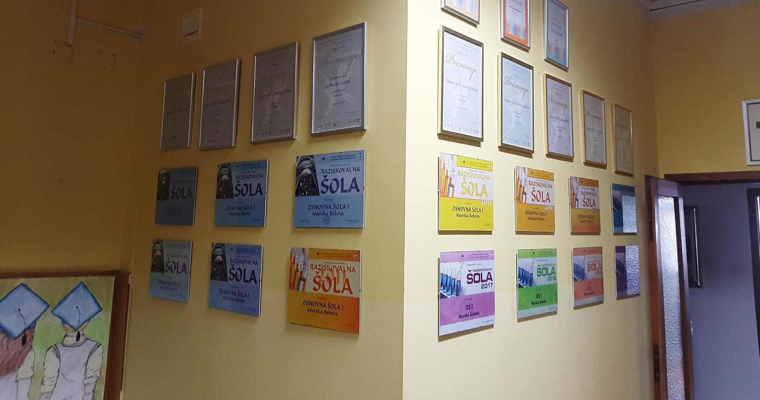

Slide 26
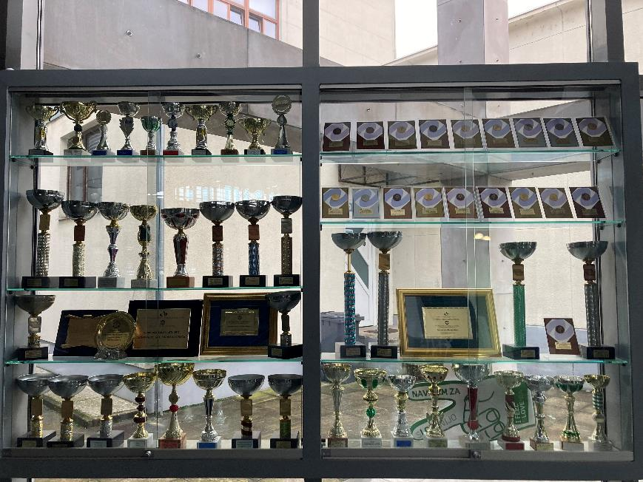
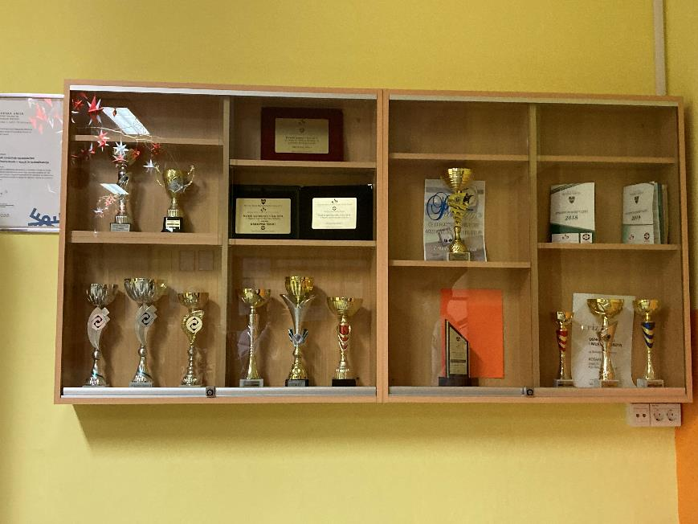

Slide 27
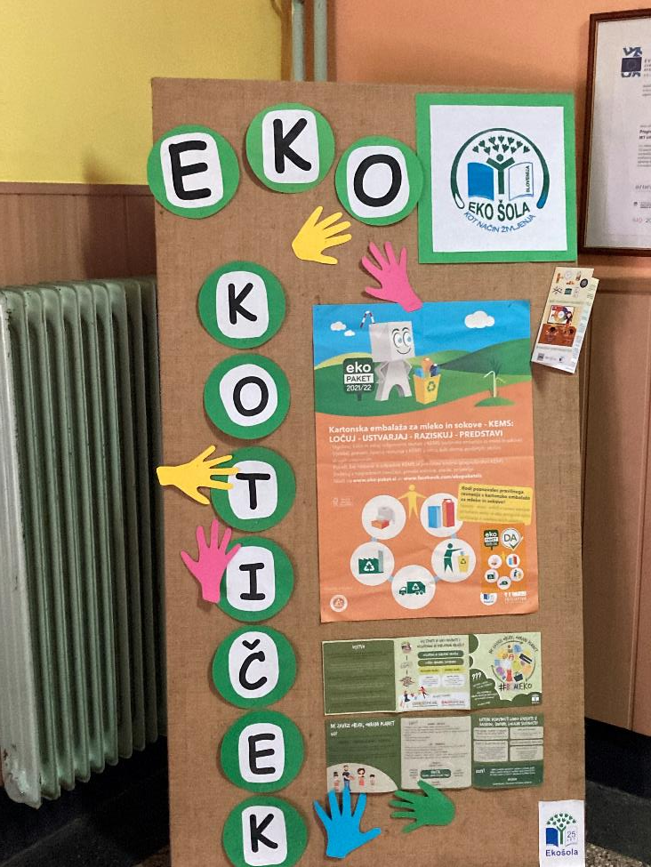

Slide 28
FAVOURITE PLACES IN SCHOOL:
Dining room: Good food
History classroom: Calms you down, a lot of maps
Library: Quietest place
Large sports hall: good concerts
Notes:
Our favourite places in school are the dining room because all people are in the same room. Our food is very good and I always eat every breakfast. The lunch is good too. Then we have history classroom because it sort of calms you down when you sit in the classroom with a lot of maps especially if it's raining or snowing outside. We also have library in our school and I like it because it's the quietest place in the school. There is also a large sports hall in it. In it there are also a lots of good concerts.

Slide 29
