Slide 1
HOMESCHOOLING
PRIMARY SCHOOL i MURSKA SOBOTA
Ema L, Ema M, matic, črtomir, sašo, aljaž d.

Slide 2
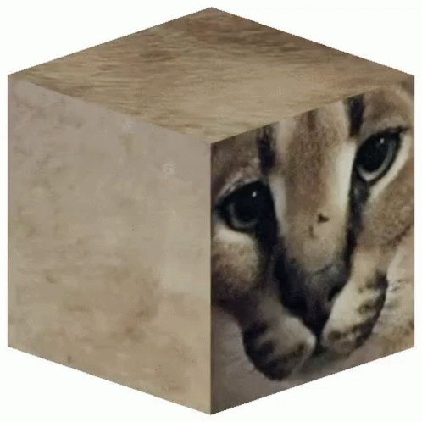
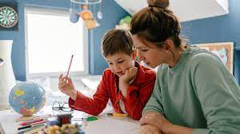
WHAT IS HOMESCHOOLING?
Learning from home
Other children (disabled, parents smart)
They don't visit public school
End of school year, final exam (3)
Notes:
Started 32.3.2020- may

Slide 3
Why did we have homeschooling?
Cause: Covid
At home: 8 months
First round: 16.3.2020- middle May
Second round: 12.10.2020-end of february
First round: at start unorganized
Second round: knew what to do
At first Zoom but then Teams

Slide 4
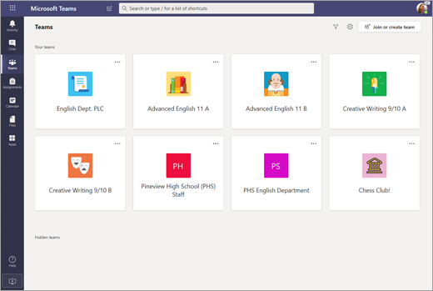
Microsoft Teams
Used for:
Lessons
Videoconferences

Slide 5
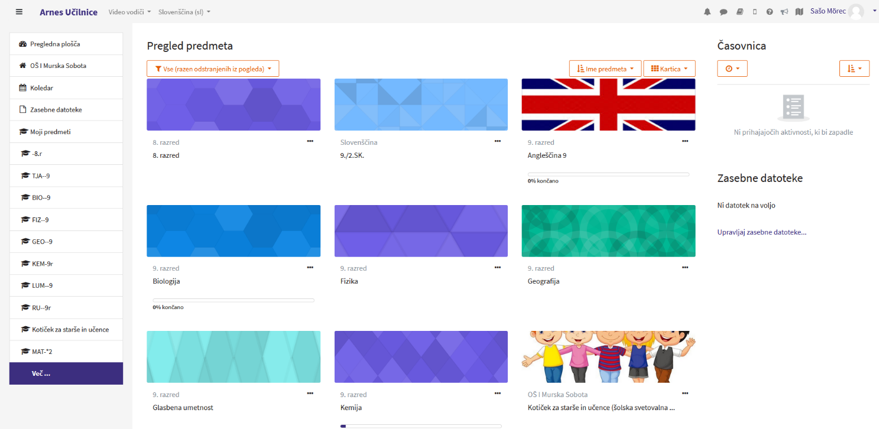
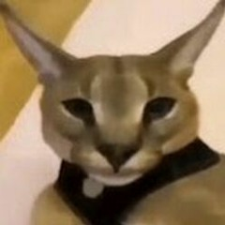
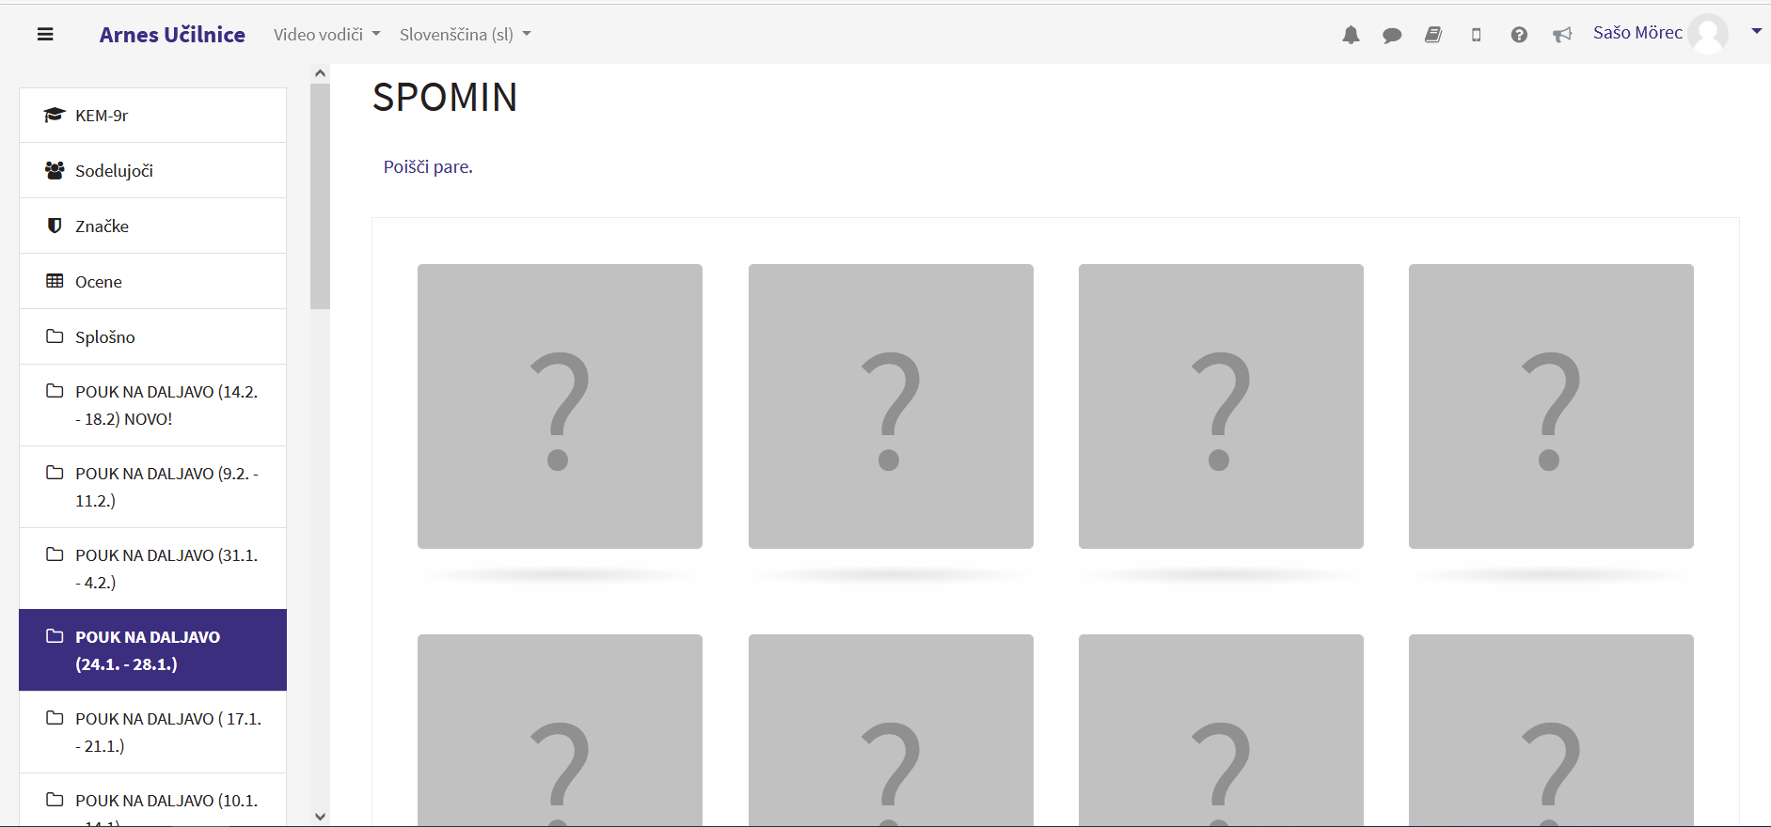
Moodle
Set up many years ago
Became popular in quarantine
Used during homeschooling
Hosted by ARNES
Academic and Research Network of Slovenia
FRI and FMA in Ljubljana
Techers gave us work weekly
Sometimes had deadlines

Slide 6
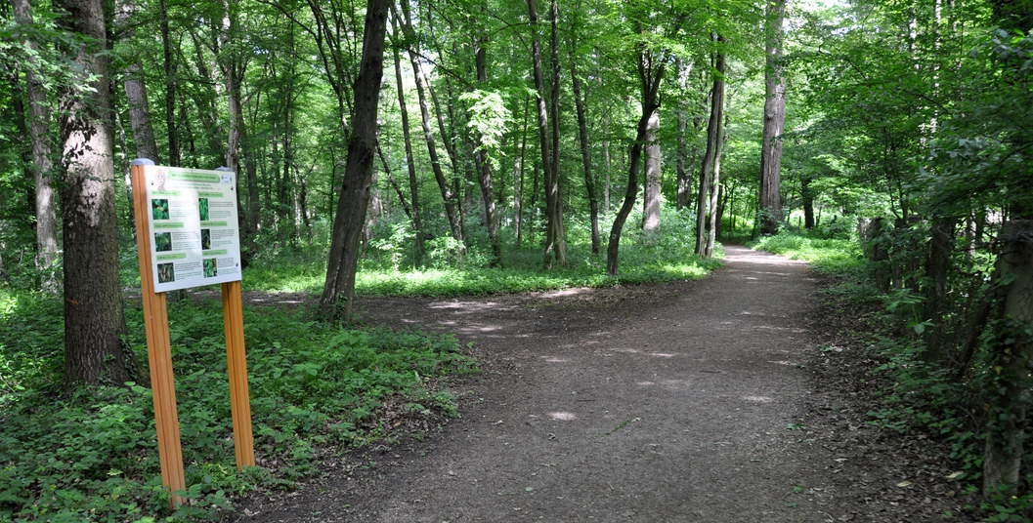
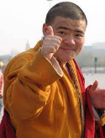
My average learning day
3-5 conferences a day
Doing school work
Going on a walk
Texting friends

Slide 7
Communication and technology
Arnes classrooms
Gmail
Teams
Word documents
Zoom
Office...
ICT (infromation and communication technology)

Slide 8
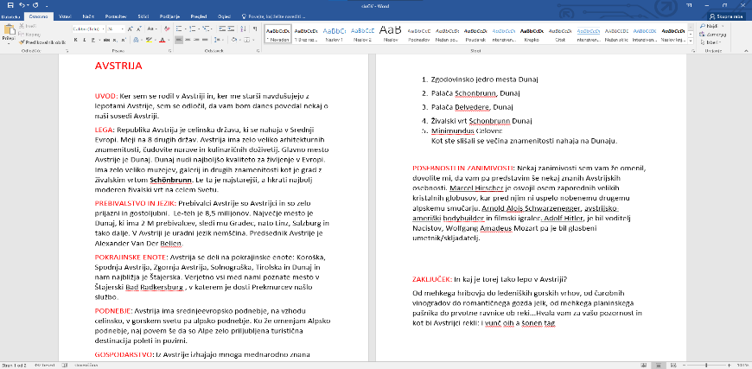
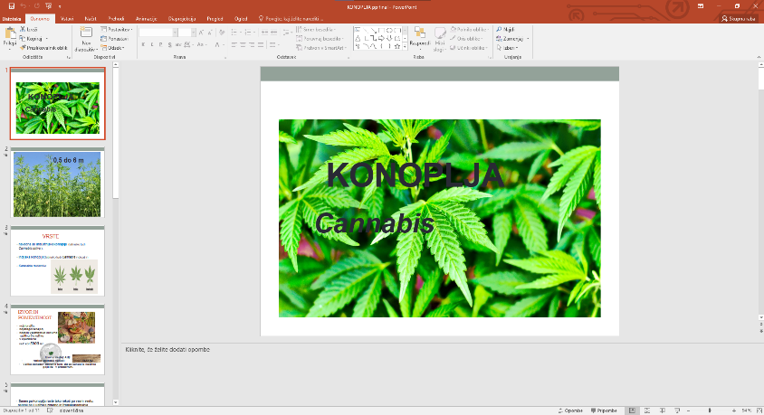
PowerPoint Word
Popular for making presentation
Used almost for every subject
Used weekly
Teachers: explanation use
Used almost daily
Used by teachers & students
Used as instructions
Popular for making shorter essays
Used for every subject

Slide 9
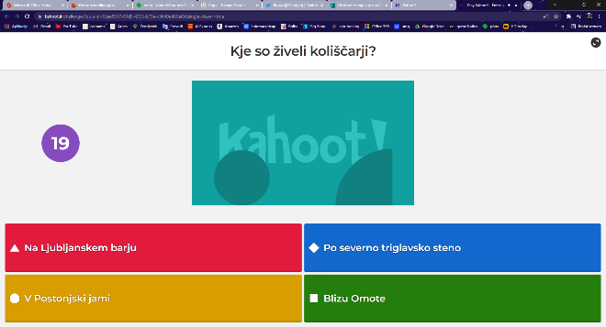
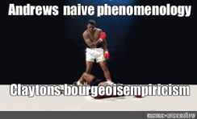
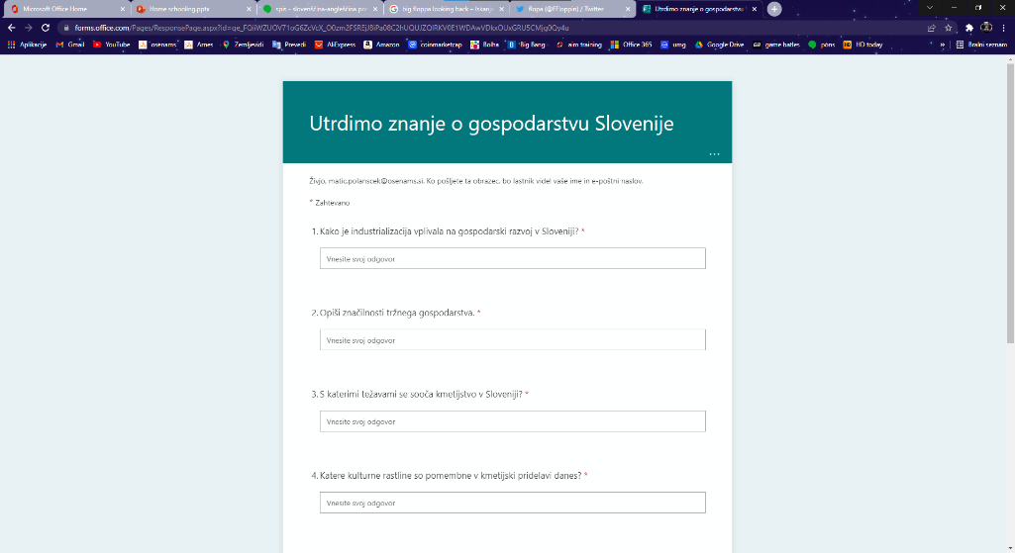
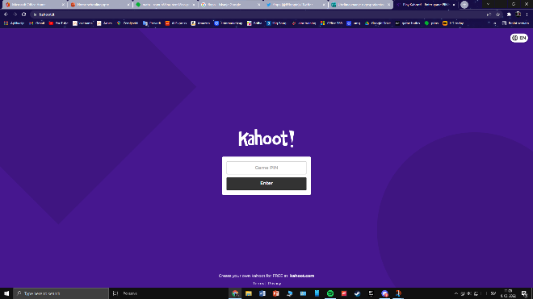
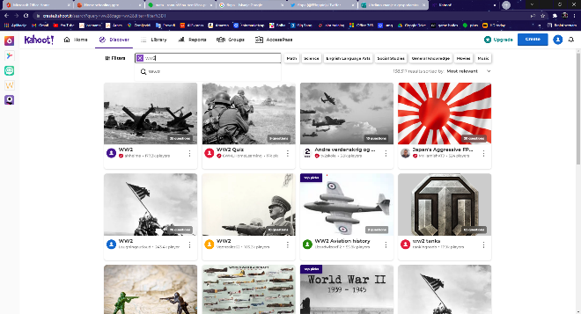
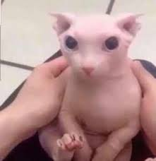
Kahoot Google Forms
Quiz
Teachers: checking knowledge
Used in History
Teachers
Students
Used as test
Teachers checked students' knowledge
Fun way to learn
An administration software
Used in Geography

Slide 10
Advantages and disadvantages
Advantages:
Disadvantages:
Having your 'own' schedule
Sleeping longer
Having more study/searching material
Less grades
Not having enough explanations
A lot of time spent on electronic devices
Too much study material

