Slide 1
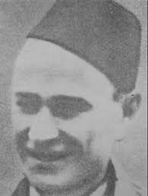
MICA STOJKOVIC

Slide 2
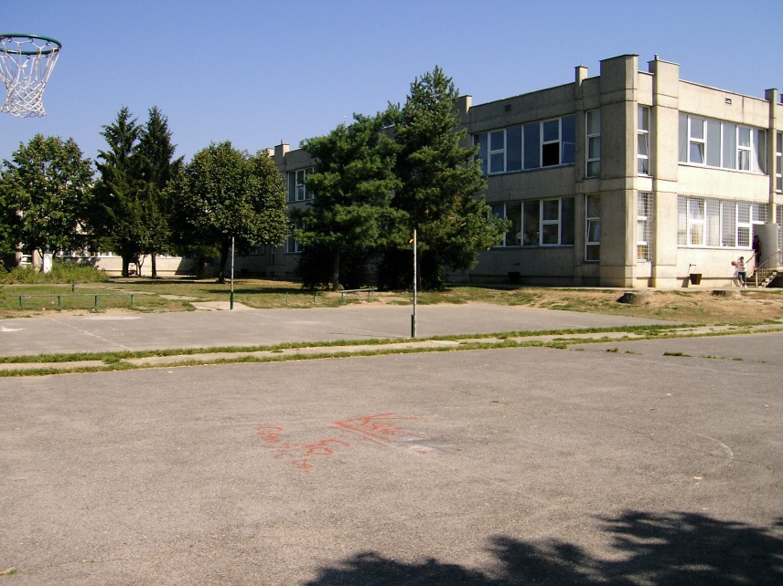
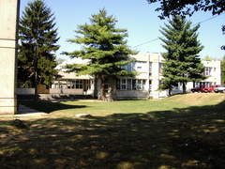
Primary school “Mica Stojkovic” is placed in the village called Umcari, municipality Grocka, on the territory of the city of Belgrade. It is named after a national hero of Yugoslavia, Mica Stojkovic, who was born in Umcari.

Slide 3
The prersent school building was build in 1976. Within the extracurricular subjects, there is a number of activities drama-recitation, art, music, geography, history, technology, foreign languages, sport.

Slide 4
Many important guests came to our school through UNESCO camp program. Those were the ambassadors of many countries: Mexico, Portugal, Brazil, Russia, Belarus, Azerbaijan, Cuba, Slovenia. There is a tradition in our school that the best student of the generation is given the prize by a famous person from cultural and public life.

Slide 5
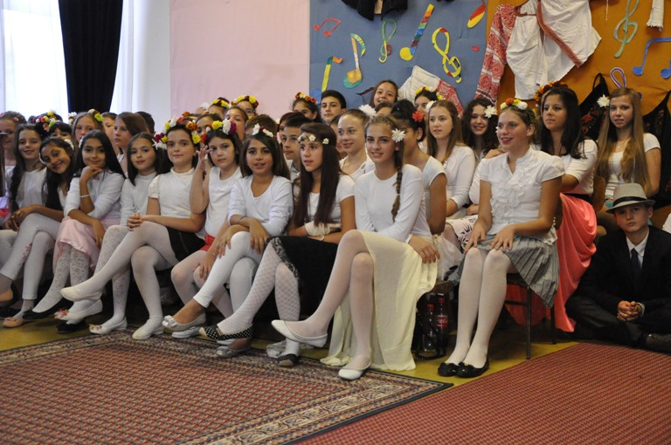
The prize gave to our students: the prince Pavle, the princess Katarina Karadjordjevic, actress Katarina Zivkovic, Mira Adanja Polak, painter Olja Ivanjicki, actor Sergej Trifunovic, journalist Jovan Memedovic and many others.

Slide 6
Pupils and teachers went to camps in Piran, Slovenia, Kotor, in Russia and Turkey. The camp in our school was visited by the schools from Piran, Russia, Belarus, Slovenia, Republic of Srpska and Montenegro. The Pupils of our school appeared on Serbian TV channels such as Studio B, Kopernikus , in the show by Drasko Acimovic” Pod sjajem zvezda” and many other shows.

Slide 7
THANK YOU FOR ATTENTION
Milosavljevic Dimitrije VII-1

