Slide 1
Příbram GPS Treasure Hunt
Created by students of Gymnázium pod Svatou Horou in Příbram within the Erasmus+ project “Neighbours, yet Different”

Slide 2
Instructions
Move on to the next slide once you reach the next place. Do not cheat by looking at what the next place is supposed to be. That would spoil the fun!
Enjoy the tour in our beautiful town!

Slide 3
1 Ernestinum (starting point)
N 49°41.383´
E014°00.632´
Ernestinum is a castle. In Ernestinum there is the city information centre and Gallery of František Drtikol (famous painter originally from Pribram).
The next stop is apx. 250 m to the west (you must go around the castle and downhill)

Slide 4
2 Horní Obora (lake)
This is a place where people go to relax a bit. You can inline skate here, ride a bike, feed the ducks or just sit and relax. There are regular markets with farm food on Saturdays. Across the lake there is the railway station.
Go to
N 49°65.788
E014°42.666

Slide 5
3 Nám. T.G.Masaryka (T.G.Masaryk Square)
N 49°65.788 E014°42.666
This is the main square in Pribram. If there are city events, mostly they take place here. There is a library. It was opened in 1900. The church of St. Jakub was built in the second half of the 13th century. There is Czechoslovak national Bank.
The fountain is quite new. The huge ball in the middle is a monolith (one piece) and it was transported from China.
Go downhill to the square and turn left.
Go straight to the street and when you see the cafe shop on the corner turn right. This cafe makes the best coffee in town and the bookshop opposite closely cooperates with our school - our students and teachers read aloud for people.

Slide 6
4 V Brance
You are in Prague Street. It is a shopping street, our “High street”. There are many local shops. The KAFERNA cafe on this corner makes the best coffee in town and the bookshop opposite closely cooperates with our school - our students and teachers read aloud for people.
Now go down the narrow street, go straight 50 meters, cross the oneway road and opposite you will see the entrance to the longest indoor staircase in Central Europe.

Slide 7
5 Svatohorské schody (staircase)
N 49°41.134 E014°00.970
The staircase was built in 1728. There are many stairs. Can you count them? They burnt down in 1978 and in 1991 people collected money and local businessmen helped to rebuild the staircase.
Enter the staircase and go uphill as far as almost to the top. Use the coordinates to leave the staircase in the right moment (you will go to the right).
N 49°41.035´ E 014°00.926´

Slide 8
6 Vyhlídka u bunkru (viewpoint)
N 49°41.035´ E 014°00.926´
Viewpoint. From here some time ago you could see the whole city but now the trees are much higher so you can only see some parts - the theatre house, the swimming pool, ice-rink, the new town and the blocks of flats. In the background you can see the Brdy mountains.
You need to go to the southeast as far as a road. There go uphill and take the second right. Use the coordinates to help you
N 49°40,968
E014°01,068
Your goal is to find a viewpoint in the forest.

Slide 9
7 Vyhlídka na haldy (viewpoint)
N 49°40,968
E014°01,068
Haldy:This heap of clay comes from the Příbram mines, uranium was mined in these mines. The space around the heap is little bit radioactive, and the Příbram heaps might be removed soon.
Go back to the road, cross it and take the first right. Go between the lines of lime trees which are Czech national trees. Go to the little house in the middle.

Slide 10
8 Studna (well)
N 49°40.986´
E014°01.068´
Mary’s well (stands on the place of original, not deep, was dug out in 1634 by a man who got miraculously treated his blindness with that water. The well is 78m deep and the chapel was built in 1973.
Stations of cross - Stations of cross was built by pattern of other world pilgrimage sites. There are 14 crosses, they were sanctified on Green Thursday. The first stop is behind the bell tower, further continue along wide path direct and it ends with the last 4 stops on the raised terrace near the well. The 12th stop (cross) is decorated with a large painting on the sheet of metal.
Go north-west approx 120m.

Slide 11
9 Svatá Hora náměstí (square)
N 49०41.103
E 014०01.107
This is the central place of the pilgrimage site of Svata Hora (Holy Mountain)
Turn your back to Svatá Hora and go down hill. Keep slightly left as far as when you see a huge oak tree.

Slide 12
10 St. Vaclav’s oak tree
N 49० 41.131
E 014० 01.202
One of the most important memorial trees in the Czech Republic. The tree is about 410 years old.
Keep going downhill and across the parking lot. Go downhill and try to find the place where we spend ⅓ of our lives. We love it there! Which place is it?

Slide 13
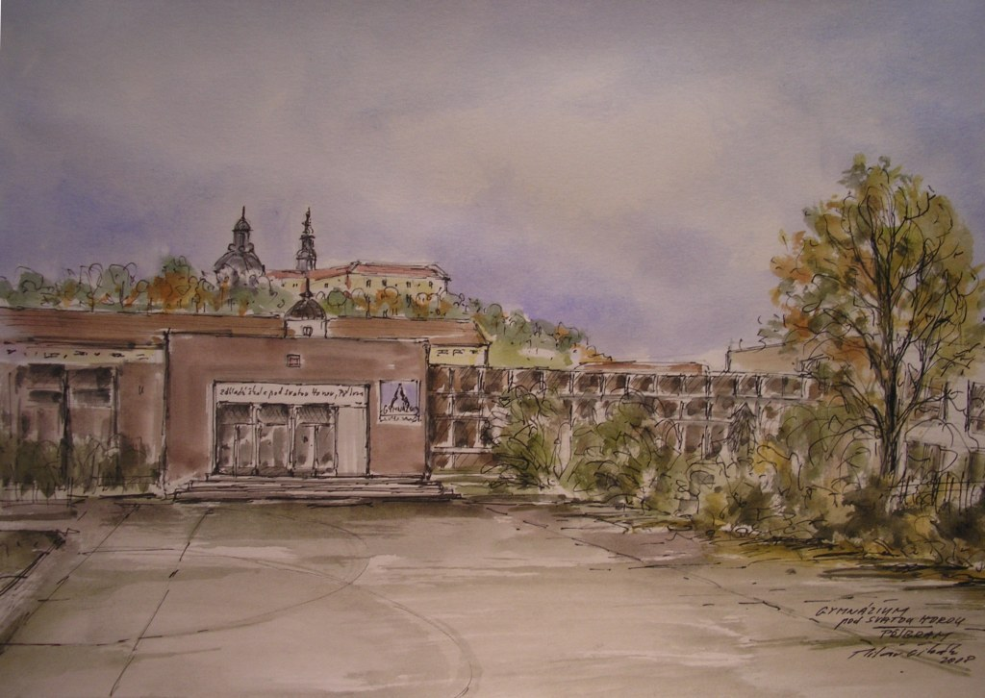
This is the place!!!!!
Well done! You made it!
Now you can continue, we have an extension for you in another part of our town. So keep going and hunting.
Go to
N 49०40.867’ E 014०00.070’
You are going to find a big beautiful building.

Slide 14
Divadlo A. Dvořáka (theatre)
N 49०40.867’ E 014०00.070’
The theatre opened on 12/9/1959. The theatre was built for two years.
The first director of the theatre was Antonín Dvořák.
Antonín Dvořák was a famous composer of romanticism. There is a cinema next to the theatre and a big hall on the other side. In that hall, big cultural events are held, for example our school prom of the final year students. Next to the hall, there is the only real hotel in Pribram.
Go around the theatre to the back of the building, here go southwest along the street of Politických vězňů (political prisoners’ street - during communism some people were imprisoned because of their political believes). Walk apx. 250m.

Slide 15
Náměstí 17. Listopadu
Square of 17th November (on 17th November in 1989 communist regime collapsed and democracy was started)
N 49०40.705´ E 013०59.707´
It is the largest place in this new part of town. On the this place there is big a fountain, regular markets and cultural events.
Go east over the square, turn to K. H. Máchy 110 m.
Continue along tř. Osvobození 100 m. Turn right to E. Beneše 270 m.
From the roundabout take the first exit to Školní street 120 m.
Turn right after 100 m. Turn left after 31 m. Turn right. It will be on the left.

Slide 16
Areál Nového rybníka
Leisure Area of the New Lake
N 49०40.505´ E 014०00.206´
There you will find beautiful pond environment and broad space for relaxation as well as slides. Now it is undergoing reconstruction. The first stage of the reconstruction was completed. For example, an island with a gazebo has been adapted to the bridge.
Go back to the entrance and go along the Příbram Creek. At the Čekalíkovský Pond, cross the bridge. Go along the course. An open green area appears.

Slide 17
Q klub hřiště (playground)
N 49०40.981 E 014०00.521
Ryneček is a frequented place. Newly built project worth almost 11 million.
Quiet Zone Ryneček has many game elements and climbers.
Now walk along the stream. Take the first stairs on the right, turn left, and follow the Průběžná Street. Go around OC Skalka, at the traffic light, go to Mílinská street. Go straight along Milínská Street and after 339 meters you will reach T. G. Masaryk Square.

Slide 18
Náměstí T. G. Masaryka (T.G.Masaryk Square)
Congratulations! Here you are again at the very heart of our town. Now you know where to go - whether you want to eat something, buy something or just relax. Enjoy!
Thank you for taking part! We hope you had fun :-)

