Slide 1
Relief

Slide 2
Kappeln (schleswig-holstein)
Příbram
Highest mountain: Bungsberg-167,4m
Lowest point: 3.5 meters under the sea level
Landscape: flat, no mountains because an Ice Age formed the landscape. The glaciers pushed the mountains away. But they carried some stones, sand and formed some small hills.
Highest mountain: Tok 865m
Lowest point: u Čími 271m
Landscape: moutains Brdy, its very old, from 2,5 bilion years ago, our mountains were made in Protezoikum

Slide 3
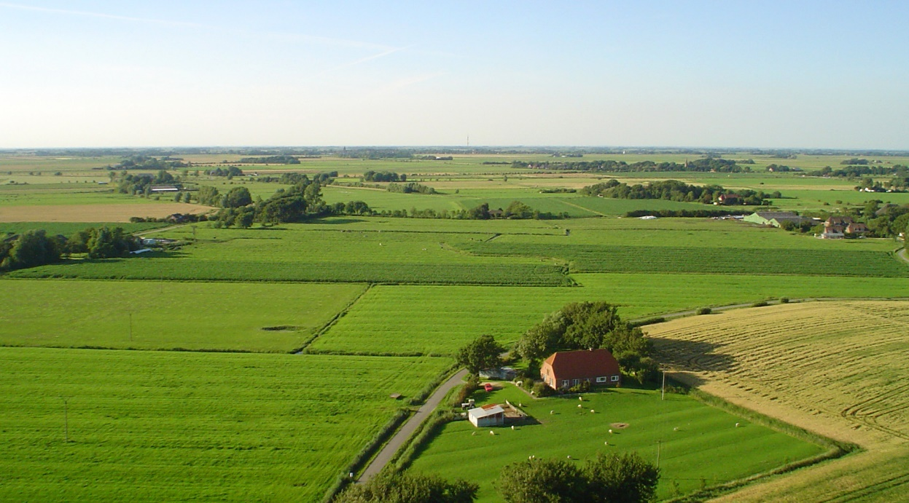
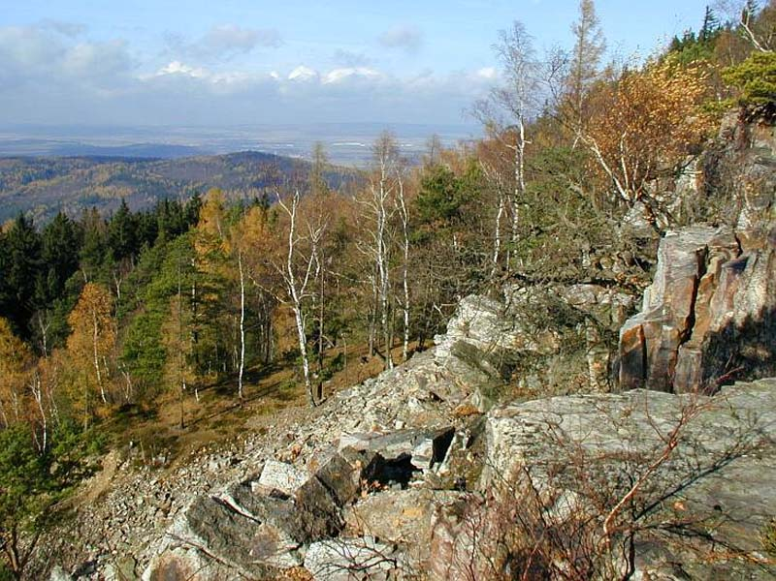
Landscape

Slide 4
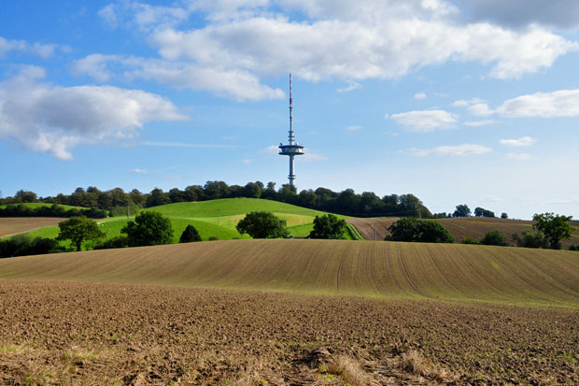
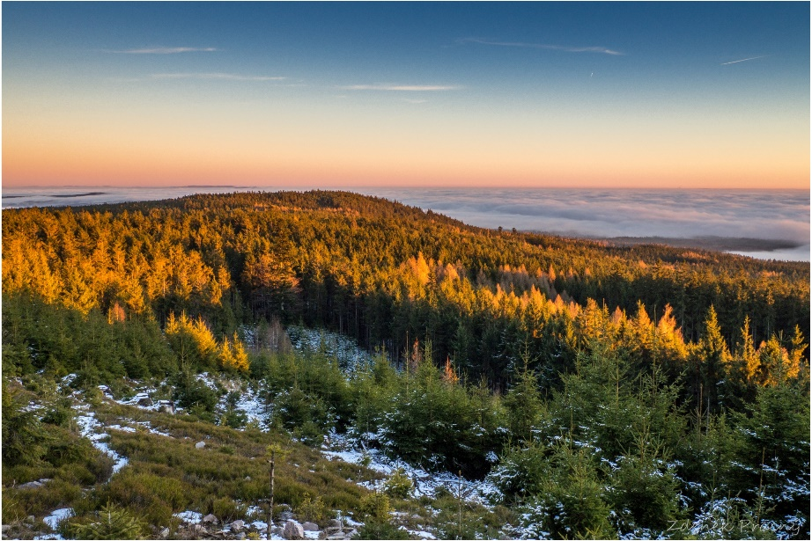
The highest mountains
Bungsberg 167,4 meters
Tok 865 meters

Slide 5
Made by:
Vojtěch Šobora Lena Schmidt
Roman Koutný Nina Henschel
Jan Parez Justin Jung

