Slide 1
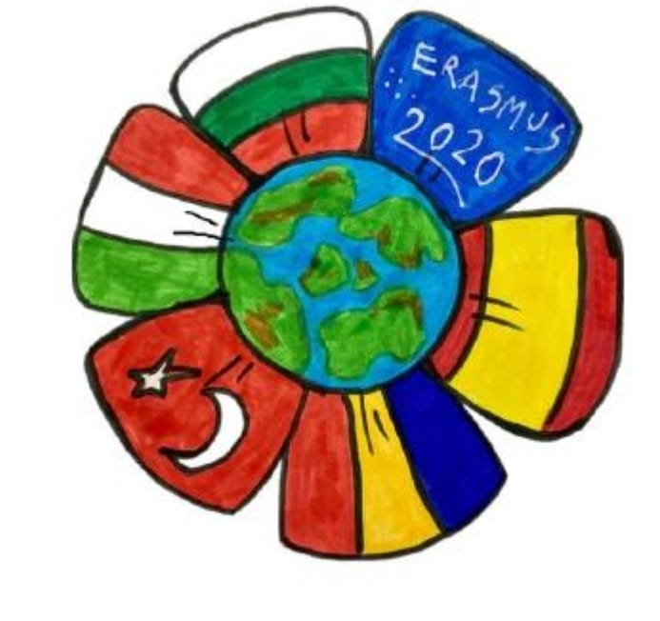
More green you live,
More life you give
Project made by 6th grade
School: “Lucian Blaga” Jibou, Salaj, Romania
Teacher: Pop Alina – Maria / Ciurbe Mariana

Slide 2
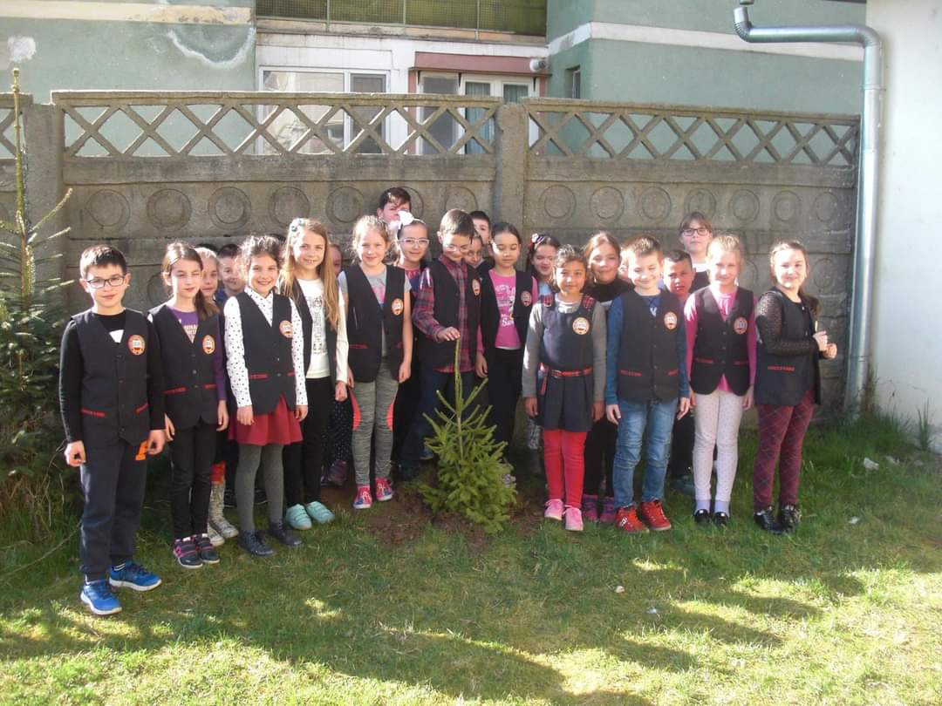
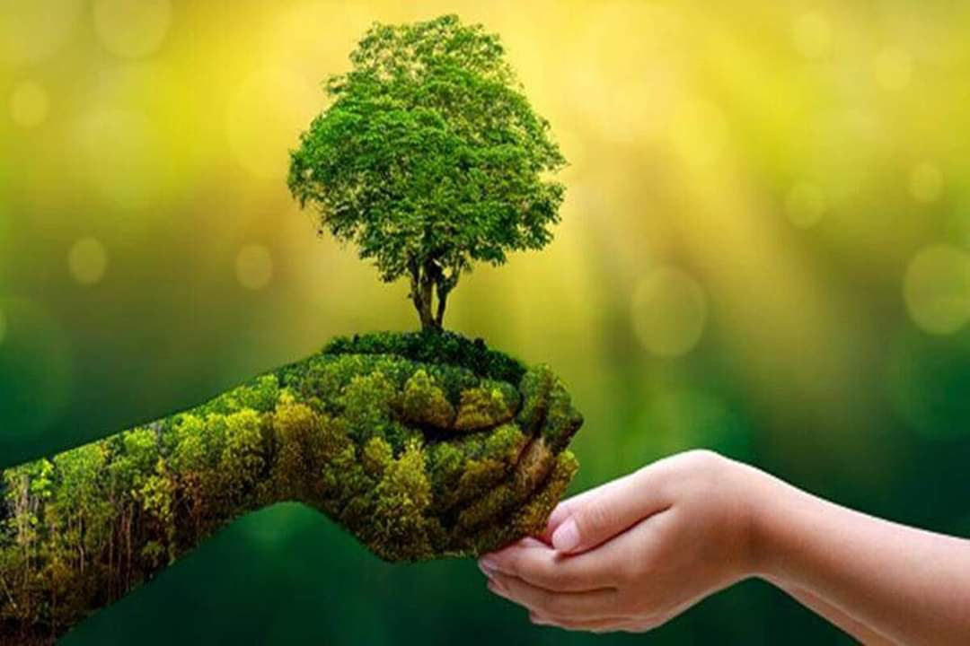
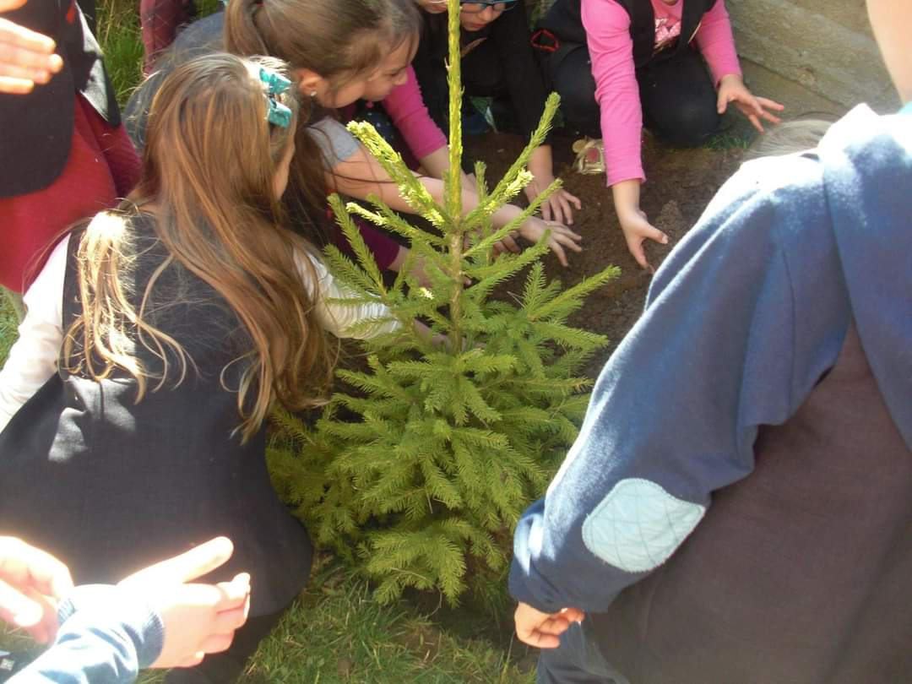
One thing anyone can do to save the planet is to plant trees. Trees are the most important plants we have because without them we would not have much of the oxygen we breathe.

Slide 3
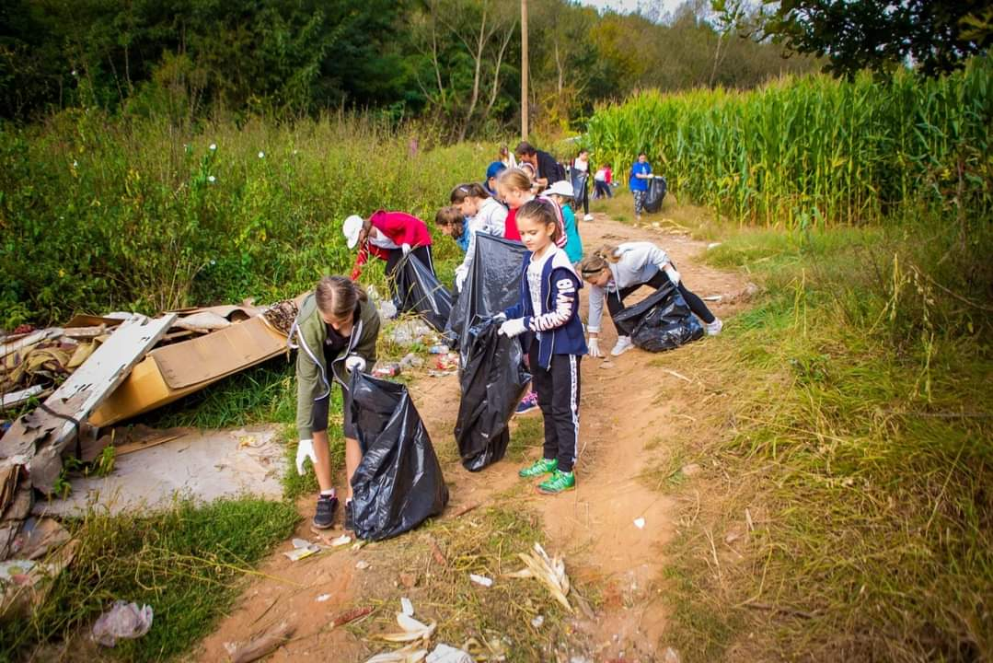
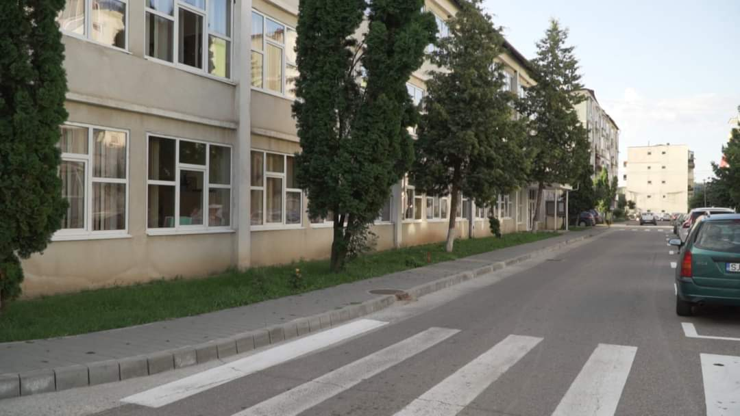
In our town, Jibou, the nature and the green spaces are very important both for population and for authorities and for that reason, we organize a lot of ecological activities like, trees planting or collecting the trash from the Somes river side.
Andrea Kovacs

Slide 4
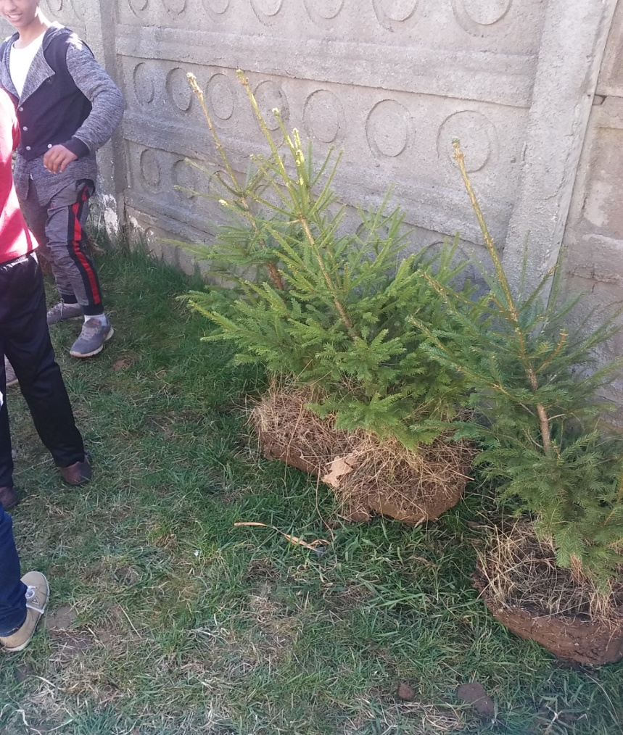
We have a tradition in our school - we plant spruce trees every year, so almost every class has a tree to take care of. Unfortunately, not all trees have withstood.

Slide 5
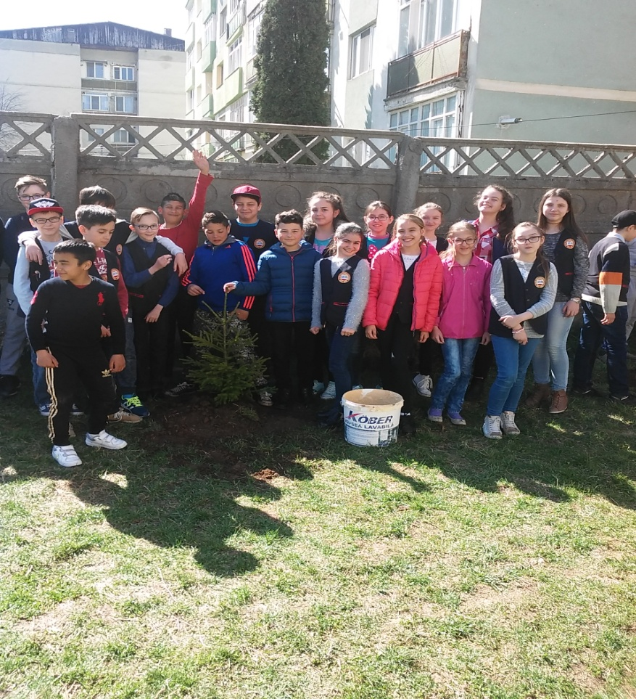
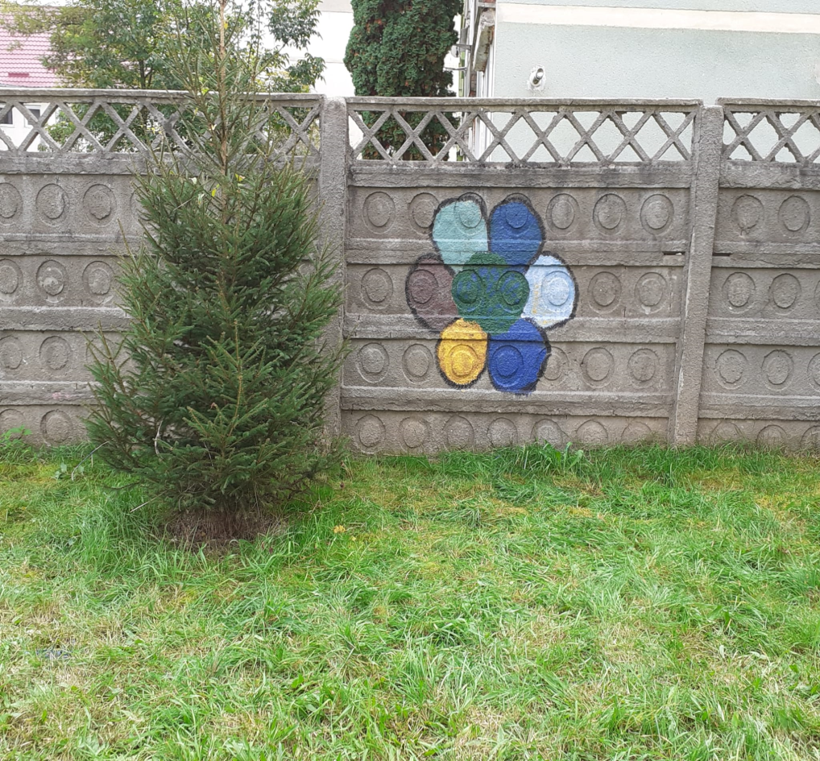
The first picture is from 5 years ago and the second one is from this Friday.

Slide 6
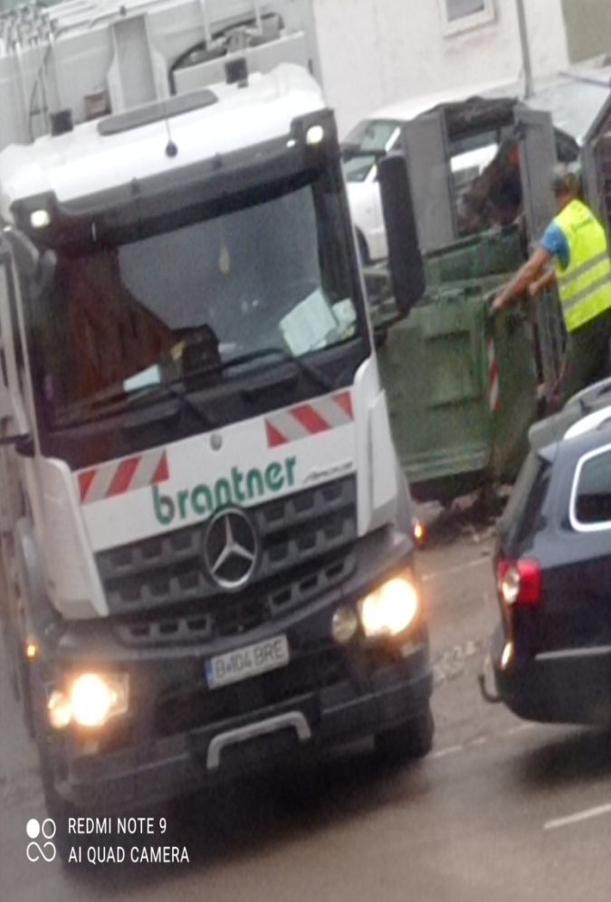
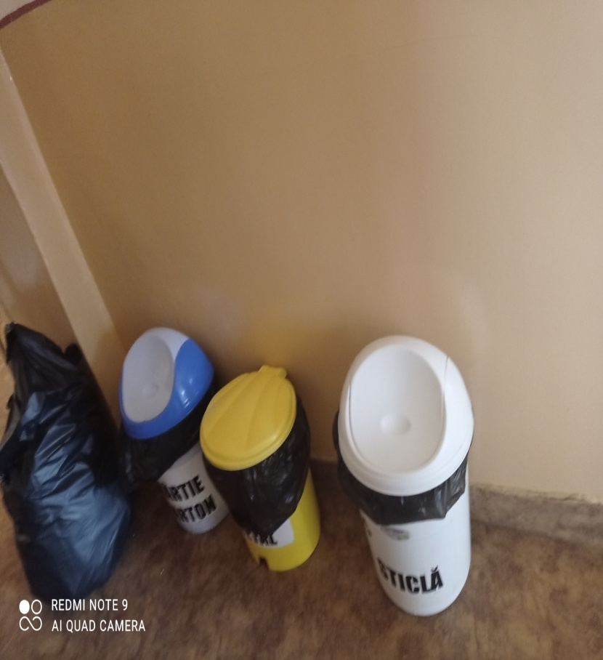
MORE GREEN YOU LIVE ,MORE LIVE YOU GIVE
In Jibou,waste is sorted according to the following categories :plastic,metal,
paper,cardboard. Which are taken to a place where they are recycled .
ROTARIU MIRIAM

Slide 7
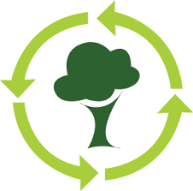
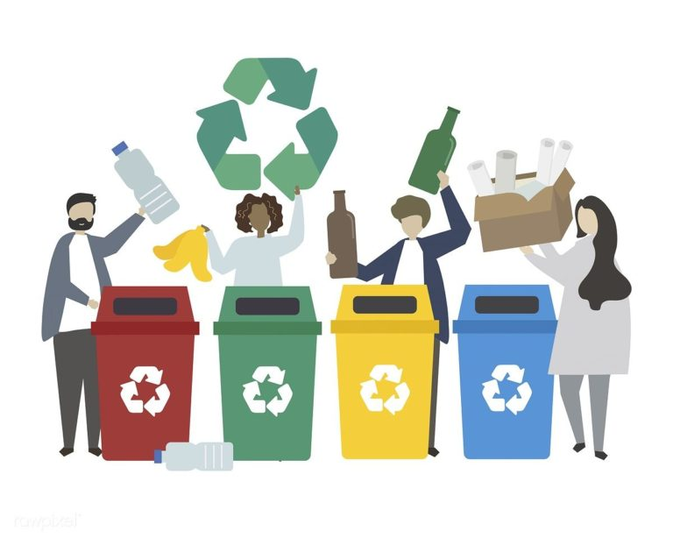
More green you live, more life you give!
In Jibou we have two schools... I study at “Lucian Blaga” school .
We have rules not to throw garbage on the floors or outside... In our school, in each class is one or two trashes where you can throw your garbage and that is very good! Outside we have trashes too and they are bigger.
Bujor Ariana Ariana

Slide 8
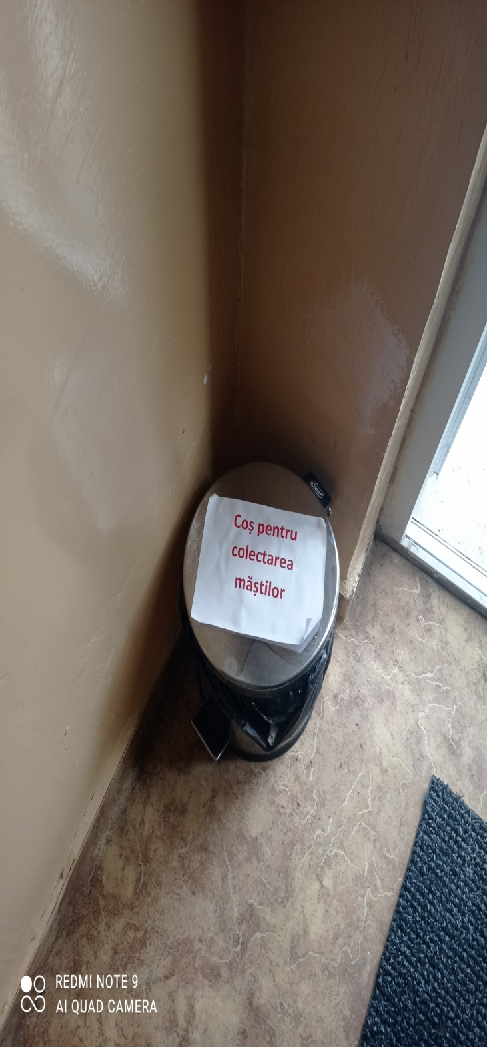
ROTARIU MIRIAM
During the pandemic, a new garbage can appeared for the recycling of used masks

Slide 9
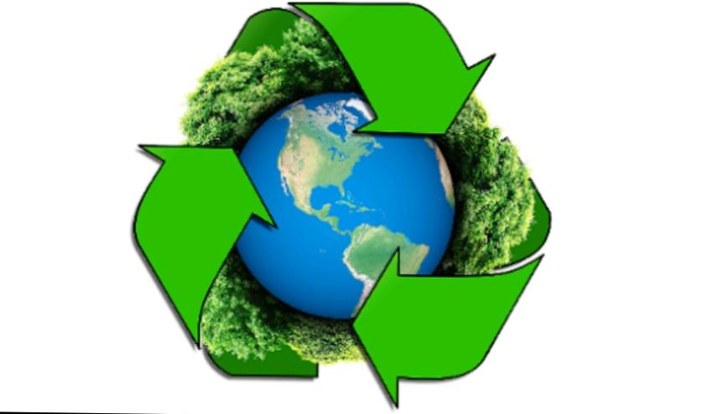
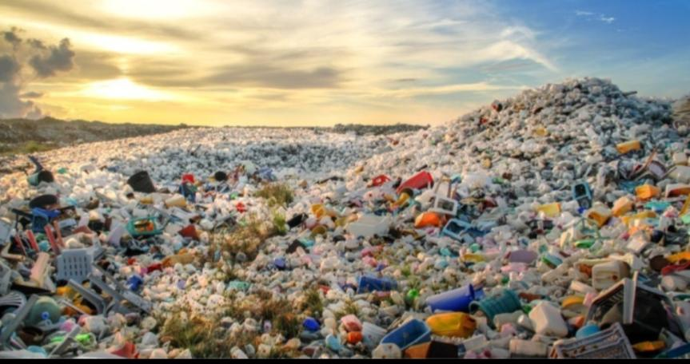
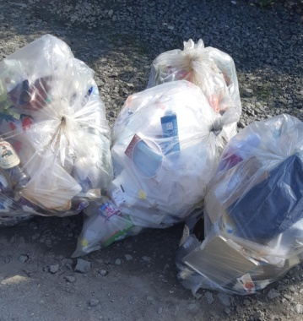
In our town we make volunteer for waste collection
Every year are a lot of volunteers who want to participate
At my school are special trash cans for :
-glass
-paper
-plastic
We use them often
take care of nature
Take care of nature and she will take care of you .We have time to save the planet
Vlasim Alessia

Slide 10
People poluate the Earth and its illegal.Nature cops are trying to save the nature…but bad people continue poluate Earth.We need to stop poluate because ,somehow,we are hurting ourselves…during the terrestrial poluation.

Slide 11
Now,we have in this picture,the water poluation.This tipe of poluation is killing the sea animals.This is one who kills the fishes and people who are counting on fish,will die because they don’t have food anymore.

Slide 12
The last poluation I want to tell you about is…air poluation.This air poluation is made from airplanes that are mading smoke.Then we breathe the smoke that can affect our lungs,and then we get bad problems with our lugs…even die!

Slide 13
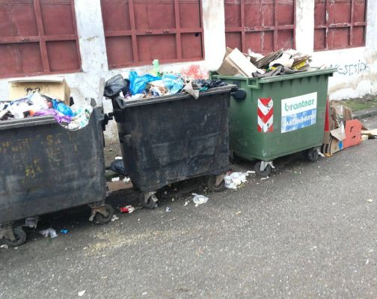
More green you live, more life you give!
In the past selective recycling wasn’t a thing in our city
We have a lot of trees and parks here in Jibou and a botanical garden too, which is very big and has a lot of flowers, animals and very much green.
We like our town, and we should stop pollute if we want us to be safe.
Iacob Antonio

Slide 14
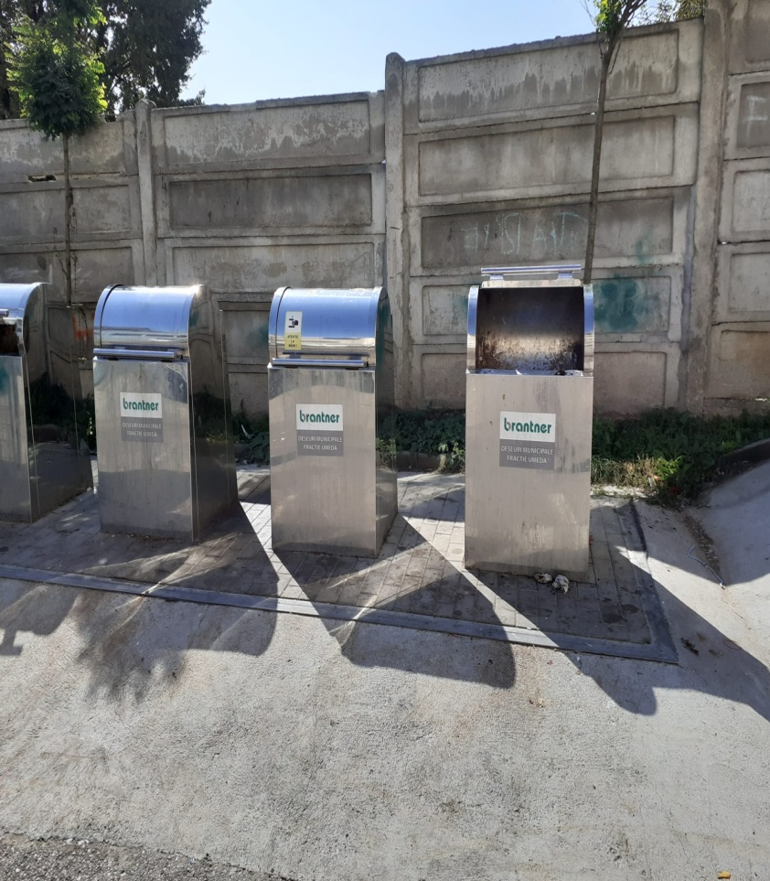
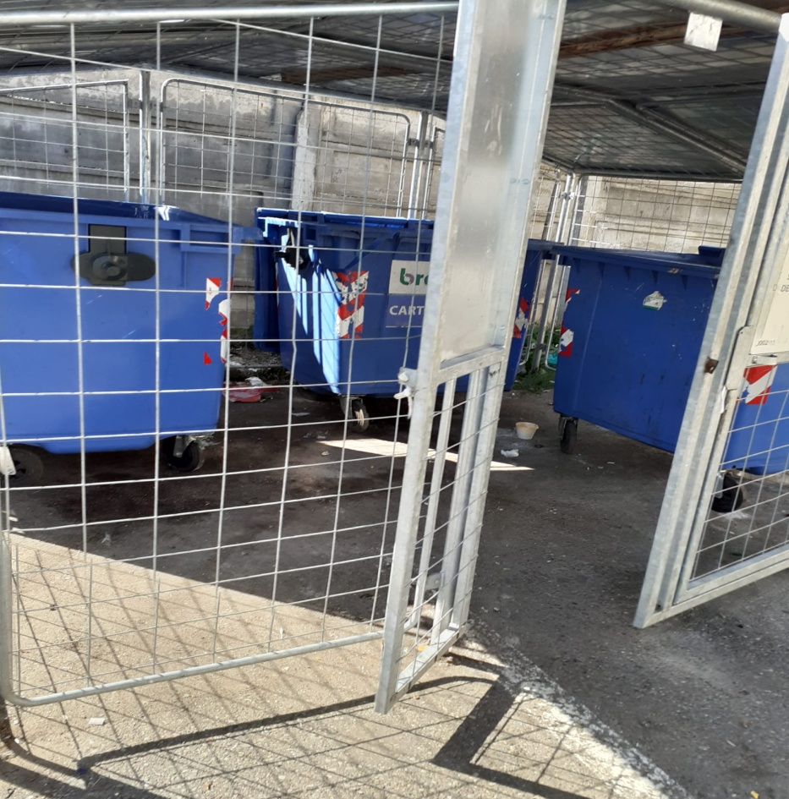
Now, we have special underground containers for selective recycling

Slide 15
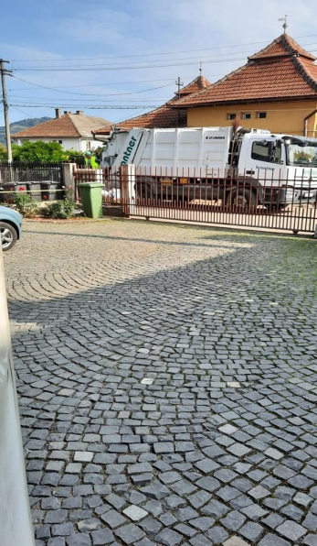
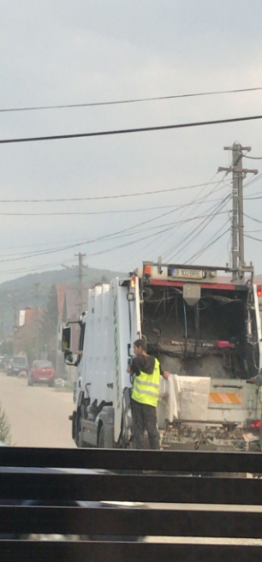
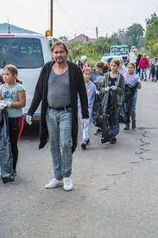
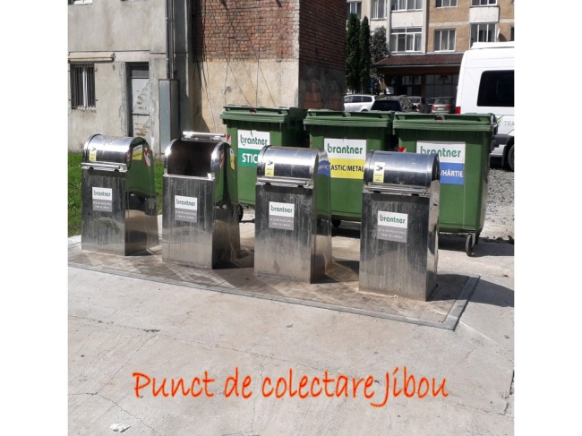
Our ECO School and Town
More Green You Live
More Life You Give
Here are some pictures of our activites from school and the sorting in the town
In our school are lots of bins sorted by difrent colors for plastic , paper , metal and new ones for used masks.
The sorting of the garbige in the town is very selective we can only use transparent garbige bags for the ....... and our own garbige can for household waste.
Big Sophie

Slide 16
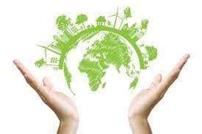
More green you life more life you give
waste recycling is closely related to waste collection, without which this process of recovery and transformation of raw materials - could not take place.
Antonia Stirb

Slide 17
More green you live more life you give
as we have already mentioned, recycling is a very important process both for human health and for the preservation and conservation of the environment. One of the many recyclable wastes is glass, glass recycling being a common practice in many countries in the European Union and beyond. Programs for collecting and sorting different types of glass have sprung up
Georgiana Crecan

Slide 18
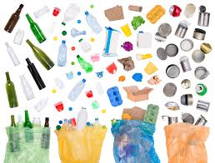
Patrick Pop
Recycling is the introduction of residues or waste into a technological process in order to obtain their reuse and recovery or for ecological purposes. Recycling reduces the consumption of new raw materials and also reduces energy consumption and the level of contamination of the natural environment.

Slide 19
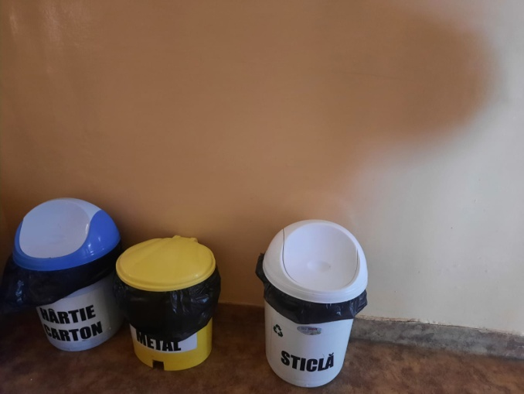
MORE GREEN YOU LIVE , MORE LIFE YOU GIVE
In our town , Jibou , from Romania , is very important to have a NON-POLLUTION NATURE.
This is the way we can have a fresh and clean nature:
1.We have waste collection centers , wich is about to recycle a lot of things , so we can reuse again those or other things , but in the same time these centers are helping us to do not pollute.
Photos with those centers (in our town)
(in our school):

Slide 20
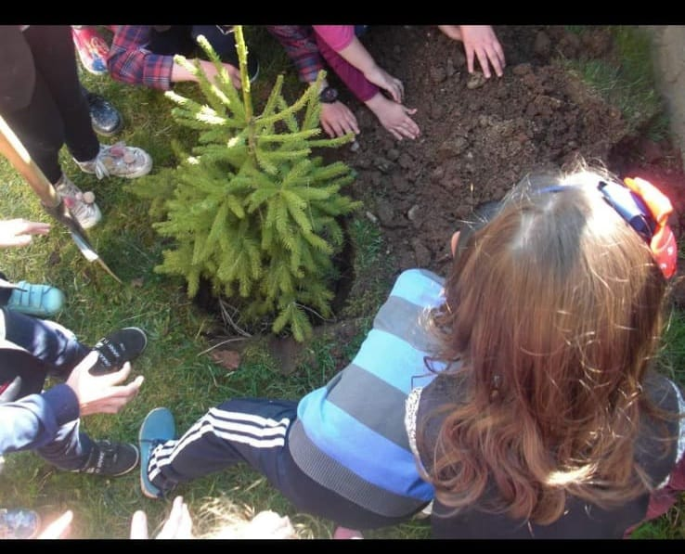
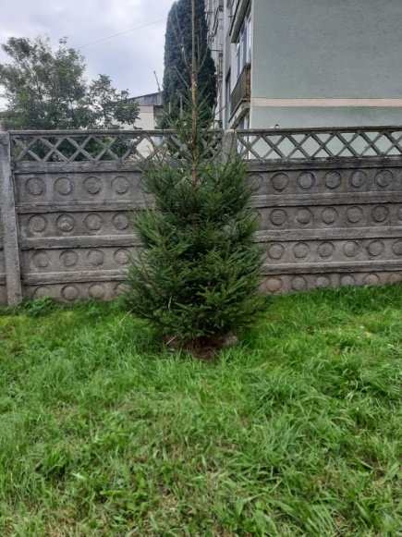
2.In our school some classes planted spruces , to teach us that the most important thing on this world are the trees , wich are helping us to exist (air).
Here we are (my class ) planting trees:
Before (first grade):
After (6th grade):
Borzan Rebeca

Slide 21
MORE GREEN YOU LIVE , MORE LIFE YOU GIVE

Slide 22
MORE GREEN YOU LIVE , MORE LIFE YOU GIVE

Slide 23
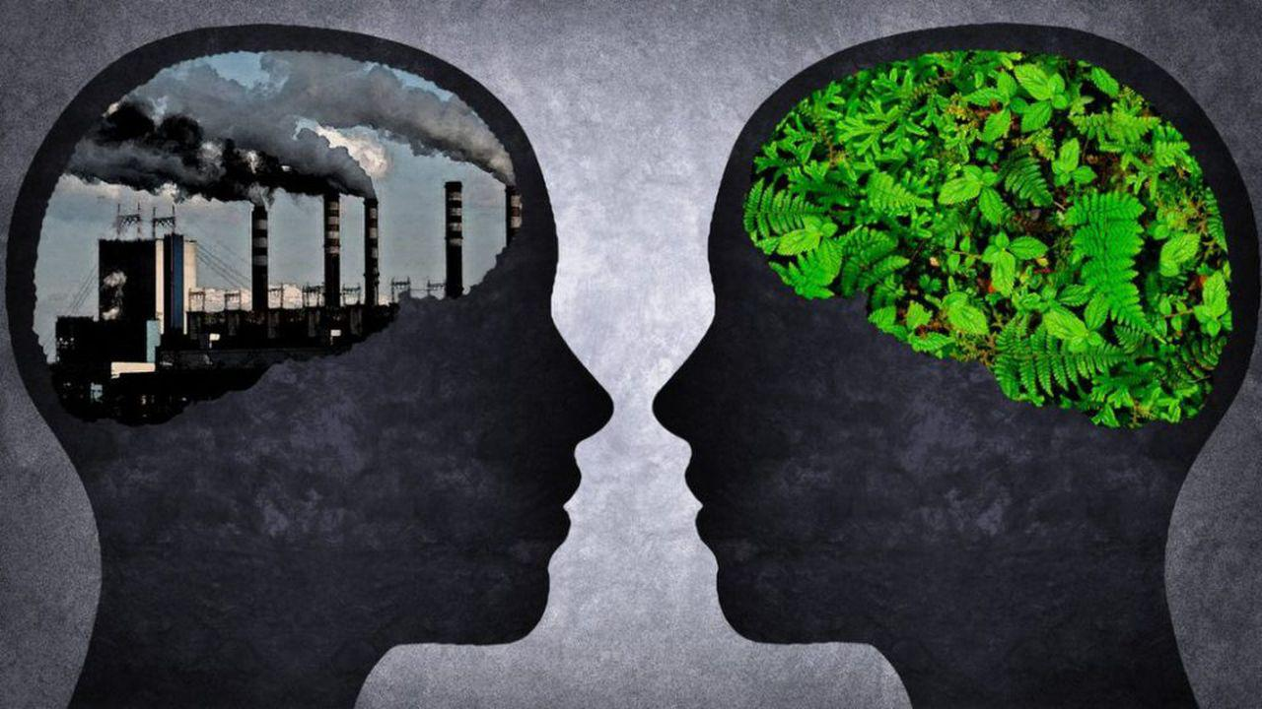
If you love the Earth…don’t poluate…it gives you a home…air…food…potable water…everything you need…and now…u give it…poluation…if you want and wish your people who are dear to you…yo live…STOP POLUATING!!!
Bujor Ariana

Slide 24
Thank you for watching

