Slide 1
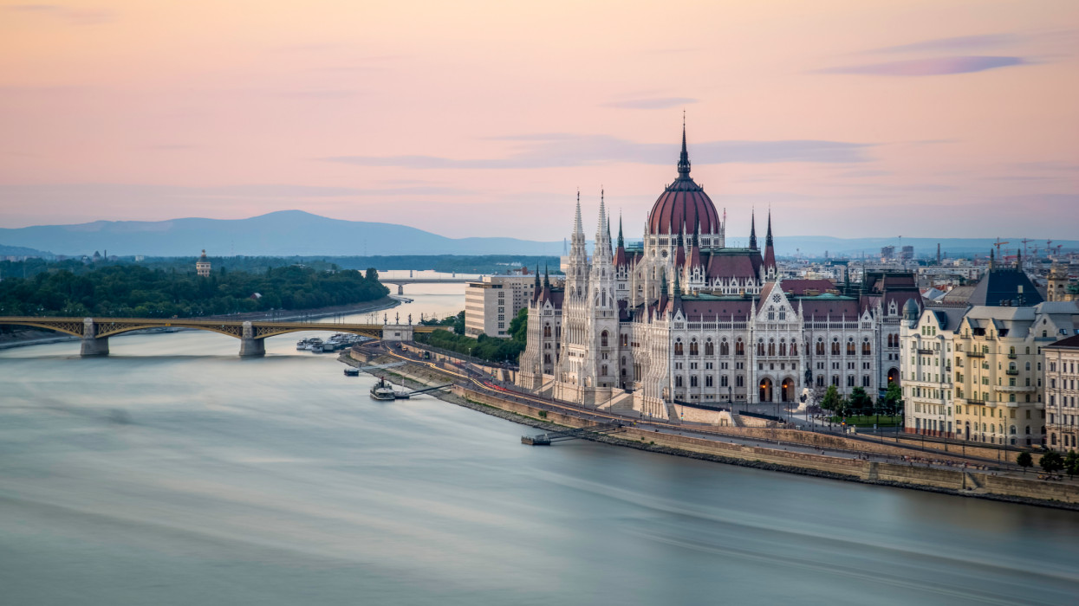
MAGYARORSZÁG - HUNGARY
CSONGRÁD

Slide 2
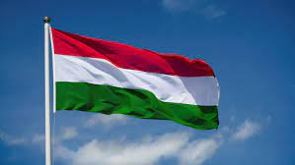
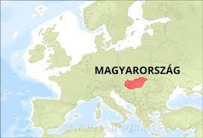
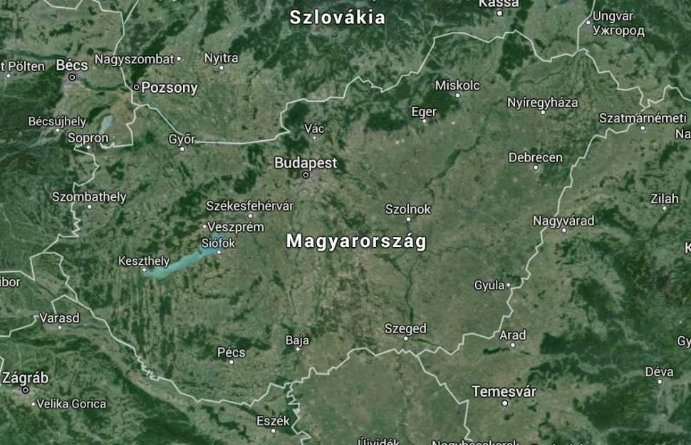
-Hungary is a country situated in the Carpathian Basin in Central Europe.
-Our neighbours are Croatia, Slovenia, Austria, Slovakia, Ukraine, Romania and Serbia.
Our flag:

Slide 3
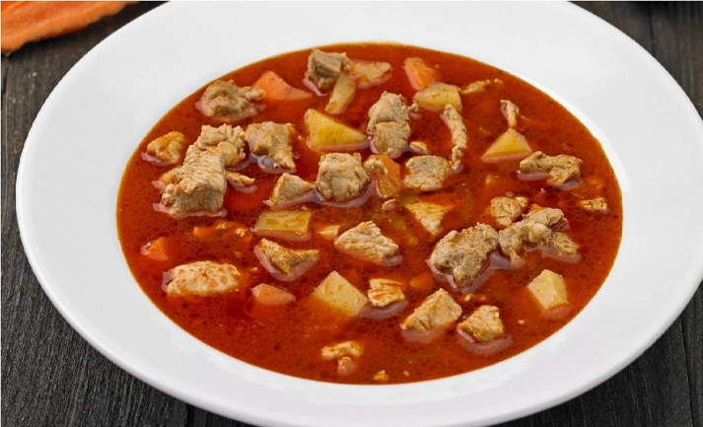
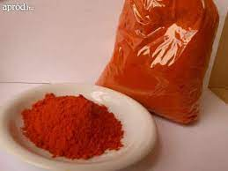
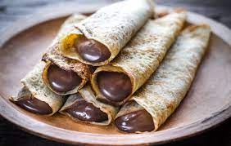
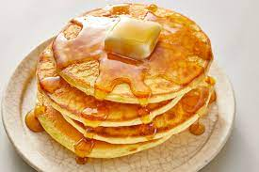
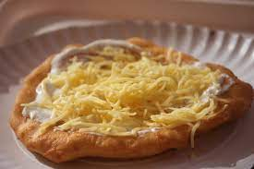
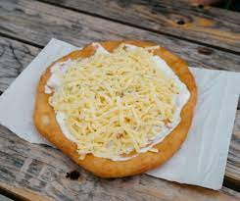
What comes to your mind when you hear the word : Hungary ?
First of all : „hungry”, yes sometimes we can be hungry, but our tasty foods make us full.
So let’s talk about our traditional foods.
palacsinta – pancake:
It’s the best because our grandmas make it.
2. Goulash-soup
hungarian
american
3. Lángos
Hungarian deep fried flat bread.
Usually we put sour cream and cheese on it, but you can put anything on it or you can make it sweety.

Slide 4
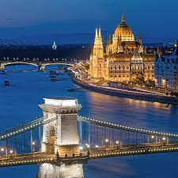
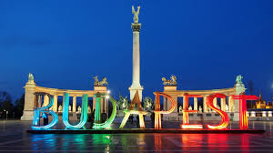
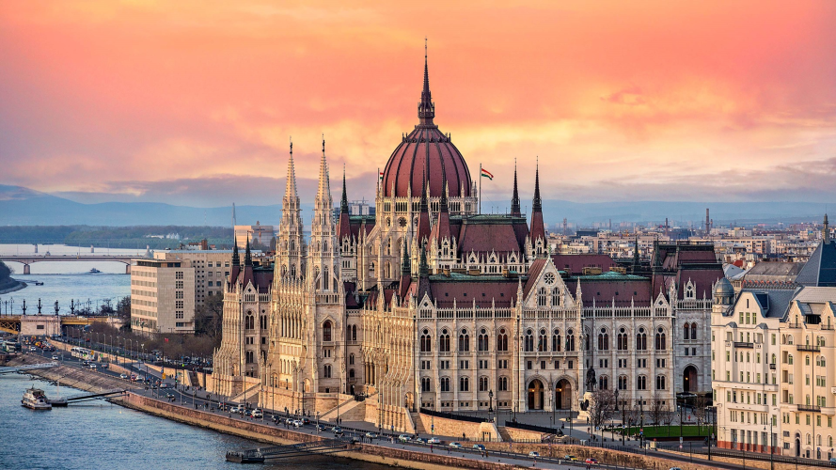
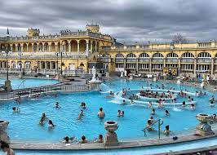
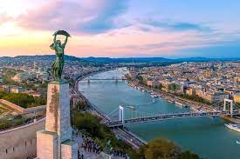
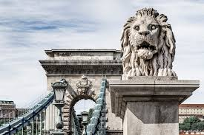
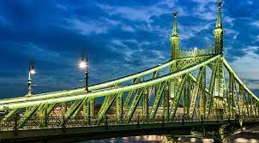
Second of all: Budapest
The capital city is Budapest and the people here are very proud of it.
Budapest have many beautifull buildings and bridges.

Slide 5
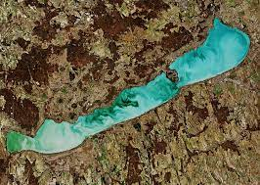
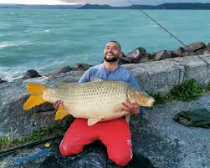
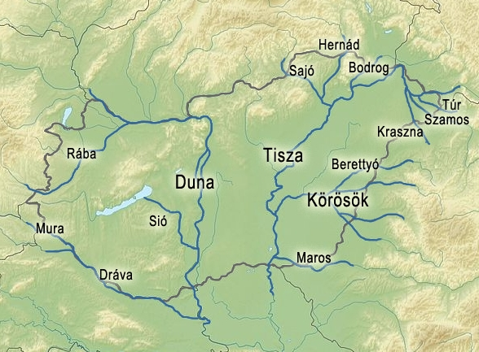
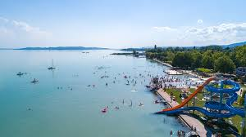
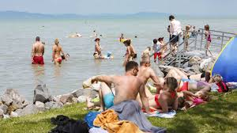
The third one is: Balaton
Balaton is the biggest lake in Hungary and we also have some rivers one of them is next to Csongrád (Tisza)
Duna
Tisza
Dráva
Maros
Körös

Slide 6
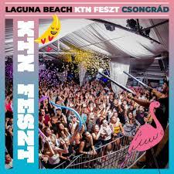
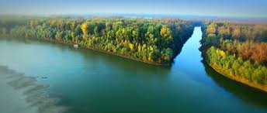
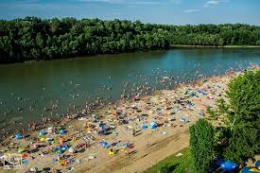
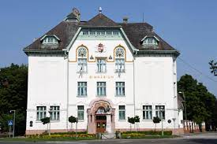
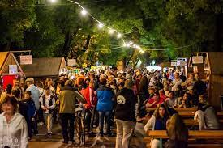
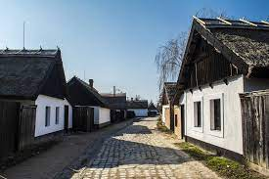
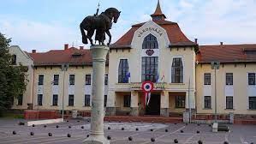
Let’s talk about Csongrád.
The population is about 17 000.
Our town is next to the river Tisza .
Körös-Torok
We also have some festivals:
-Csongrád Wine Festival,which usually lasts for 3–4 days
-Körös-Toroki Days which lasts for a week
Csongrád's traditional style house
Town hall

Slide 7
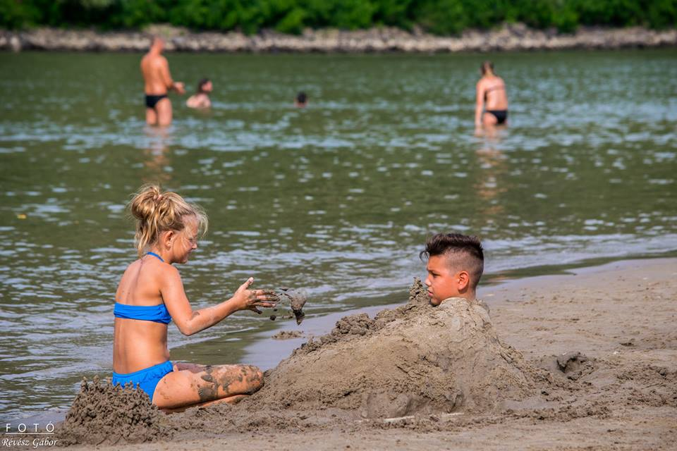
THANK YOU FOR YOUR ATTENTION!

