Slide 1
Our town - Csongrád
Made by the Hungarian team

Slide 3
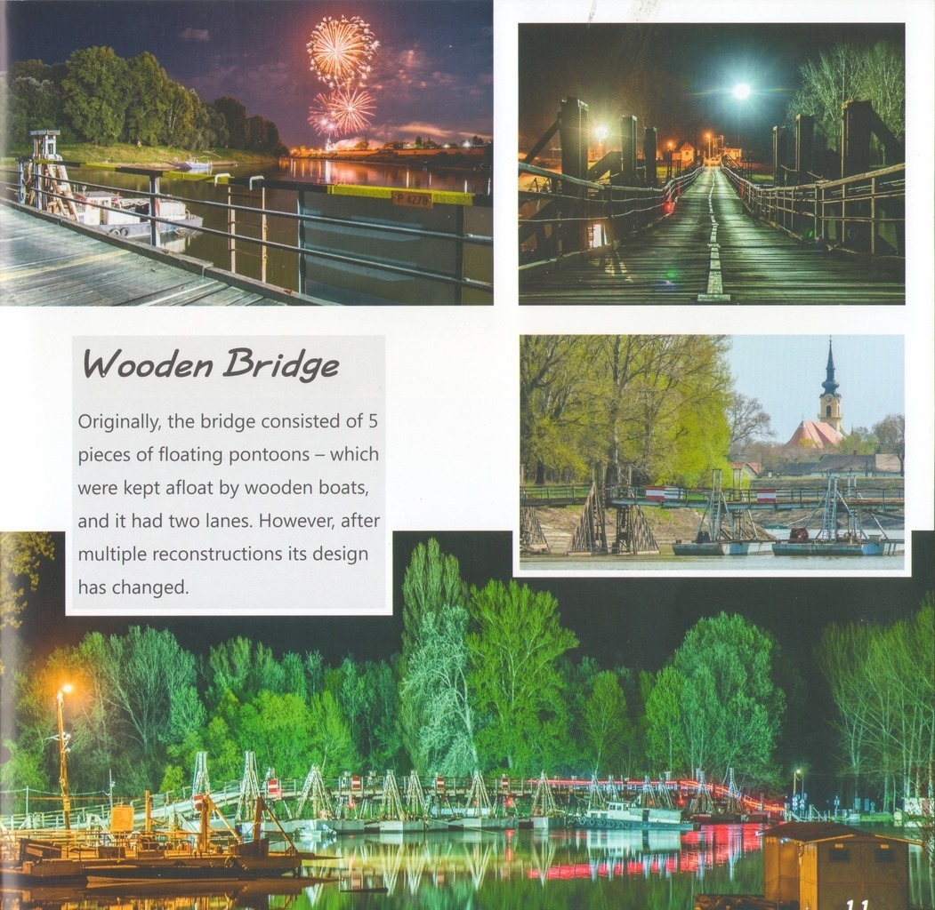

Slide 10
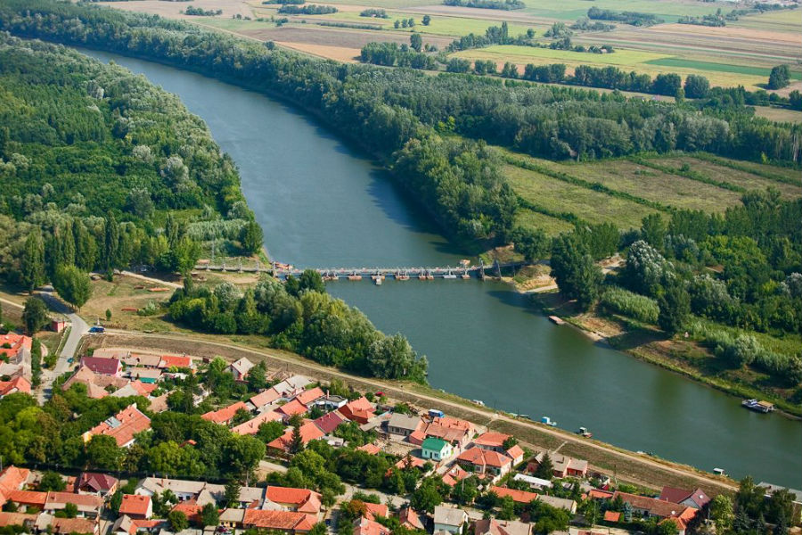
Thank you for your attention!

