Slide 1
Hungarian Easter
Made by: Maya Spinello, Zsóka Tóth, Eszter Szabó

Slide 2
Sprinkling the womenfolk
One of the most popular Hungarian Easter traditions is locsolkodás, loosely translated at 'sprinkling the womenfolk', practised in town and countryside. On Easter Monday, boys are allowed to sprinkle girls with water or perfume – traditionally, a bucket of water is thrown on them! They get some treats in return. To earn their treats, men must also recite a locsoló verse, wich is a slightly humorous poem.

Slide 3
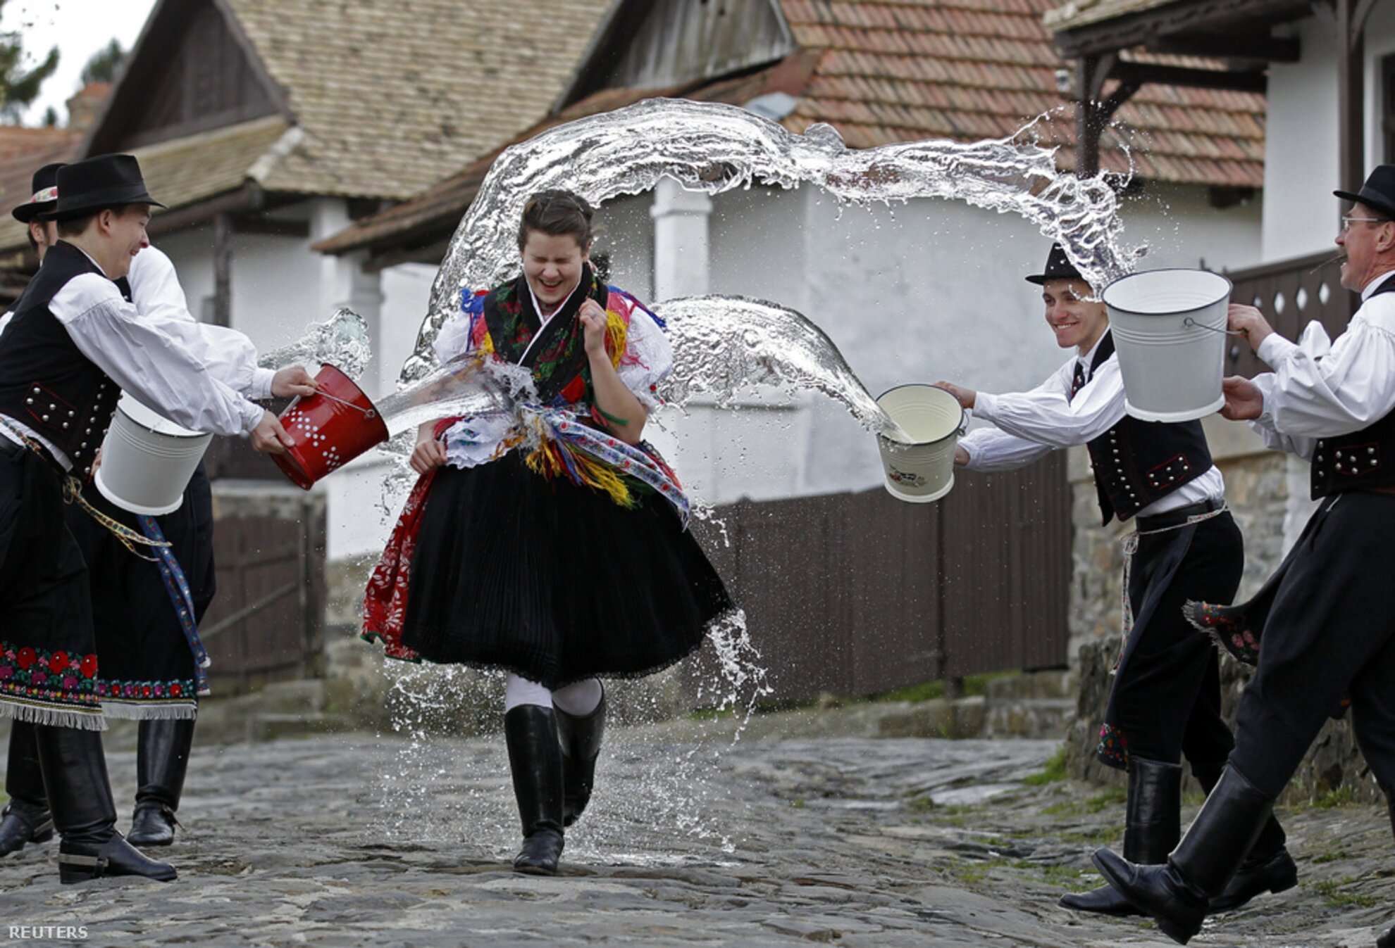
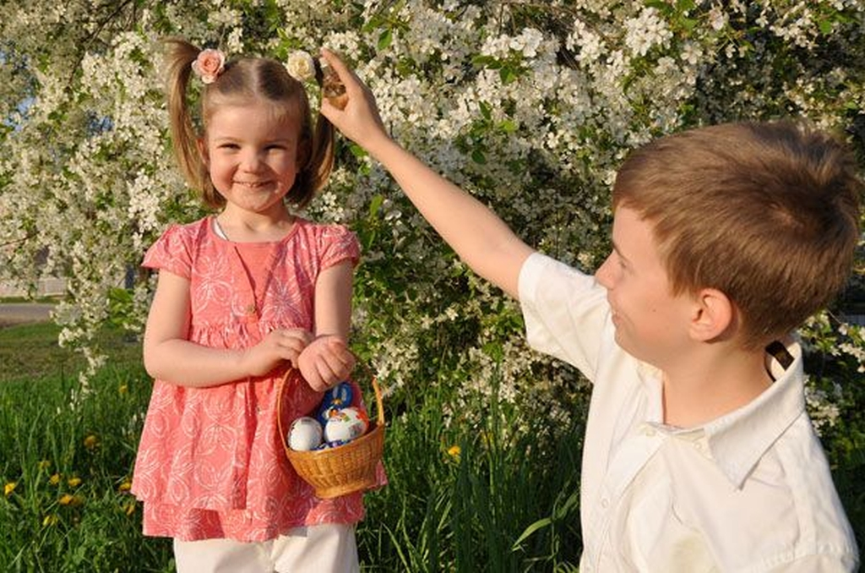
Sprinkling the womenfolk

Slide 4
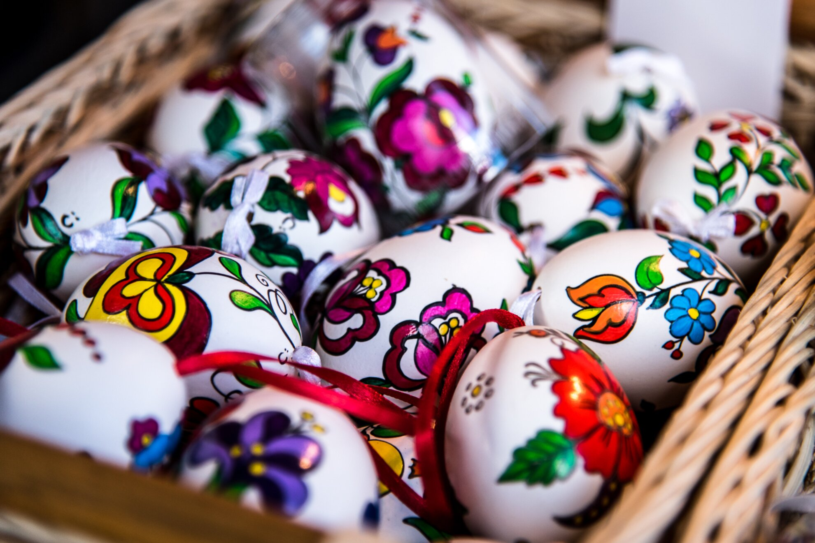
Painting eggs
Egg-painting is a common Easter tradition around the world, and Hungary is no exception. Hungarian Easter eggs are decorated with simple geometric shapes or ornamental swirls.

Slide 5
Traditional food
Traditional Easter meals in Hungary involve ham, boiled eggs and braided loaves called kalács, pickled horseradish and lamb. This was a time when the long fast for Lent was being broken, so a rich meal was part of the celebration. For those following Christian examples, Good Friday is customarily a time to eat fish, saving the meat for Easter Sunday.
Of course, the modern age has brought delicious chocolate eggs as part of the Easter menu, as well.

Slide 6
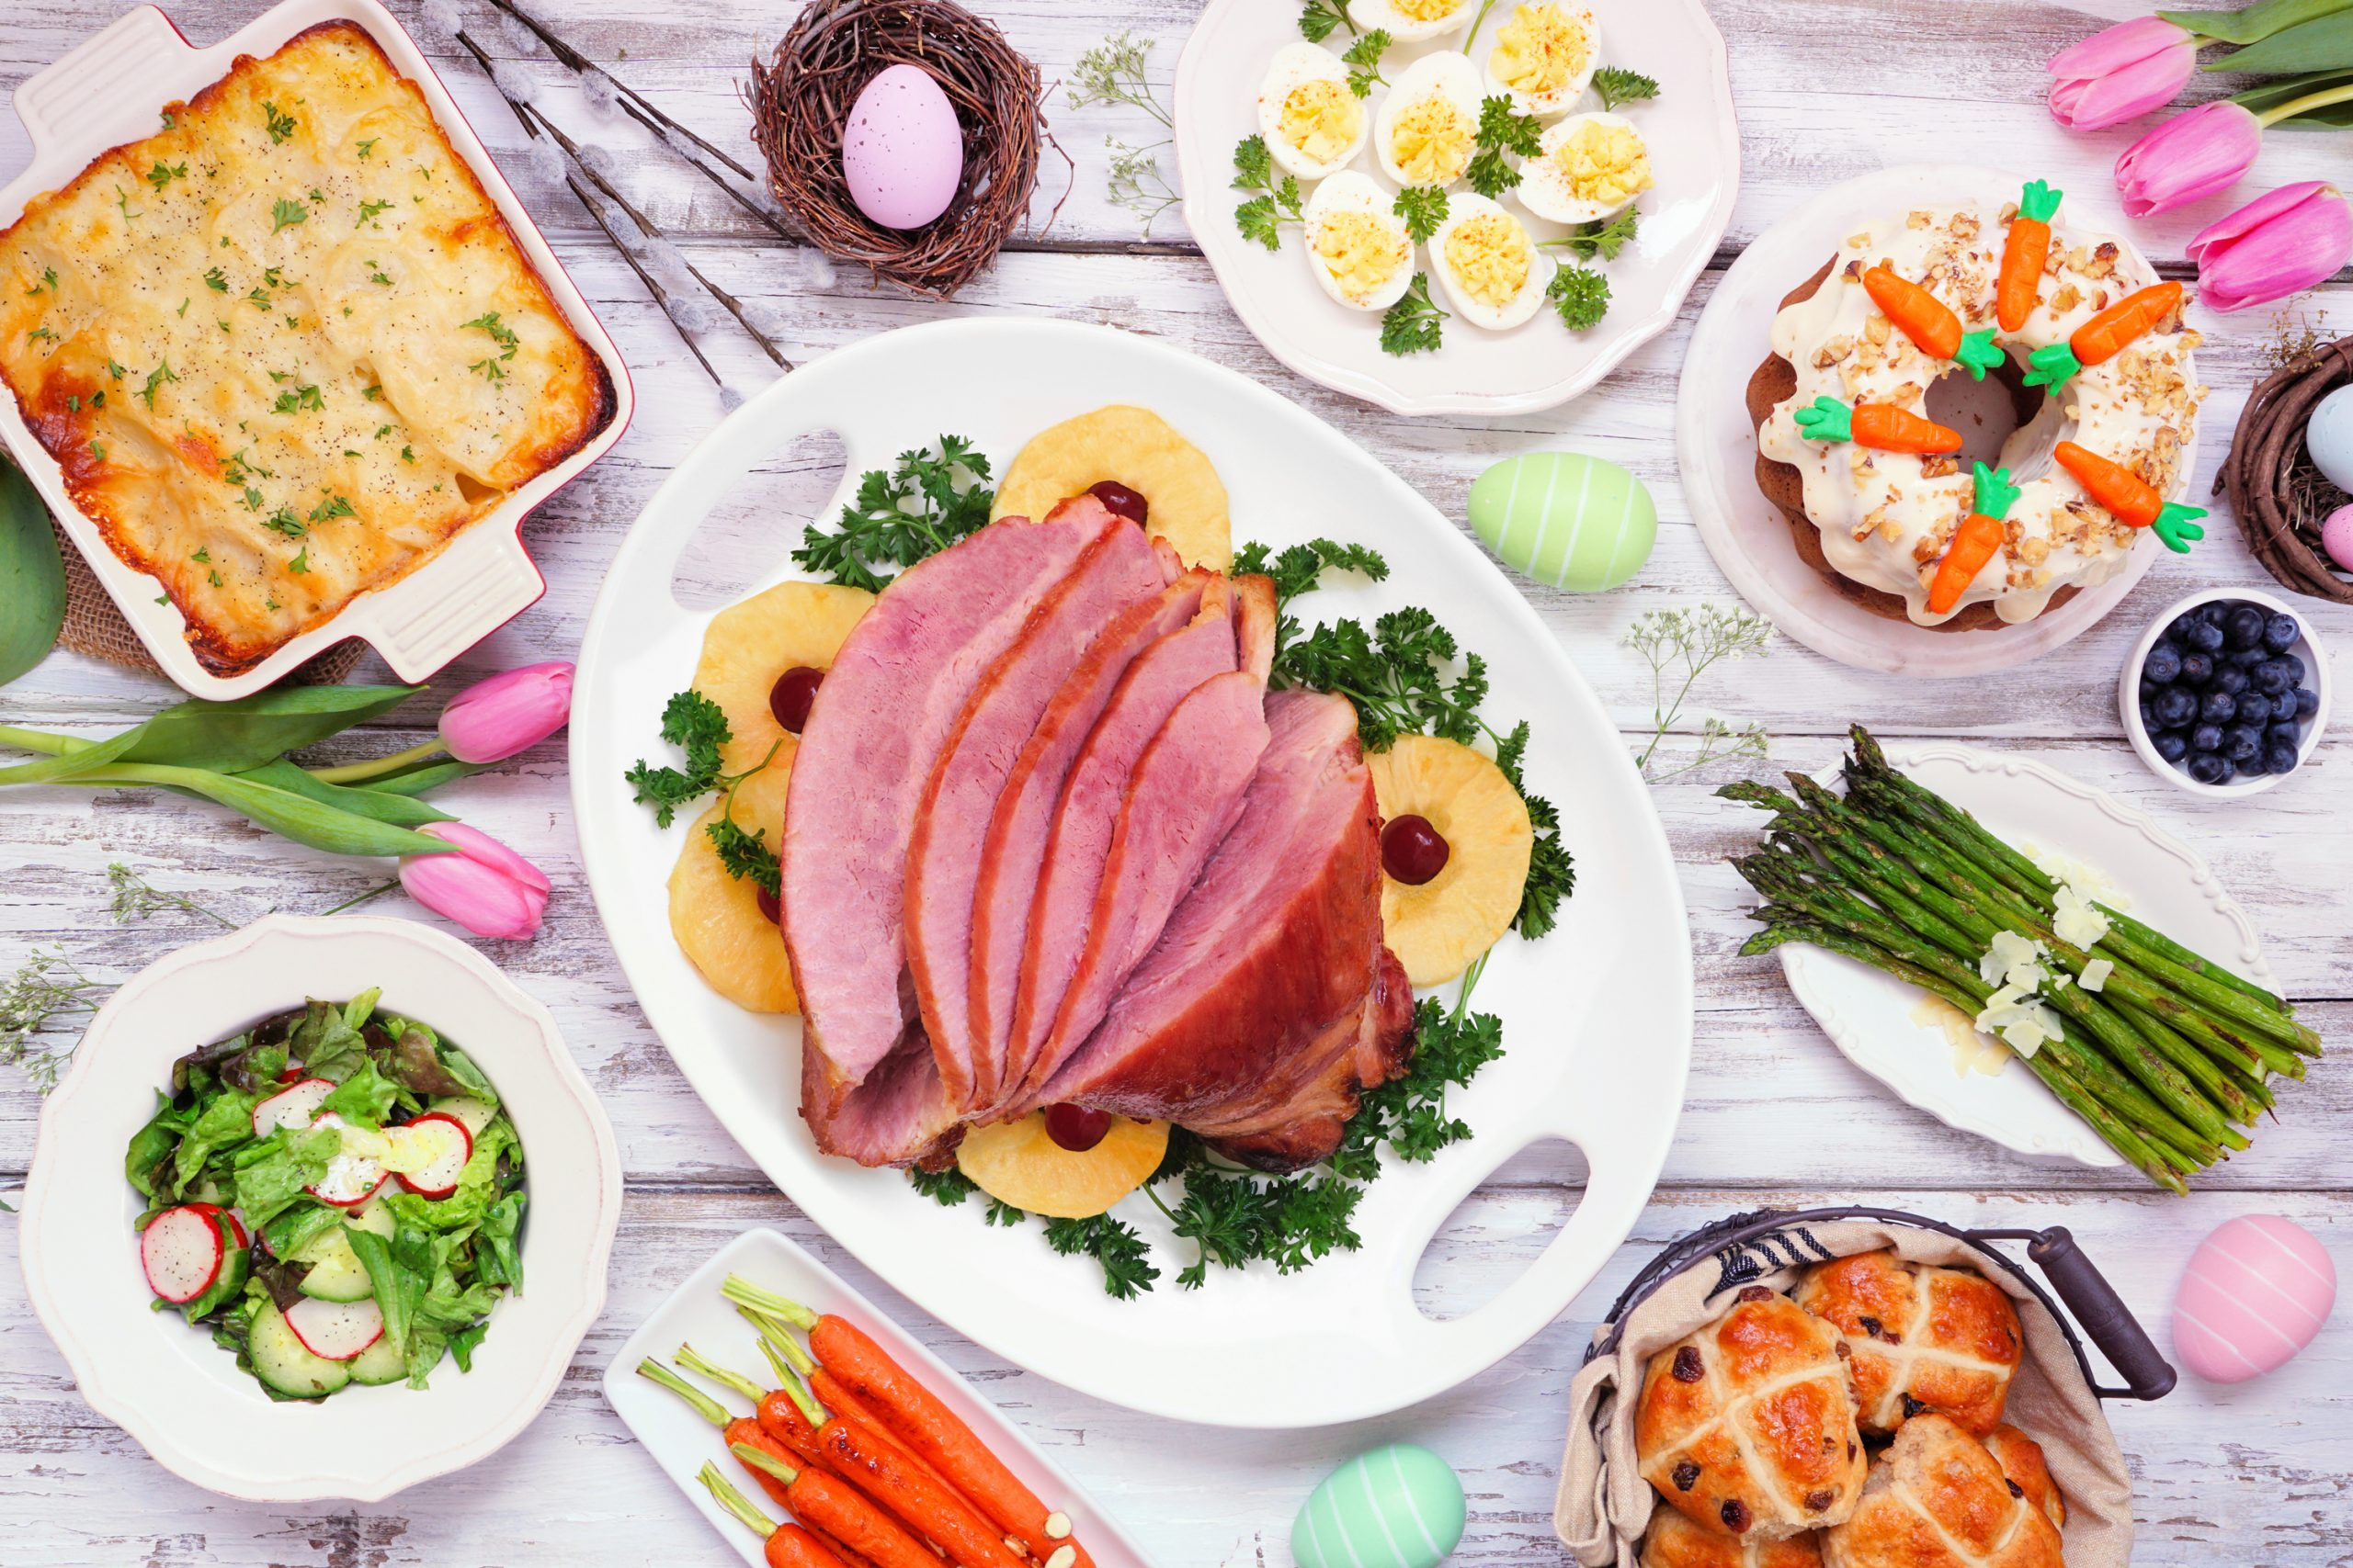
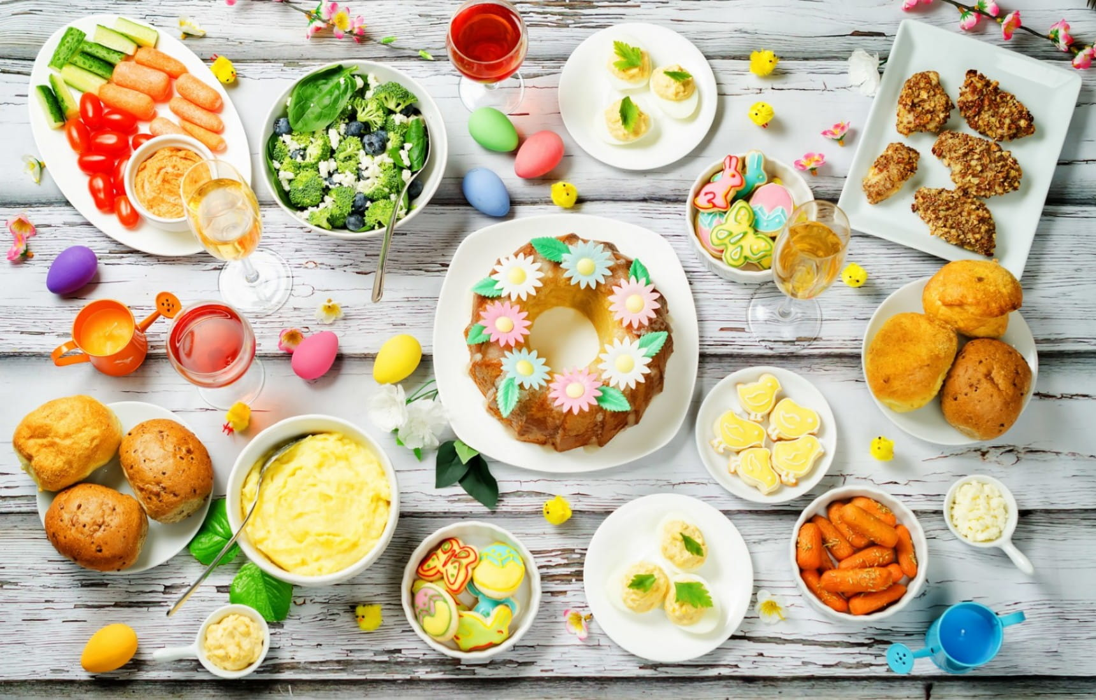
Traditional food

Slide 7
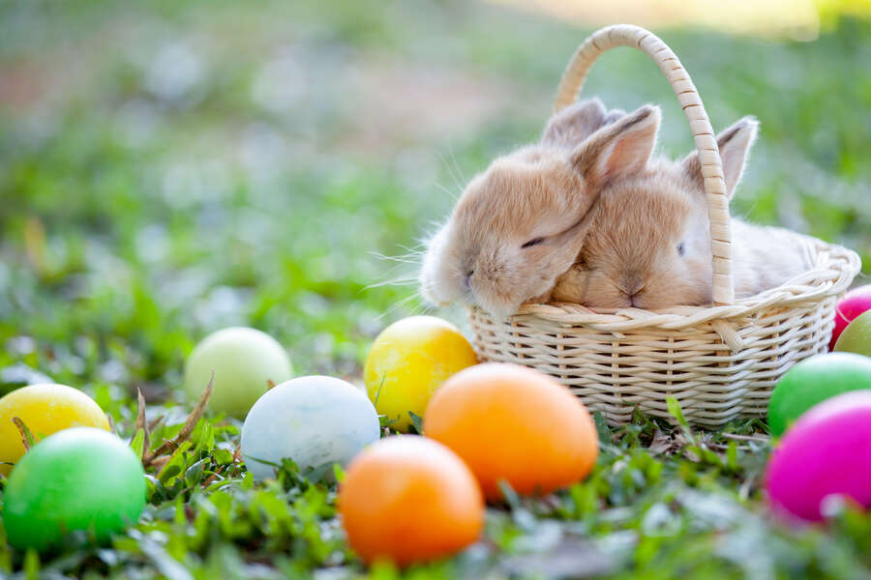
Easter bunny
The Easter bunny is the children’s favourite because of the delicious treats he leaves behind, and the thrill of the Easter Egg Hunt.
Painted eggs, chocolates and other sweets are hidden around the garden for children to find on Easter Sunday morning.

Slide 8
THANKS FOR YOUR ATTENTION!!

