Slide 1
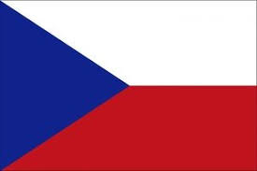
The Czech Republic

Slide 2
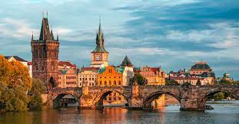
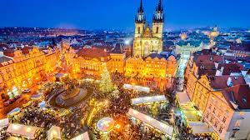
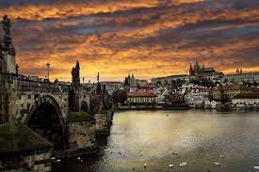
Capital City
-1 335 084 people live there
-it has the area of 496 km2, it makes it the biggest city in the Czech Republic
-It´s one of the most beautiful cities in Europe
-In 2017 8 500 000 tourists visited Prague, so it is the 5th most visited capital city in Europe
-Prague has a lot of awesome monuments, for example Astronomical clock, the Old Town Square and Charles Bridge

Slide 3
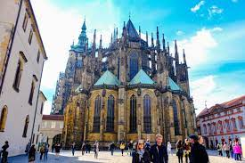
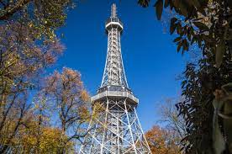
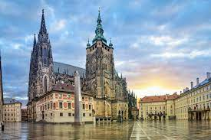
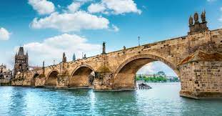
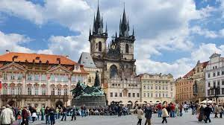
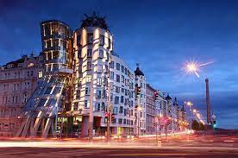
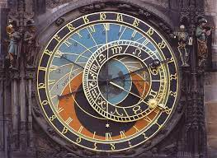
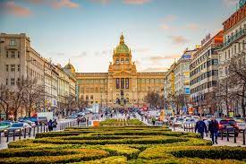
Monuments of Prague
-Prague castle
-Petřín Lookout Tower
-St. Vitus Cathedral
-Charles Bridge
-the Old Town Square
-Dancing House
-Old Town Astronomical Clock
-Wenceslas Square
Kliknutím vložíte text.

Slide 4
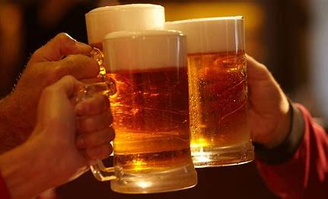
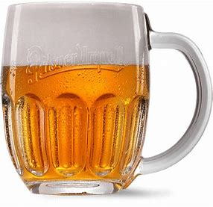
Beer
-One of the thing Czechia is known for is of course beer
-the oldest proved place in the CR where beer was brewed is Břevnov monastery and it is from year 993
The most famous breweries and TMs are Pilsner Urquell, Gambrinus, Velkopopovický Kozel, Budvar and many others
An average person older then 18 years drinks on average 135 litres every year (1 444 500 000), which is the most in the whole world

Slide 5
Vodňany
-7 000 people
- „If there were no fish Vodňany wouldn‘t exist“
- schools
-Church of the Nativity of the Virgin Mary built in 1327, repaired in 1734
Writers František Herites and Julius Zeyer and a painter Otakar Mokrý

Slide 6
Our school-Gymnázium Vodňany
Our school is divided into 3 districts „the old school“
„the new school„
„Výstavní“

Slide 7
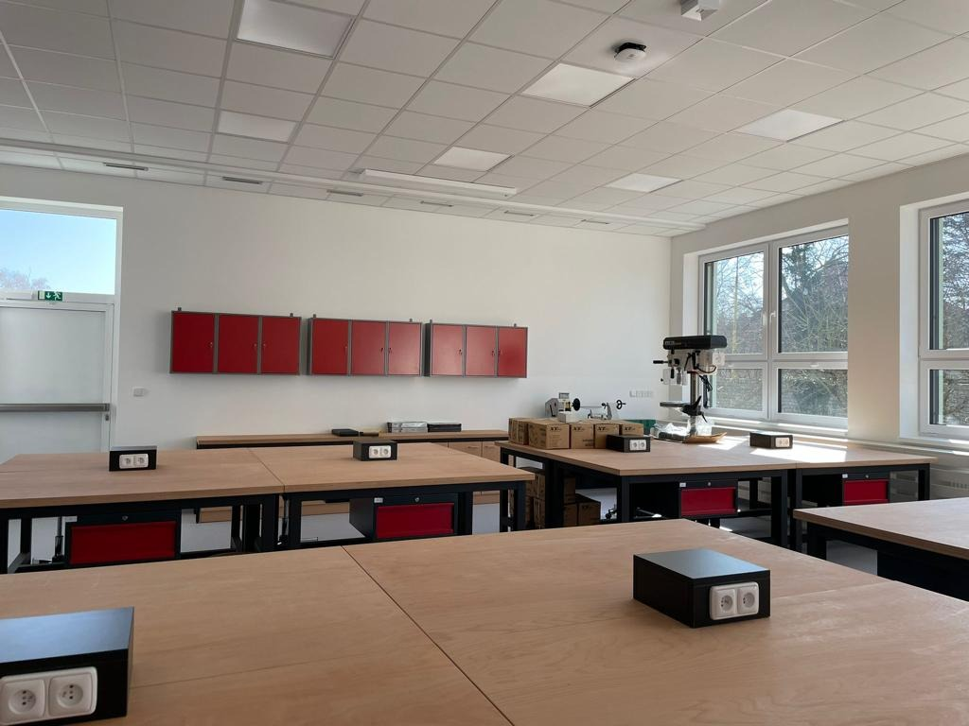
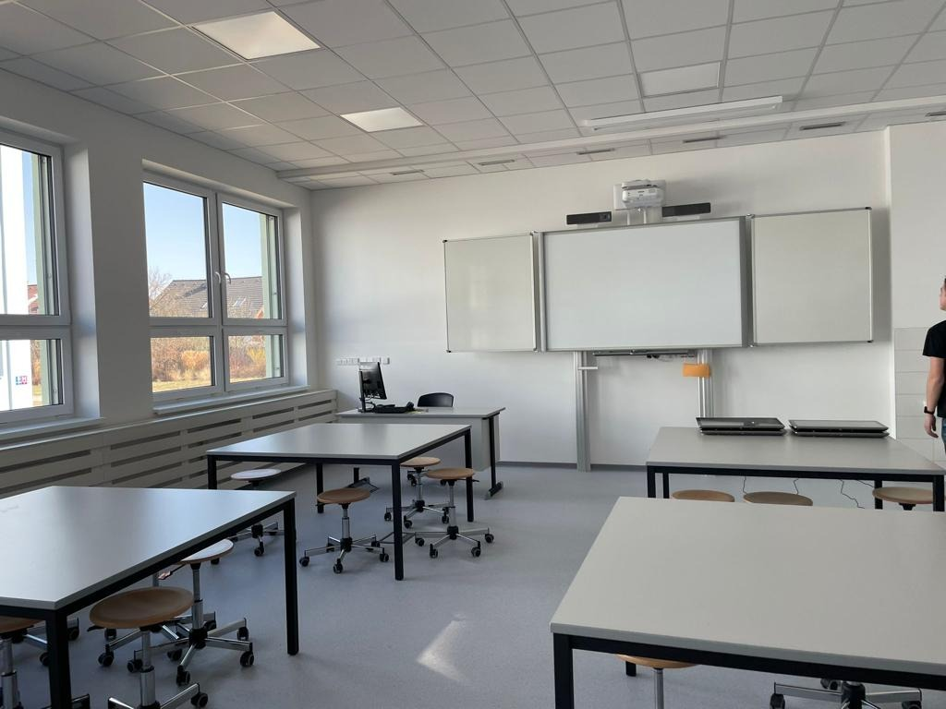
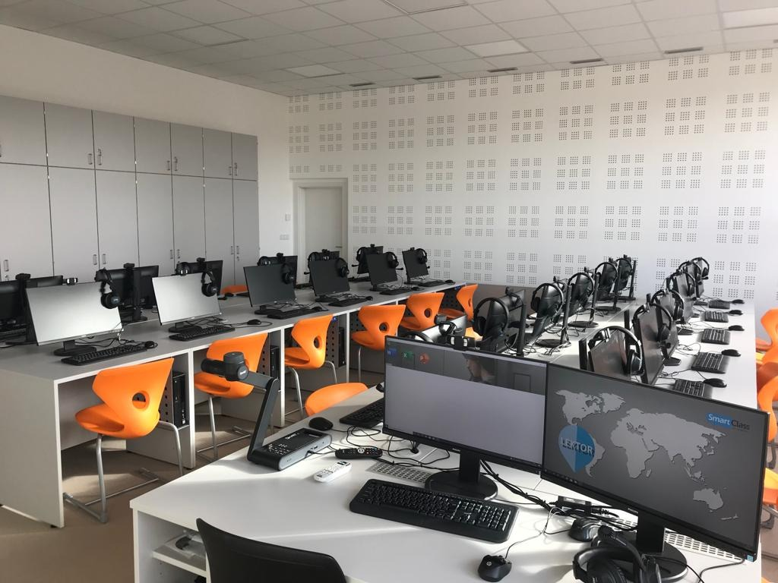
The grammar school
Although the school is located in a small town with the commitment from the teachers and hard work we have managed to make really high quality school
The students have a lot of opportunities to improve and practice languages with the projects like this one, we have great environment modern technologies and specialized class rooms and with the recent addition of a new building it gets even better
And also the teachers try their best get the best out of us so it is not surprise when some of our student succeed in any kind of kompetitions where we compete with school from way bigger towns

Slide 9
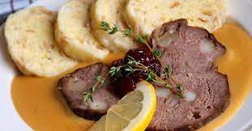
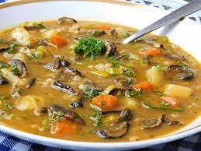
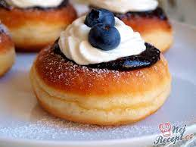
Traditional food
Svíčková (sirloin)- vegetable cream sauce with beef
Vepřo-knedlo-zelo -pork dumplings and cabbage
Mushrooms soup (soup made from mushrooms)
Garlic soup (soup made of garlic)
Vdolky- sweet dough stuffed with jam.

Slide 10
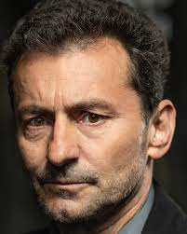
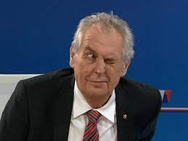
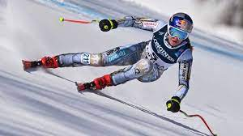
Famous people
Actors: Ondřej Vetchý, Zdeněk Svěrák
Singer: Karel Gott, Ben Cristovao and Olga Lounová
President: Miloš Zeman
Sport: Jaromír Jágr (hockey player)
Ester Ledecká (skier, snowborder)

