Slide 1
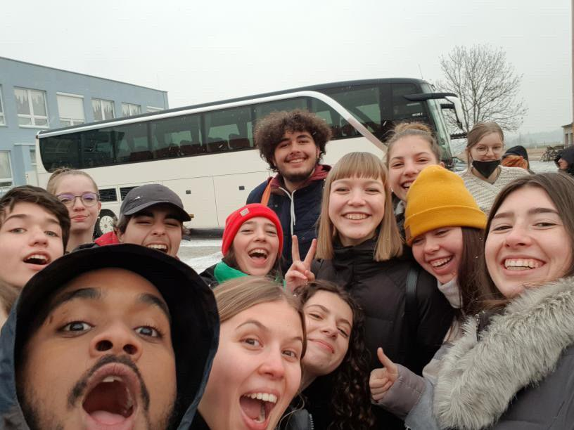
Acting for a better Europe
Travelling to the Czech Republic

Slide 2
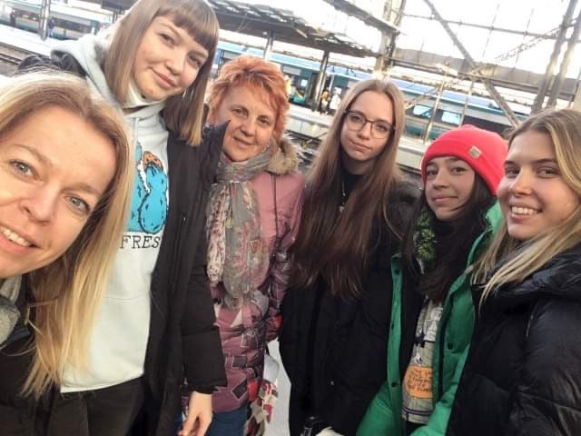
Introducion
In the framework of the 'Acting for a better Europe' Erasmus + program, two teachers from our school (Ágnes Leirerné Katona and Mónika Pataki) and four students (Nina Tonomár, Szilvia Puskás, Sára Tóth, Lotti Vig) travelled to the Czech Republic to attend the fourth international meeting within the project.

Slide 3
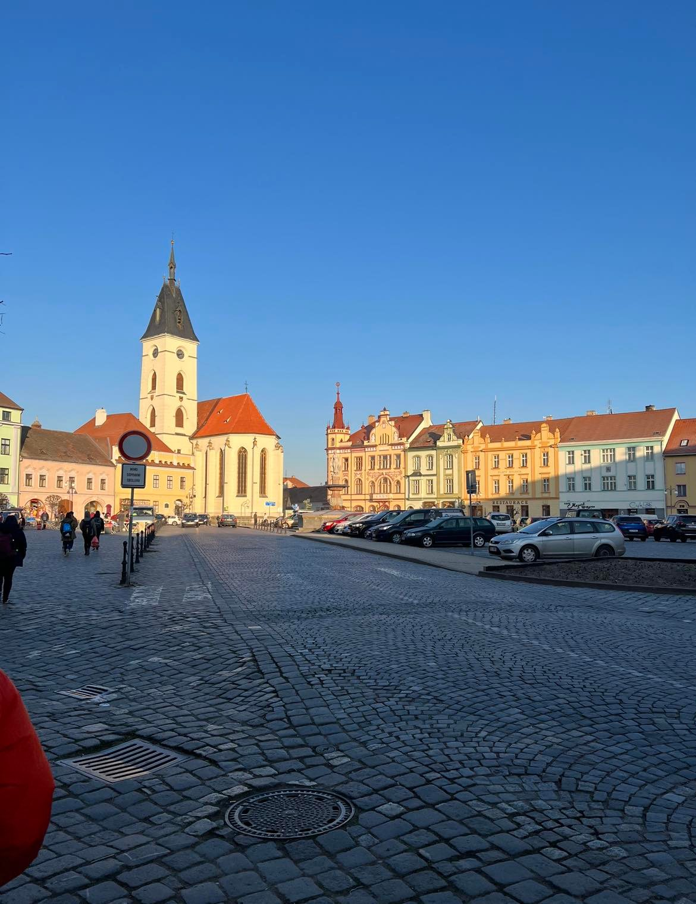
Monday and the night before
We met the host families as early as we arrived and got to know each other a bit. We started the day on Monday morning with presentations about the countries, and then we played ‘ice-breaking’ games in different groups, so we had the chance to memorise each other's name and favorite free time activities. Even that evening the host students took us to a bowling alley in a local restaurant where everyone had fun.

Slide 4
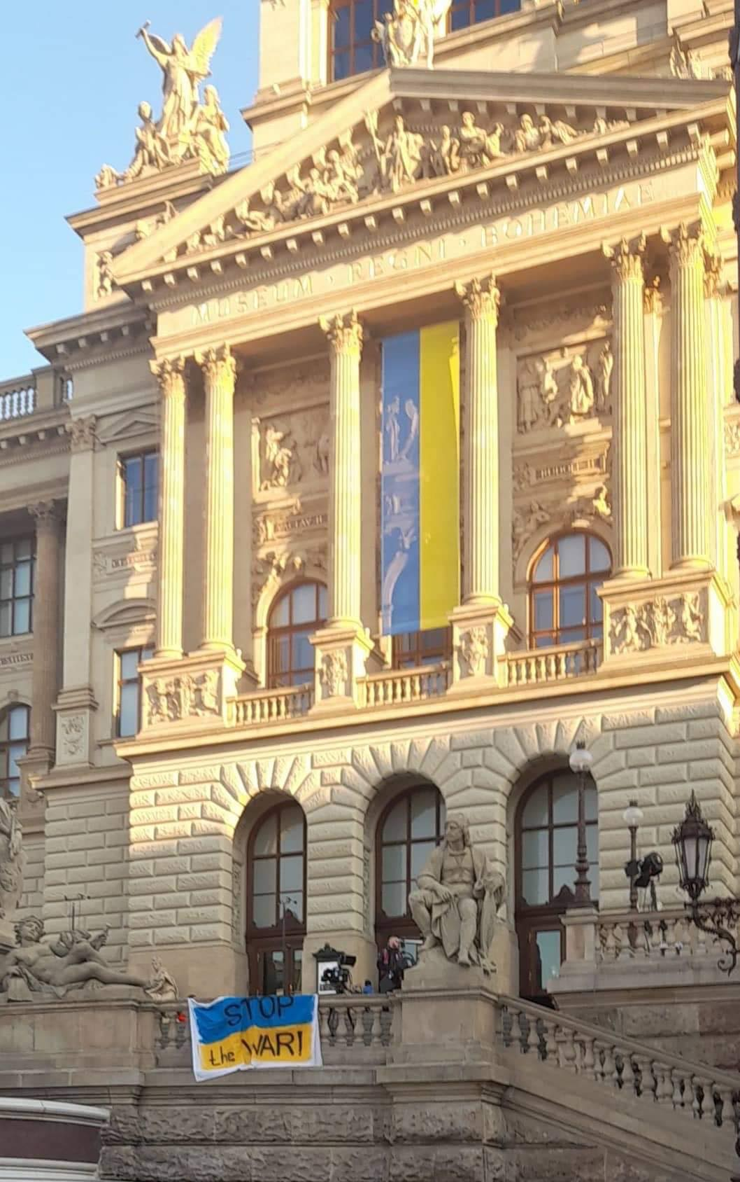
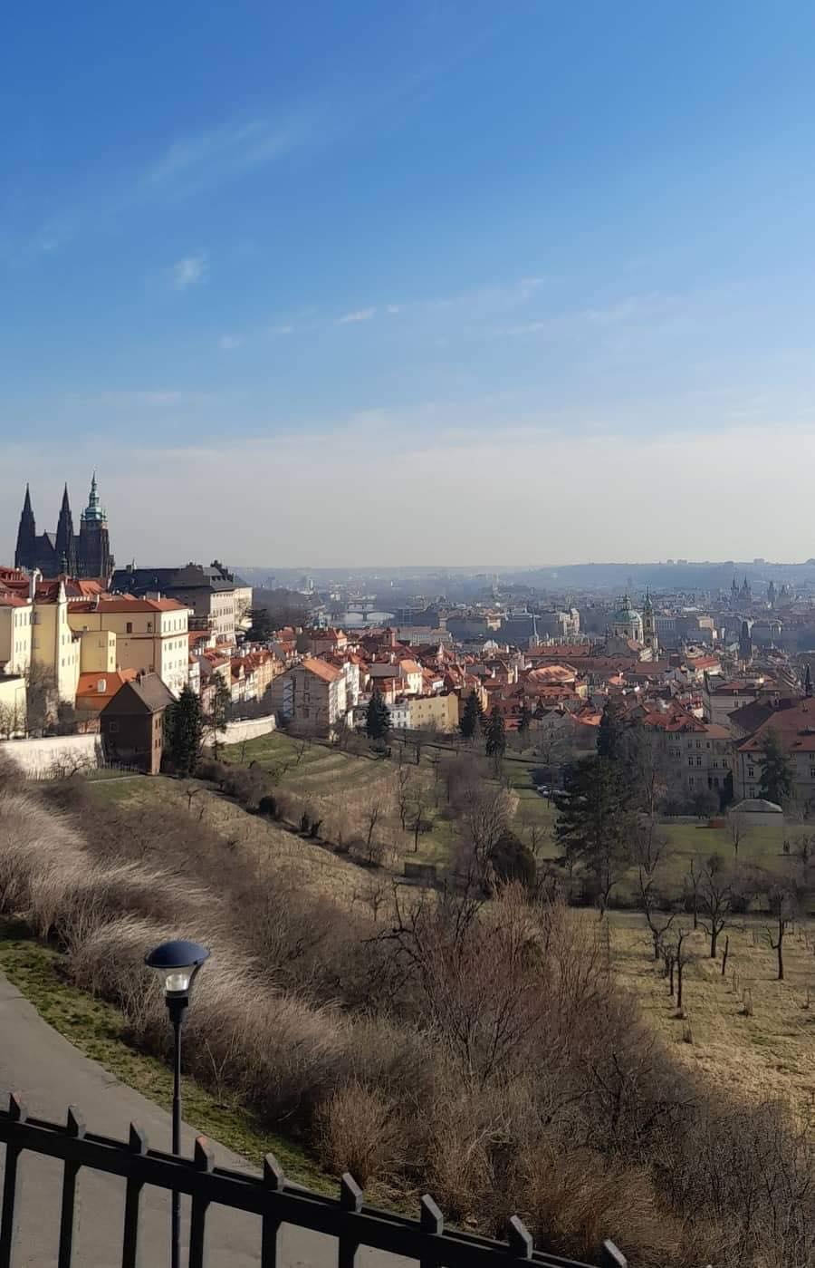
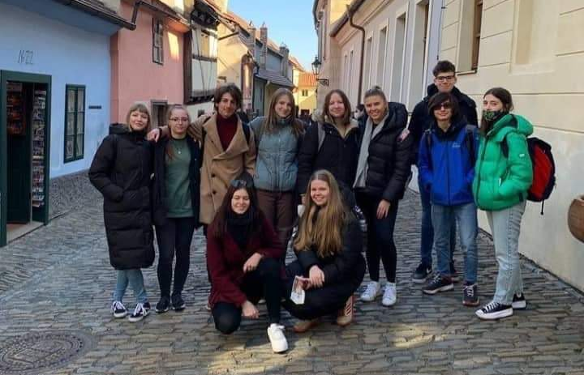
Tuesday
We spent the whole day in Prague on Tuesday. A tour guide led us through the city, showing the sights of Prague. We were also in the palace, where we could observe the church from the inside. We were then taken to a square where we had some free time.

Slide 5
Wednesday
Wednesday morning we formed mixed groups and each team was given different tasks to do. We were taken to the local fishing school in the afternoon and also visited the Puppet Theatre where we performed a well known story called Beet Tale together. In the evening we went to Písek for a laser fight. Even if not everyone was completely familiar with it, we all enjoyed the fight.

Slide 6
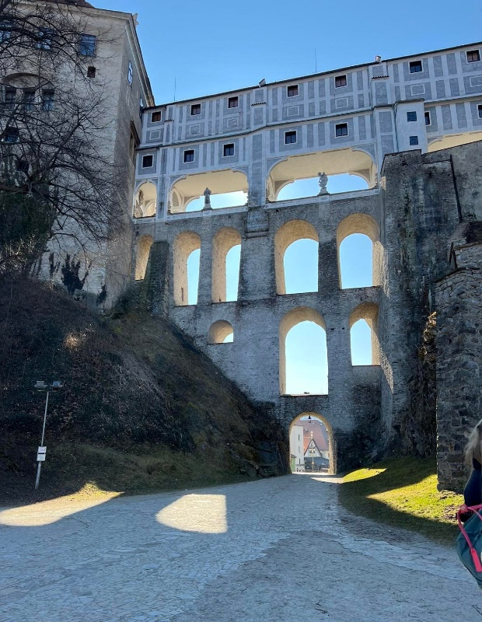
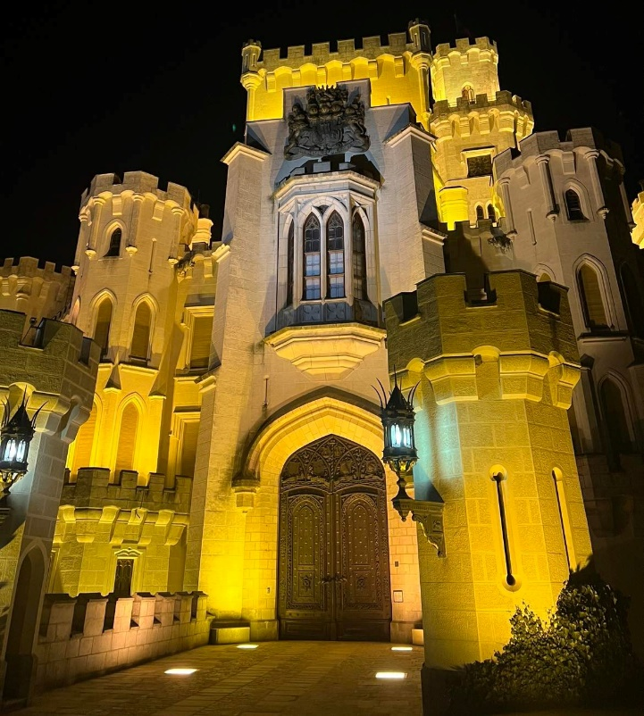
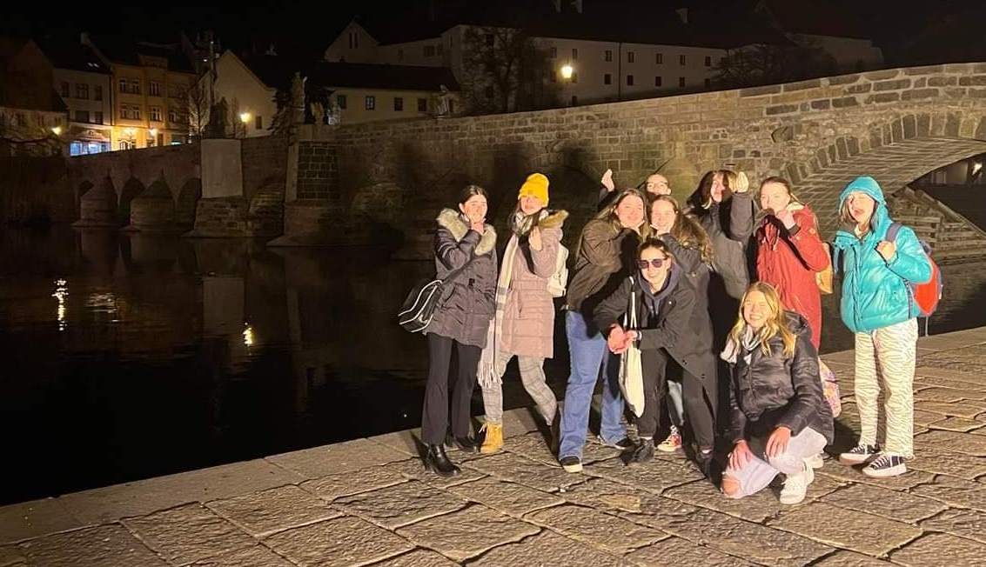
Thursday
We went on a one-day on Thursday. First we visited the Planetarium, then we went to Cesky Krumlov. We went on a guided tour of the historic city, then we also toured the city’s convent.

Slide 7
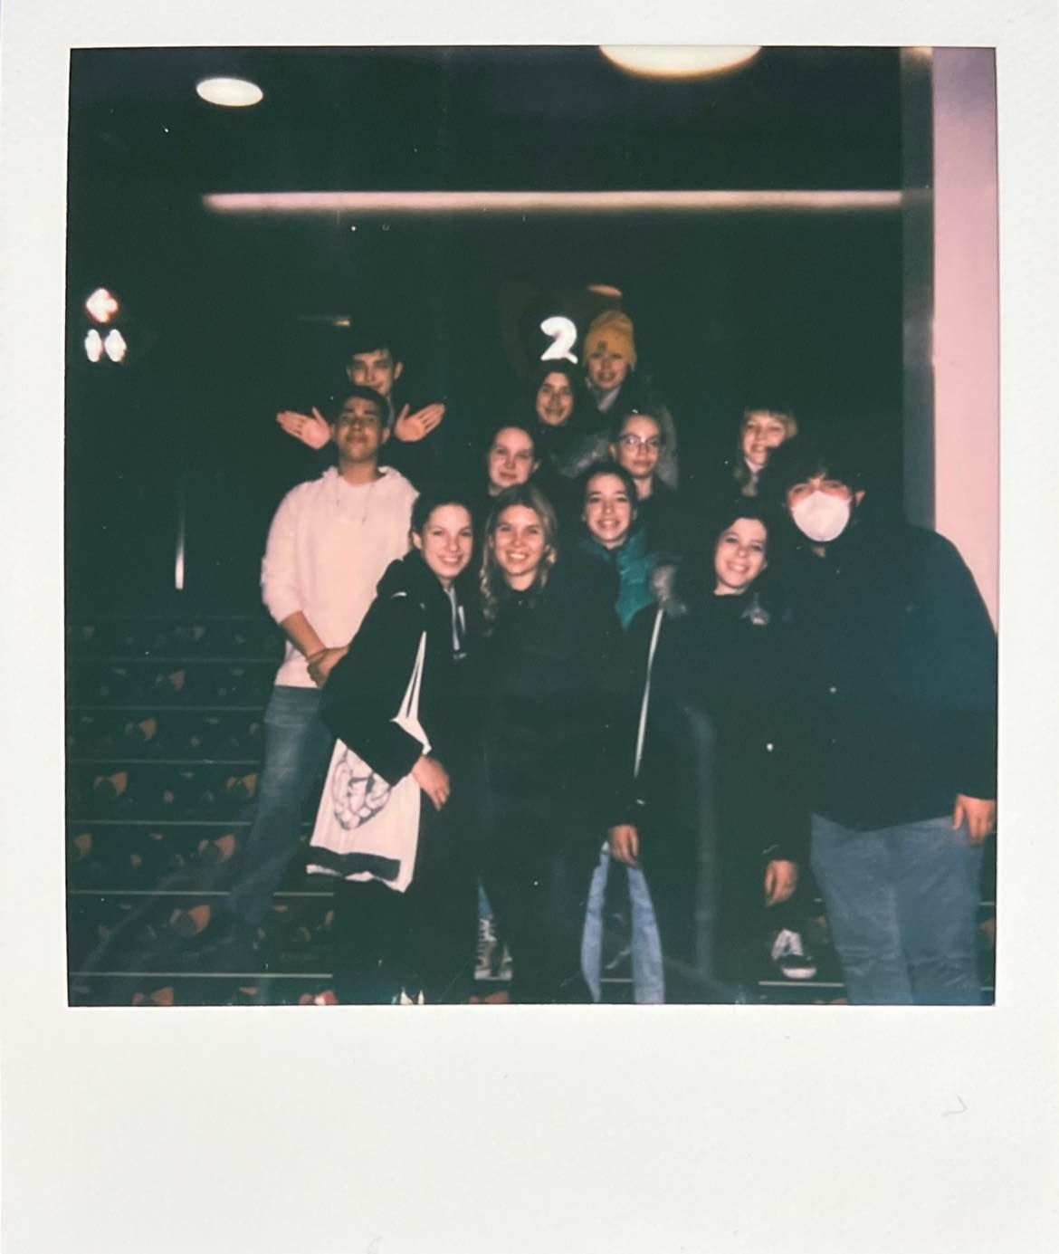
Friday
We continued the group work on Friday, which we presented later in the afternoon. In the evening we went to a cinema to watch Death on the Nile, which surprised everyone with its unexpected twist.

Slide 8
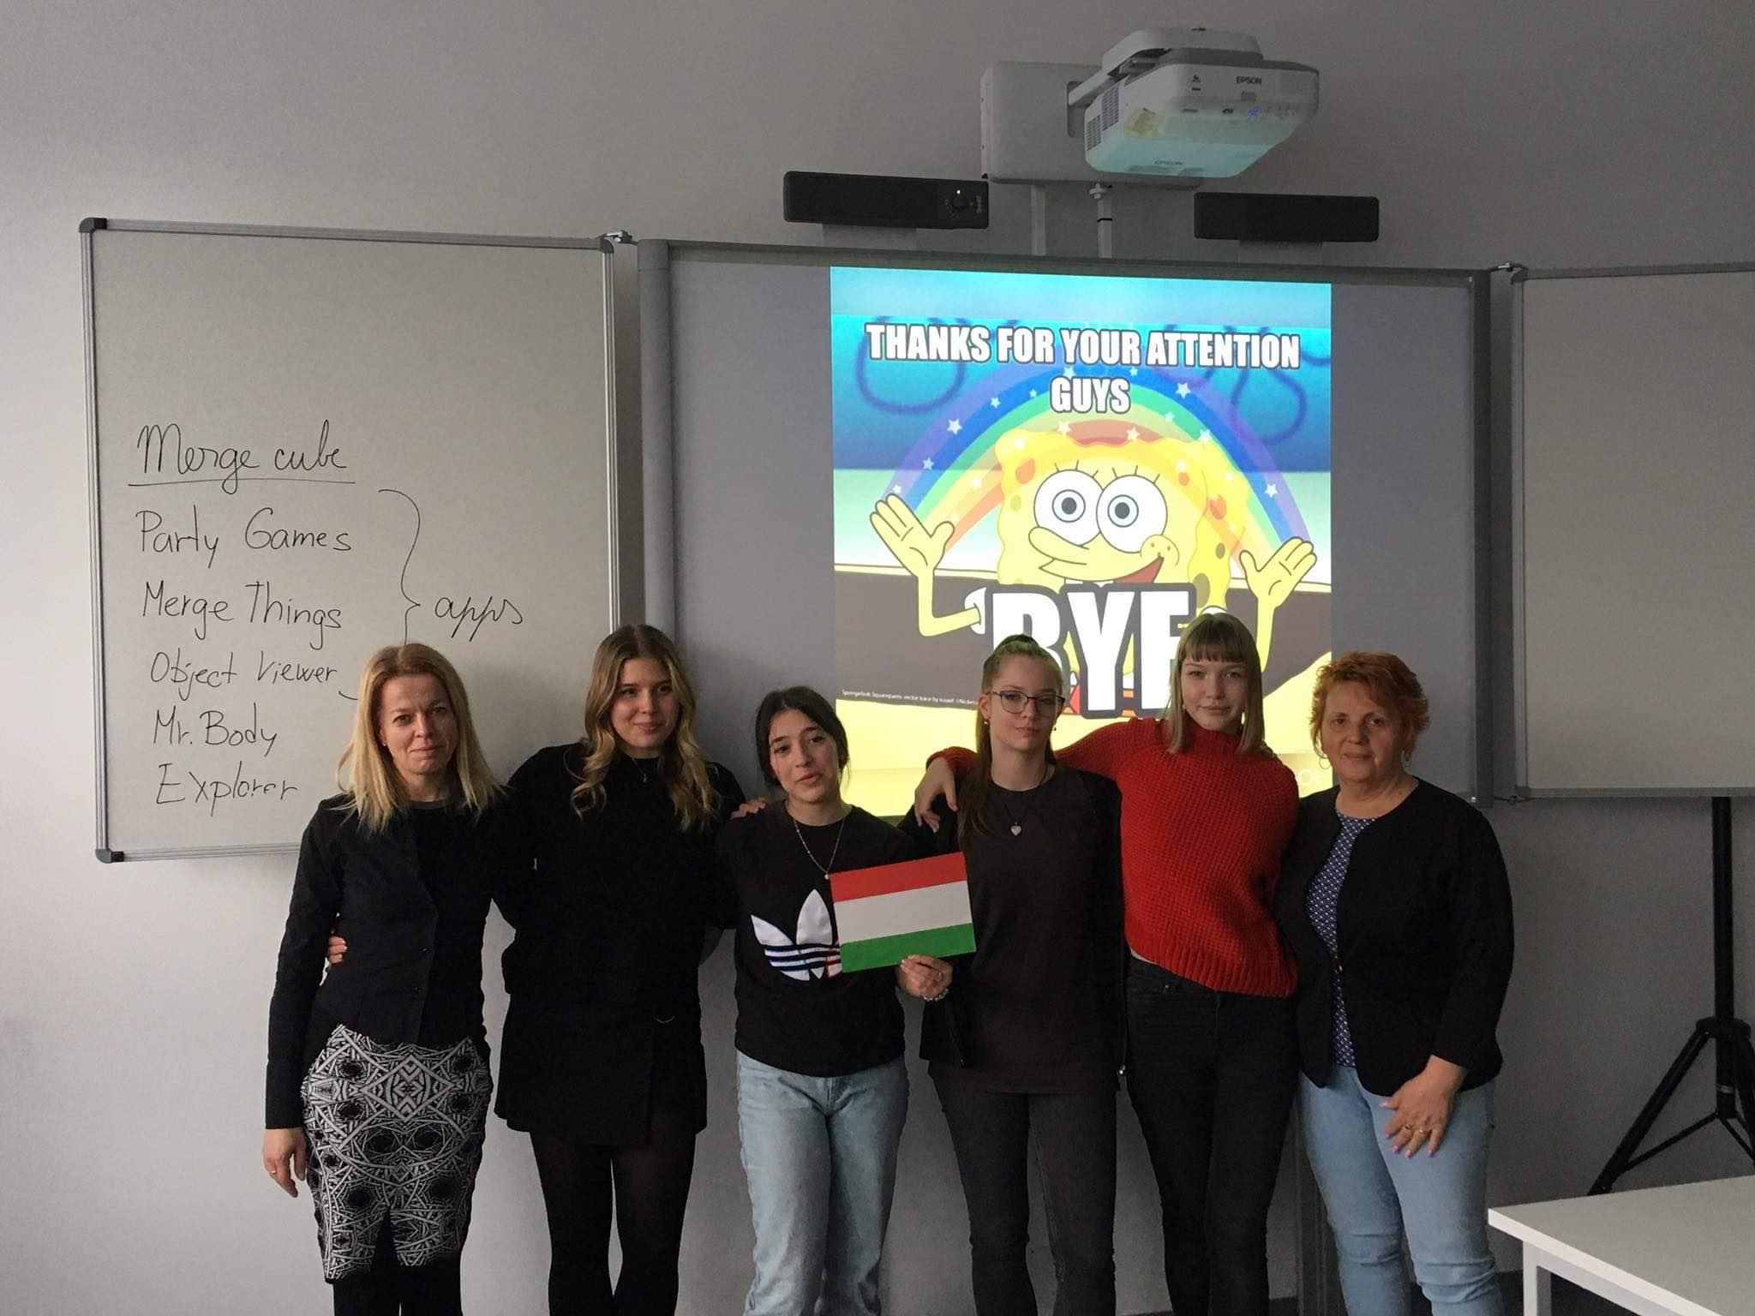
Final words
All in all, the whole program was very enjoyable. We met many new people and made many new friendships. On behalf of all of us, I can say that every program was fun, we gained a lot of experience and knowledge during the week we spent there.

Slide 9
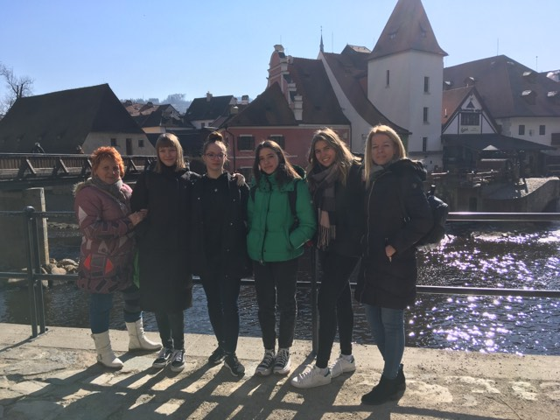
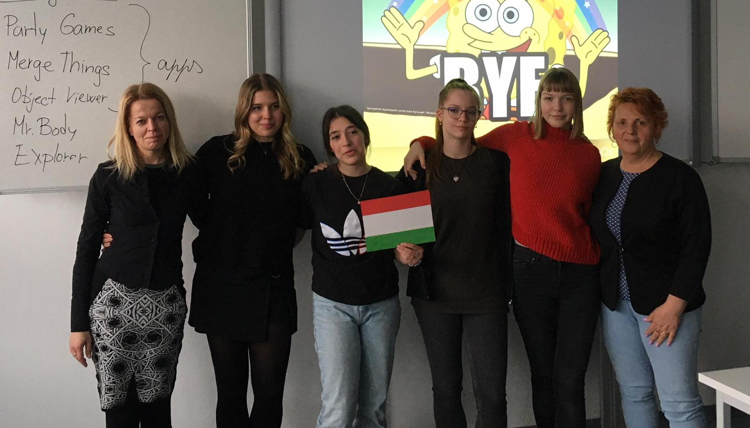
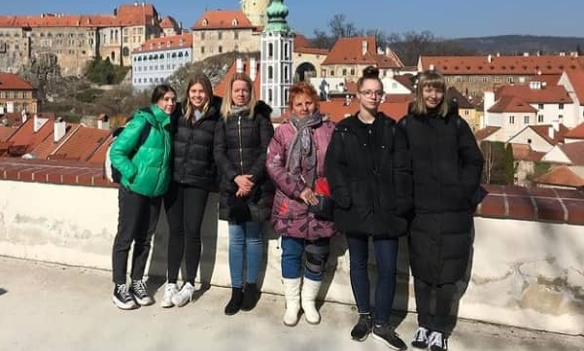
Thank you for your attention!

