Slide 1
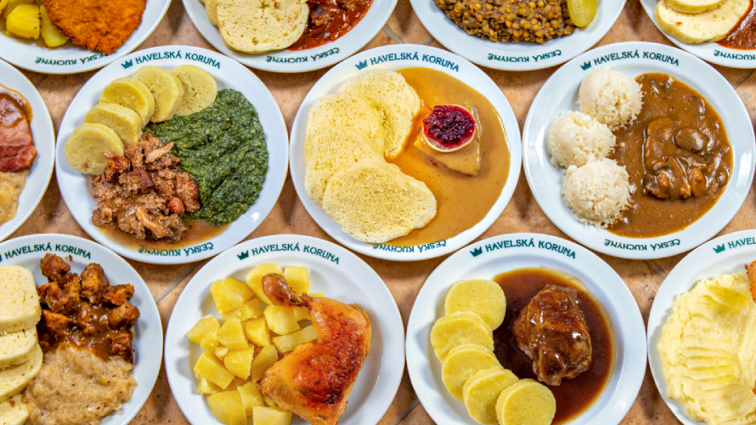
Czech cuisine

Slide 2
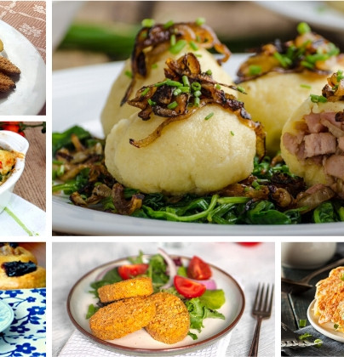
Czech cuisine
For czech cuisine are typical thick soups a many kinds of sauces
Base is often cooked vegetables, cream and roast meat
We also have many kinds of cakes and pastries that are popular in Central Europe
Czech menu usually consists of two or more courses – first is soup, then main dish and dessert

Slide 3
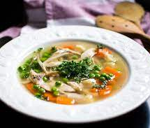
Soups
Important part of Czech cuisine and traditional catering are soups
Some soups are served as a main dish with pastries
Some traditional Czech soups: lentil soup, rice soup, gralic, potatoe soup, cabbage, noodle soup and Hokkaido pumpkin soup (my favourite)

Slide 4
Main dishes
Meals dominated the main dishes
Mainly pork, beef and chicken
An important part of main dishes are sauces
Rice, potatoes, pasta and Czech speciality dumplings are used as a side dishes to meat

Slide 5
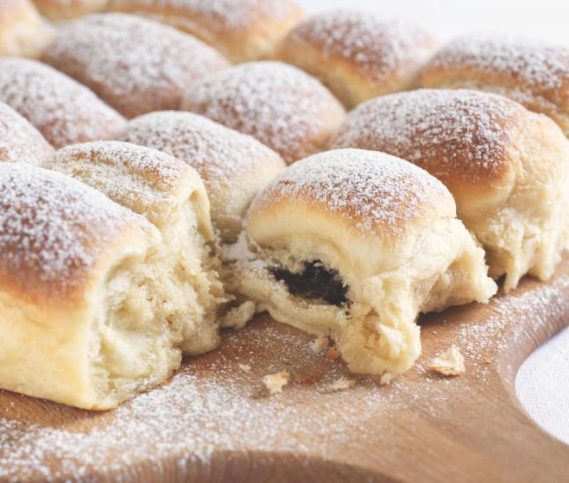
Dessert
Frequent dessert are cakes
Are made from different kinds of dough with filling or covered in chocolate
Some desserts: pitcher buns, strudel, blueberry pie, honey cake

Slide 6
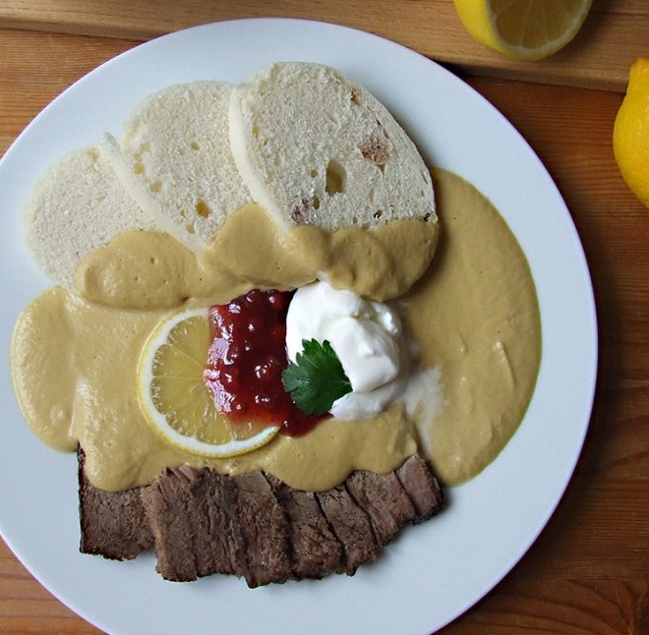
Typical Czech dishes
Dumplings, roasted pork and sauerkraut
Vegetable sauce with dumplings
Beef in tomato sauce with pasta
Sweet dumplings
Fried cheese and fries with tartar sauce
Goulash
Mincemeat with potatoes

Slide 7
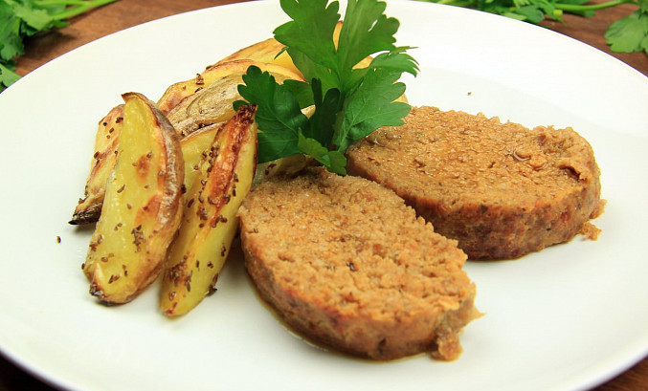
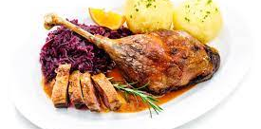

Slide 8
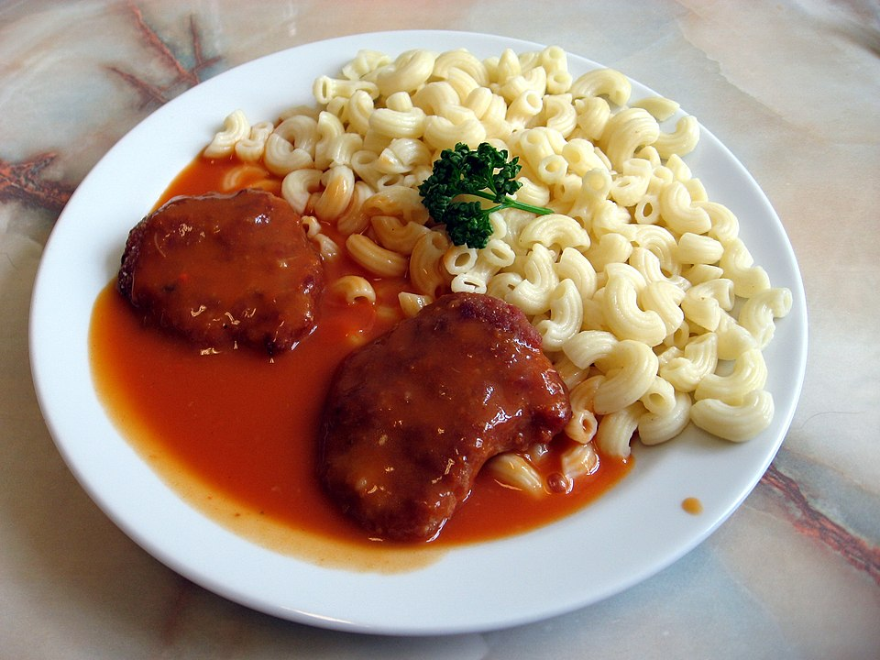
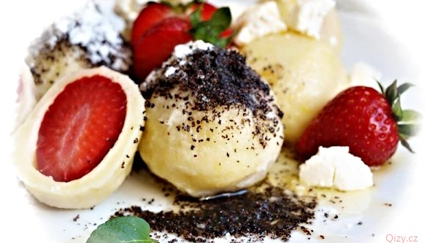
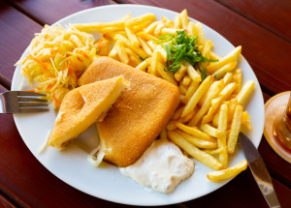

Slide 9
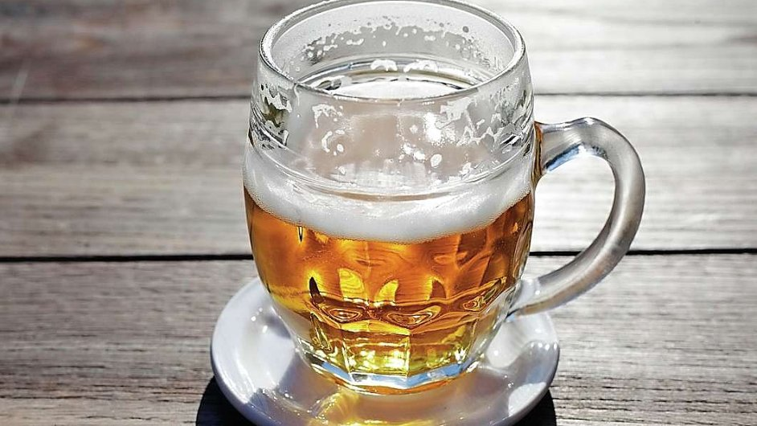
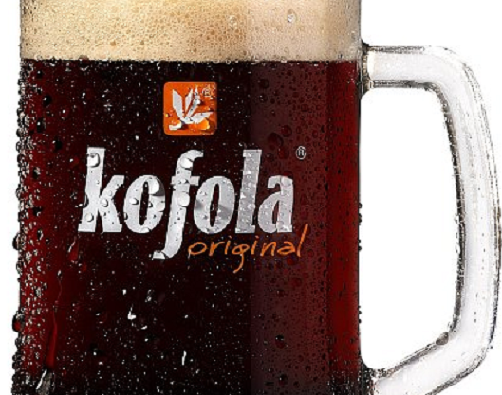
Drinks
Beers: Pilsner Urquell, Budweiser Budvar, Platan
Kofola – original Czech limonade, better Coca-Cola
Mattoni

Slide 10
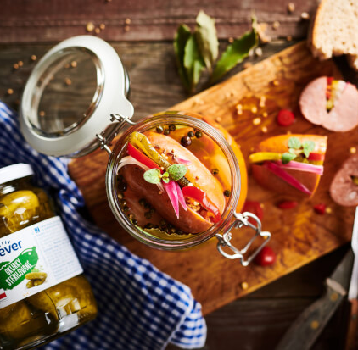
To beer
Marinade cheese
Drowned men
Fried potato pancakes
Wine sausage

Slide 11
Christmas
Carp (schnitzel in some families) with potato salad is eaten for Christmas
Baking Christmas cookies

Slide 12
Thank you for your attention
I personally don´t like Czech cuisine, so if the presentation was bad I am sorry.

