Slide 1
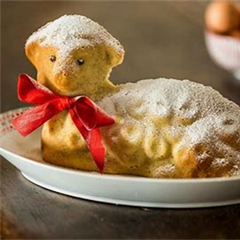
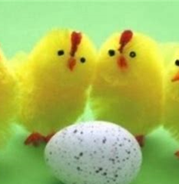
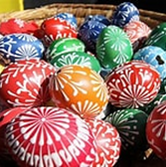
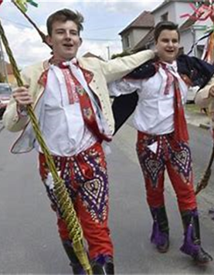
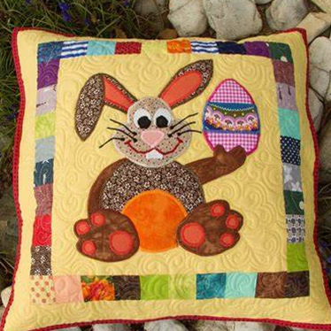
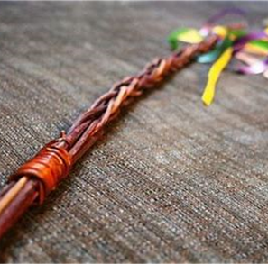
Czech Easter

Slide 2
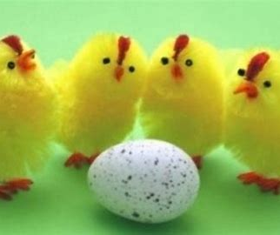
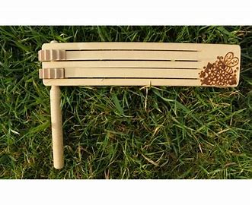
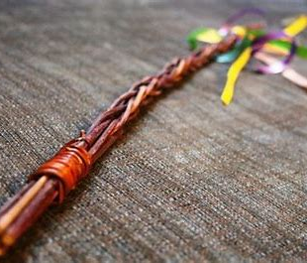
Symbols
Bunny
Sweet lamb
Dyed Eggs
Chicks
Whips
Rattles

Slide 3
Holy week
Palm Sunday - Churches are decorated.
Blue Monday - You must not work.
•Gray Tuesday - Women must sweep all the dust and the cobwebs.
•Ash Wednesday – On Wednesday you shouldn´t frown.
•Maundy Thursday- You should eat something green or plant peas.
•Good Friday - On this day ground opens.
•White Saturday – You should sweep before the sun rises.
•Easter Sunday - You walk through the village, rattle and say one special Easter poem.
•Easter Monday - This is THE day you go around the village/town and you whip the girls (that is if you are a boy) if you are not, then you wait for them and you want to get whipped in hopes that it will work and you will be healthy and beautiful.
•Easter is celebrated on the first spring Sunday after the first spring fullmoon.

Slide 4
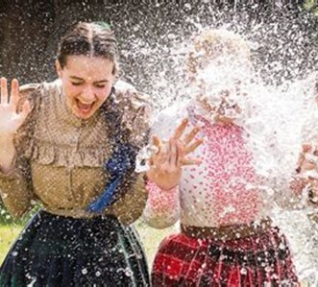
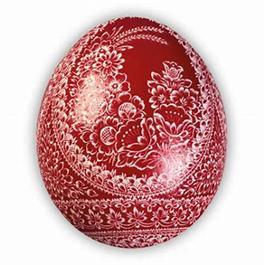
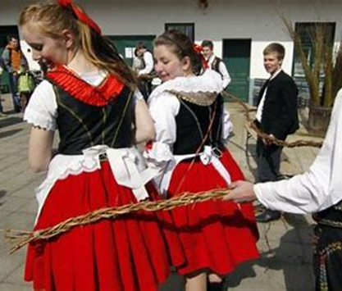
Traditions
It used to be that the boys would go around the village with rattles and whip all the girls or pour water on them so they would be healthy and beautiful.
The girls would give them dyed eggs- the colours were symbols:
Red-love, green-sympathy, yellow-refusal and blue-hope
Nowadays you usually just whip your relatives and friends and get sweets (adults get alcohol)

Slide 5
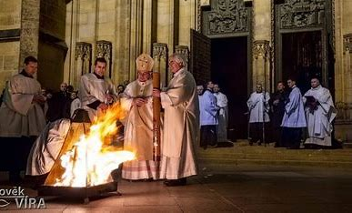
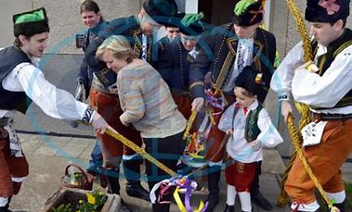
Christian x Folk traditions
The Christian- the Easter are celebrations of resurrections of Jesus Christ
They usually go to mass in the church
The folk part is more of a celebration of spring and the folk traditions

Slide 6
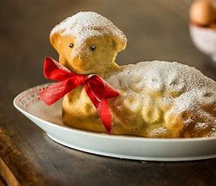
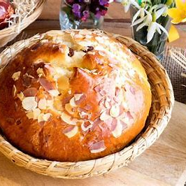
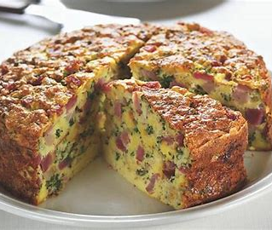
The traditional meals
Sweet lamb
Hot cross bun
Easter stuffing

