Slide 1
ITALIAN EASTER TRADITIONS

Slide 2
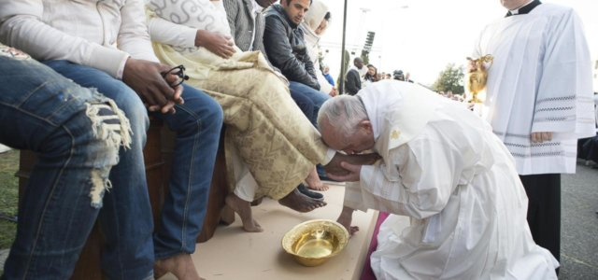

Slide 3
The Washing of the Feet which takes place on Saint Thursday means that Jesus Christ came on earth among humans not to be served but to serve and offer his life to redeem many other human beings.

Slide 4
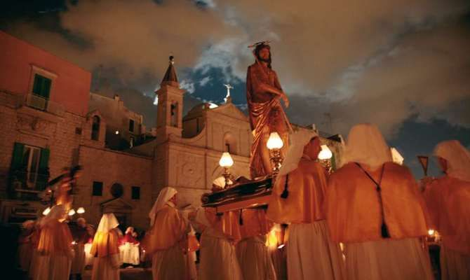

Slide 5
«Via Crucis» shows the way Jesus Christ walked through stumbling with the heavy huge cross on his shoulders before being crucified. It takes place on Saint Friday.

Slide 6
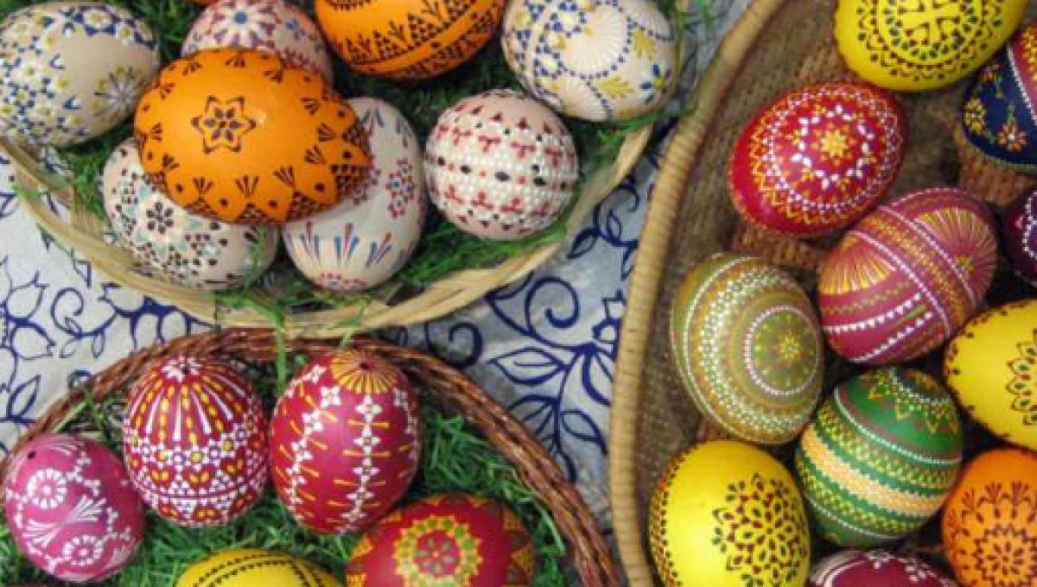

Slide 7
Easter Eggs date back to Middle Ages and they are the symbol of Resurrection and the Rebirth of life

Slide 8
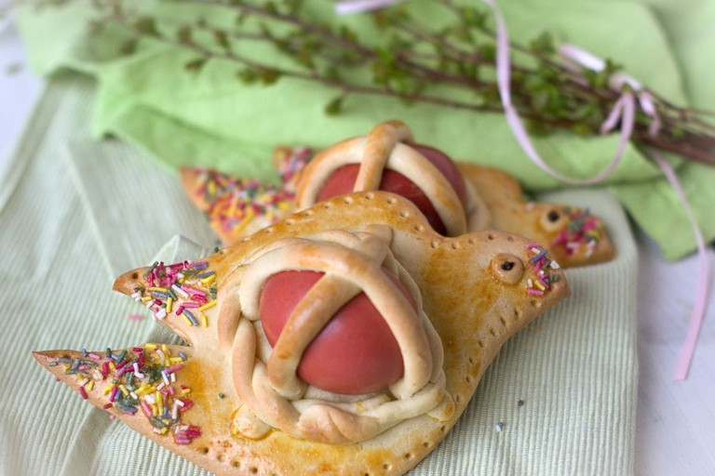

Slide 9
«Scarcella» is a typical Apulian Easter cake, homemade, It is the symbol of the freedom from the Original Sin

Slide 10
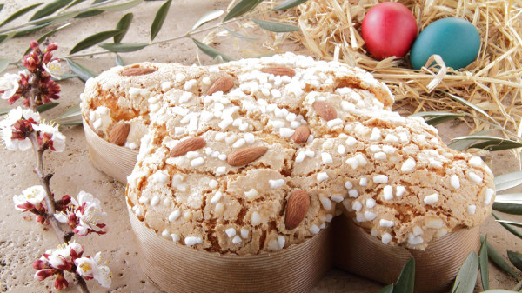

Slide 11
«Colomba» is a typical Italian Easter cake . The word colomba means female dove and it represents the Holy Spirit symbol of Peace and Redention.

