Slide 1
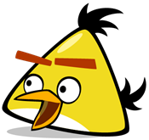
NATIONAL COLLEGE GRIGORE GHICA
ROMANIA
Daniela’s class

Slide 2
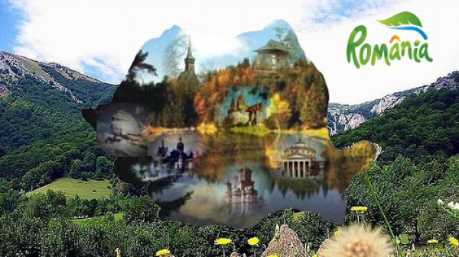
WELCOME TO ROMANIA

Slide 3
THE SARMALS FESTIVAL
What festival do you think we will meet in Romania?
Let’s find out!

Slide 4
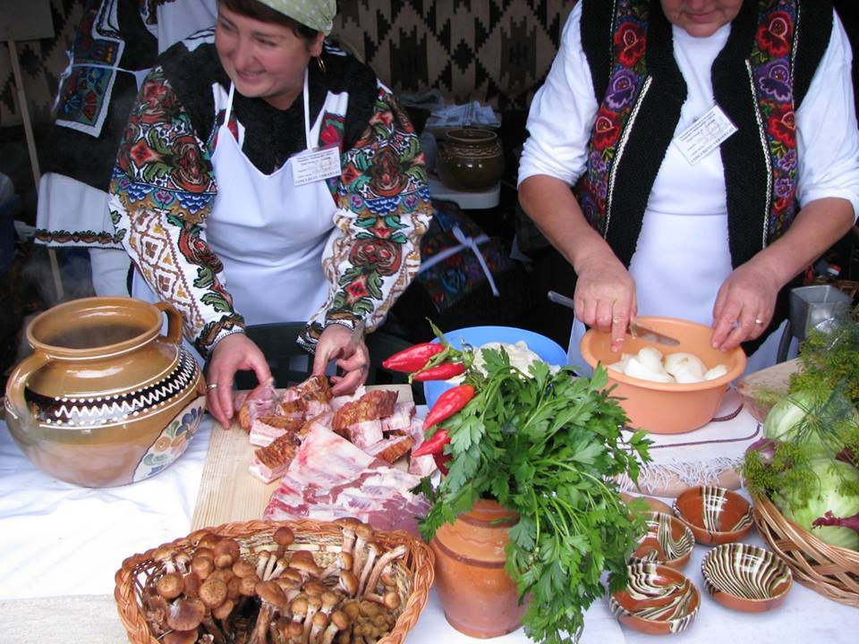
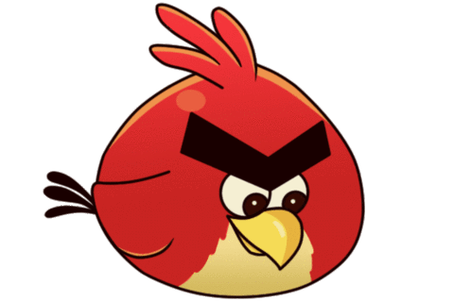
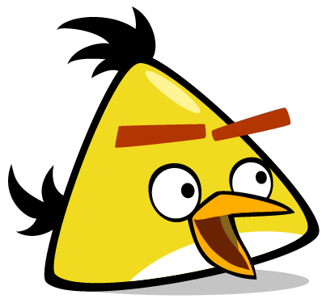
We arrived at The Sarmals Festival
I think it’s a food festival.

Slide 5
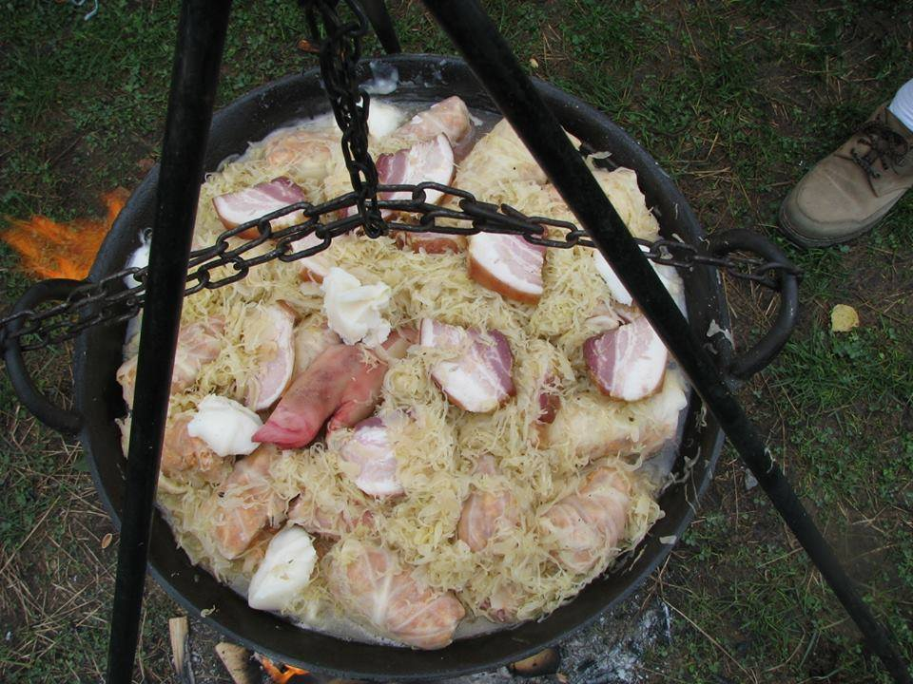
What is in that pot?
It is a dish made of cabbage, meat, rice and vegetables

Slide 6
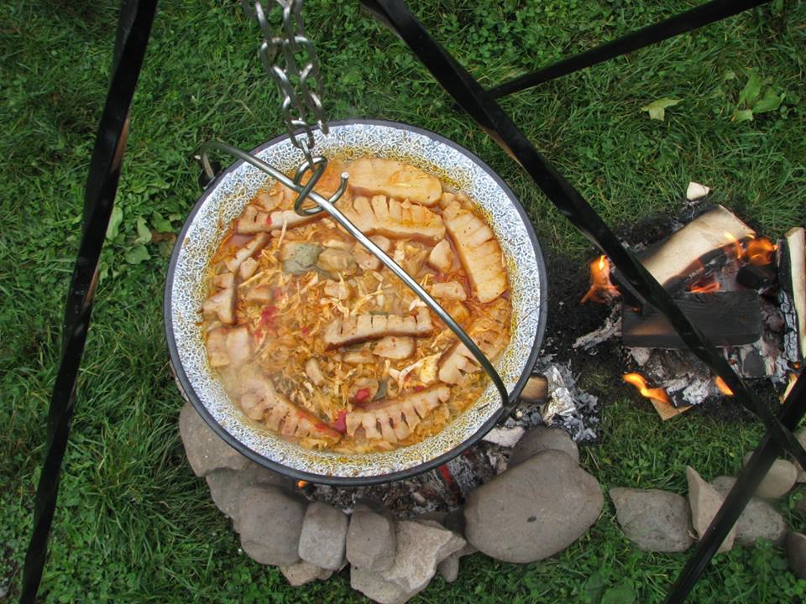
This kind of dish has different sizes and it is prepared according to traditional recipes - sometimes even secret.
It seems almost ready. Let's get ready to eat!

Slide 7
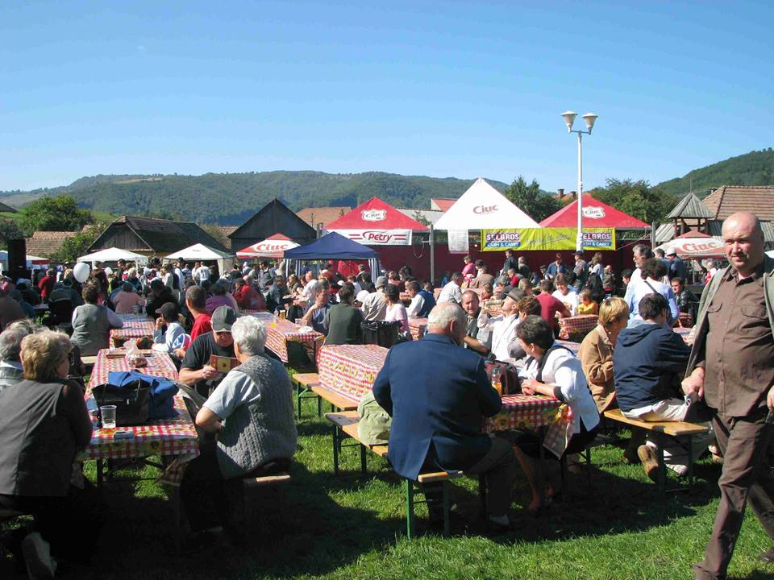
Let’s find a place quikly!
Wow! So many people!

Slide 8
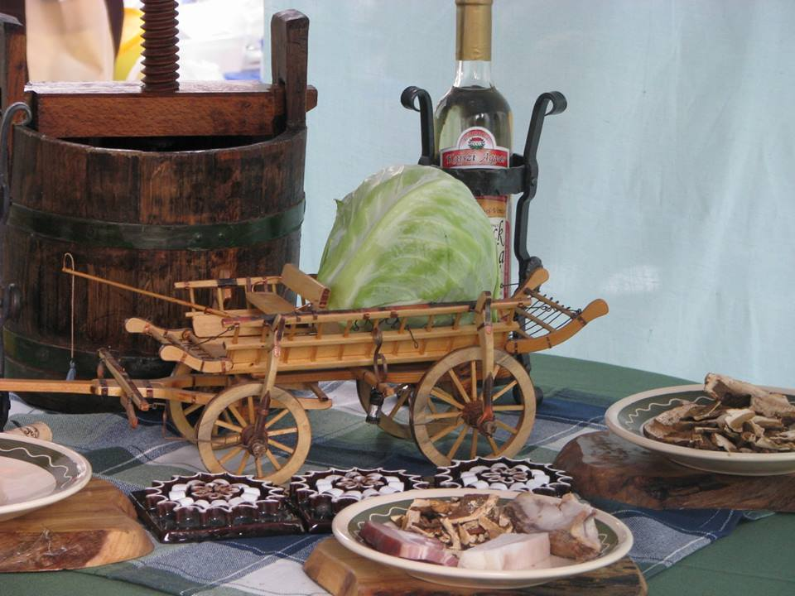
I don’t think so!
Is it a joke?
A cabbage in a carriage?

Slide 9
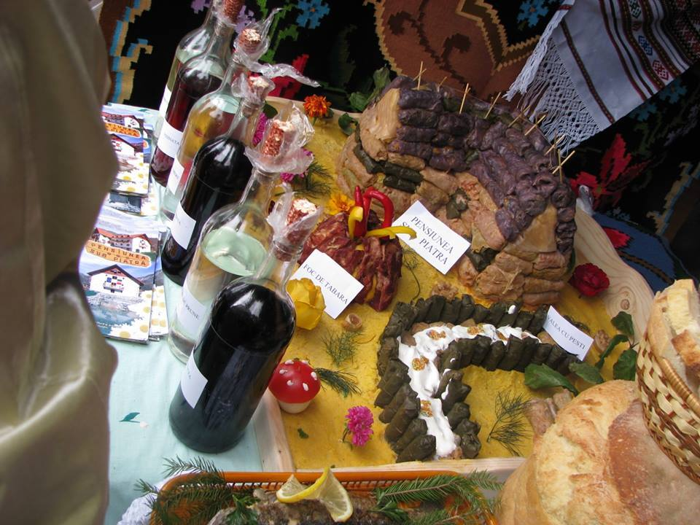
They make exhibitions using this kind of food.

Slide 10
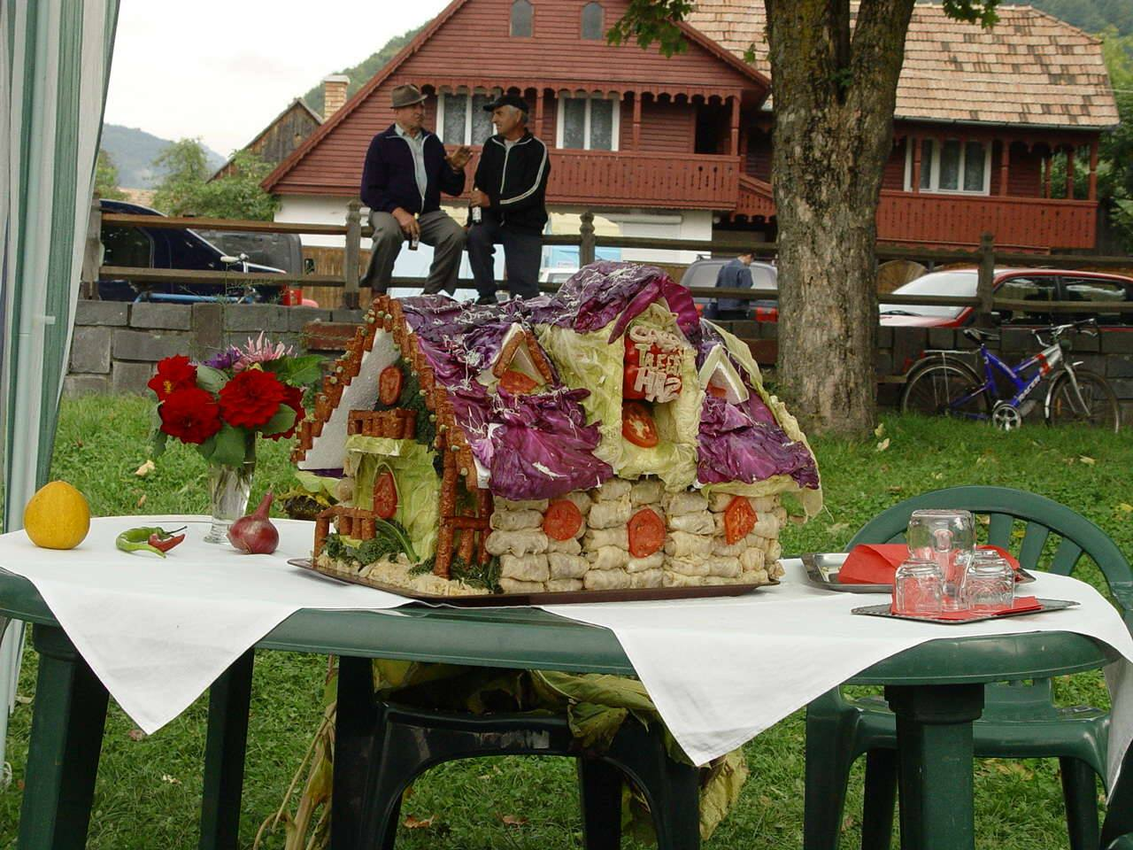
Let’s ask those men if we can live in this house.

Slide 11
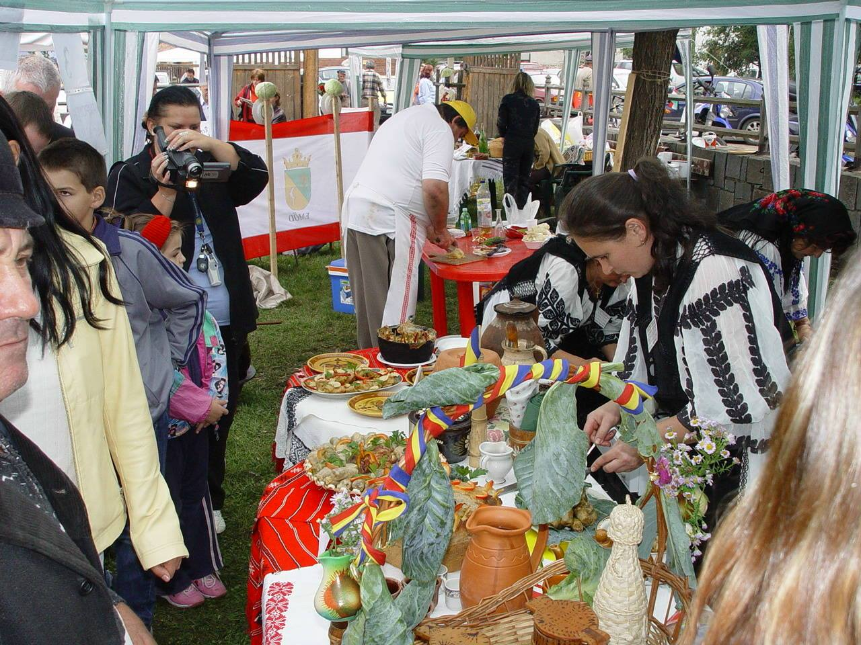
I guess there will be a lot of people.
Look! They still prepare food!

Slide 12
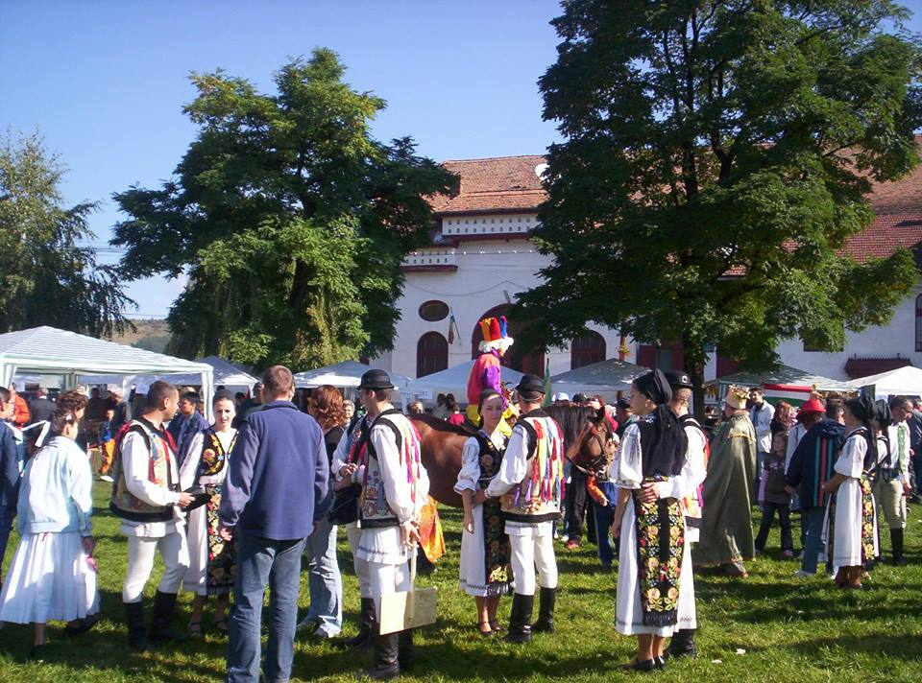
We have already eaten. Now let's dance
They dance too.

Slide 13
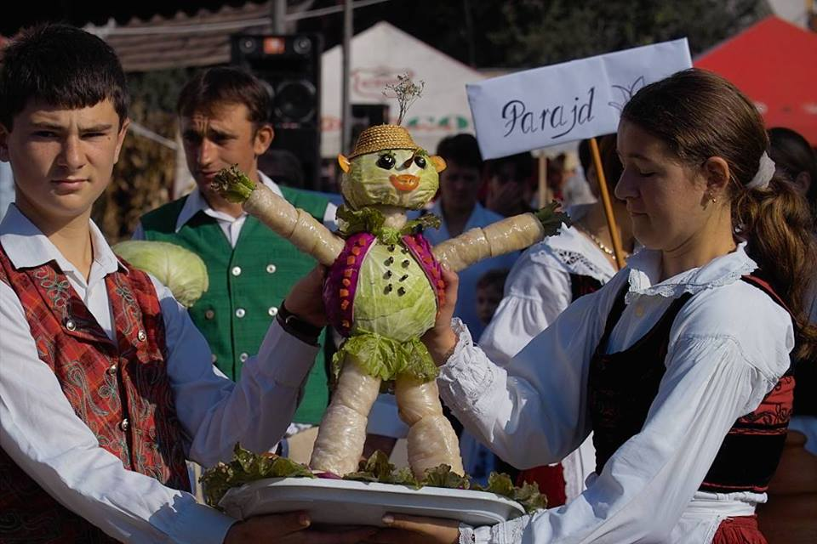
A man doll?
It’s made of cabbage.

Slide 14
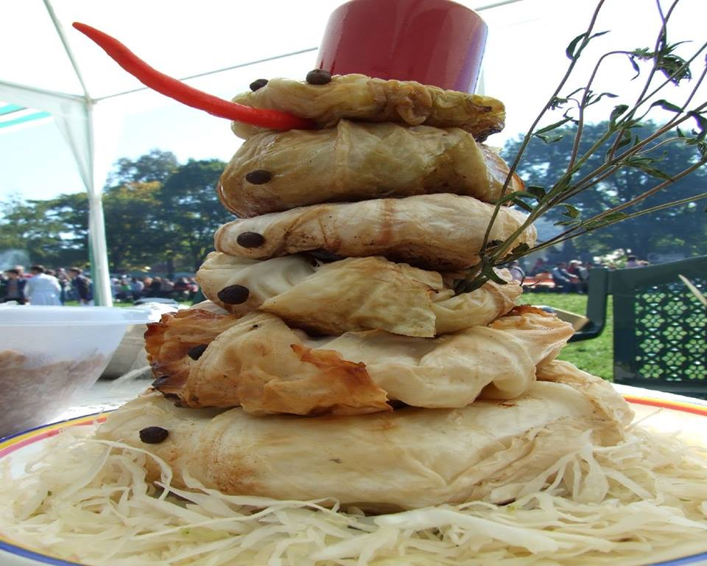
Wow. It’s a snowman!
It has a very large carrot nose.

Slide 15
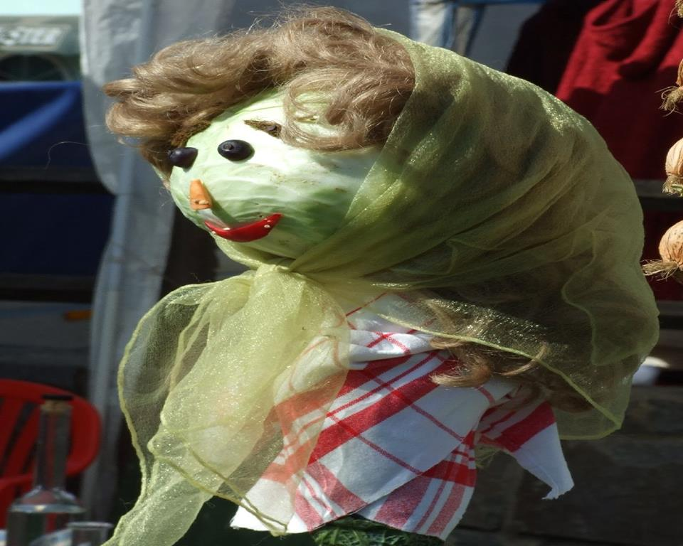
A woman doll!
She’s very pretty!

Slide 16
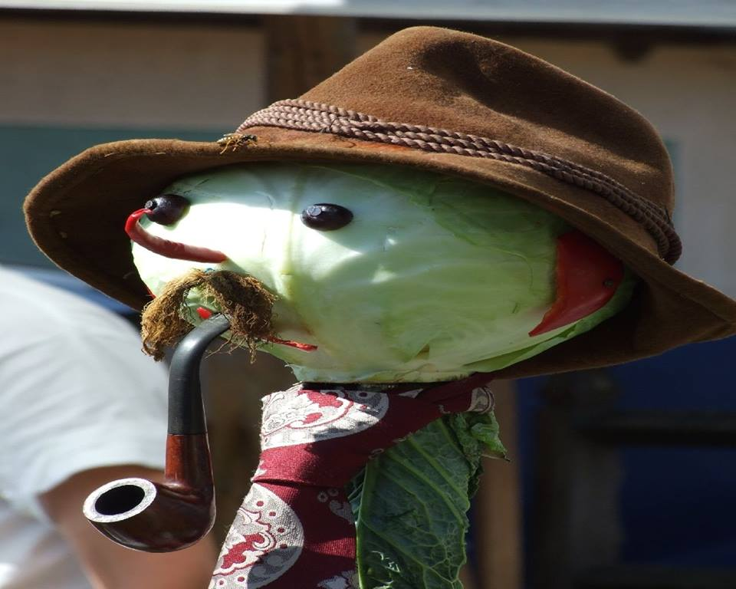
He has an interesting hat

Slide 17
Goodbye
It’s an interesting festival!
We will come here again next year.

