Slide 1
Dragobete The Romanian day of love

Slide 2
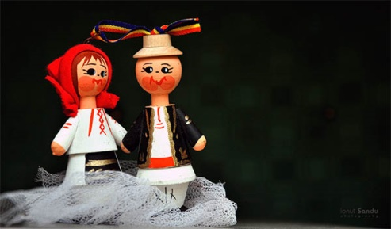
History of Dragobete
While no one really knows when Dragobete started, it is believed to go back to ancient Romania. In ancient myths, Dragobete is the son of Dochia and is seen as somewhat of a divine god. He was often said to be seen riding a flying white horse during daylight hours and is considered a symbol of spring and light.

Slide 3
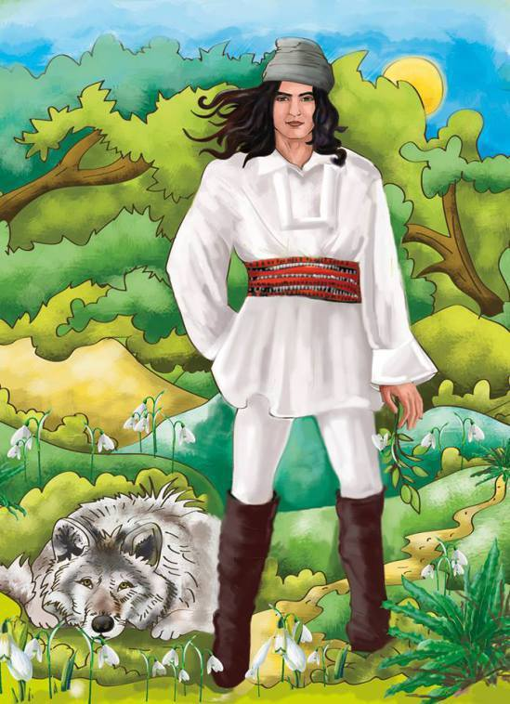
It is said that his magical presence could make the trees flower, insects, and birds to multiply and can turn men and women into lovers. He is the Romanian version of Cupid or Eros ( the greek god) – bringing love and life with him.

Slide 4
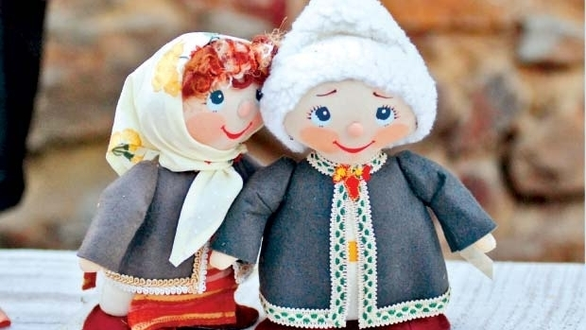
Tradions locked in time
In some parts of the country, single women used to wake up in the morning, gather some remaining snow and melt it down. If there was no snow left, they had to fill a pot with rainwater or from a nearby spring. The water obtained like this had magical powers – it was used for beauty treatments and for love rituals.

Slide 5
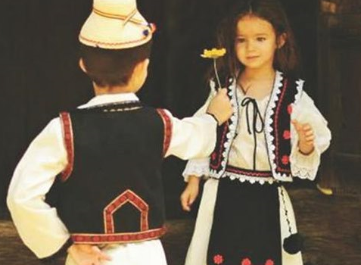
Young girls were taught to eat a piece of salty bread (baked by the eldest woman in the household), then place some basil under the pillow. During the night, they were supposed to see their future husband in their dreams.

Slide 6
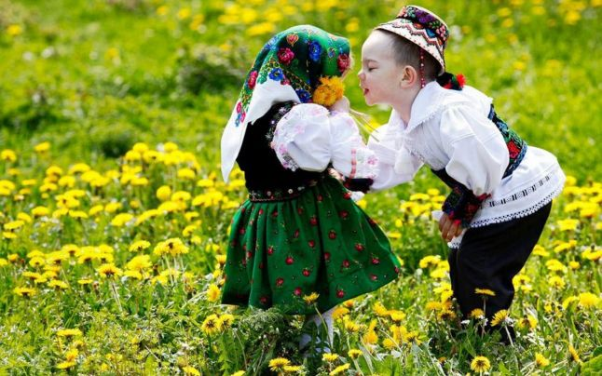
So, what happened on Dragobete’s day? Boys and girls used to dress-up in their “Sunday clothes” (fancy clothing) and meet in front of the church. Then, they would go to the nearest woods or meadows, singing in groups and looking for spring flowers. After sitting and talking around a fire, the girls would run back to the village, each being followed by the boy who had fallen in love with her.

Slide 7
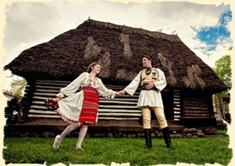
If the boy caught the girl and if she liked him, he would steal a kiss in front of everybody.This wasn’t just a game, it was a vow of love for the whole year along with the opportunity to show their attachment in front of the community. The traditional saying is that “Dragobetele kisses the girls!” (Dragobetele saruta fetele!), with each boy that stole a kiss becoming a “Dragobete”.

Slide 8
Made by:
-Antochi Iulia Maria
-Botezatu Alexandra Gabriela
-Iordache Denisia
-Leancă Petrică

