Slide 1
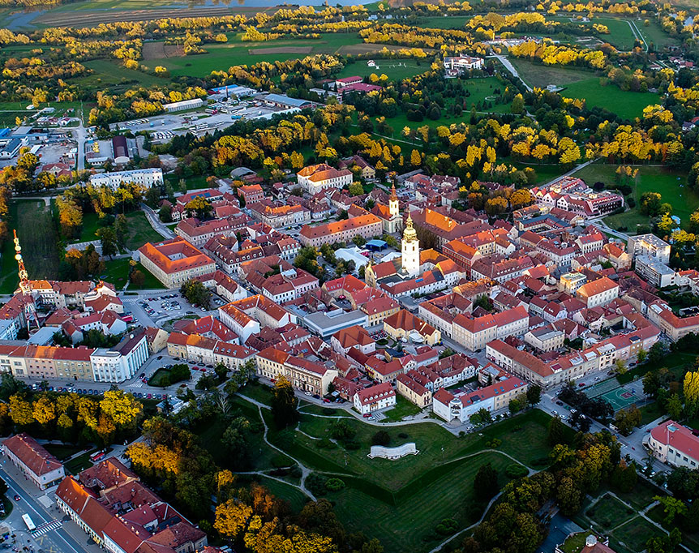
Karlovac
City on four rivers

Slide 2
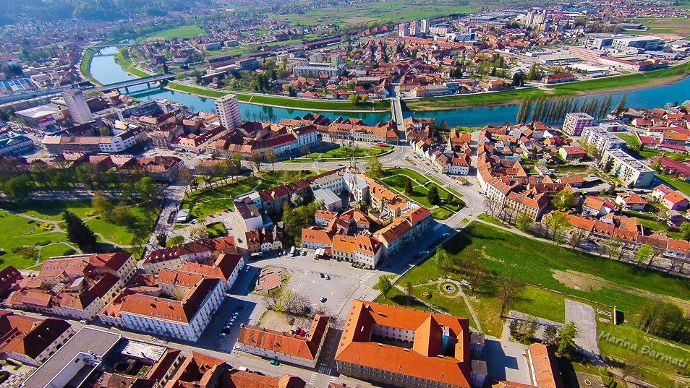
Must see locations
Karlovac Star
Homeland War Museum Turanj
Old town of Dubovac
„Zorin dom” theatre
Freshwater aquarium „Aquatika”
NK Karlovac 1919 football stadium „Branko Čavlović Čavlek”
Four rivers – Kupa, Korana, Mrežnica and Dobra

Slide 3
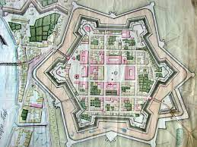
Karlovac Star
The city of Karlovac was built on the edge of the Pannonian Plain in times when the border of the Ottoman and Habsburg Empires was formed along the Rivers Kupa and Korana
This is the oldest part of Karlovac, surrounded by the defensive moats, giving a new dimension to today’s parks, clearly delineating the Star.

Slide 4
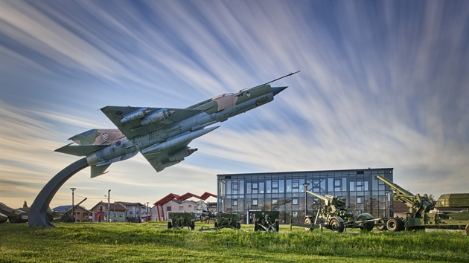
Homeland War Museum Turanj
The city of Karlovac and its defenders endured fierce attacks in the Homeland War and played a key role in the defence of the Croatian territory, as well as in the creation of the independent Republic of Croatia.
The permanent interactive museum exhibition containing 350 original artefacts and more than 3 hours of multimedia content
It also has a Memorial Room of the Fallen Karlovac Defenders from the Homeland War

Slide 5
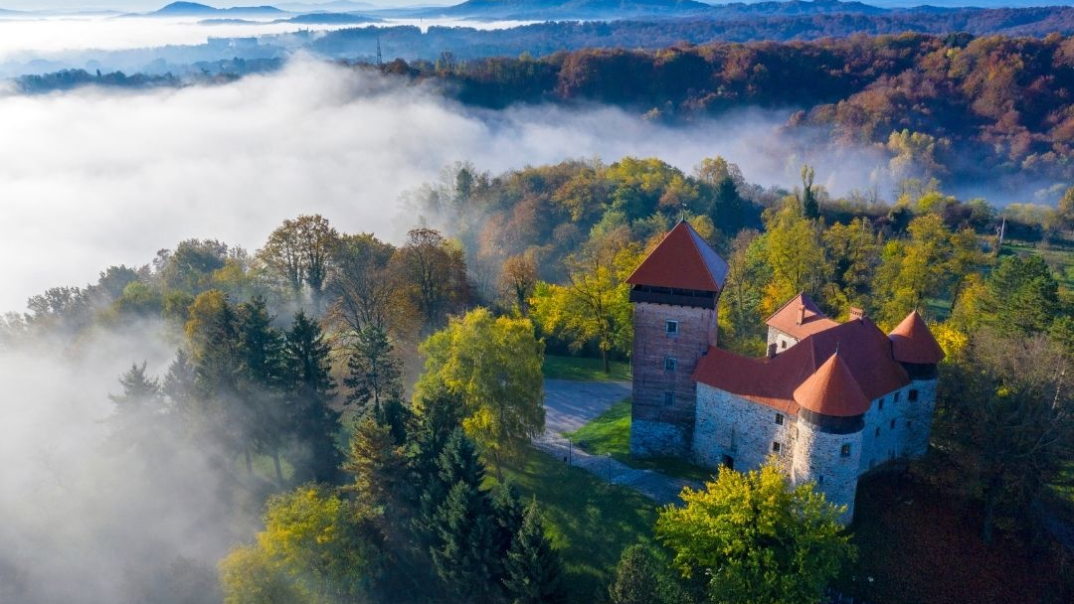
Old town of Dubovac
It was buldt in 13th century
The Dubovac Castle is one of the best-preserved and most beautiful monuments of medieval architecture in Croatia.

Slide 6
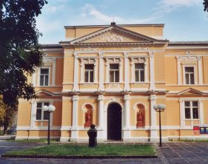
„Zorin dom” theatre
The beautiful building is the pride of Karlovac and its citizens and has become a symbol of its culture, connecting all generations.
Sometimes, during the quiet Karlovac nights, while sitting on a bench in the Zorin dom park, you can hear the soprano singing and let your mind wander back to the age of great formal balls.

Slide 7
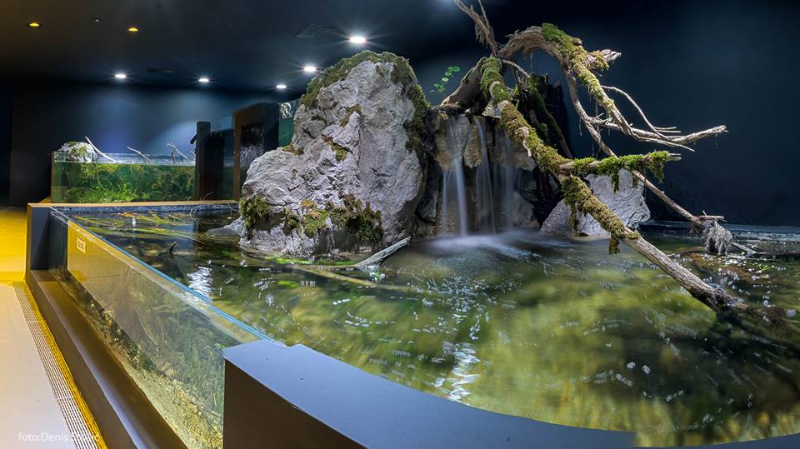
Freshwater aquarium „Aquatika”
Freshwater aquarium Aquatika presents the flora and fauna of Croatian rivers and lakes, geological history, traditional culture and history of the basin of four Karlovac rivers.
Visitors can witness richness of life in rivers and lakes, and more than one hundred freshwater fish species, of which 40 are endemic.

Slide 8
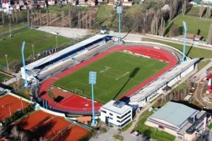
NK Karlovac 1919 football stadium „Branko Čavlović Čavlek”
The stadium was built in 1975 and has a capacity of 12,000 seats.
It serves as home stadium for the NK Karlovac 1919 football club which is the best in far area
The stadium is named after Branko Čavlović, a footballer from Karlovac who was active with local clubs in the 1940s

Slide 9
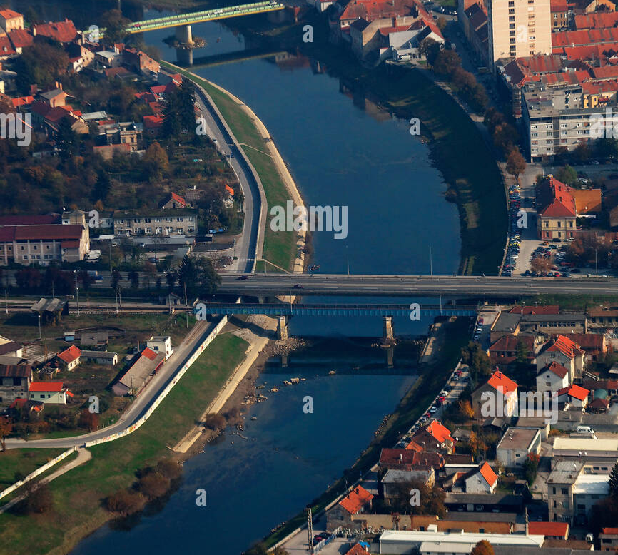
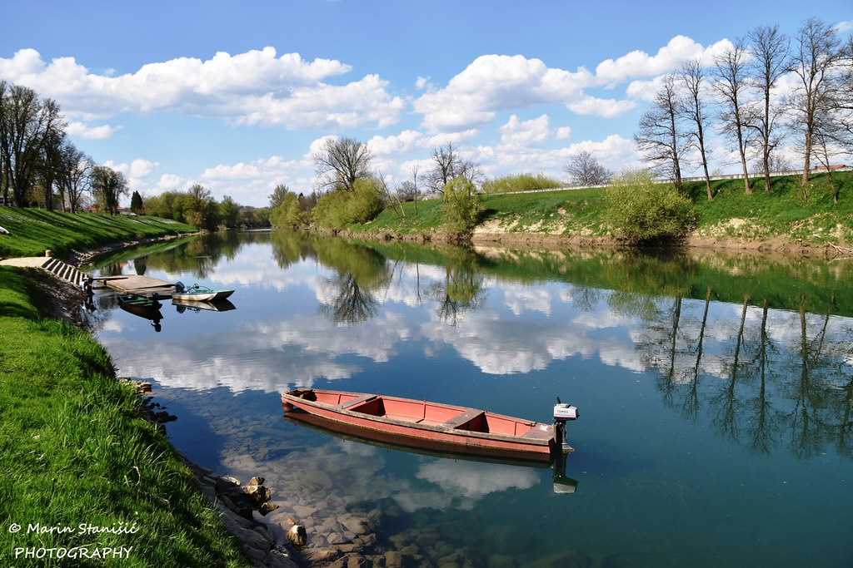
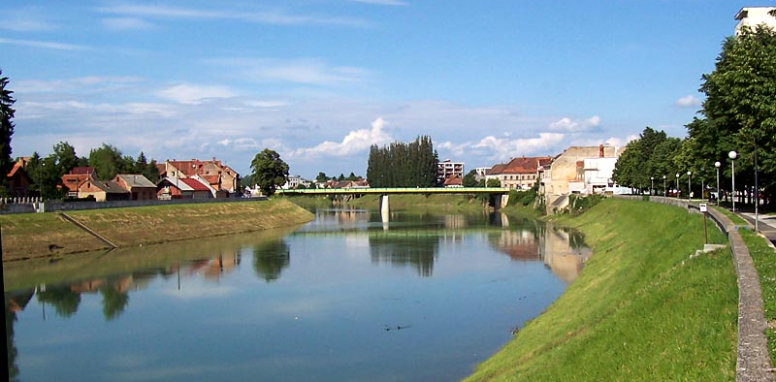
KUPA

Slide 10
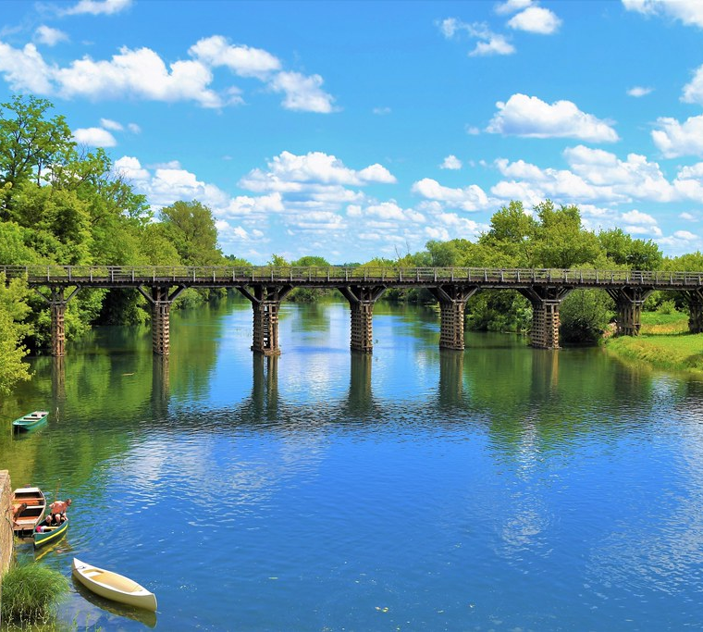
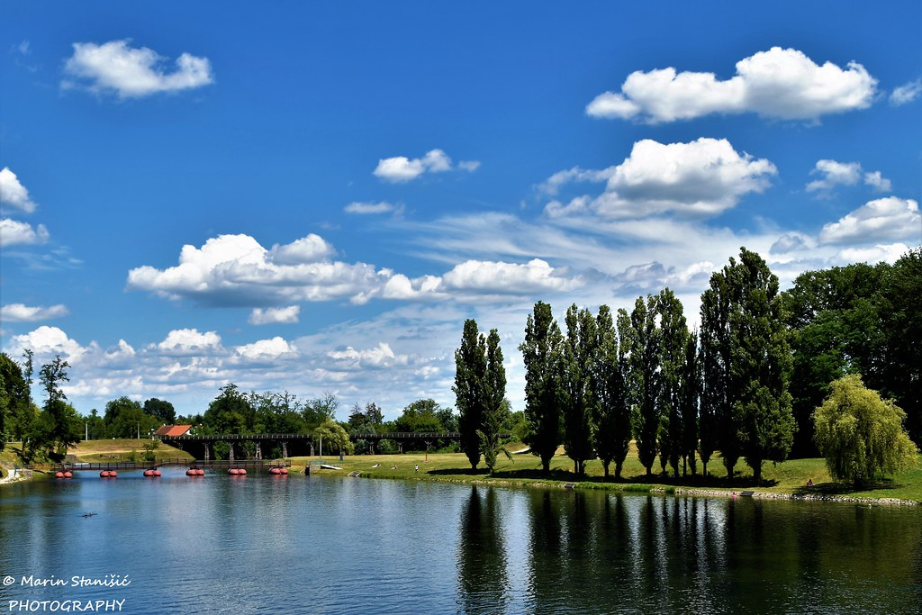
KORANA

Slide 11
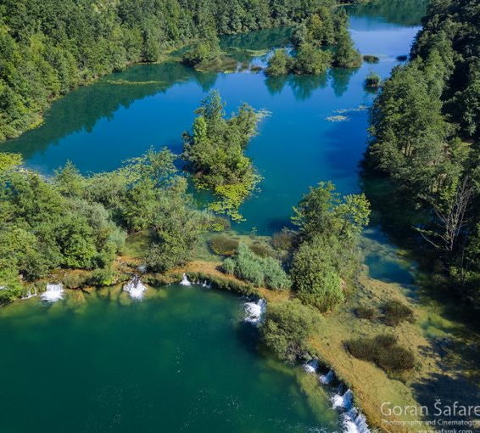
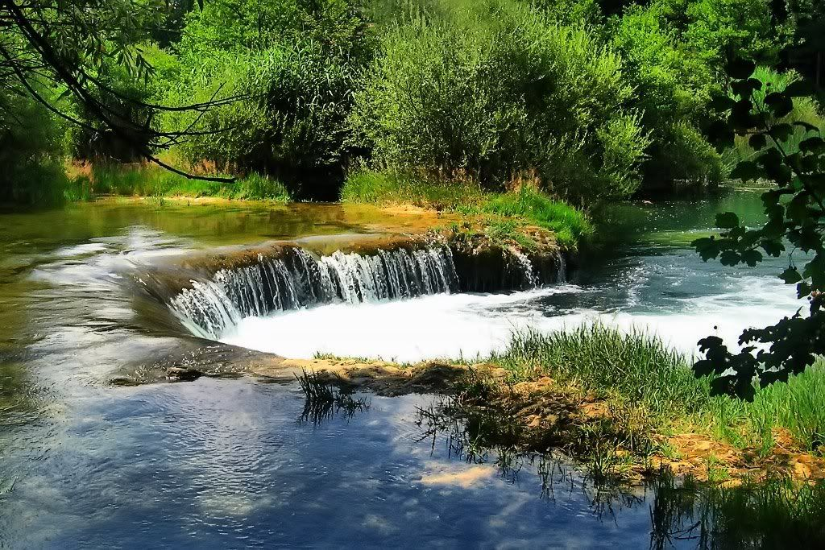
MREŽNICA

Slide 12
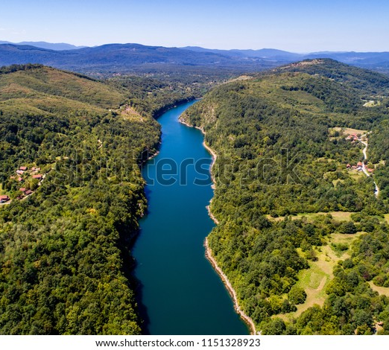
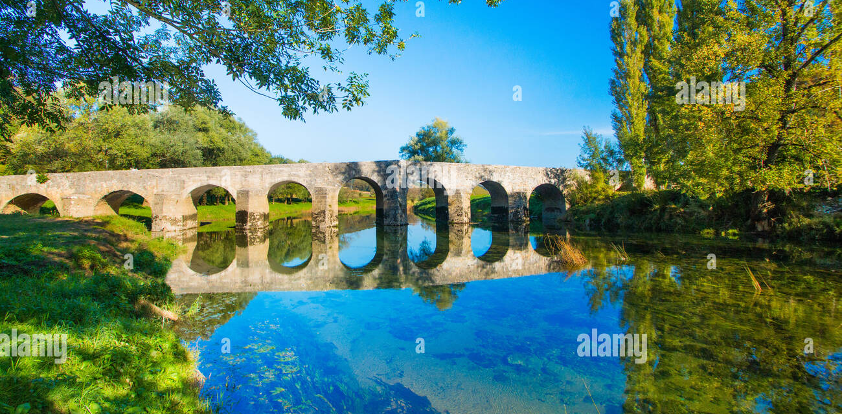
DOBRA

Slide 13
Thank you for your attention! We are sure you will like our city Karlovac!
Made by J. Bukovac and L. Novosel from Tehnical School Karlovac

