Slide 2
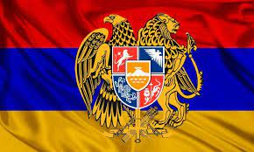
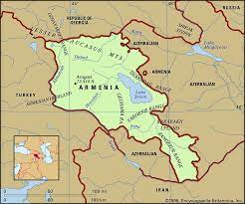
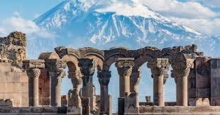

Slide 3
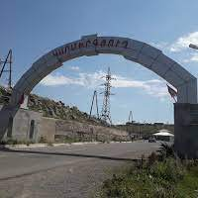
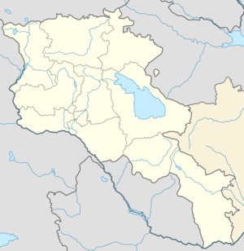
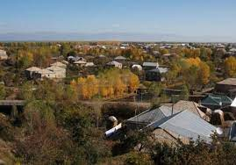

Slide 4
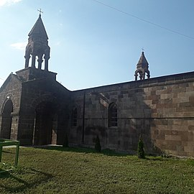
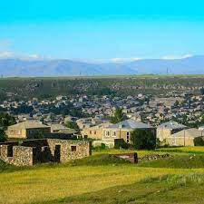
Karmirgyugh is 102 km away from the capital Yerevan. In Karmirgyugh, people are mainly engaged in agriculture. There are also small undertakings. People adapt to climate change and grow different crops, such as watermelon, cucumber, grape, blackberry, etc. And the youth actively participates in many programs.

Slide 5
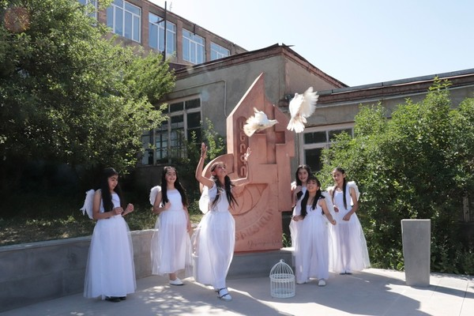
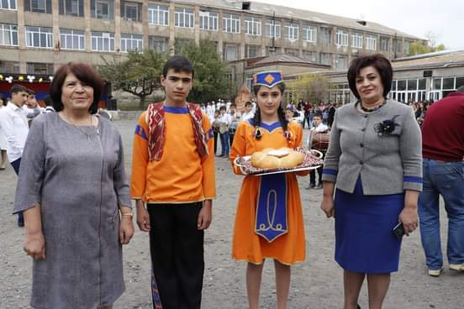
Karmirgyugh secondary school N1 of Gegharkunik region was put into operation in 1971. During the 51 years of its existence, many generations have been educated, brought up here, make their way in life.
Students actively participate in many programs and record great success.

Slide 6
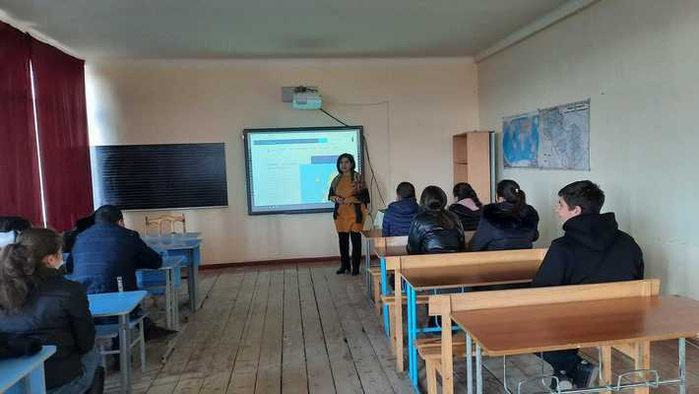
The students of Karmirgyugh Secondary School N1, led by H. Umrshatyan, are involved in the eTwinning e-learning community of European schools, where teachers and students from participating countries can register, use online twinning tools, meet each other in a virtual environment,
exchange of best practices, acquire teamwork skills, develop knowledge of foreign languages, computer skills, implement educational and other online educational programs

Slide 7
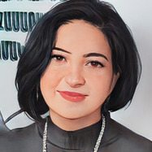
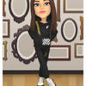
Our group members
Hasmik Umrshatyan- group leader
Meline Mardoyan
Milena Navoyan
Seda Chngryan
Anna Engoyan
Arevik Amiryan
Laurita Hakobyan
Mary Vardanyan

Slide 8
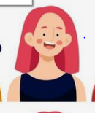
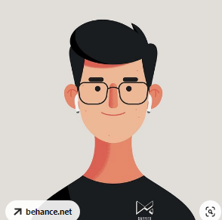
Mery
Gasparyan
Syuzanna
Jraghaspanyan
Irina
Bnyan
Arpine
Hodabashyan
Mery
Davityan
Nelly
Vardanyan
Shushan
Jraghaspanyan
Meruzan
Nersisyan
Tamara
Amiryan

Slide 9
Our logo
The logo itself is simple, because with simple steps a person can change the environment, a person seems to change the surrounding nature (with the help of masters), and by changing, keeping the environment clean and green, a person feels healthier and happier (like a logo man). The bottom line is that as a healthy environment, a person's emotional, physical, and mental health levels increase. The green changemakers-The font is different because we want to change the environment for the better.

Slide 10
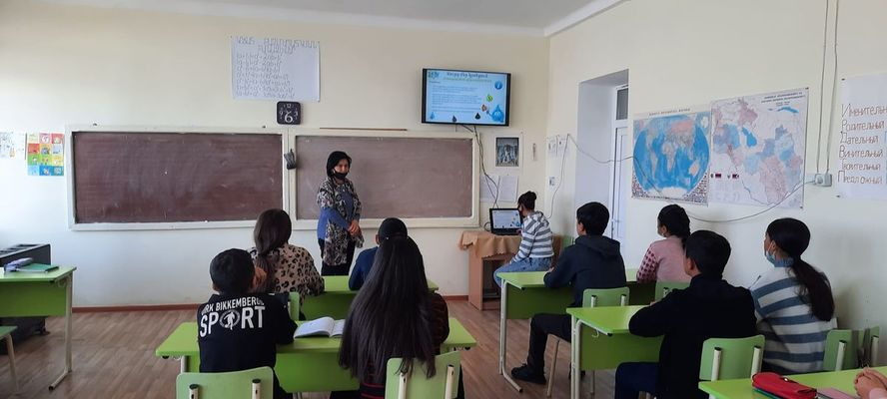
9th grade students conducted a quiz game "Water in our life" under the guidance of H. Umrshatyan and A. Khachatryan. The students took an active part in the quiz game.

Slide 11
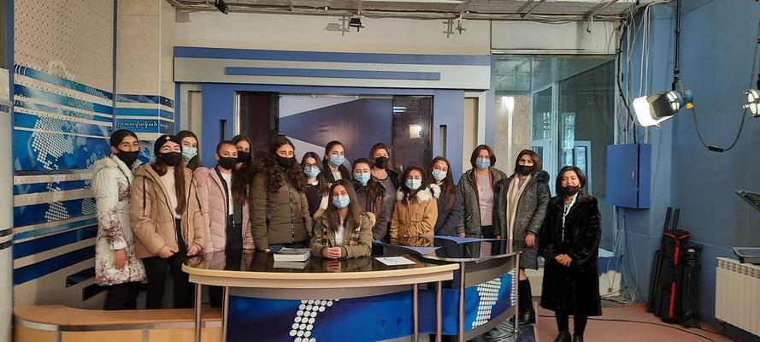
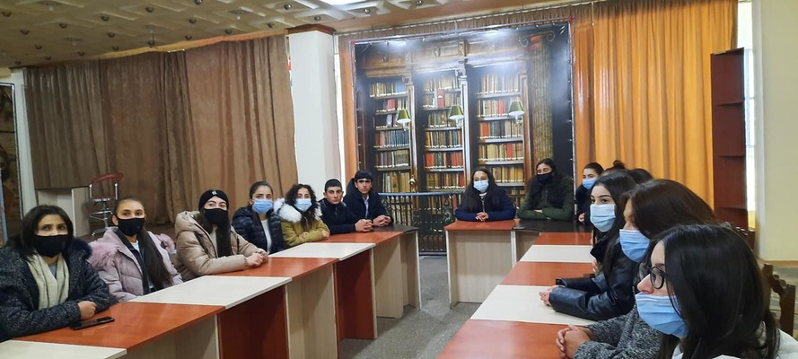
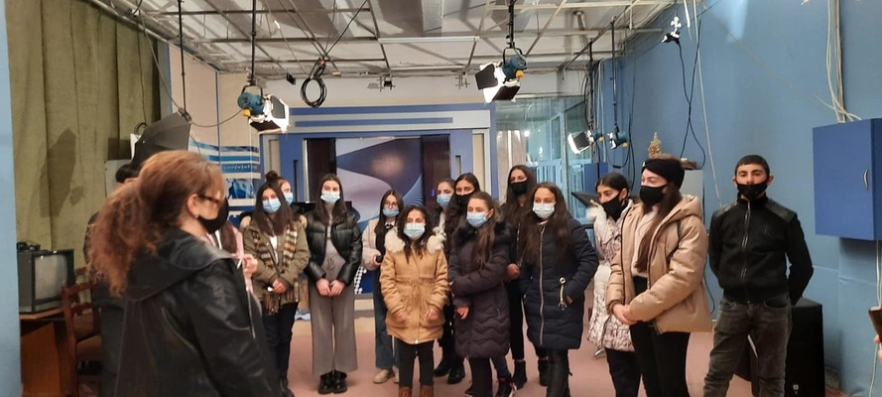
Within the framework of the Media Literacy Week, the students of our school visited the TV studio. Arpik Kakoyan presented the activities of the studio and information about media literacy. The next visit took place in the editorial office of "Geghama Ashkharh" newspaper of the RA Gegharkunik regional administration.

Slide 12
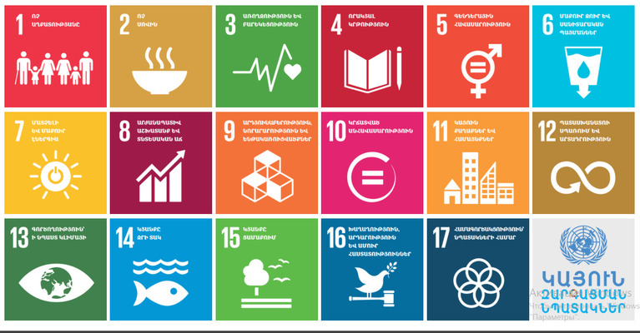

Slide 13
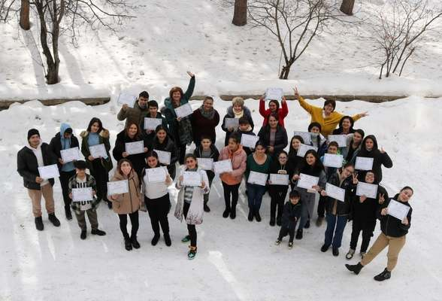
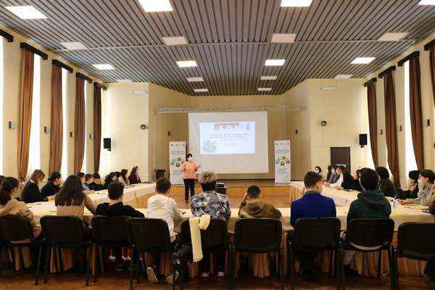
In the frame of the UNDP-GCF Armenia's National Adaptation Plan (NAP) project we continue raising awareness on climate change and adaptation related issues and strengthening adaptation capacity among young people.

Slide 14
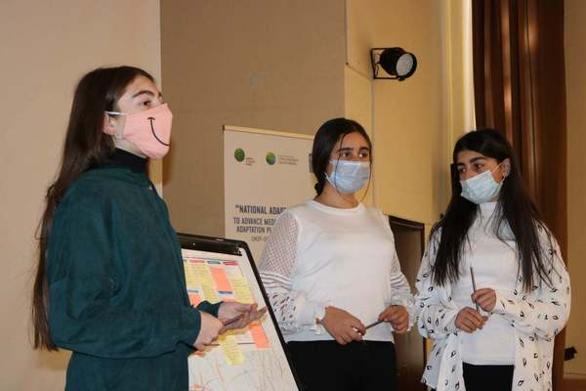
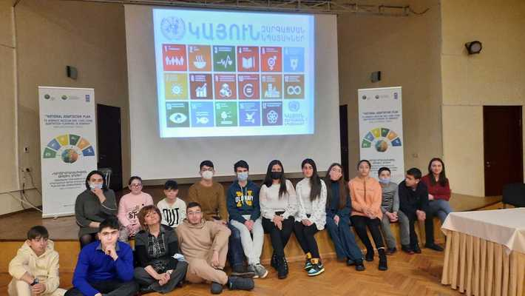
"Adapting to climate change: from idea to results” a three-day training session, organized in the frame of NAP project in cooperation with Impact Hub Yerevan, aimed at deepening participants' knowledge on climate change and adaptation as well as at building the capacity of schoolchildren and teachers to develop and implement climate change adaptation related projects.

Slide 15
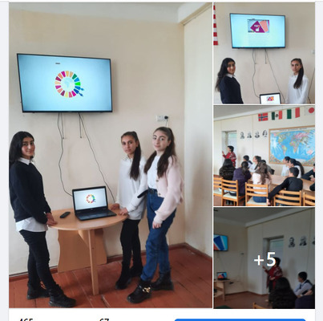
eTwinning in the e-learning community of European schools Students in Karmirgyugh school Green Change project explored the 17 Global Sustainable Development Goals: In the framework of the UNDP-CSF project "Tackling Climate Change - From Idea to Implementation", a three-day training course was held, where they discussed the Sustainable Development Goals, and obtained projects and business proposals.

Slide 16
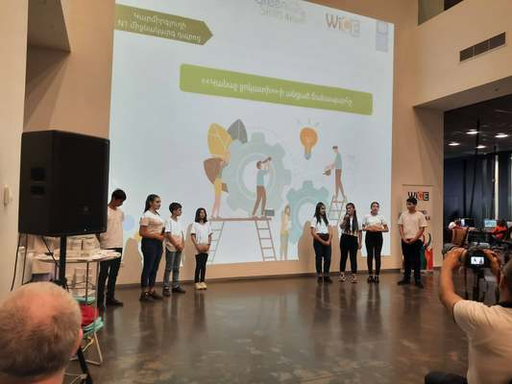
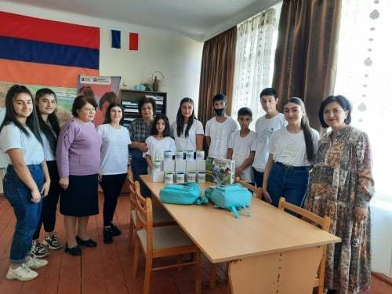
The goal of the UNDP-GEF Small Grants Program, Green Skills for Youth, was to raise awareness in schools about mitigating and adapting to the effects of climate change, involving schoolchildren in assessing their schools' energy use through green technologies, and building energy-efficient buildings to the works. Our school was among the 8 selected schools.
A "Green Detachment" was created, where 10 students were involved. The "Green Squad" carried out an assessment of the energy use of the school building, using the provided computer program.

Slide 17
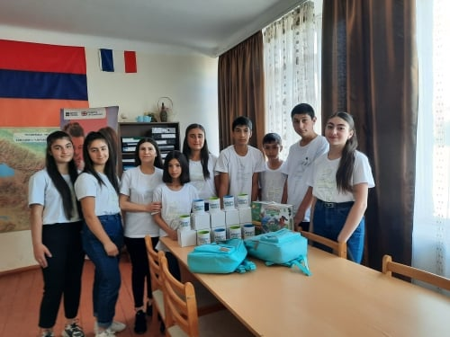
On April 25, Karmirgyugh secondary school N1 "Green Detachment" led by Susanna Mardoyan participated in the "Green Technologies for Youth" program within the framework of the "Green Technologies in Schools" competition, to ensure adequate energy saving and energy efficiency. The school windows will be renovated with a monetary reward.

Slide 18
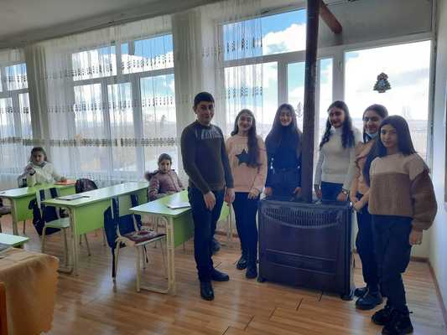
Within the framework of the "Green Skills for Youth" program, the "Green Detachment" of our School implemented one more program, contributing to the increase of the school's energy efficiency and energy saving.
The stoves in the three classrooms were replaced with 3 new energy efficient stoves. The stoves are installed, the result is already obvious.
We also received 10 solar LED lamps as a gift.

Slide 19
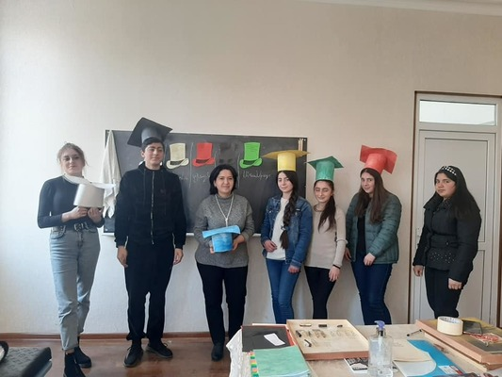
In 11th grade, Hasmik Umrshatyan, a teacher of chemistry "Natural sources of carbohydrates", studied Eduard de Bono's "6 Thinking Hats" method. With the help of "6 colored hats" the group discussion becomes more effective, helps to plan the process of thinking backwards. The environmental problems caused by oil, natural gas, coal were presented;

Slide 20
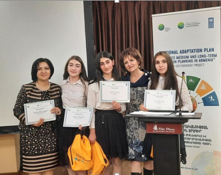
"Let's face climate change"
On September 20, the National Adaptation Program in Armenia (NAP) launched a competition for schoolchildren entitled "Resisting Climate Change" within the framework of the UNDP-CSF program. The aim of the competition was to raise awareness among young people about climate change adaptation, to involve them in mitigating the negative effects of climate change, to prevent it, and to develop adaptation measures.
Students of Karmirgyugh Secondary School No. 1 Milena Navoyan, Meline Mardoyan, Seda Chngryan under the guidance of teacher Hasmik Umrshatyan participated in the video contest.
The submitted video passed to the final stage, was selected from the top ten best works, which were presented during the final event of the competition on December 10. Our video took the first place.

Slide 21
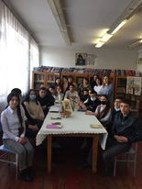
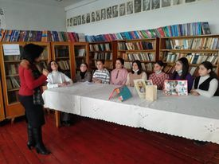
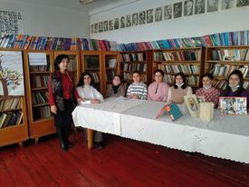
February 19 has been declared Book Donation Day in Armenia.
The participants of our project actively participated in an interesting and meaningful lesson in the library, dedicated to Book Donation Day.

Slide 22
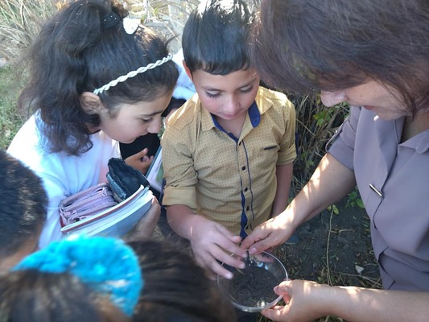
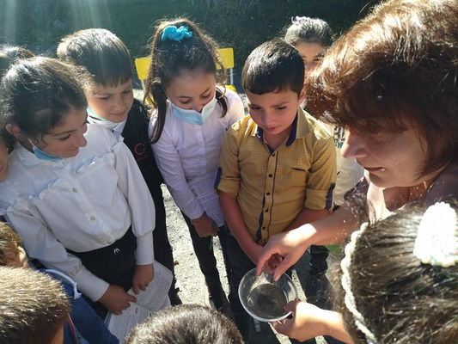
"I and the world around me" was the subject of the lesson "Land" and "Water is life".
The students learned the importance of land and water in human life, performed interesting experiments. The lesson ended with the belief that there is no life without land and water instructed to write sayings about land and water

Slide 23
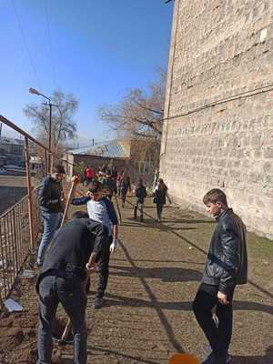
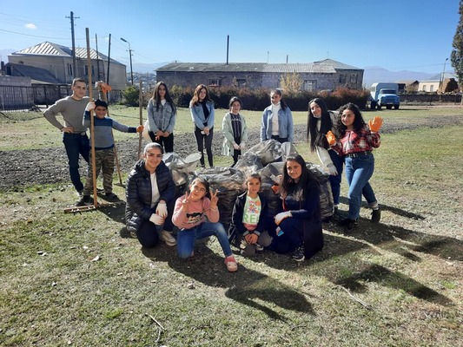
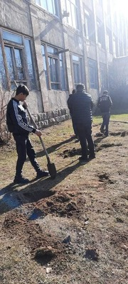
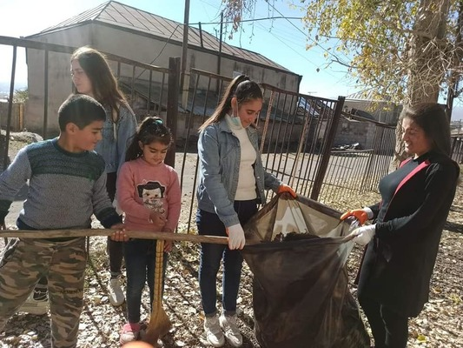
"Tree instead of garbage" environmental campaign. tree planting in Karmirgyugh

Slide 24
THANKS FOR ATTENTION

