Slide 1
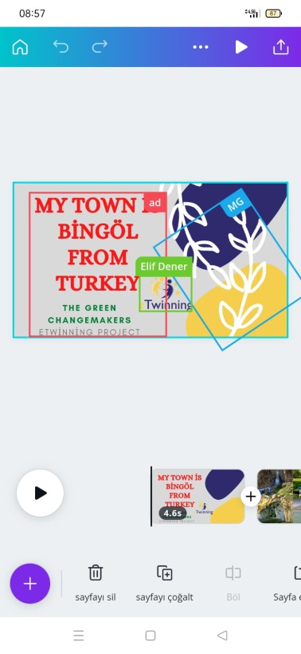
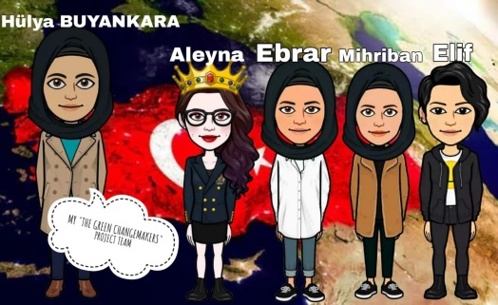
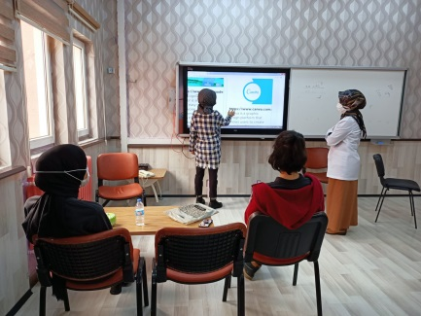
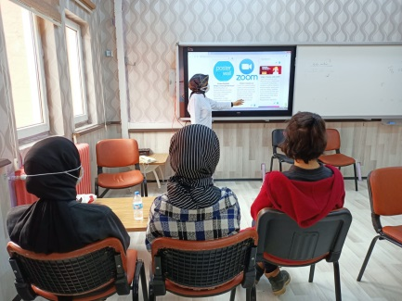
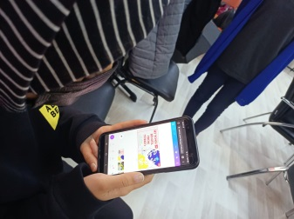
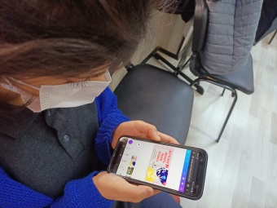
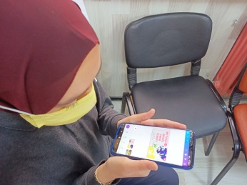
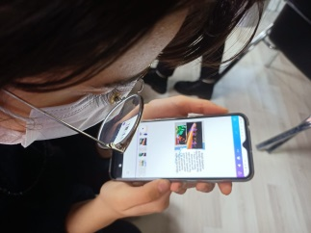
6. activity: ONLINE MEETING with the aim of exchanging experiences and achievements so far within the project (08.03.2022)
Our teacher Hülya BUYANKARA held an information meeting about web2 tools at school for project member students.
As Yunus Emre Anatolian High School Team, we used the canva web2 tool in the City Promotion event of our project. Our teacher shared a canva edit sharing link with us. ebrar, mihriban, elif and aleyna clicked on the canva editing link sent to their e-mail addresses and prepared a presentation in cooperation.
https://youtu.be/9fL2D4RndK8

Slide 2
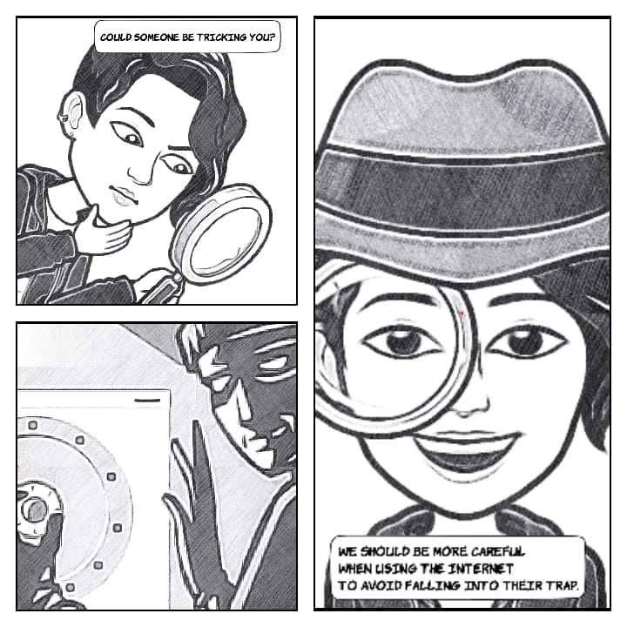
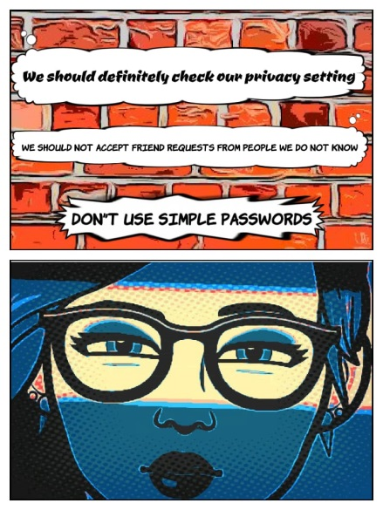
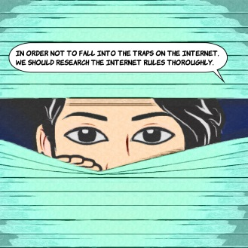
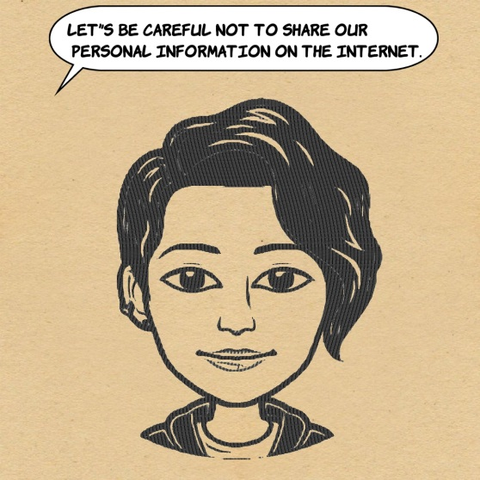
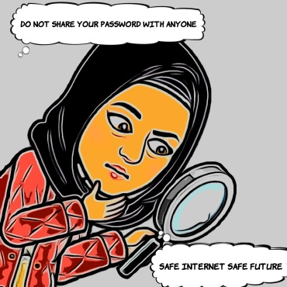
WE LEARN ABOUT MEDIA LITERACY
For this activity we have chosen to work on "internet safety and eTwinning ethics".
Yunus Emre Anatolian High School students designed cartoons about internet safety and eTwinning ethics from their own avatars using the Comica web2 tool. It was a lot of fun to design cartoons and we learned a new web2 tool.
https://youtu.be/_vZHmuutILw

Slide 3
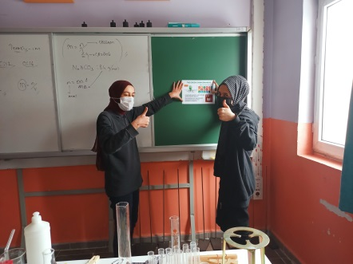
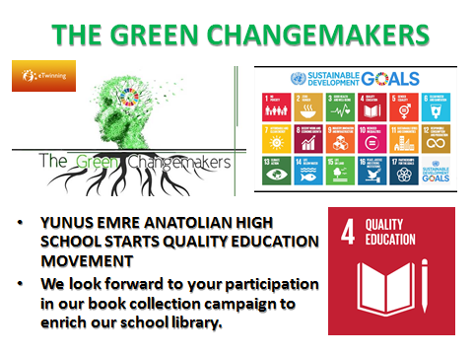
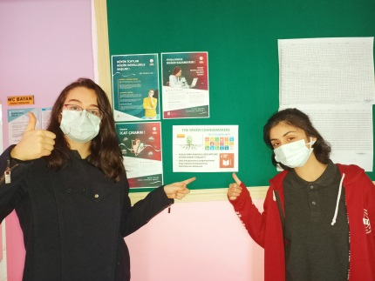
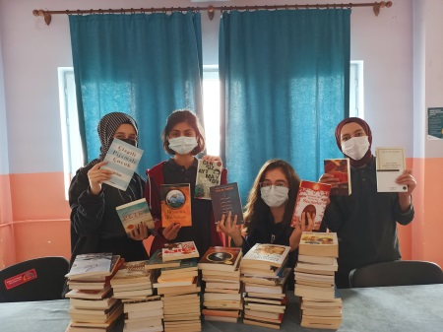
4.GOAL: QUALIFIED EDUCATION MOVEMENT OF YUNUS EMRE ANATOLIAN HIGH SCHOOL TEAM
We started a book collection campaign to enrich our school library and bring our students together with more books. We believe that sharing the books we read with others will be a collaboration that will make everyone happy.
We printed posters and hung them on school boards to announce our campaign, distributed brochures to all classes in our school and explained our project. to everyone. We have provided the necessary information for our book collection campaign.
So far, 2000 books have been donated. We examined the donated books and classified them according to their types. We recorded it in the inventory book of the school library.
Campaign continues...

Slide 4
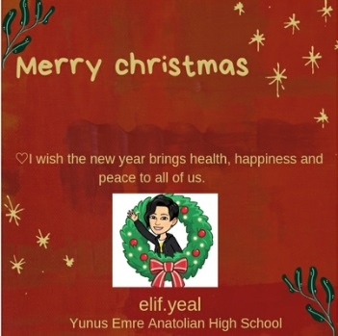
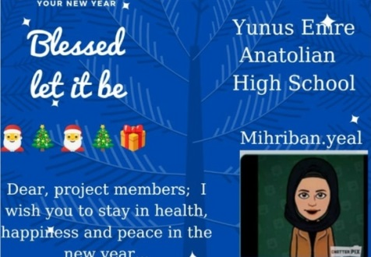
12.GOAL: RESPONSIBLE CONSUMPTION AND PRODUCTION YUNUS EMRE ANATOLIAN HIGH SCHOOL TEAM'S NEW YEAR ACTIVITIES
We designed new year cards with canva web2 tool.
We designed a decorative Christmas tree using waste materials.🎄We both had fun and learned to evaluate waste materials.
https://youtu.be/XgKgG7KHf9c

Slide 5
15.GOAL: LIFE ON LAND GOOD IDEAS FOR ANIMAL FRIENDS
IN OUR CITY, BİNGÖL, SNOW IS CONTINUOUS FOR DAYS IN WINTER AND OUR LIFE IS DIFFICULT. THIS IS EVEN DIFFICULT FOR ANIMALS. THAT'S WHY WE DEVELOPED AN IDEAS FOR BIRDS THAT CANNOT FIND FOOD ON SNOW.
WE DESIGNED A FEED CONTAINER FOR BIRDS FROM WASTE PLASTIC BEVERAGE BOTTLE.
https://youtu.be/DM2T1K_miec
https://youtu.be/nkMuQGUsDfA
https://youtu.be/Hx2ayZB86CE
https://youtu.be/Rj6s9ItZnfY
ALSO, WE CAN PROVIDE THERMAL INSULATION OF ANIMALS' SHELTERS, USING OLD BLANKETS IN OUR HOME, SO THAT THE ANIMALS LIVING ON THE STREET ARE NOT AFFECTED BY THE COLD AIR IN WINTER
https://youtu.be/EuxMXoaK_Ew

Slide 6
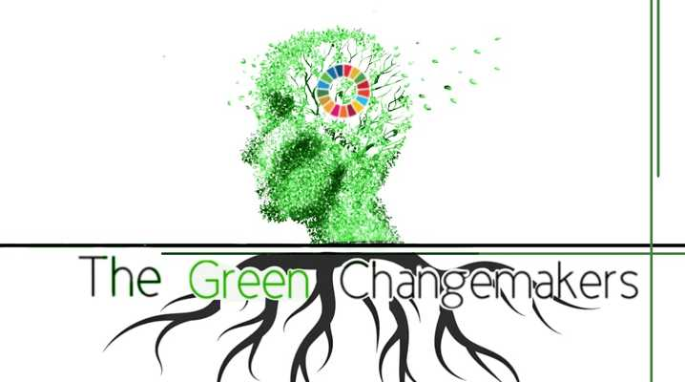
THANKS FOR WATCHING

