Slide 1
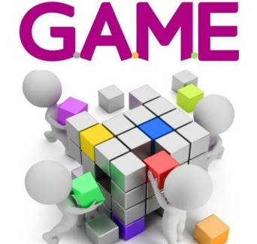
eTwinning project What about playing a G.A.M.E. with me? (G. Games- A. Active learning- M. Mind - E. Education)
STUDENTS EVALUATION
2018-06-04

Slide 2
We are from...
10 students from KONYA, Turkey
(teachers Zahide Kicali and Ibrahim Resuloglu)
7 students from KEDAINIAI, Lithuania
(teacher Ingrida Jurevičienė)
14 students from ADANA, Turkey
(teachers TUĞBA GÜNGÖR ŞAHİN and Ali Coşkun)
5 students from Dąbrowie Górniczej, Poland (teacher Katarzyna Zmysłowska)
4 students from ROKIŠKIS, Lithuania
(teacher Jolanta Viršulienė)

Slide 3
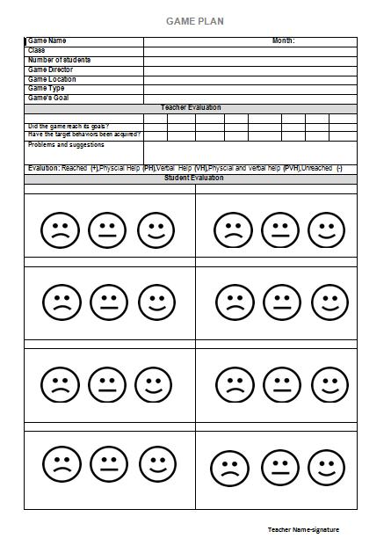
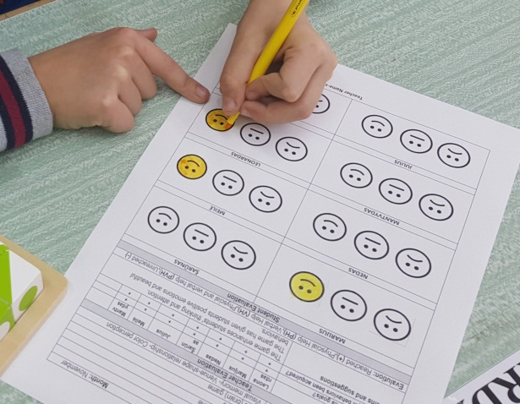
Evaluation symbols chosen by students
- I liked very much
- I liked
- I didn’t like

Slide 4
Number of students participating in the games
Teacher | Q-Bitz | Candy | Learning Apps JigsawPlanet | Tangram Tangramino | Skippity | Blinds Man’s Puf | Puss in the corner
Ingrida | 7 | 7 | 7 | 7 | 7 | 7 | 7
Zahide | 6 | 6 | 5 | 4 | 6 | 6 | 6
İbrahim | 3 | 3 | 4 | 4 | 2 | 4 | 4
Ali | 6 | 6 | 6 | 6 | 6 | 5 | 9
Tuğba | 5 | 5 | 5 | 5 | 5 | 5 | 5
Katarzyna | 4 | 4 | 4 | 5 | 4 | 4 | 4
Jolanta | 4 | 4 | 4 | 4 | 4 | 4 | 4
TOTAL | 35 | 35 | 35 | 35 | 34 | 35 | 39

Slide 5
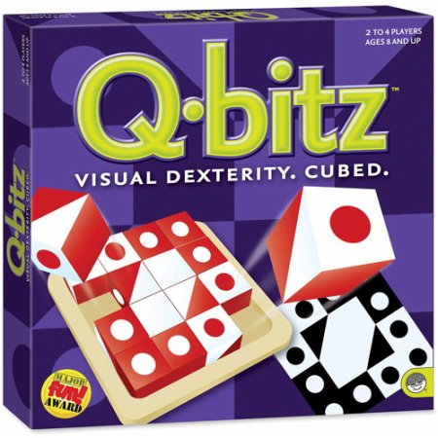
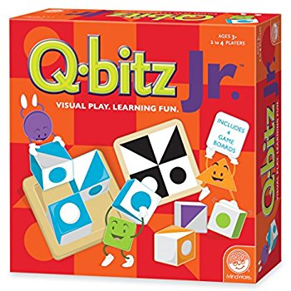
The game Q-BITZ

Slide 6
Did you like game Q-BITZ?
33 students
2 students
0 students

Slide 7
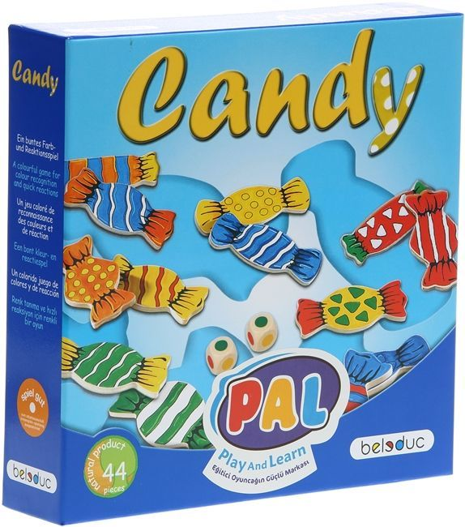
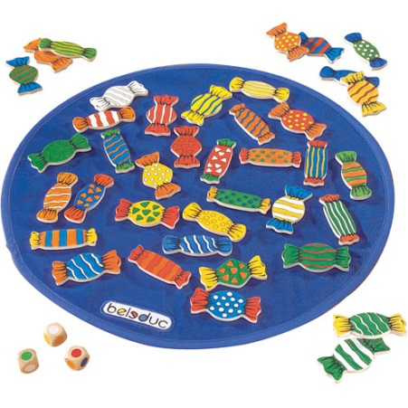
The game CANDY

Slide 8
Did you like game CANDY ?
35 students
0 students
0 students

Slide 9
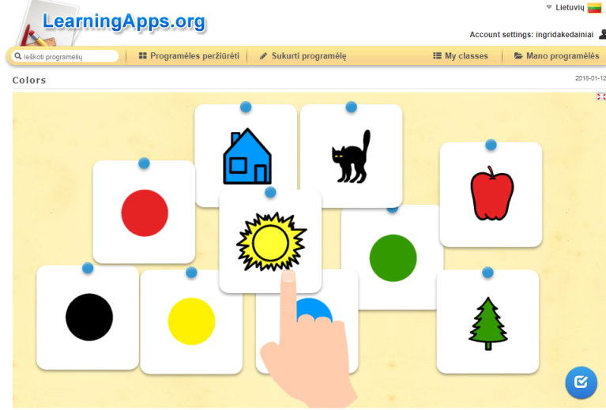
The Web 2.0 games LEARNINGAPPS and JIGSAW

Slide 10
Did you like Web 2.0 games: LEARNINGAPPS and JIGSAW?
35 students
0 students
0 students

Slide 11
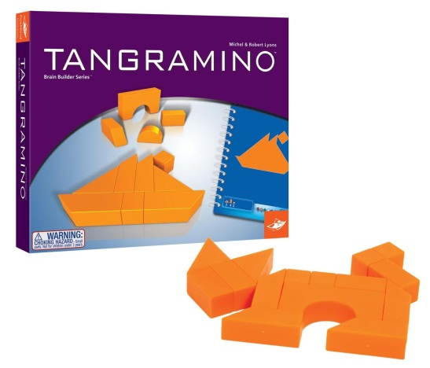
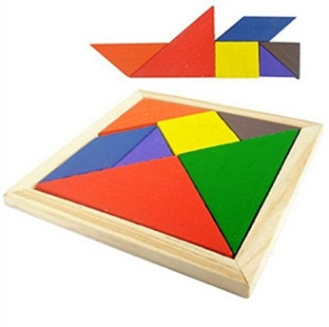
The games TANGRAMINO and TANGRAM

Slide 12
Did you like games TANGRAMINO and TANGRAM ?
35 students
0 students
0 students

Slide 13
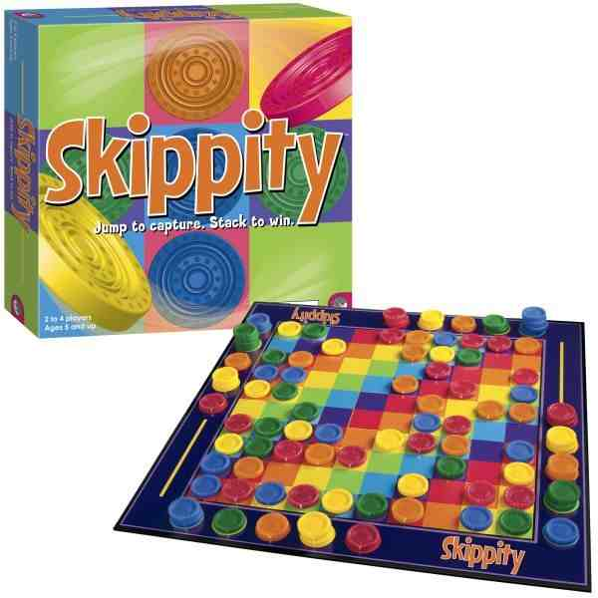
The game SKIPPITY

Slide 14
Did you like game SKIPPITY ?
34 students
0 students
0 students

Slide 15
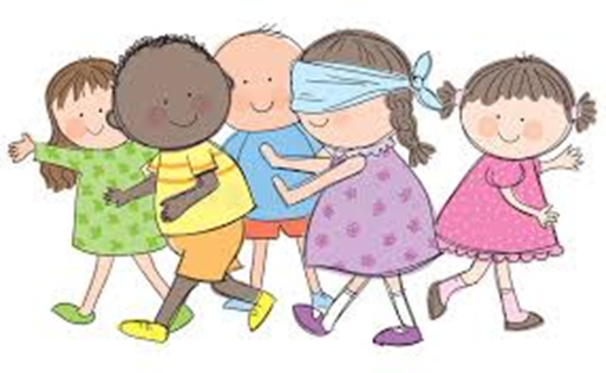
The game BLIND MAN’S BUFF

Slide 16
Did you like game BLIND MAN’S BUFF?
35 students
0 students
0 students

Slide 17
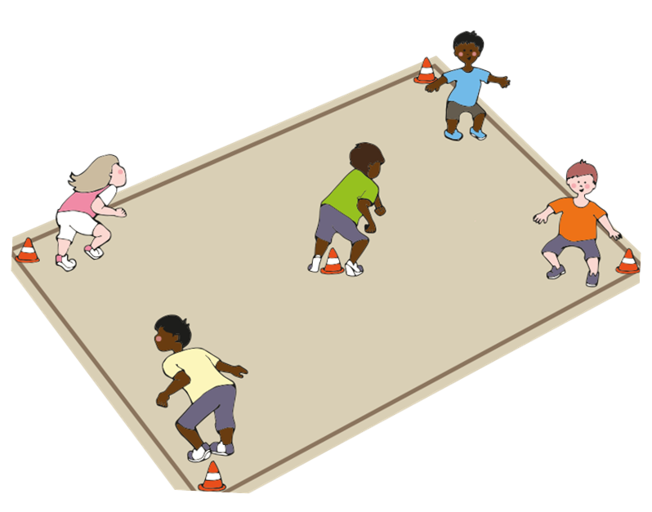
The game PUSS IN THE CORNER

Slide 18
Did you like game PUSS IN THE CORNER ?
39 students
0 students
0 students

Slide 19
Results
All the students liked very much the games.
Students play games daily at lessons and at leisure.
Games were very valuable for students in the educational sense.

