Slide 1
THIS IS OUR SCHOOL
Ferruccio Parri-Pinerolo

Slide 2
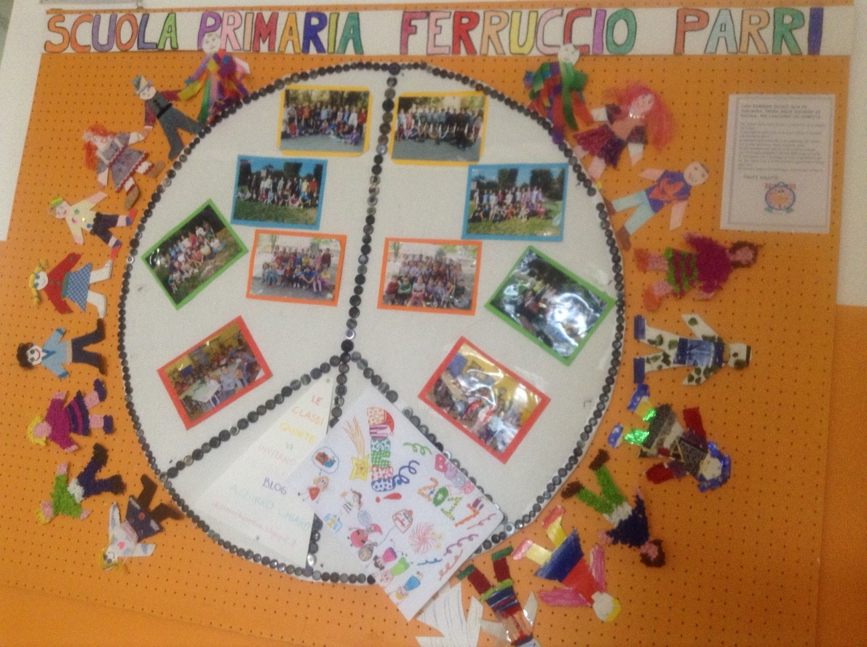
In our school there are more than 200 children aged from 6 to 11

Slide 3
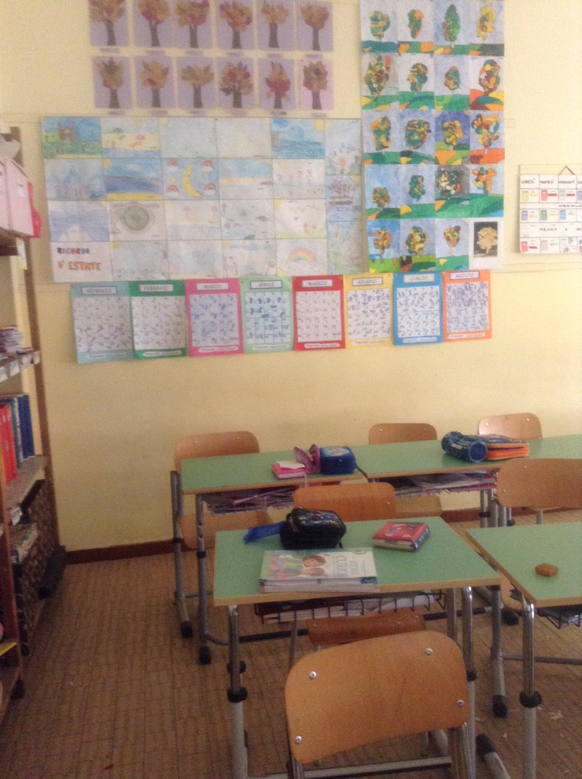
This is our classroom

Slide 4
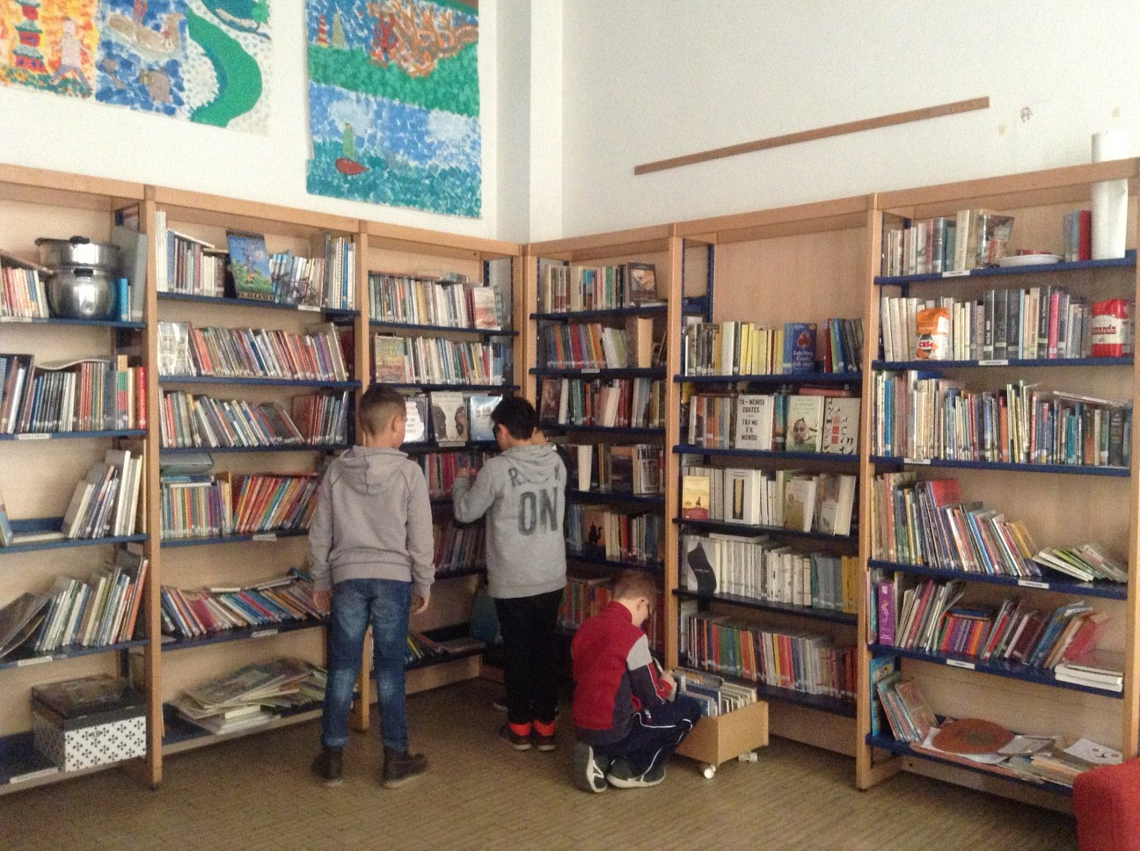
In our school there is a library

Slide 5
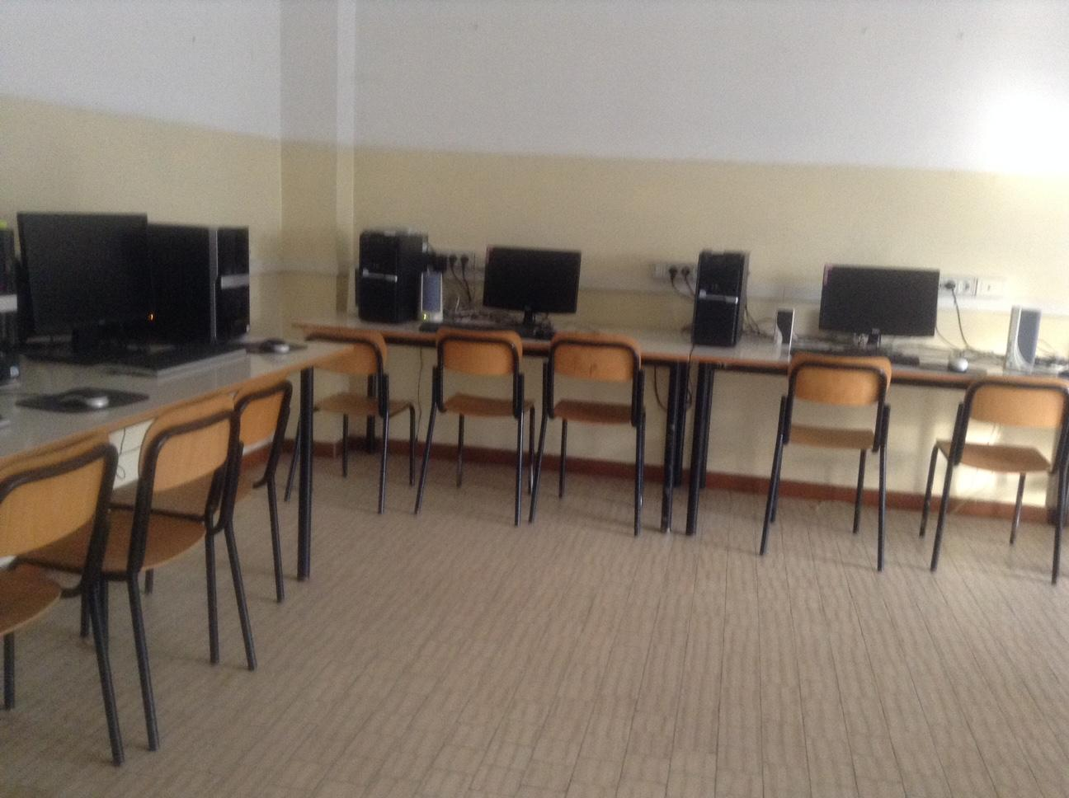
This is the computer room

Slide 6
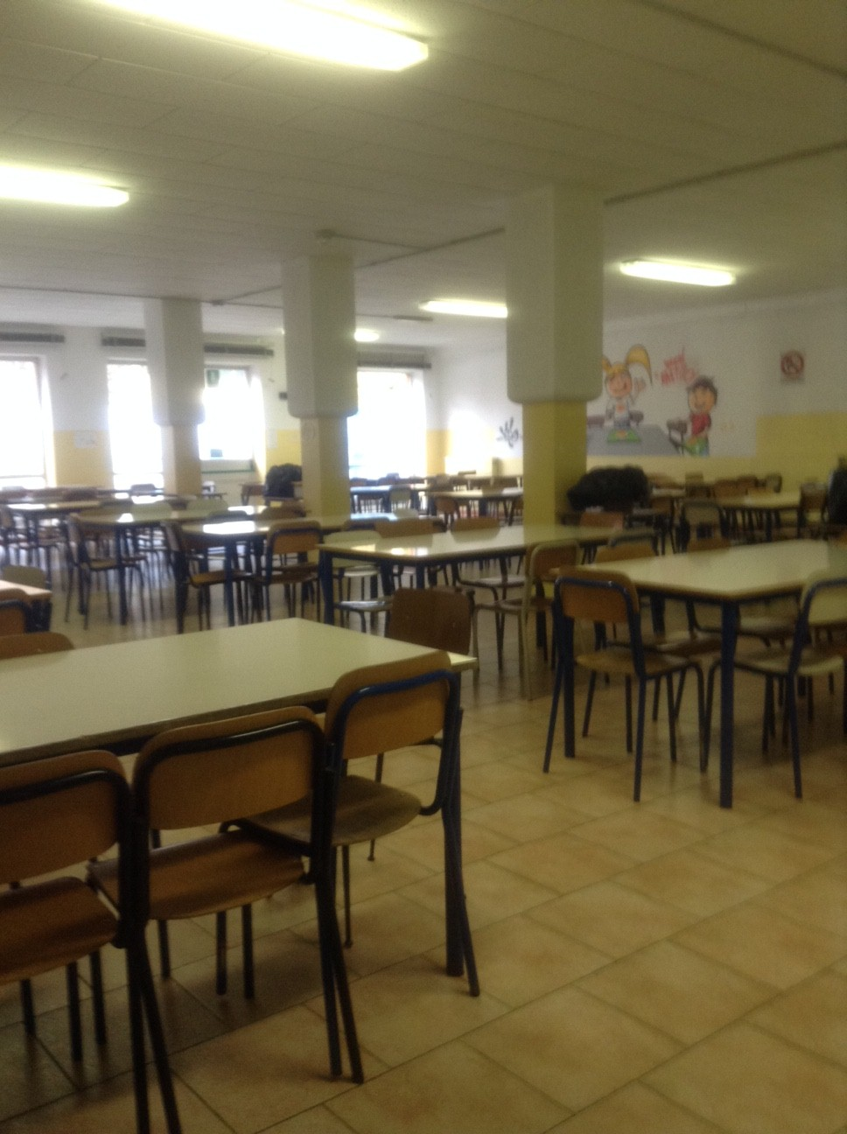
This is the dining room

Slide 7
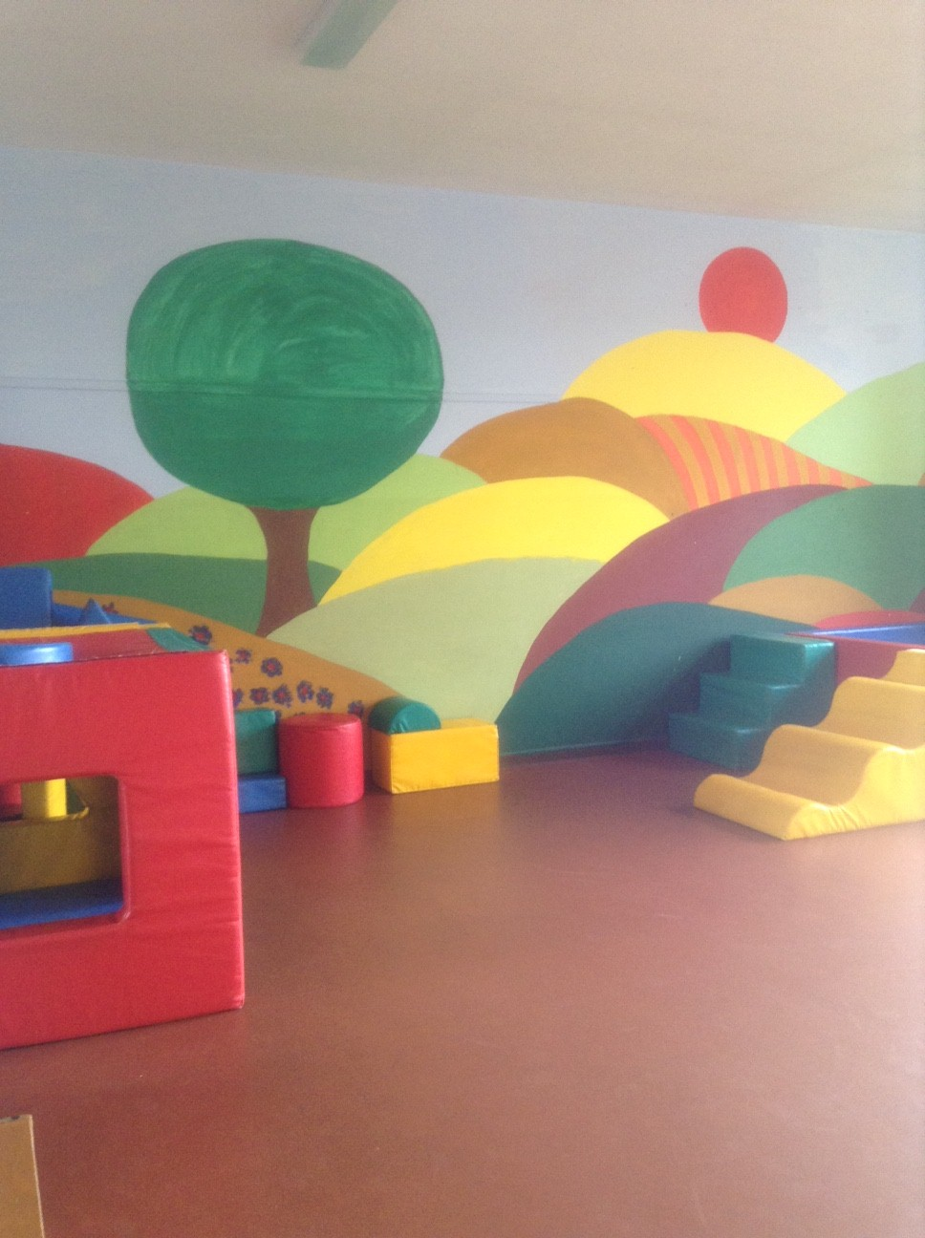
This is
the
playroom for
little children

Slide 8
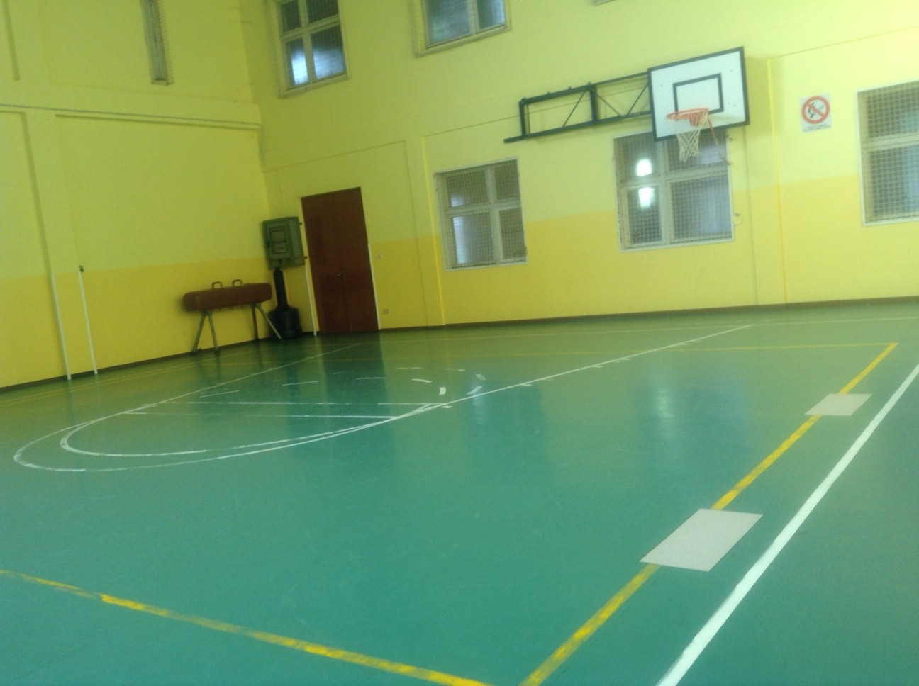
And this is the gym!

