Slide 1
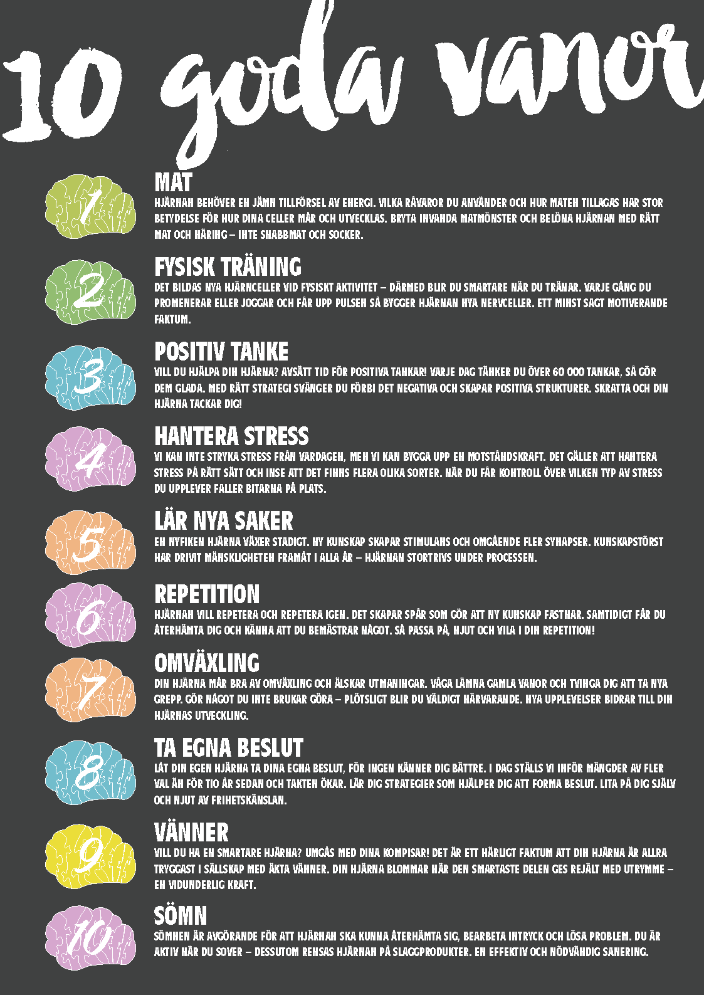
LEARN MORE
ABOUT
10 GOOD Habits

Slide 2
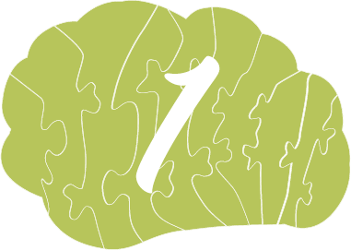
FOOD
What you eat affects how you feel and how your brain works.
Eat brain-smart food!
Examples of brain smart food:
Whole grains
Fish
Avocado and blueberries
Dark chocolate, fruit and strawberries
Egg
Meat and chicken
olives
Broccoli

Slide 3
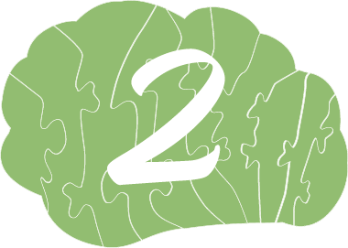
PHYSICAL TRAINING
New brain cells are formed during physical activity - thus you become smarter when you exercise. Every time you walk

Slide 4
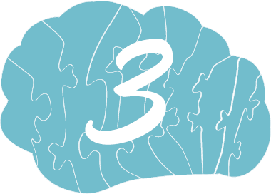
POSITIVE THOUGHTS
Want to help your brain? Set aside time for positive thoughts! Every day you think over 60,000 thoughts, so make them happy. With the right strategy, you swing past the negative and create positive structures. Laugh and your brain thanks you!

Slide 5
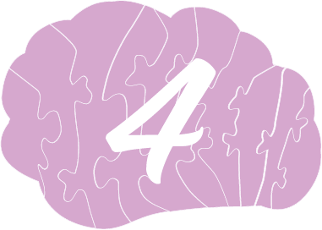
HANDLE STRESS
We cannot relieve stress from everyday life, but we can build up a resilience. It is important to manage stress properly and to realize that there are several different varieties. When you get control of what kind of stress you are experiencing, the pieces fall into place.

Slide 6
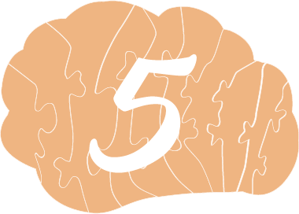
LEARN NEW THINGS
A curious brain is growing steadily. New knowledge creates stimuli and immediately more synapses. The thirst for knowledge has propelled humanity forward in all its brains during the process.

Slide 7
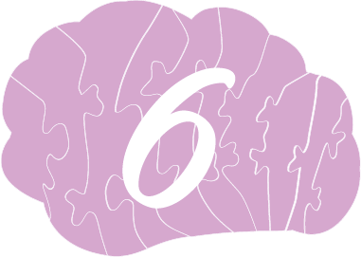
REPETITION
The brain wants to repeat and repeat again. It creates tracks that make new knowledge stuck. At the same time, you get to recover and feel that you are mastering something. So watch out, enjoy and rest in your rehearsal!

Slide 8
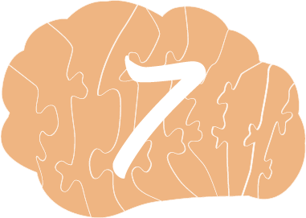
VARIETY
Your brain feels good about change and loves challenges. Dare to leave old habits and force yourself to take new grips. Do something you don't usually - suddenly you become very present, new experiences contribute to the development of your brain.

Slide 9
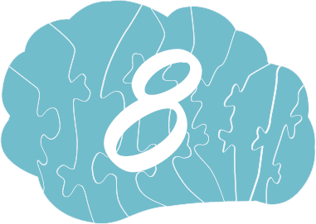
MAKE YOUR OWN DECISIONS
Let your own brain make your own decisions, because no one knows you better. Today we are faced with many more choices than ten years ago and the pace is increasing. Learn strategies that help you make decisions. Trust yourself and enjoy the feeling of freedom.

Slide 10
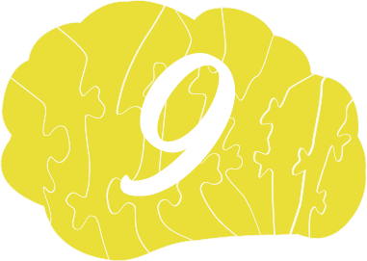
FRIENDS & RELATIONSHIPS
Want a smarter brain? Spend time with your friends!
It is a fact that your brain is most secure in the company of true friends. Your brain blooms when the smartest part is given a lot of space - a wonderful force.

Slide 11
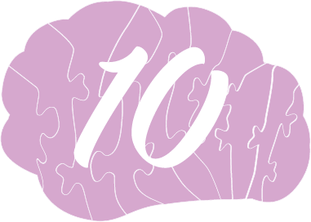
SLEEP
Sleep is essential for the brain to recover, process impressions and solve problems. You are active when you sleep - in addition, the brain is cleansed of slag products, an effective and necessary remediation.

