Slide 1
Good habit of the month: Diet

Slide 2
Why should you eat?
What we eat and how we eat affects our wellbeing in different ways.
When we eat healthily and regularly, we get what our body needs, which means we can cope more and feel better. On the other hand, when we eat unhealthily, the body does not get enough of everything it needs, and we become tired, more easily irritated and more difficult to concentrate.

Slide 3
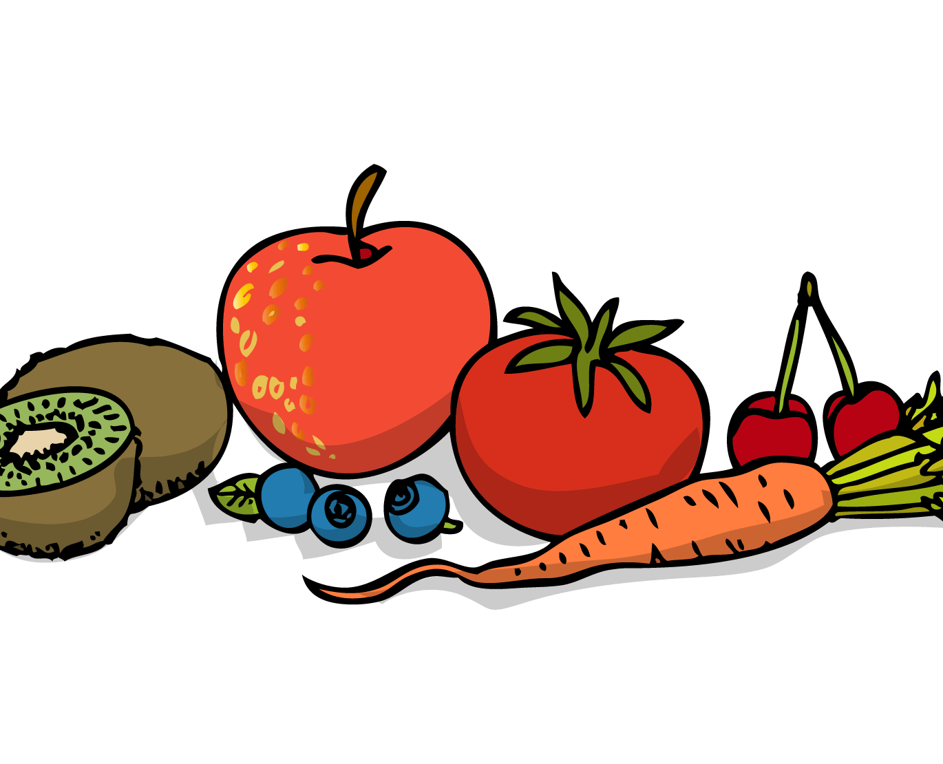
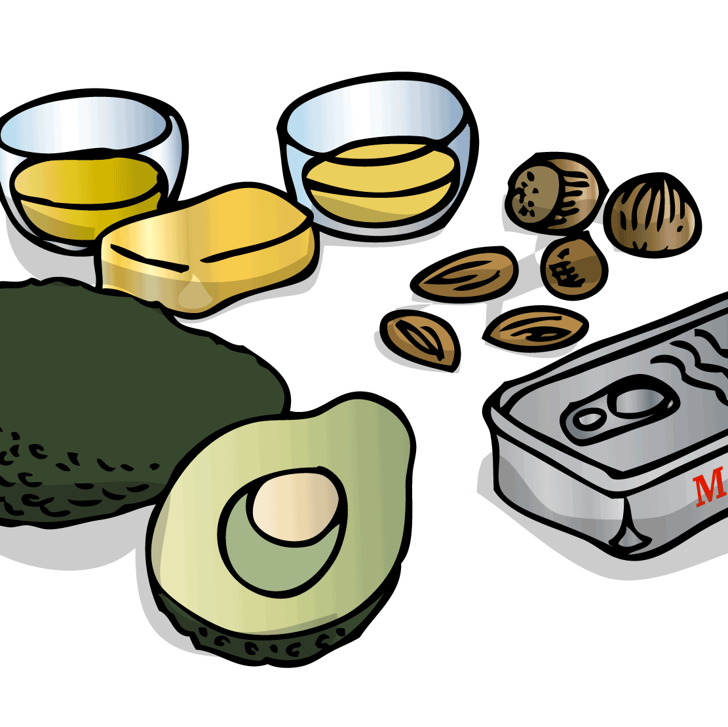
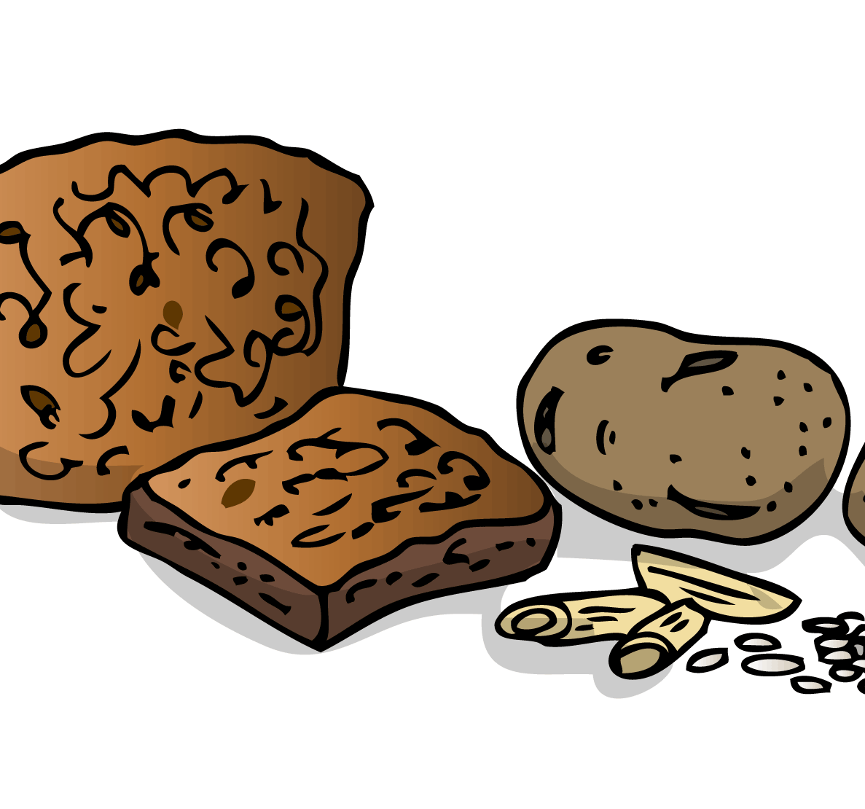
What will you eat?
The body and the brain need food and drink for you to grow, move, have fun, think and learn new things. There are many ways to eat well.
The body needs a mix of different kinds of food and almost all food is good but some things you should not eat too much or too often such as sweets, soft drinks, chips.
Eating healthy does not mean that you are not allowed to eat sweets, chips and soft drinks, but that you should limit your intake and eat it at times. Not every day. Thinking "Saturday candy" is good for us even when we are adults!
The breakfast - extra important meal for the brain. The breakfast needs to contain carbohydrates as this is brain fuel and something it has been without for a long time when we slept. If you have difficulty eating before you get started, a tip might be to take a walk before breakfast or to bring your food to school and eat there.

Slide 4
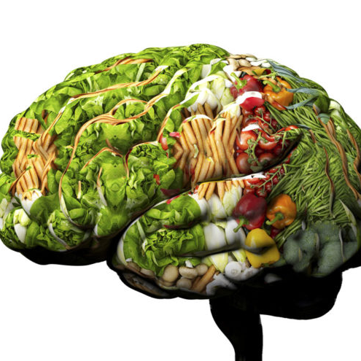
What is brain smart food?
Below you will see raw materials that are extra good for a smarter brain. Challenge yourself and make sure you get some things off the list every day!
Rye bread | Brussels sprouts | Spinach
Rolled oats | Strawberries | Lentils
Muesli | Ginger | Dark chocolate
Whole fruit | Blood pudding | Sunflower seeds
Fish | Lettuce | Quinoa
Seafood | Olive oil | Beans
Coffee | Avocado | Egg
Kale | Nuts | Blueberry

Slide 5
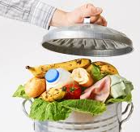
Food waste & environmental impact
About 19 kilos of edible food is thrown in the garbage and 26 kilos of food and drink is thrown away in the trash. The figures are per person and year.
Much of the food is thrown away because it is not eaten up in time - we buy too much, forget it at the far end of the refrigerator and throw away food that is left over instead of eating the leftovers.
But the waste costs more than money, it also costs for the environment. Producing food causes, among other things, greenhouse gases that affect the climate and also contributes to eutrophication. All this happens unnecessarily if we then throw away the food.

Slide 6
Tips, steps, to reduce your food waste
Plan your purchases - don't buy more than you need
Eat the food on time
Take care of the leftovers - make a food box for the next day and avoid cooking!

