Slide 1
Good Habits of the Month: Friends & Relationships

Slide 2
Friends & Relationships
Do you want a smarter brain? Hanging out with real friends!
Spending time with genuine friends gives your brain confidence. The brain releases the garden and opens its arms.
Friends and relationships give the smart part free space. That's why you get creative, skilled and smart when you interact with people you like!

Slide 3
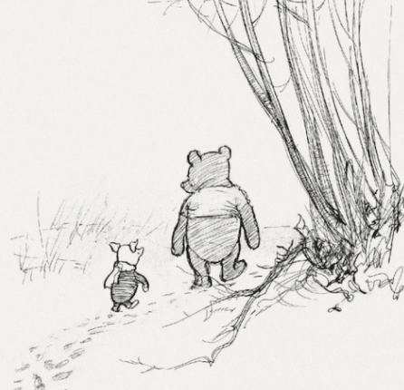
Winnie the Pooh: How do you spell for love?
Piggy: You don't spell it, you know it.

