Slide 1
Use of ICT in Geography
Facts about the school:
Students have no access to tablets /laptops.
Possible use of mobiles Access to labs very limited as there are only 4 labs and they are used by IT teachers and Media Studies teacher.

Slide 2
Web tools
1- To improve students' understanding of course materials
Click on images or links to access examples of the use of ICT in Geography

Slide 3
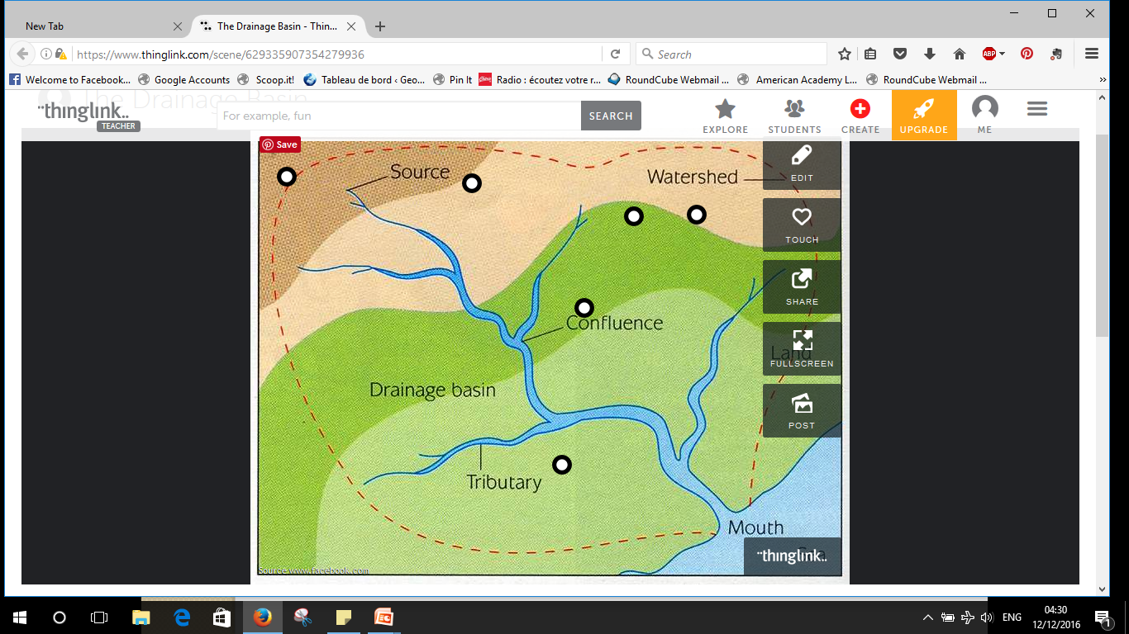
Thinglink

Slide 4
ThingLink makes your images interactive by adding notes, links, another images and even YouTube videos on top of them.

Slide 5
2- To improve long-term memory and literacy
In our school, the majority of students are EFL students. I have found this web tool to create a fun activity to learn/revise new key words - year 2 (KS3 year 8).

Slide 6
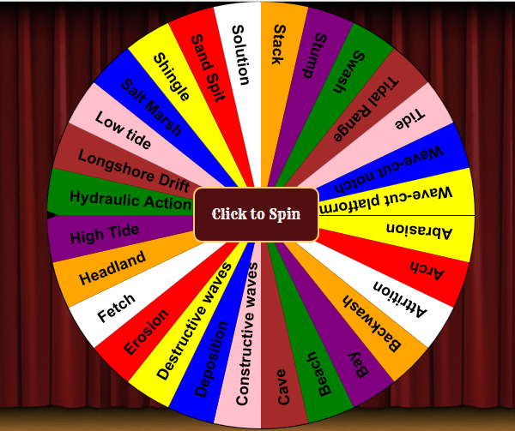
Random key word picker on coasts

Slide 7
3- For presentations
Use of Prezi by the students for PBL
Sustainable schools

Slide 8
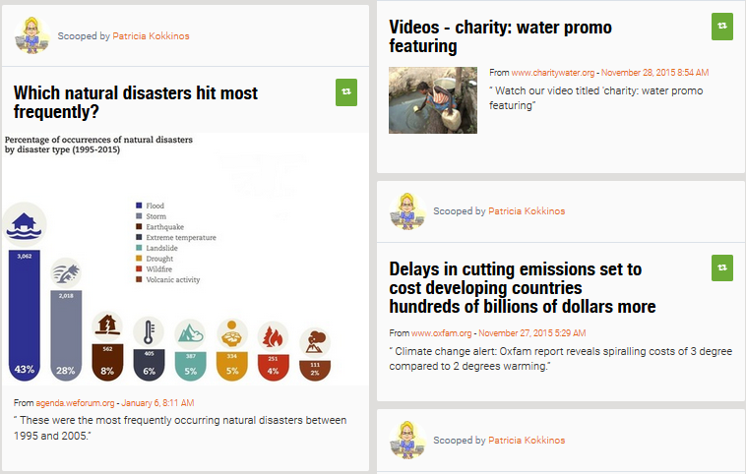
4- To curate resources

Slide 9
5- Other use of
Ask students to curate articles on a specific topic.
The main drawback of this tool is that you can’t create more than one topic.

Slide 10
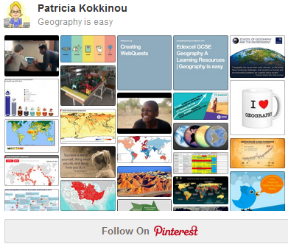
6- Alternative tool: Pinterest

Slide 11
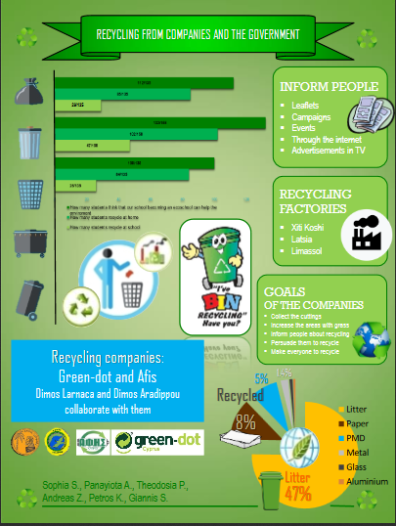
7-Use of Infographic to create poster
10 free tools for creating infographics

Slide 12
Use of a blog/site
Linked to a public Facebook page and twitter account
Linked to a site on teaching methods
Notes:
Click on images for internet links. Explain the use of Facebook and Twitter.

Slide 13
1- Access to notes/presentations/exam and revision skills
Online revision notes with videos
Knowledge organisers
Questions for self-quizzing and exam skills: e,g. Final Self-quizzing and exam skills- GCSE Coastal Landscapes
Revision skills
Notes:
Knowledge organisers are created by students and checked by teacher➔ skills on taking notes/ long-term memory.

Slide 14
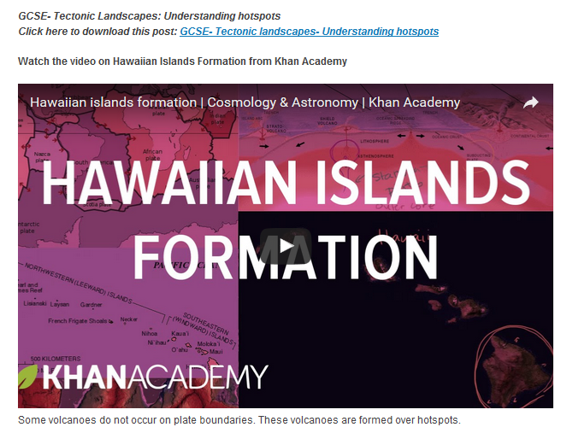
2- Blended learning
Lesson on hot spots (GCSE)

Slide 15
3- Project-based learning
Project-based learning: ‘How to make our school more sustainable’
Year 3 Project on eco-cities
YEAR 2 Project on processes of coastal erosion
Year 3 Three-dimensional scale models of plate boundaries
Year 3- Project on Boxing day tsunami

Slide 16
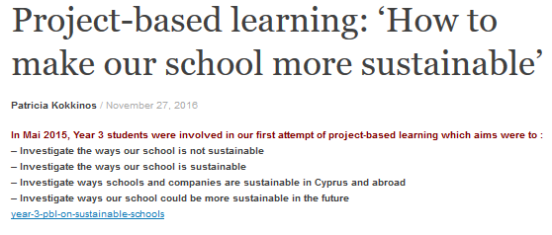

Slide 17
4- Promoting excellence

