Slide 1
Collaborative A/V project for the
Erasmus + Website
ǮIn E sharpǯ
NEKTARIOS RODOSTHENOUS

Slide 2
INBFLAT.NET → HOW DOES IT WORK?
© dr Nektarios Rodosthenous – AAL

Slide 3
INBFLAT.NET → DESCRIPTION
How can we use this idea?
© dr Nektarios Rodosthenous – AAL

Slide 4
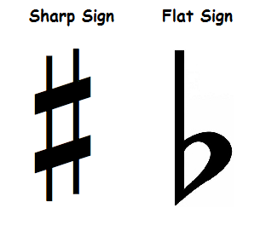
In E sharp: why this name?
Music theory:
International music alphabet: A – B – C – D - E – F – G
La Si Do Re Mi Fa Sol
Accidentals/ Alterations:
How does it relate to our programme?
© dr Nektarios Rodosthenous – AAL

Slide 5
A/V PLATFORM MATERIAL - HOW TO ACHIEVE THIS
Things to do:
Music:
Record traditional music[s] from each country, solo or group instruments
All recordings must be in the Key of E sharp = the key of F. Do not specify major (happy) or minor (sad) keys. Avoid using the 3rd note of the scale (Ab/ A)
Speech:
7 different countries will create a multi-lingual spoken-word project (Cyprus could use different accent on Greece)
This could be based on interviews of students on their exchange experiences?
They interviewees could comment on the folk music of their country.
Visual: Video-record important places (coast, countryside) from each country.
© dr Nektarios Rodosthenous – AAL

Slide 6
OUTCOMES OF THIS PROJECT
Use of existing technology
→ Creative use: the result will work musically and visually no matter what
→ YouTube platform: free and available to anyone
→ Video-recording: use of tablets and smartphones
Collaboration
→ Simple methodology → complex idea: Music and speech as
international language
→ Project: it highlights the main aim of the Erasmus + To create a
platform which unites 7 different countries, cultures and languages
© dr Nektarios Rodosthenous – AAL

Slide 7
When?!
→ Upload all the material (videos) BEFORE the trip to Greece!
© dr Nektarios Rodosthenous – AAL

Slide 8
THANK YOU FOR YOUR ATTENTION!
© dr Nektarios Rodosthenous – AAL

