Slide 1
Orienteering... Don´t get lost!
CREATIVE LEARNING & TEACHING ERASMUS + KA2
DOVER 16-20 APRIL 2018

Slide 2
AIM:
To know how to guide us and develop ourselves with freedom, security and autonomy in sites that we may know or not.

Slide 3
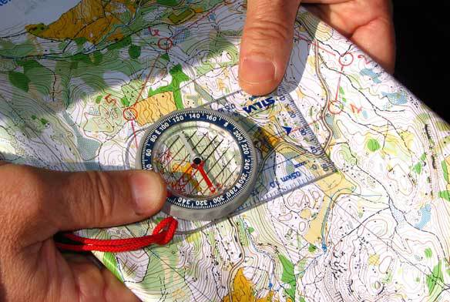
What is orienteering?
To recogize the situation of the North and therefore, the other cardinal points.
Any form of displacement where we need to take references and marks in order to locate ourselves.

Slide 4
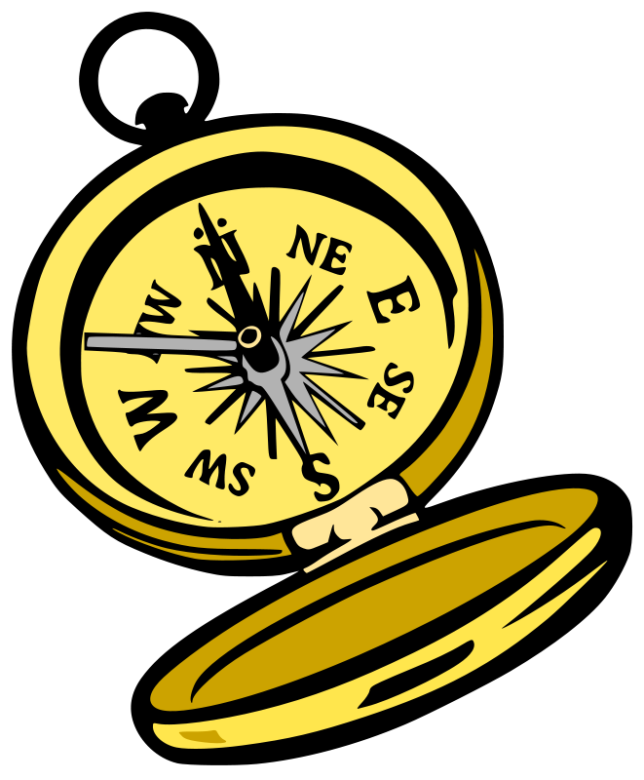
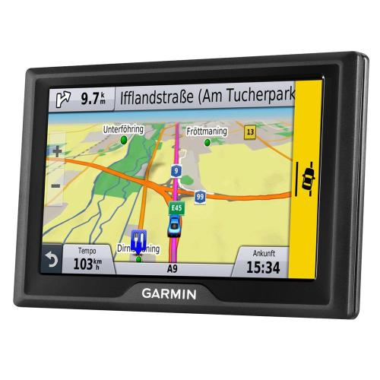
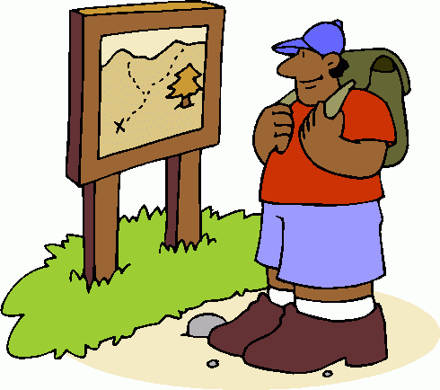
REFERENCES
NATURAL ELEMENTS: The sun, stars, vegetation...
ARTIFICIAL ELEMENTS: Posters, drawings, maps, guides, buildings, GPS or compasses.

Slide 5
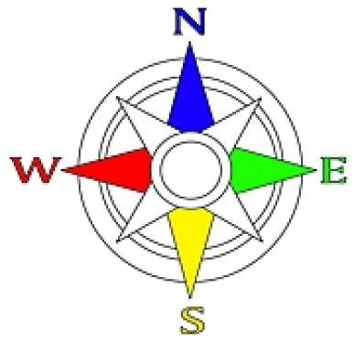
UNIVERSAL REFERENCES
CARDINAL POINTS:
NORTH
SOUTH
EAST
WEST

Slide 6
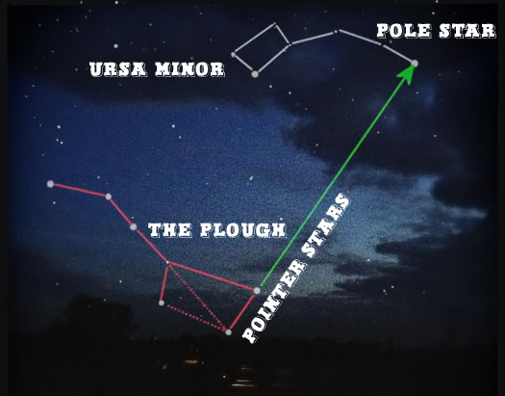
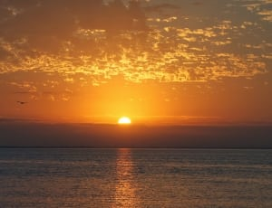
STARS
POLE STAR: At night, it helps us to find the North
SUN: It raises from the East. Sunset is on the West SHADOWS are really important.

Slide 7
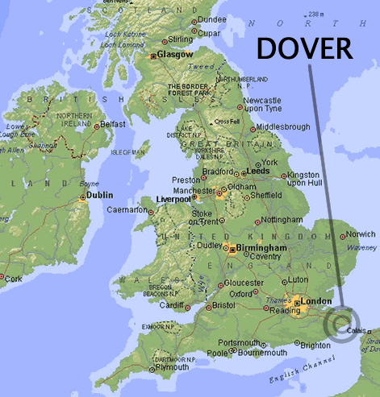
PLANS AND MAPS
Representation of a portion of Earth in reduced size.

Slide 8
LEGEND SCALE CONTOUR LINES
They define the height and slope of the ground. They join points of equal elevation.
A table with clear and schematic representation of the symbols and colors that are used on the map
The ratio of distance on the map to the corresponding distance on the ground.

Slide 9
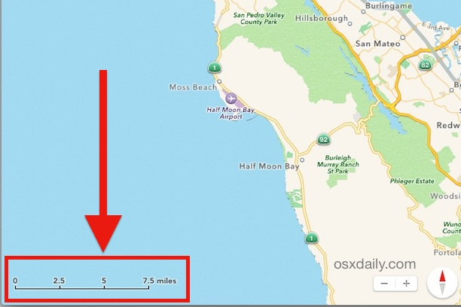
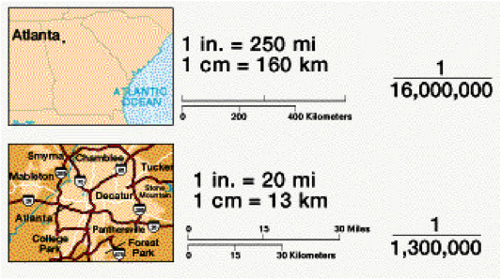
SCALE

Slide 10
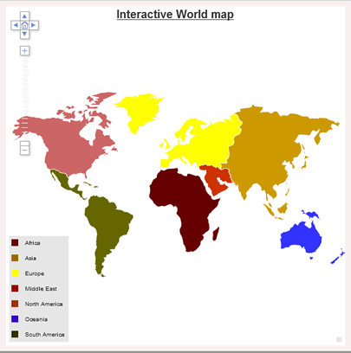
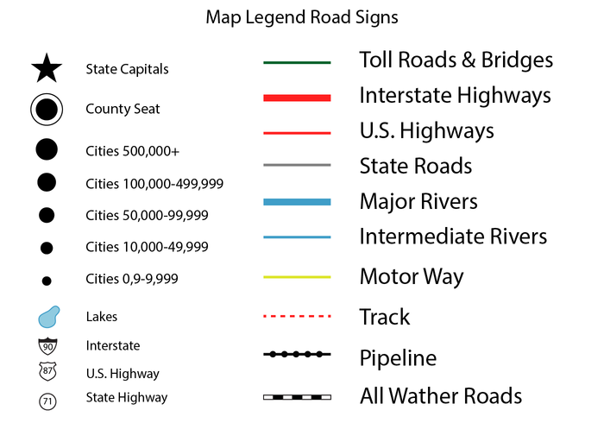
MAP LEGEND

Slide 11
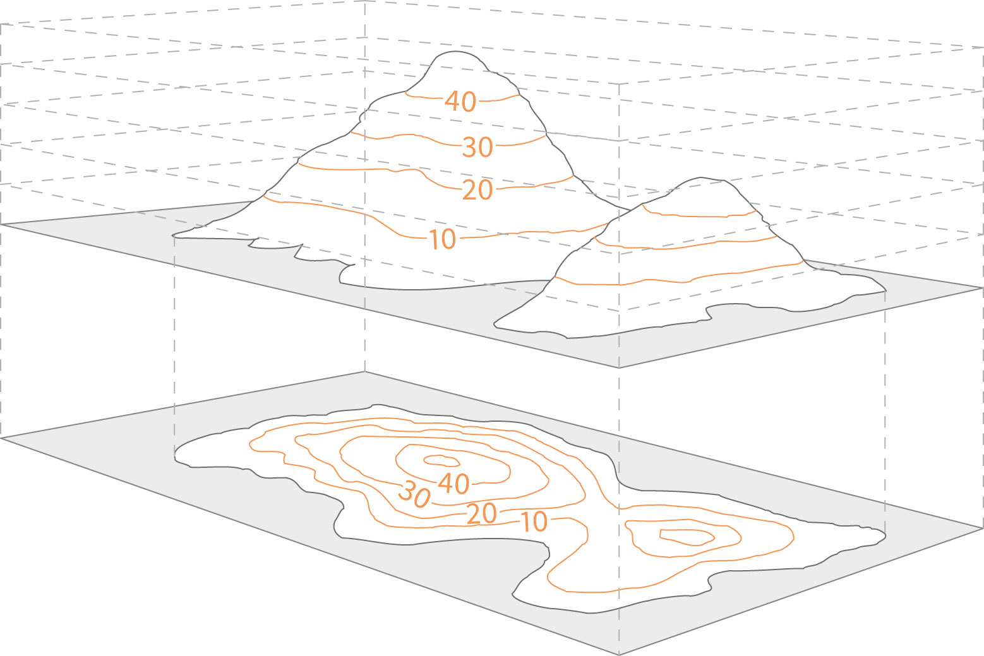
CONTOUR LINES

Slide 12
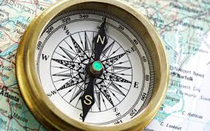
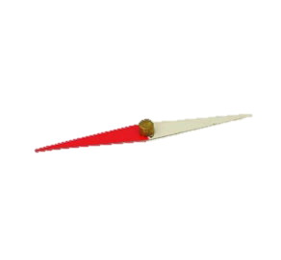
COMPASS
It consists of a magnetic needle.
One of the sides of the needle always points the North.

Slide 13
TEST WHAT YOU HAVE LEARNT!

Slide 14
ACTIVITIES
BOOKLET
PRACTICAL ACTIVITIES
ACTIVITY ONE
Cards with different pictures of the school. In pairs, locate in the school map where they are.
ACTIVITY TWO
Follow a table with an initial point and use the compass to determine the rhumb and distance to the next point. Repeat this action until reaching the last point.

Slide 15
TEST YOUR SENSE OF ORIENTATION!
Work in groups of four, and each will be divided in two pairs.
First, a couple will hide 2 cards in the school and they will mark in the map of Astor College where they have hidden the cards. The other partner needs to find them following the indications in the map.
Later, couples will change roles.

