Slide 1
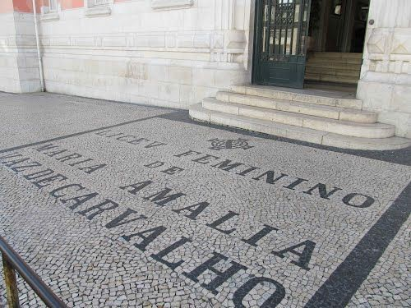


Creativity in teaching
and in learning
Erasmus +
Valencia
Matilde Santos
Ana Matilde Correia João Pedro Monteiro
★ 10th grade
13/12-17/12/2016
Florida secundaria

Slide 2
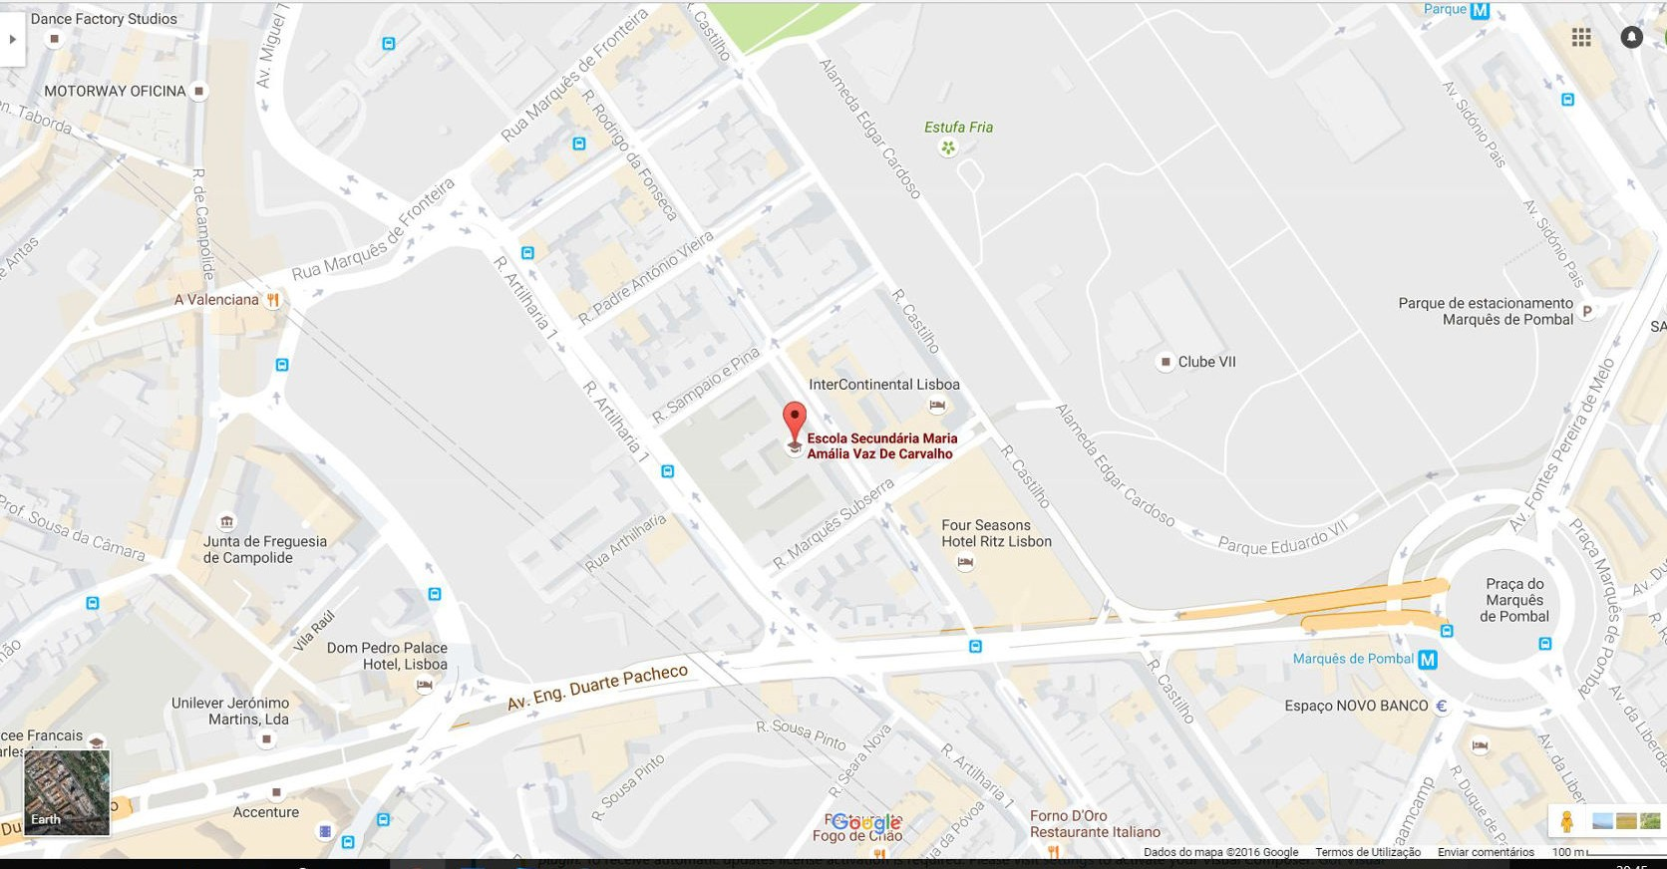
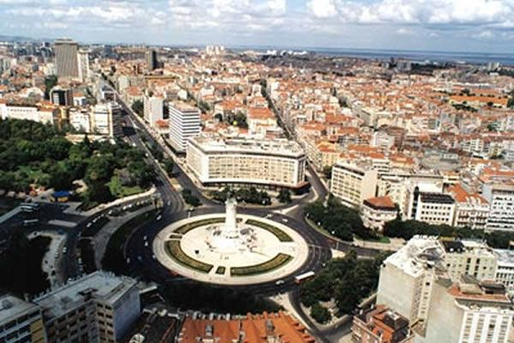
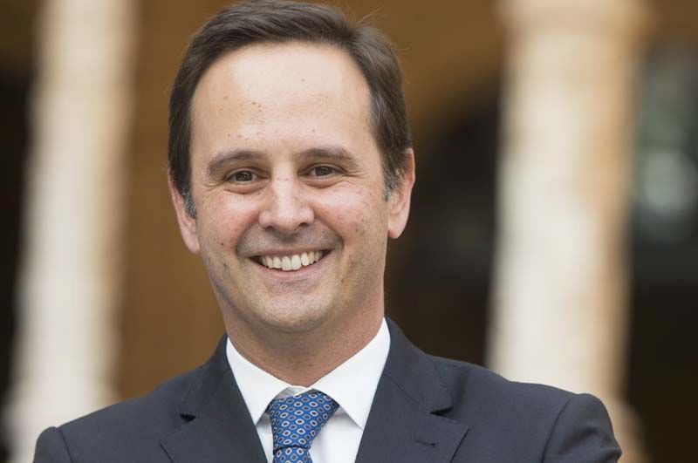
Index
Genealogy maps
Story of a river
3. Conflicts Worldwide
School location
4. We Suggest
Mayor of Lisbon: Fernando Medina

Slide 3
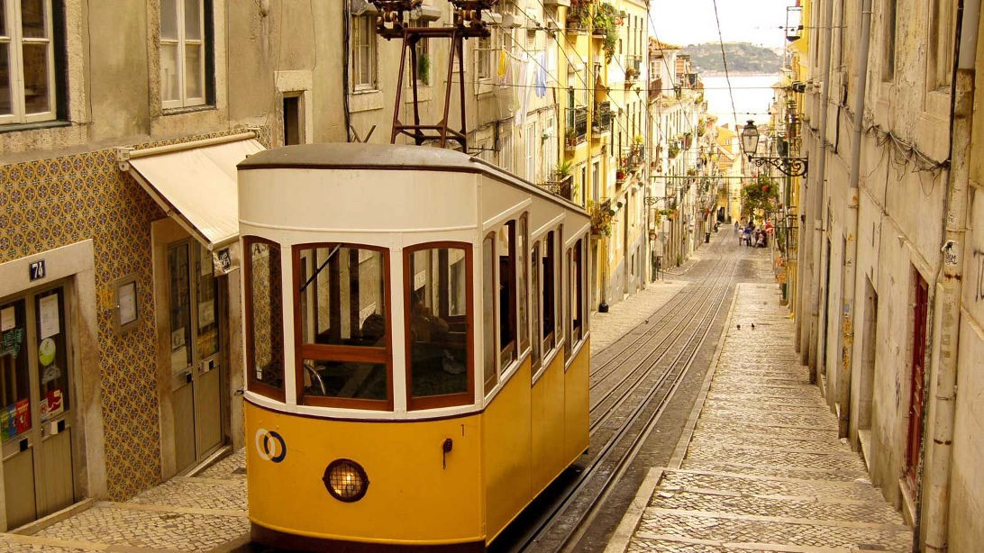
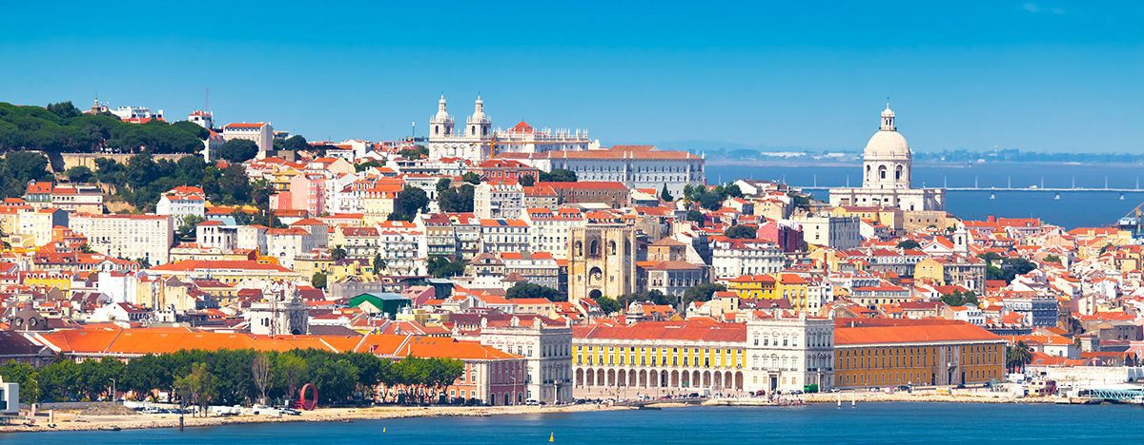
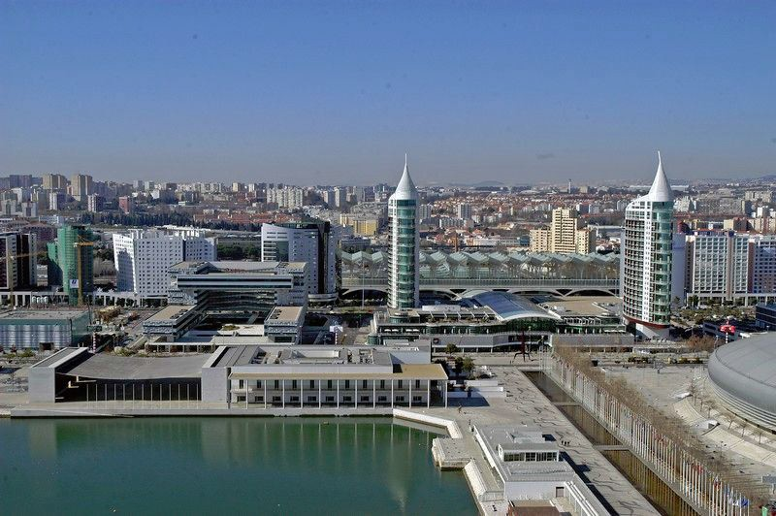
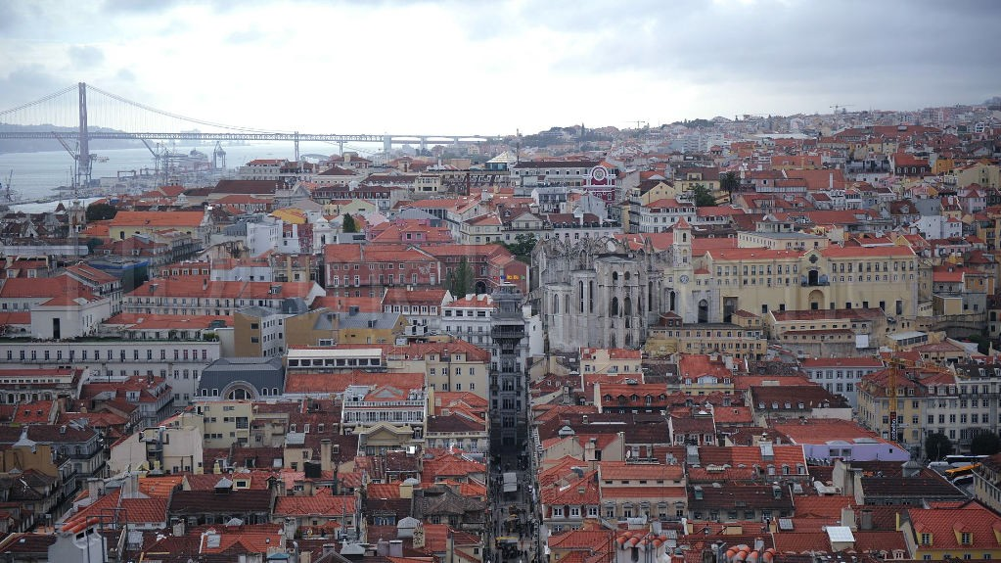
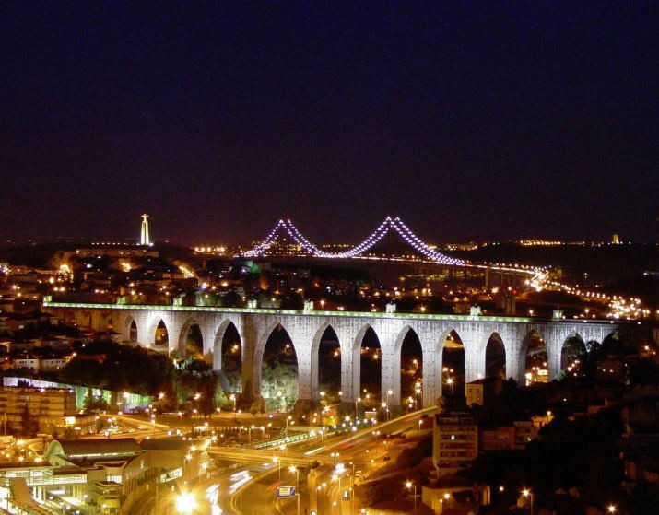
Portugal
Lisbon

Slide 4
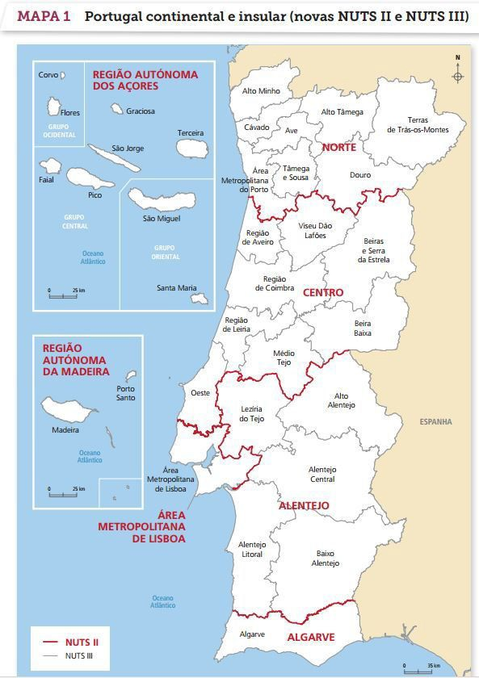
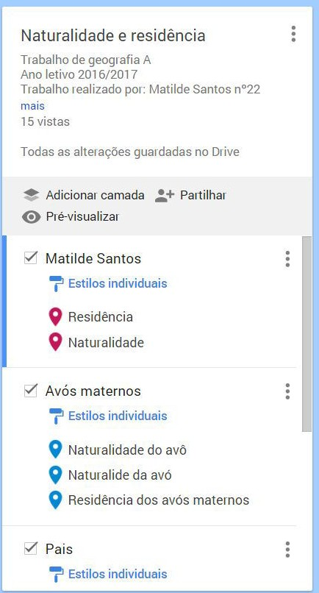
1. Genealogy maps
Administrative divisions of Portugal
Map legend

Slide 5
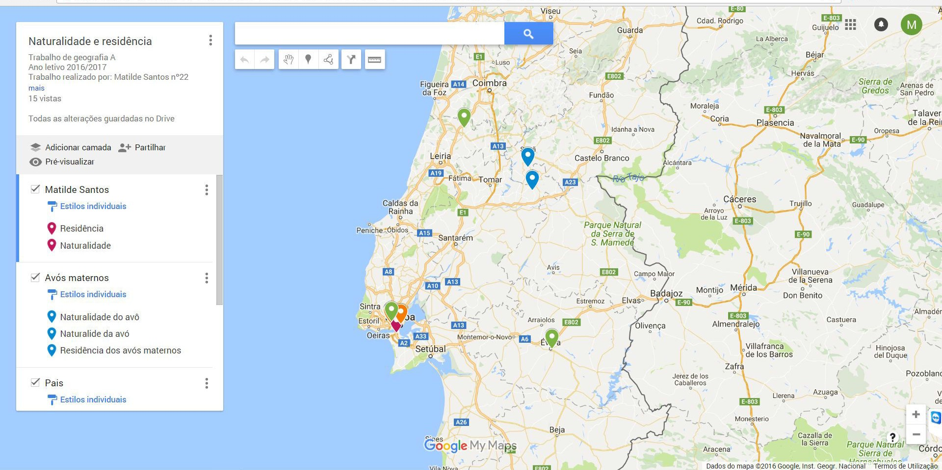
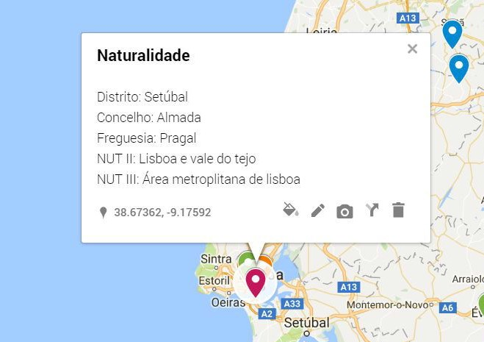
Genealogy maps
Matilde Santos

Slide 6
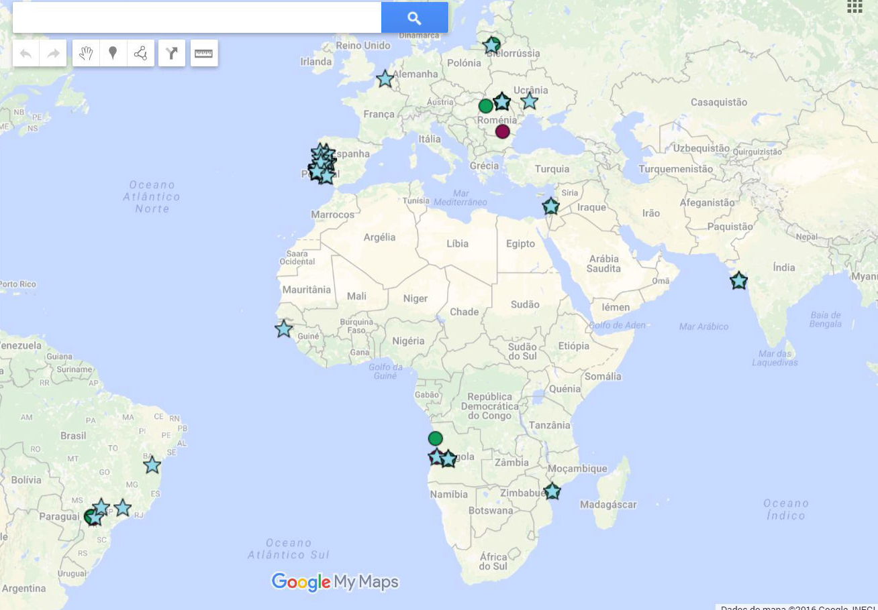
Genealogy maps
10ºSE1 - Our class

Slide 7

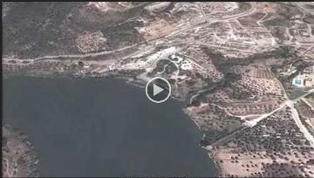
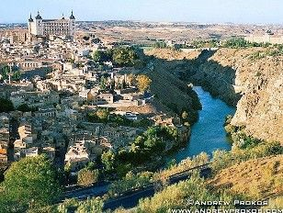
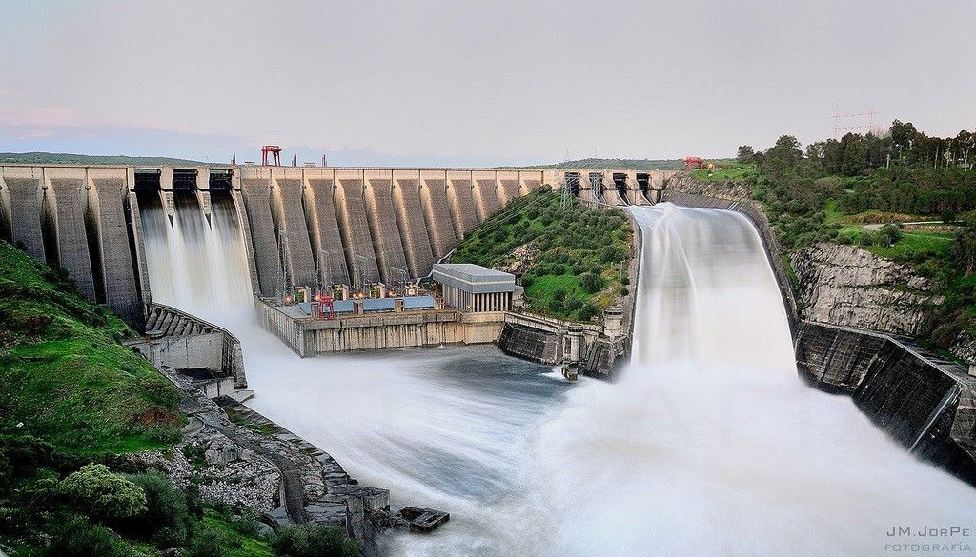
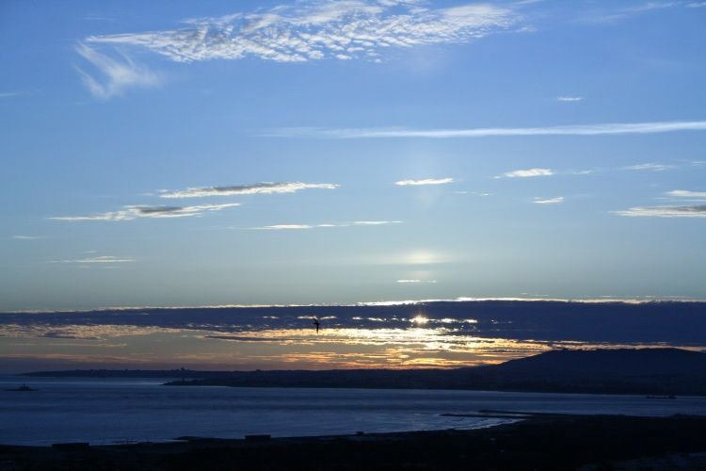
2. A river story...
Toledo, España
Presa José Maria de Oriol,España
River mouth of
Tejo,Portugal

Slide 8
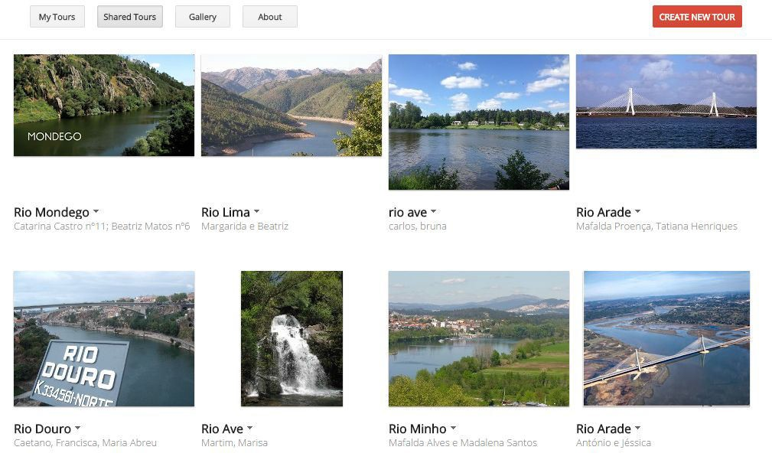

Many rivers... many stories...

Slide 9

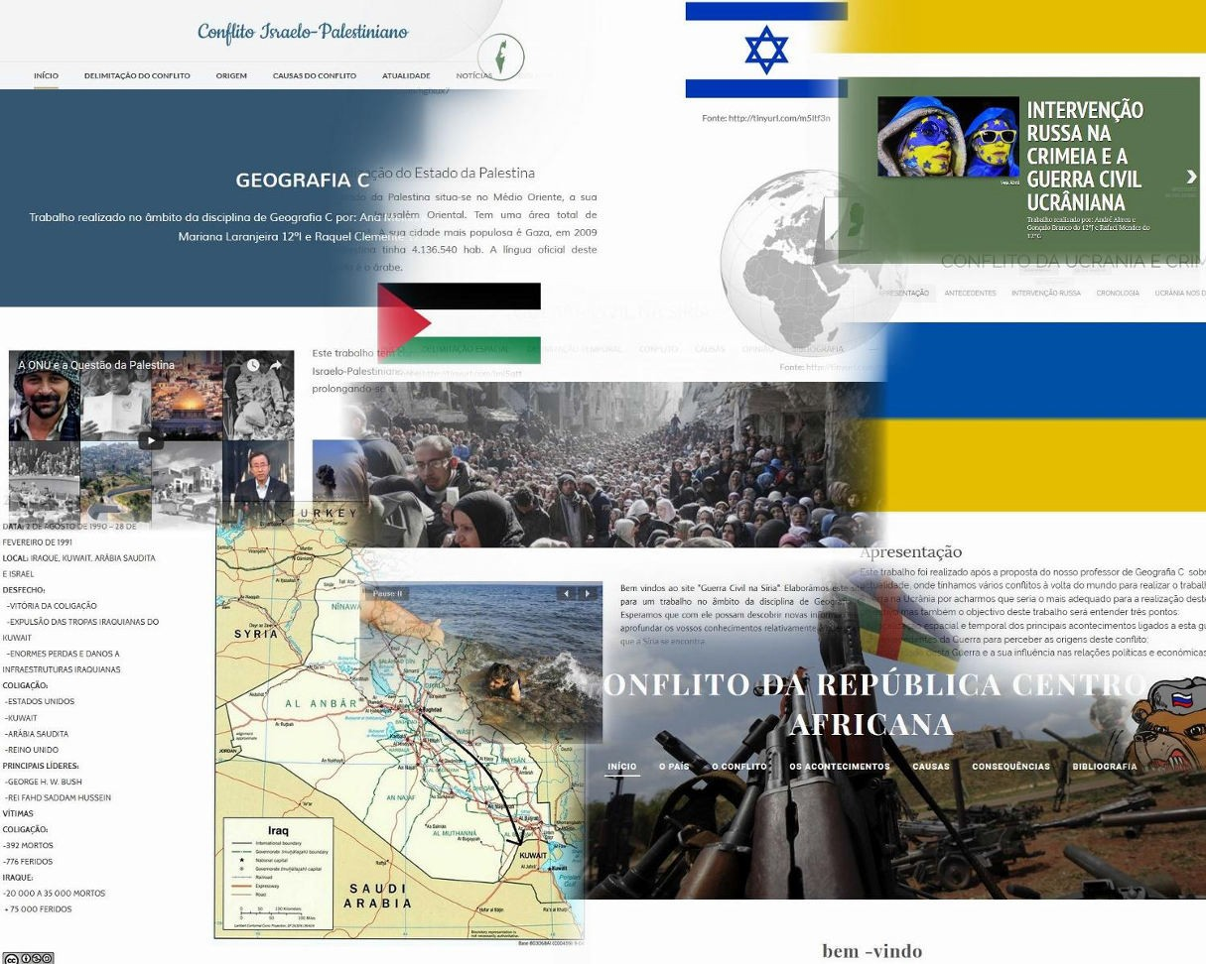

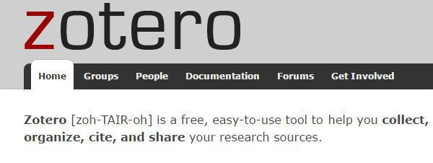
3. Ways of doing a different school assignment
Organise, Integrate
Websites with Weebly

Slide 10
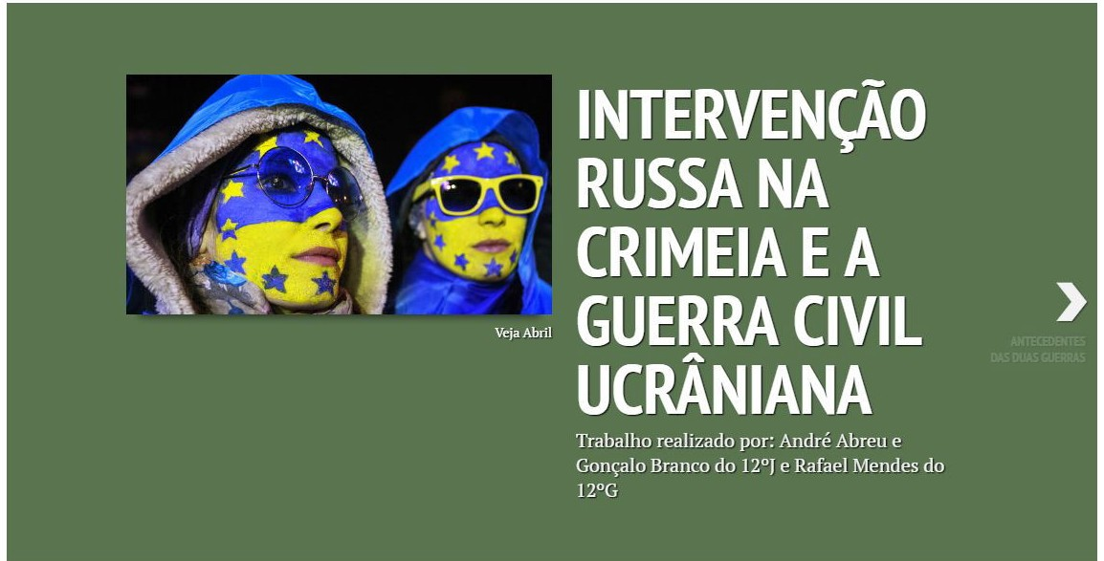

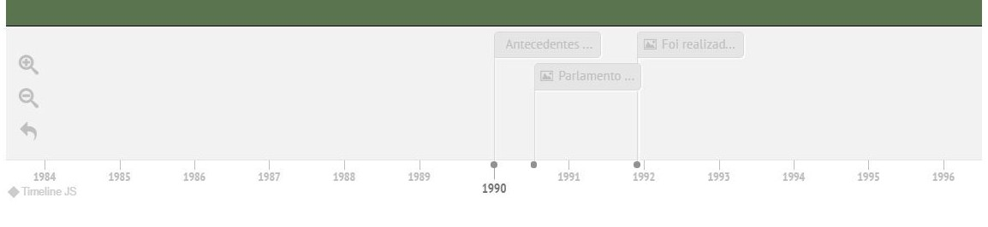
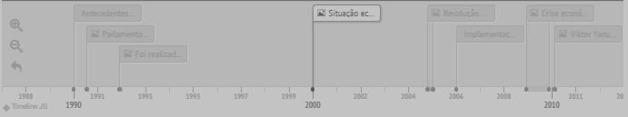
When did it happen?

Slide 11
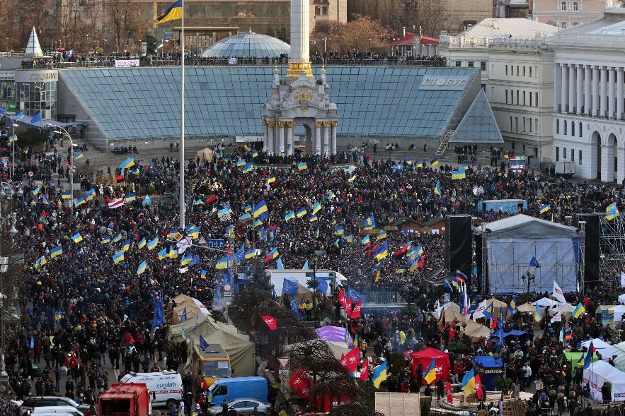

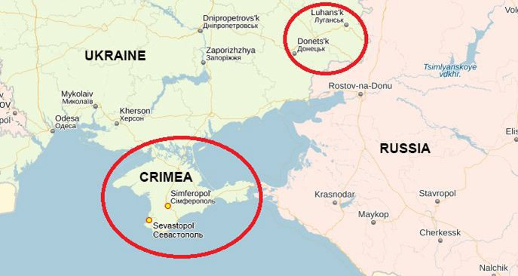
Conflict in Ukraine (Website)
Website: http://conflitoucraniaecrimeia.weebly.com/

Slide 12
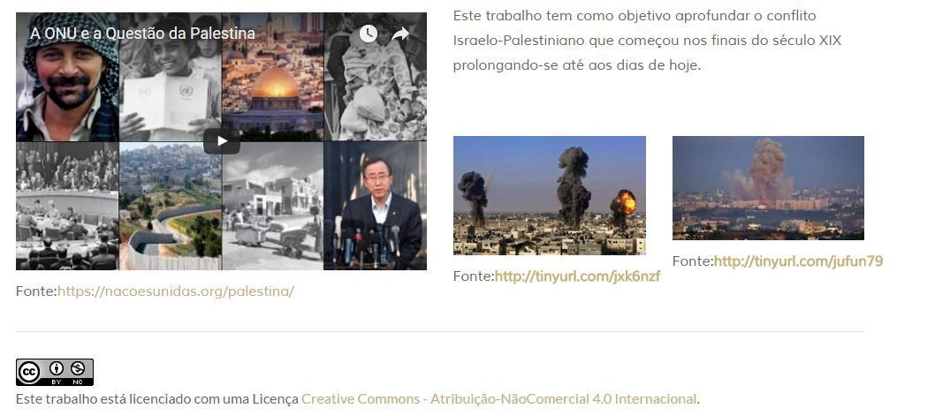

We are the authors...

Slide 13


We Suggest !
The ‘We Suggest’’ project is aimed at students and Geography teachers of 11th grade.
Identify problems in your area of residence or in the School Area
Giving suggestions to solve the problems.

Slide 14

We Suggest
In 2015/2016, 46 Schools from the North to the South of Portugal, including The Madeira and Azores Archipelago.
International recognition for originality and innovation .
Already being implemented in several states of Brazil and also here in Spain.

Slide 15

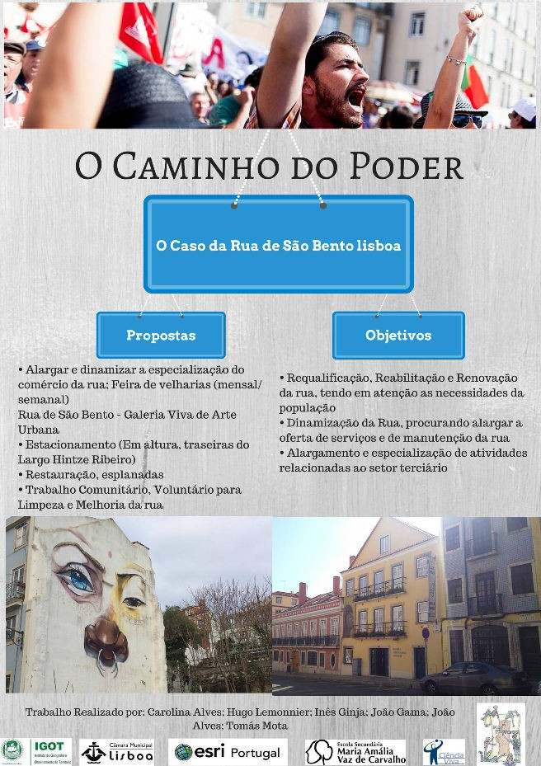
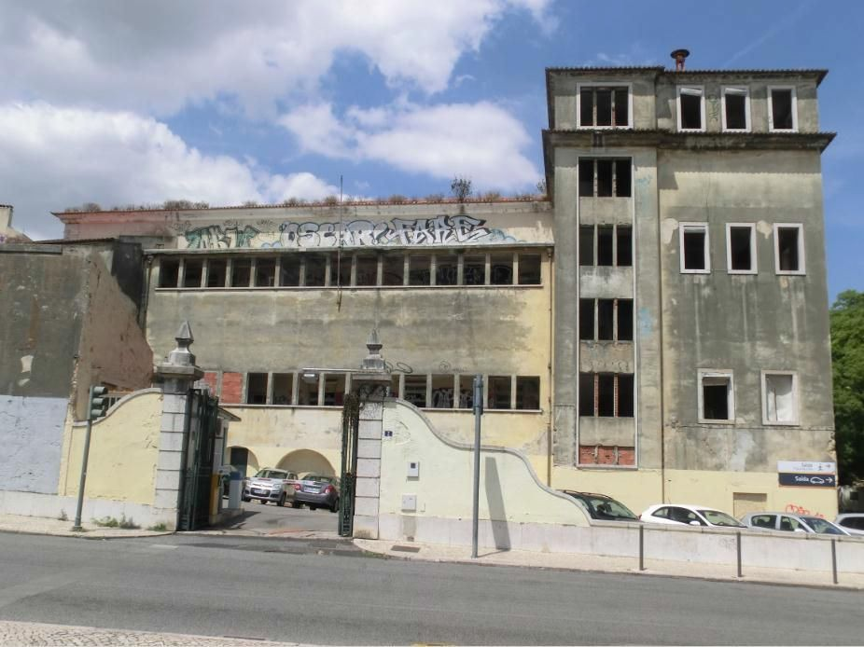
We Suggest !
Praça da Alegria
Hospital of Arroios

