Slide 1
ERASMUS+
Welcome to Portugal

Slide 2
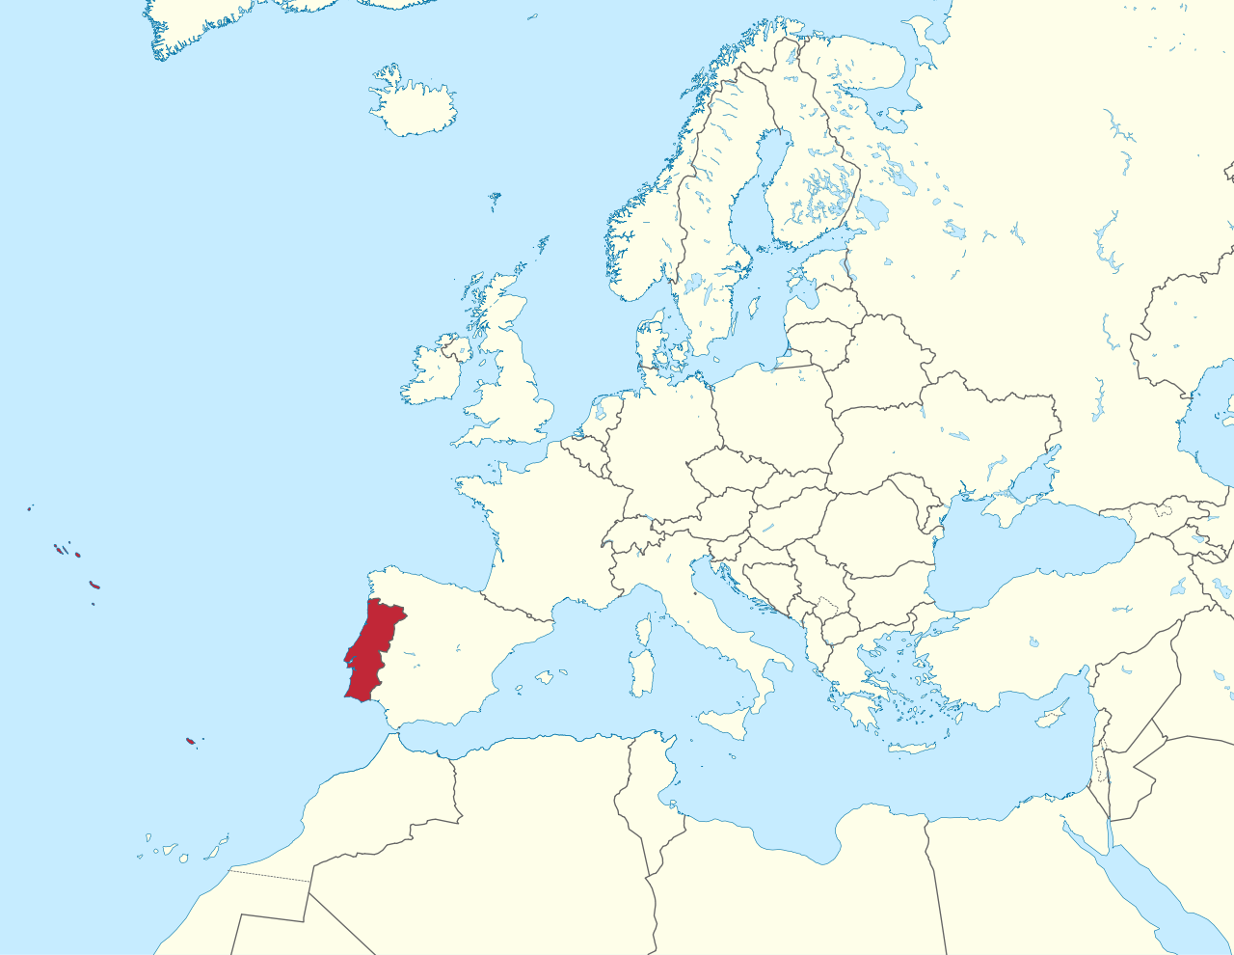
Where are you right now?

Slide 3
Portugal’s ID
Population:10M
Capital: Lisbon
Lisbon’s Population: 2M
The Flag:

Slide 4
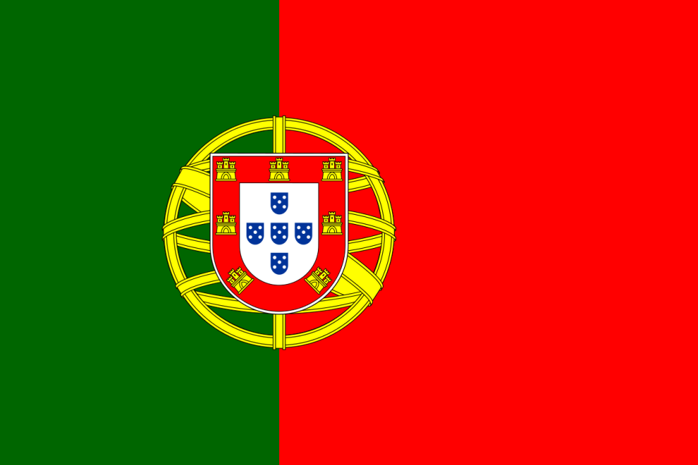
The Flag
The world that Portuguese navigators found and the different people they exchanged ideas with
Hope
The courage and the blood of those fallen in combat

Slide 5
The Flag
The Battles D. Afonso III won
National Independence
A tribute to the brave Portuguese fighters
The Battles D. Afonso Henriques won

Slide 6
History of Portugal
D. Afonso Henriques
The Age of Discoveries
The succession crisis – Iberian Union
Pombaline era
The first Republic
Estado Novo
25th of April 1974

Slide 7
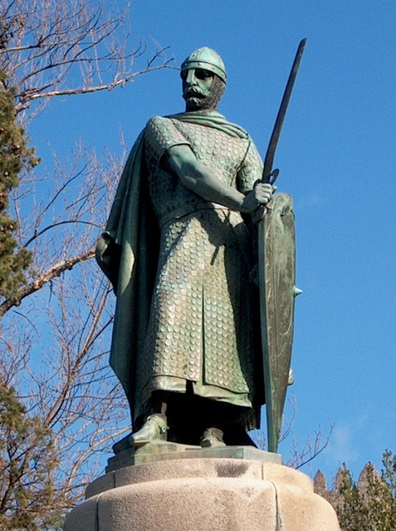
History of Portugal – D. Afonso Henriques
D. Afonso Henriques was Portugal’s first king. After his dad’s passing he fought against his own mother trying to keep the Portuguese county independent from Spain.

Slide 8
History of Portugal – The Age of Discoveries
From 1415 to 1543 Portuguese navigators found a lot of the world we now know – part of it being habited as well as some others unhabited. We also colonized some countries such as Brazil, Angola and Mozambique.

Slide 9
History of Portugal – The Age of Discoveries

Slide 10
History of Portugal – The Succession Crisis
August 1578, while fighting in Morocco the young king Sebastião (Sebastian) died without an heir. His great uncle then became king. However two years later Henry passed as well. There were no heirs left leading to a succession crisis.

Slide 11
History of Portugal – The Succession Crisis
After the whole conflict Portugal spent the next 60 years in a personal union with the Spanish crown. This was the Philippine Dynasty.

Slide 12
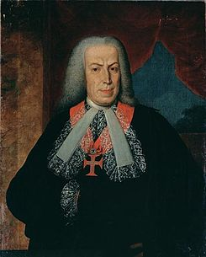
History of Portugal – Pombaline Era
In 1755 a huge earthquake hit Lisbon destroying the whole city not only by its huge magnitude (9 in the Richter scale) but also by the subsequent tsunami and fires. Marquês de Pombal is now known for rebuilding the city.
“What now? We bury the dead and feed the living.“

Slide 13
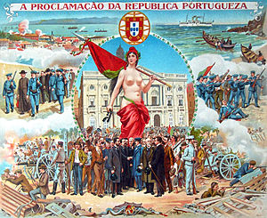
History of Portugal- The First Republic
On the 1st of February 1908 the king D.Carlos and the heir prince Luís Filipe were assassinated in Lisbon’s Commerce Square. On the 5th October 1910, the constitutional monarchy was over and it was established a republican regime in Portugal.

Slide 14
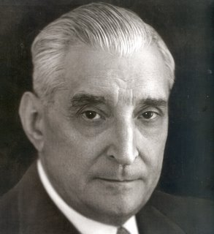
History of Portugal- Estado Novo
After the first republic Salazar’s dictatorship was installed in Portugal. This brought along a huge amount of unhappiness related to the political life and social as well. It also brought wars against the colonies due to the Portuguese will to keep them part of our own country.

Slide 15
History of Portugal – 25th of April 1974 (The Carnation Revolution)
Due to the unhappiness that was being felt in the whole country the Armed Forces Movement and with the sudden help from the civil resistance on the 25th of April 1974 the dictatorship was put to an end. This also led to the independence of most of the colonies and the end of the colonial war.

Slide 16
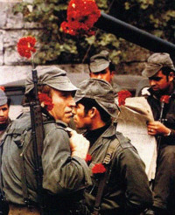
History of Portugal – 25th of April 1974 (The Carnation Revolution)
This is also known as the carnation revolution because almost no shots were fired and after this the population came out to the streets to celebrate and carnation were put in the muzzles of rifle.

Slide 17
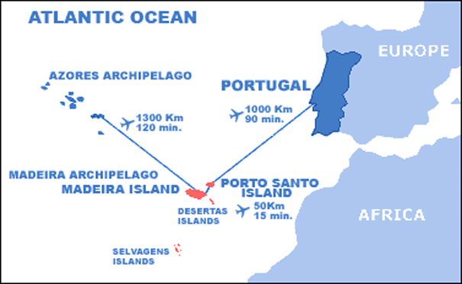
Geography of Portugal
Part of the Iberian Peninsula
Borders Spain
Mainland Portugal + Archipelagos (Azores and Madeira)
Total area – 92 090 square kilometers

Slide 18
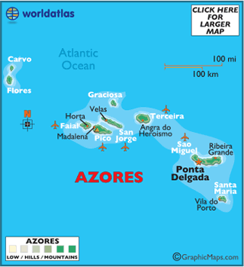
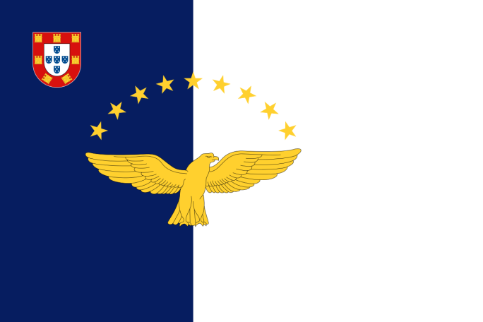
Geography of Portugal - Azores
9 Volcanic Islands
West Islands: Flores and Corvo
Centre Islands: Graciosa, Terceira, São Jorge, Pico and Faial
East Islands: São Miguel and Santa Maria

Slide 19
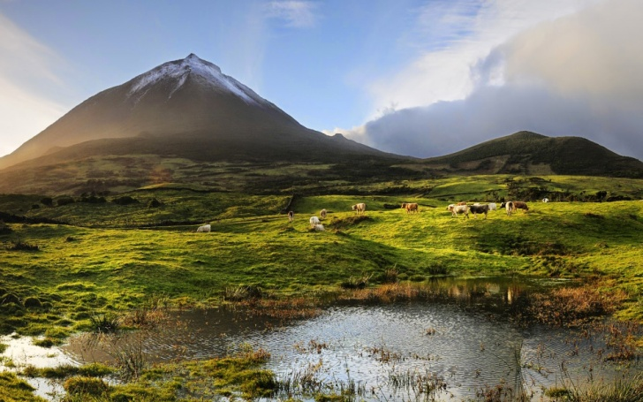
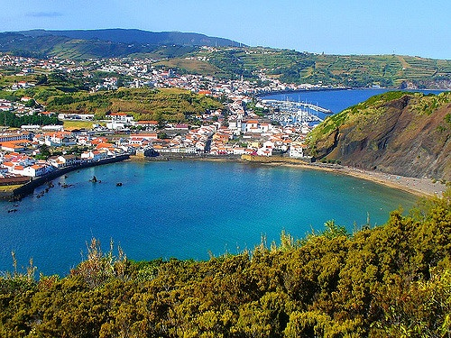
Geography of Portugal - Azores
São Miguel
Pico
Faial

Slide 20
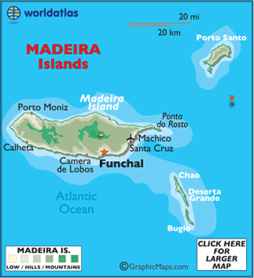
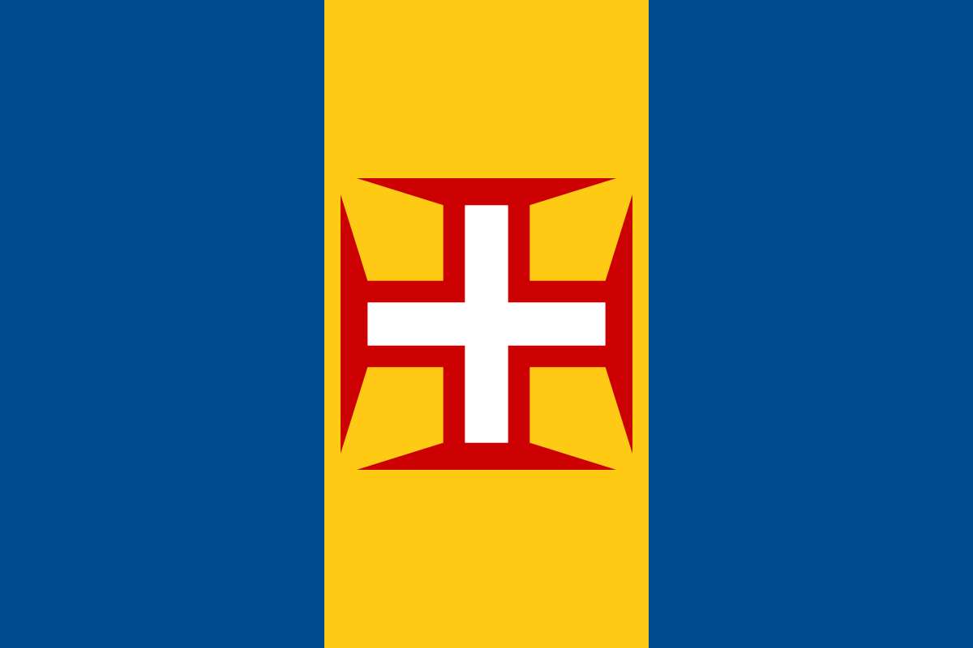
Geography of Portugal - Madeira
Main Islands: Madeira, Porto Santo

Slide 21
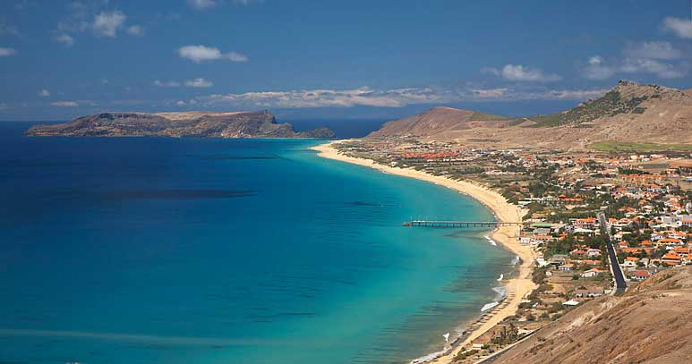
Geography of Portugal - Madeira
Funchal
Porto Santo

Slide 22
Geography of Portugal – Mainland Portugal
Located on the western coast of the Iberian Peninsula dividing the Mediterranean Sea from the Atlantic Ocean.
It is crossed by several rivers which have their origin in Spain (the main rivers being: Minho, Douro, Mondego, Tagus and Guadiana)

Slide 23
Geography of Portugal – Mainland Portugal
The Regions

Slide 24
Geography of Portugal – Mainland Portugal
The Districts:

Slide 25
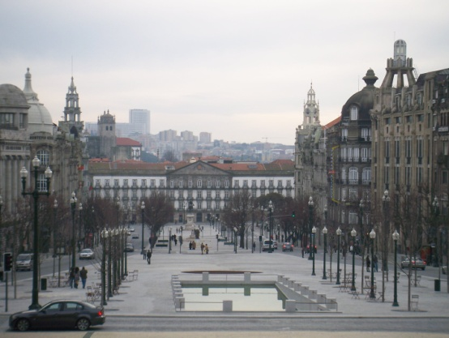
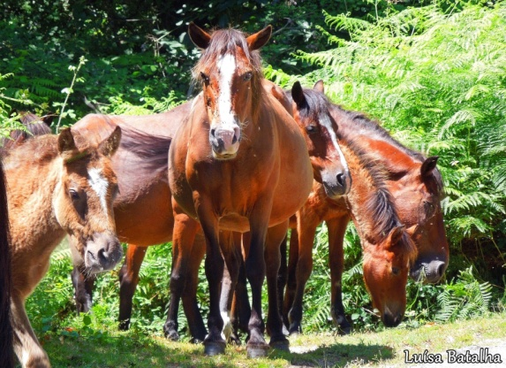
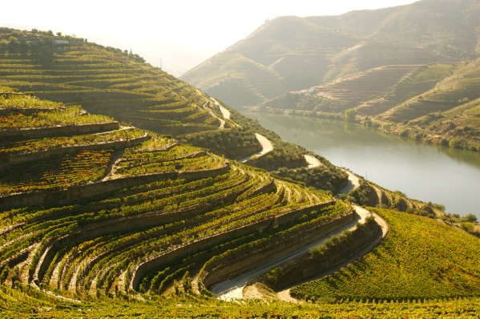
Geography of Portugal – Mainland Portugal
North:
Mountainous landscape
Porto, Douro, Gerês
Porto
Gerês
Douro

Slide 26
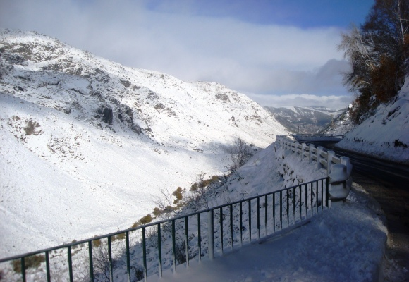
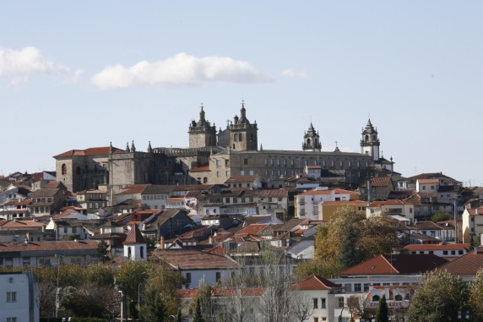
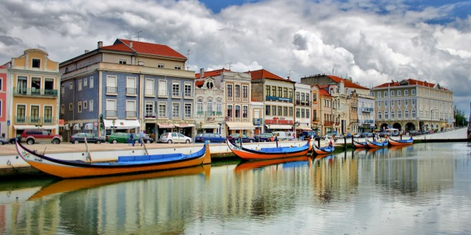
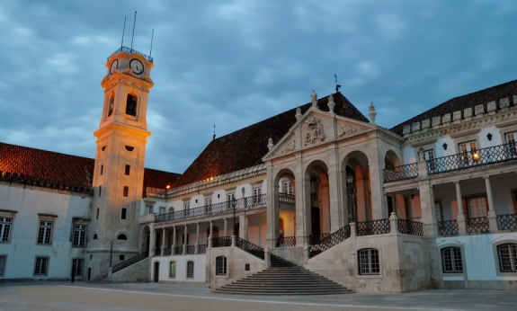
Geography of Portugal – Mainland Portugal
Centre:
Diversity in landscapes
Serra da Estrela
Allows outdoor activities (hiking,
fishing or canoeing).
Aveiro, Coimbra, Viseu
Serra da Estrela
Aveiro
Viseu
Coimbra

Slide 27
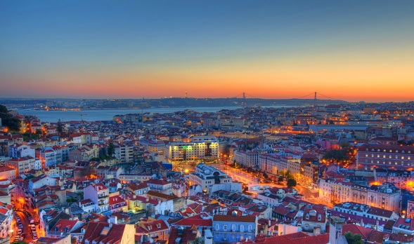
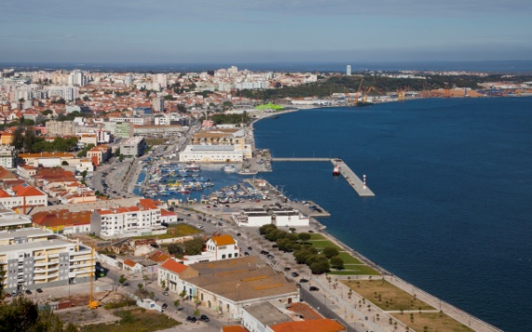
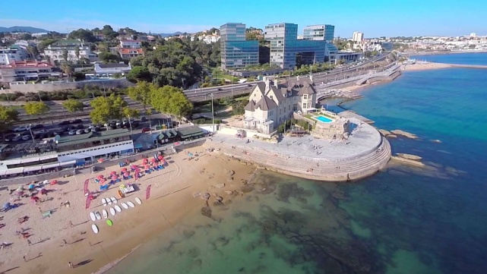
Geography of Portugal – Mainland Portugal
Lisbon:
Where the capital is located
Lisbon, Cascais, Setúbal
Lisbon
Setúbal
Cascais

Slide 28
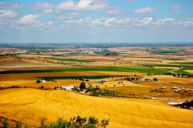
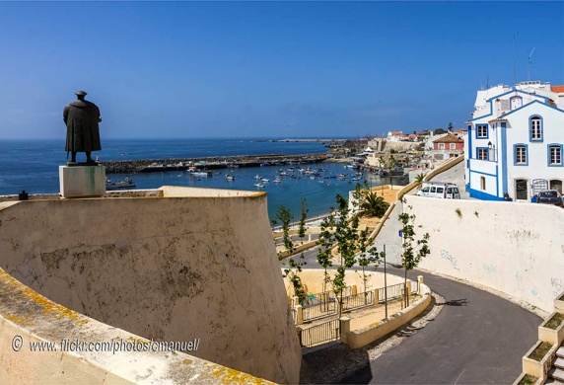
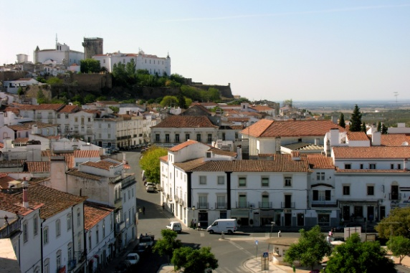
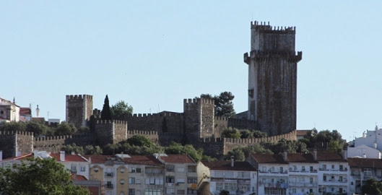
Geography of Portugal – Mainland Portugal
Alentejo:
Soft rolling hills and plains
Sines, Beja, Estremoz
Alentejo’s common landscape
Sines
Estremoz
Beja

Slide 29
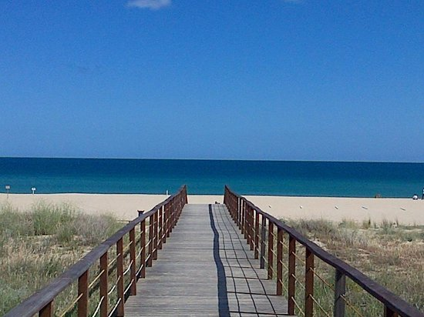
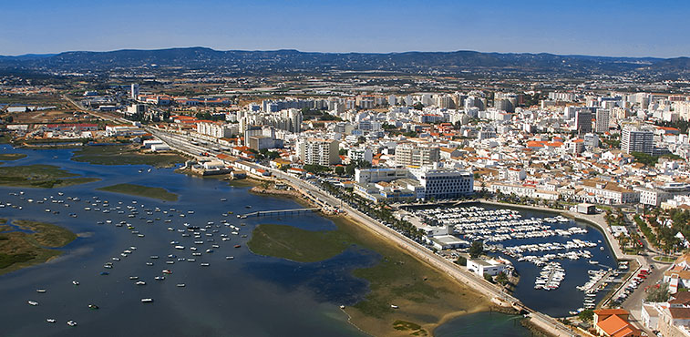
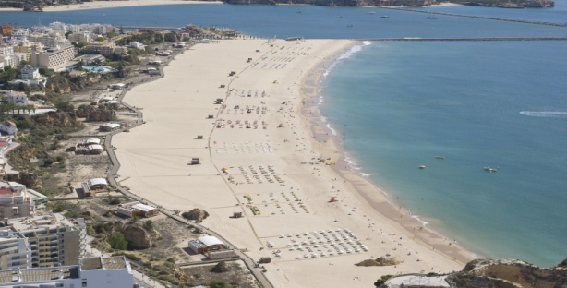
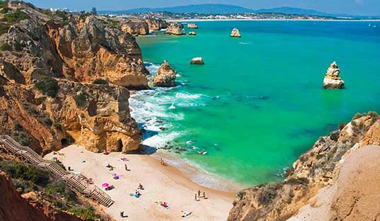
Geography of Portugal – Mainland Portugal
Algarve:
Landscape is typically the beach
Appeals tourists mostly in the summer
Faro, Lagos, Portimão
The beach in Algarve
Faro
Portimão
Lagos

Slide 30
Geography of Portugal – Climate
Annual average temperature in mainland:
Mountainous interior north – 12-13ºC
South – 17-18ºC
Annual average temperature in the archipelagos:
Around 20ºC

Slide 31
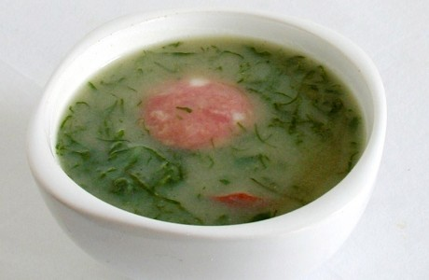
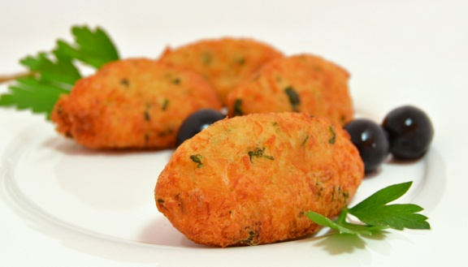
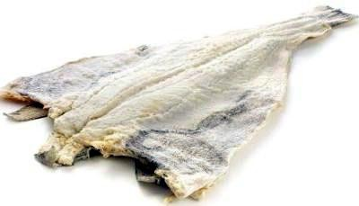
Gastronomy in Portugal
Caldo Verde
Pastéis de bacalhau
Dry codfish

Slide 32
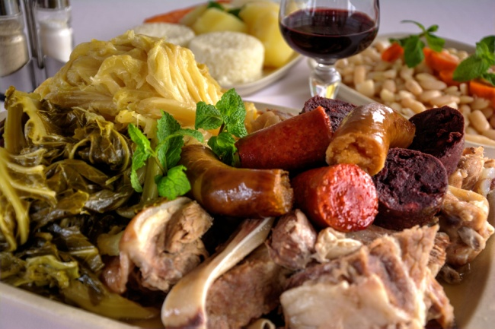
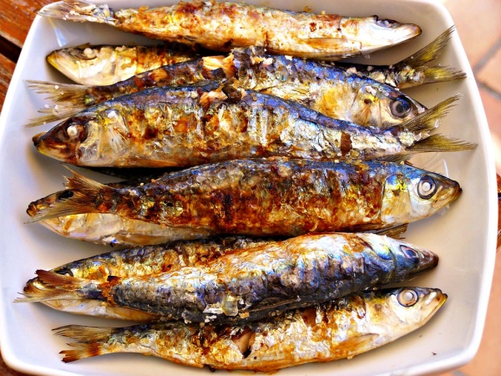
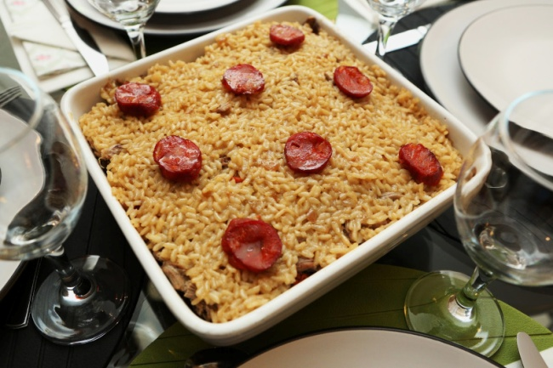
Gastronomy in Portugal
Cozido à Portuguesa
Sardinhas assadas
Arroz de Pato

Slide 33
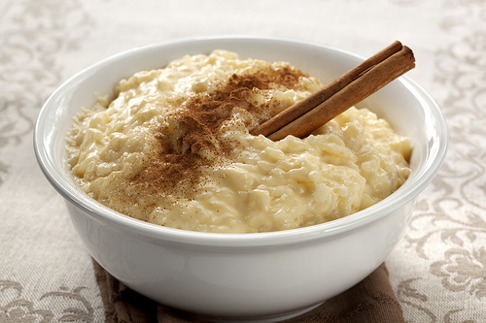
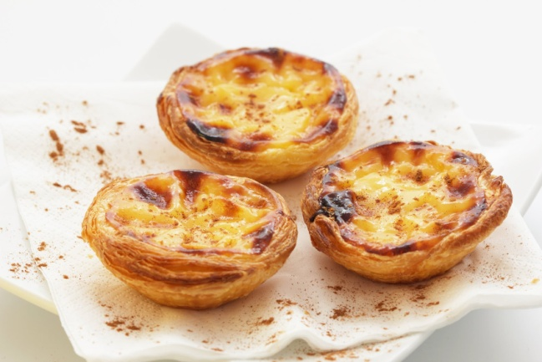
Gastronomy in Portugal
Arroz doce
Pastéis de nata

Slide 34
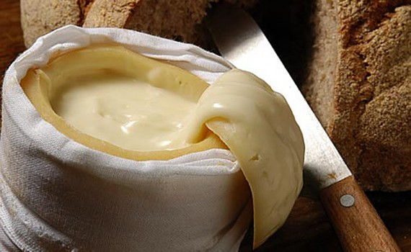
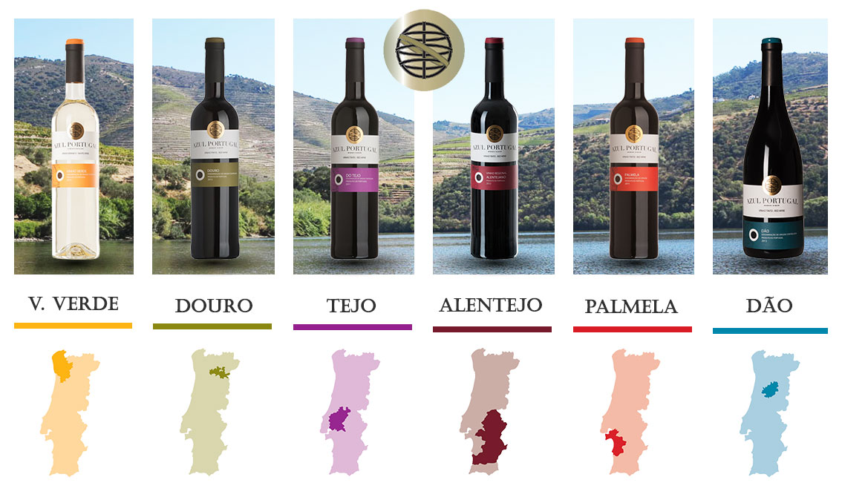
Gastronomy in Portugal
Queijo da Serra
Portuguese wine

Slide 35
Portugal – our everyday life
School starts around 8:00 – 8:30am
Classes might go up to around 7:00pm some days.
Lunch time usually starts at 1:00 – 1:30 pm.
After school activities tend to be fitted right after school or later at night.
People usually start having dinner around 8:00 – 8:30pm.
Bed time’s a personal choice but during the week teens usually go to bed around 10:30-11:00pm

Slide 36
http://www.pordata.pt/

Slide 37
Welcome to Portugal

