Slide 1
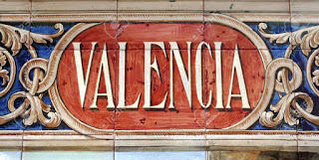
Welcome in Valencia

Slide 2
Culture Guide
For Valencia
Made by the Bulgarian school

Slide 3
Our group
This is our group which contain 3 teachers with 4 student who wants to take a part in one big adventure and to see and get to know the big city Valencia .
Teachers: Natasha Dzhurkova, Miroslav Kostov and Valq Garbacheva
Student: Denislav Garkov, Ani Petrova
Temenuga Kirilova and Steliana Radeva.

Slide 4
During our knowledge of the city we had a task to find some landmarks.
Our task: a) Look for an image of the Central Market (Mercat Central) and copy the link on your word file. b) Which are some of the most representative products of Valencian gastronomy? Look for some pictures in google images (you can type "Mercat Central Valencia puestos" on the search bar) take a look, choose some products (fruit, vegetables, fish, sweets...) and write down their names on your word file.

Slide 5
The Cathedral and the Plaza de la Virgen (Virgin's Square)
We had a task: a) Look for an image of the Cathedral and copy the link on your word file. b) Cities change a lot along the centuries, but some of the most important spaces remain for similar uses: political centre, commercial areas, religious places,etc. This is also the case of Valencia. Why did the Christians build the Cathedral exactly on this location? What was there before their arrival to the city? You can look for the information on this link. Once you find it out write the answer on your word file.

Slide 6
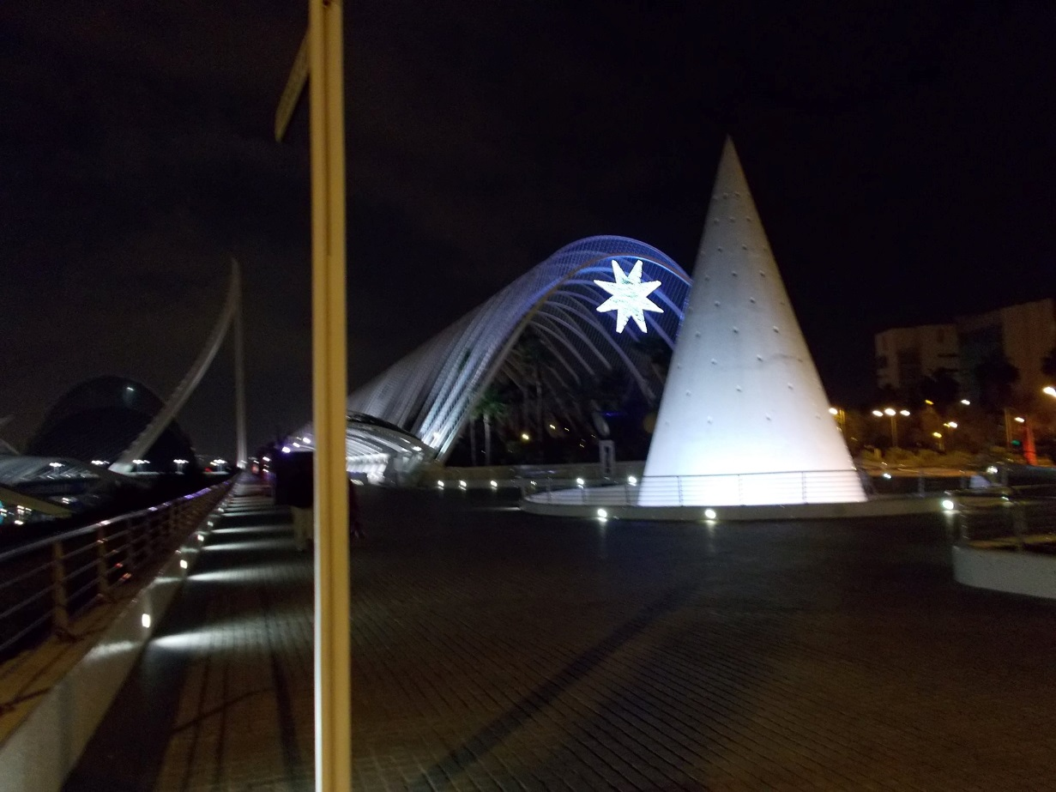
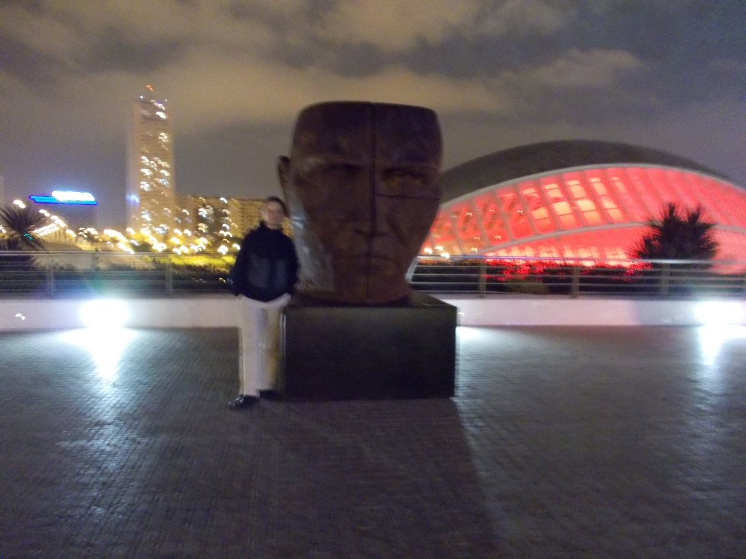
Lets see some picture from the city which were made by us.

Slide 7
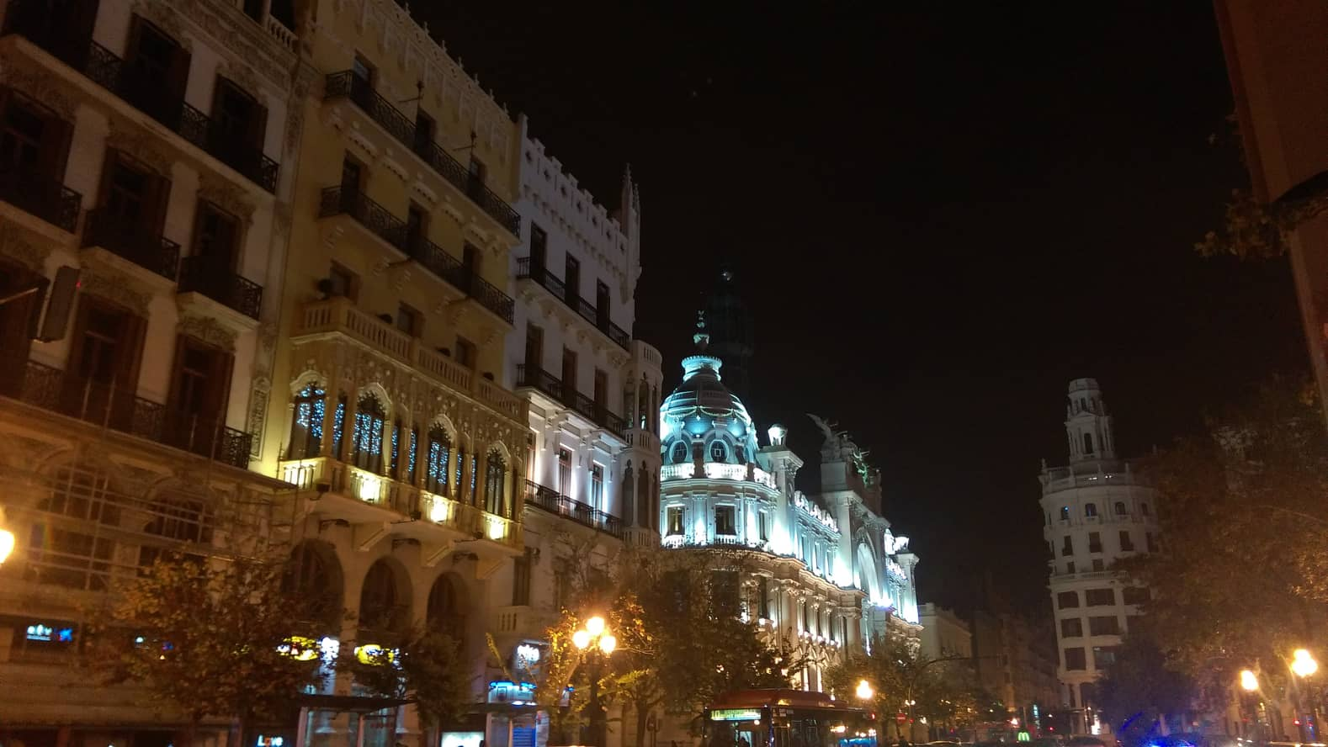
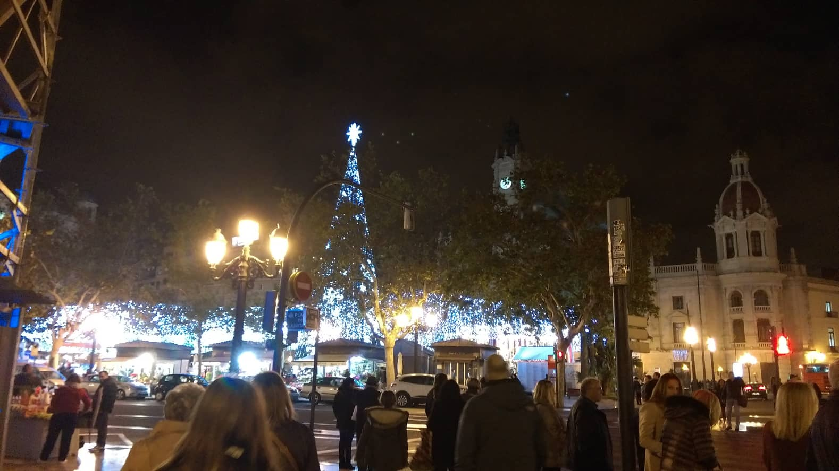
One night in Valencia

Slide 8
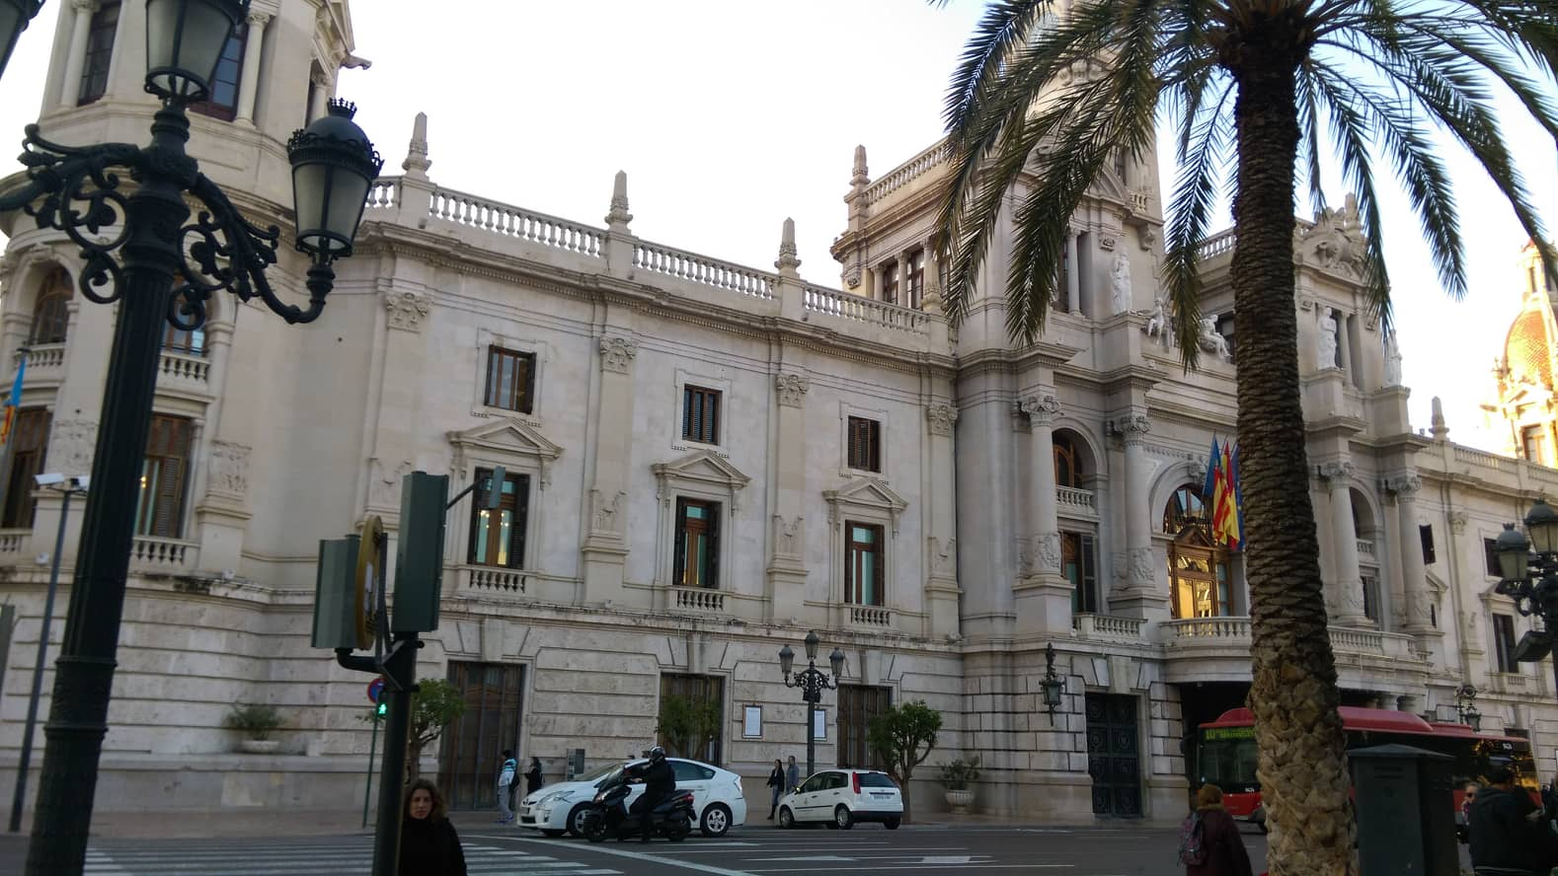
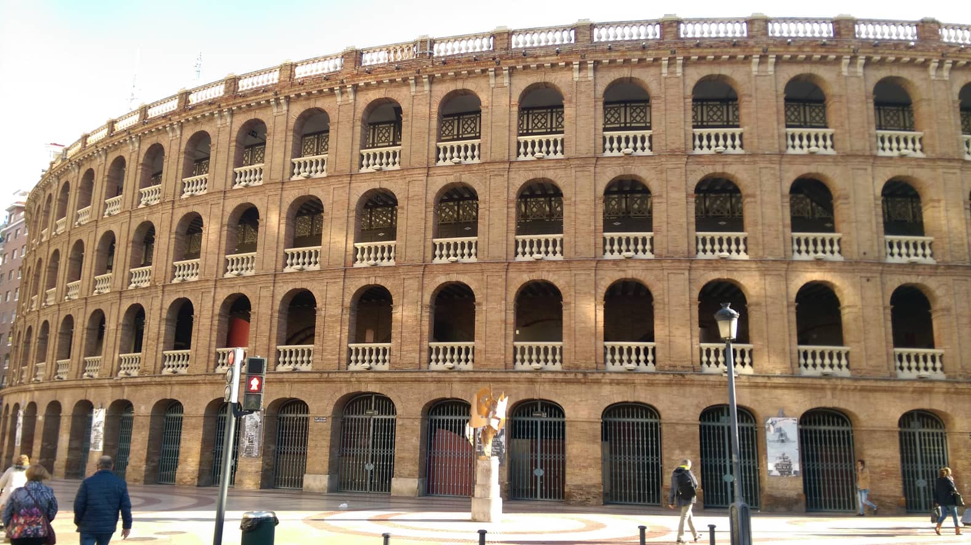
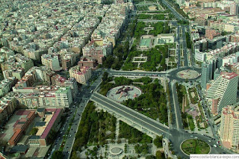
beautiful Valencia

Slide 9
Food
Spanish food is very taste and while we were there we tried to try many kind of Spanish food. One of the most taste meals is paella- our favorite one ☺

