Slide 1
Science can be simple
ERASMUS+
Helena Trigo Teixeira
José Orlando
Escola Maria Amália Vaz de Carvalho

Slide 2
Background:
“Even the artists appreciate sunsets, and the ocean waves, and the march of the stars across the sky. There is then some reason to talk sometimes of other things. As we look into these things we get an aesthetic pleasure from them directly from observation. There is also a rhythm and a pattern between the phenomena of nature which is not apparent to the eye, but only to the eye of analysis; and it is these rhythms and patterns which we call Physical Laws.”
Feynman, R; The Character of Physical Law (p 13)

Slide 3
Background:
Algebra is an indispensable tool for problem solving in science, and although algebraic expressions are simplified expressions of natural language, […]
To be fluent in science requires the ability to translate concepts from natural language into algebraic expressions and translate algebraic expressions into natural language.
Bass, Jossey; The Sourcebook for Teaching Science Grades (p 264 & 266)

Slide 4
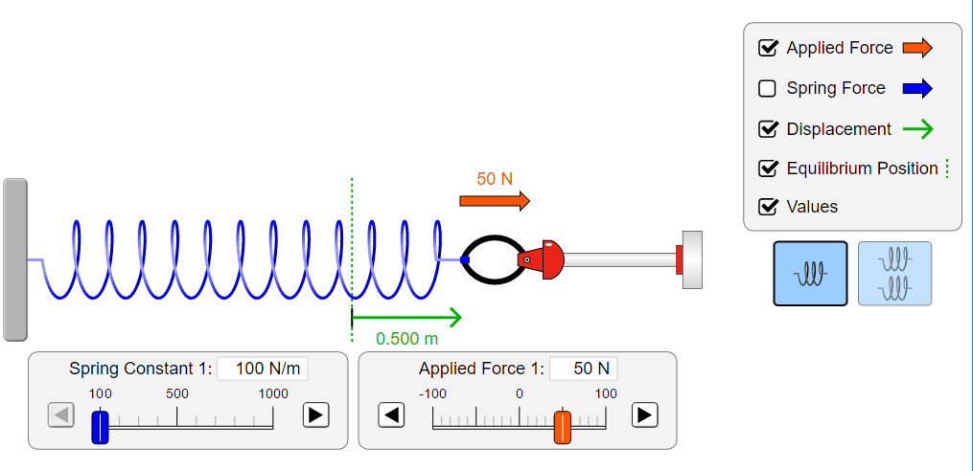
Activities
Goal: Find out how forces change the length of a spring
PhET Simulations

Slide 5
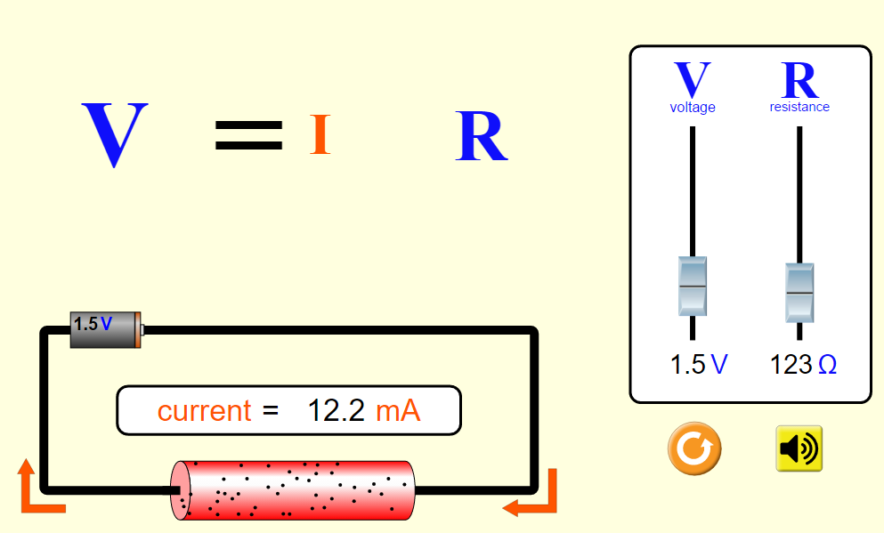
Activities
Goal:
Determine the relationship between current and resistance in a simple circuit
PhET Simulations

Slide 6
Science is a fusion of experimental observation & mathematics

Slide 7
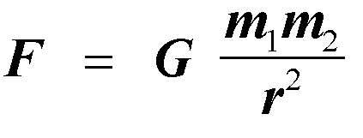
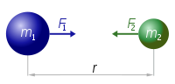
Other Laws
Newton’s law of universal gravitation
Every point mass attracts every single other point mass by a force pointing along the line intersecting both points. The force is proportional to the product of the two masses and inversely proportional to the square of the distance between them.
Where:
F is the force between the masses;
G is the gravitational constant (6.674×10⁻¹¹ N · (m/kg)²);
m₁ is the first mass;
m₂ is the second mass;
r is the distance between the centers of the masses.
Gravity (Scientific Version of John Mayer's Gravity)
https://www.youtube.com/watch?v=u7KpH9_I2Dw&feature=relmfu

Slide 8
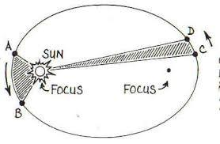
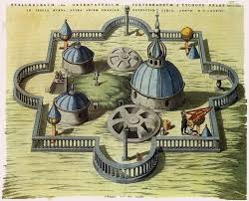
To conclude that the force holding the planets in their orbits obeys an inverse square Newton used Kepler’s laws of planetary motion. Kepler formulates these laws doing a meticulous analysis of data collected by Danish astronomer Tycho Brahe.
Drawing of Tycho Brahe's observatory

Slide 9
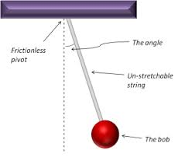
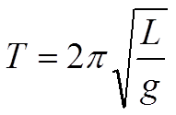
Pendulum Activity
Galileo discovered that, for small swings, the period of a pendulum is approximately independent of the amplitude of the swing. He also found that the period is independent of the mass of the bob, and proportional to the square root of the length of the pendulum.
L is the length of the pendulum and g is the local acceleration of gravity

Slide 10
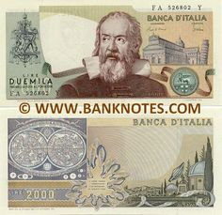
Curiosity
Galileo interest had been sparked by the swinging motion of a chandelier in Pisa Cathedral.

Slide 11
Goal:
Use the equation to measure the local acceleration of gravity, g.
Solve the equation for the acceleration due to gravity g
Measure the length of the pendulum to the middle of the pendulum bob.
Set the pendulum in motion until it completes 10 oscillations and record this time. The period T for one oscillation is the number recorded divided by 10.
Calculate g.

