Slide 1
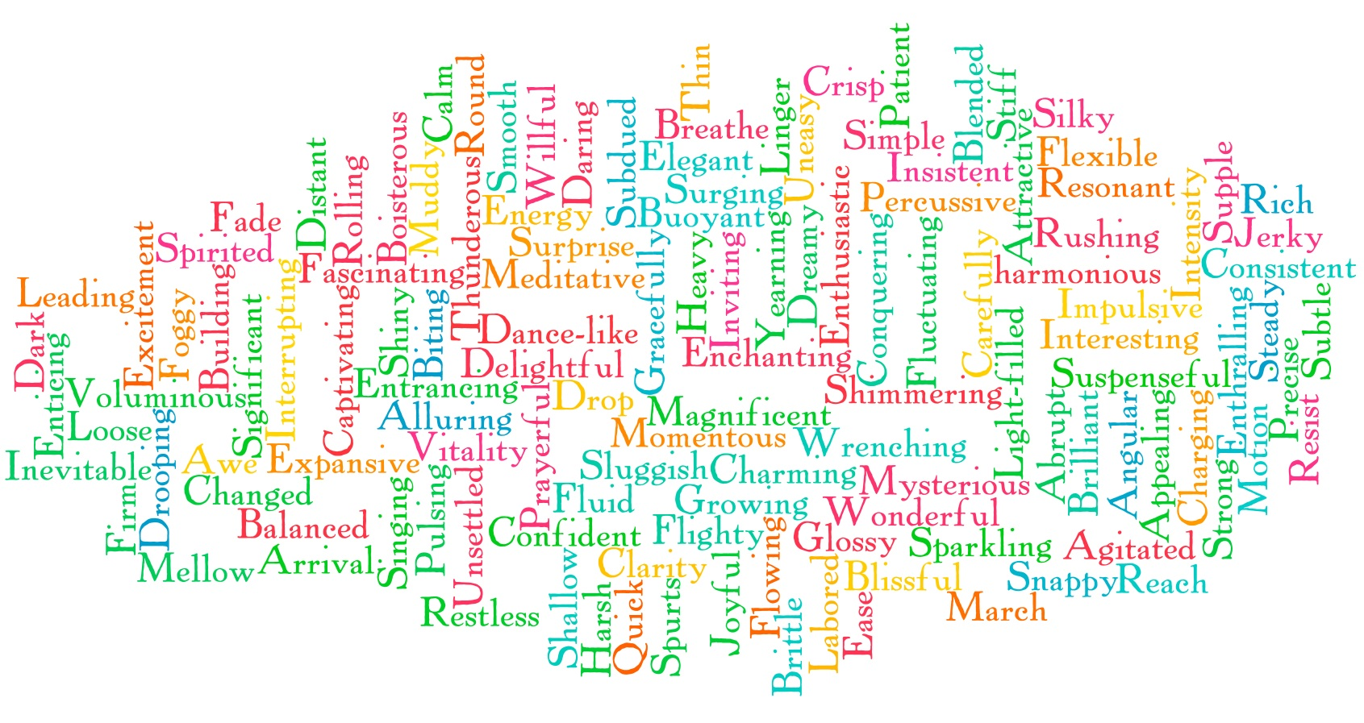
How can we improve our writing?
Look back at the piece of writing that you did last lesson.
What would you give it out of ten, taking into consideration:
use of a range of punctuation
ambitious and suitable vocabulary
advanced and experimental sentence structure
varied use of connectives?
Read your work out loud- which of the above four areas is the one you need to focus on the most?

Slide 2
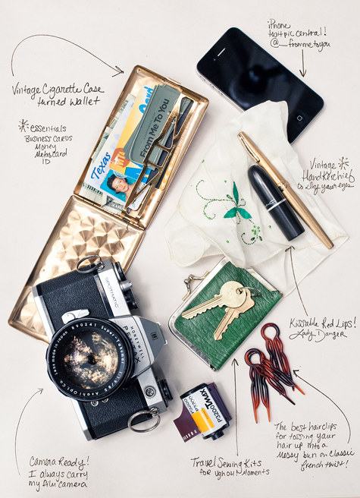
Explain yourself!
Explain your character to the person next to you.
Who were they? Where were they? What are they like? What do they love? Hate? What are they afraid of? Would you be friends with them? Why? Why Not?
Add one more sentence to your writing based on that conversation.
Draw five things that would be in your character’s pocket and explain why next to your drawings.

Slide 3
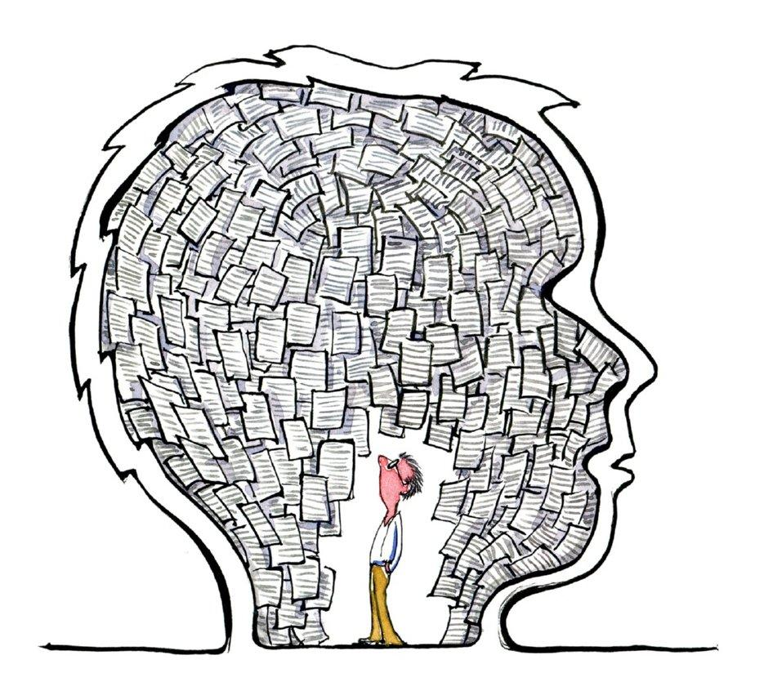
Slow writing helps you to:
think about your writing and focus on the quality
Punctuate your work correctly
experiment with different types of sentences when you write.
You will have one minute to write each type of sentence within your writing- as an extra challenge, choose words from the word wall to experiment with.
SLOW WRITE YOUR AMAZING SENTENCES

Slide 4
BOYS
a sentence using but, or, yet and so
It was truly terrifying, yet I stood my ground.
The sky started to darken, but there was still time for me to get home.

Slide 5
2A
a sentence using 2 adjectives, twice.
He was a tall, awkward man with a crooked, unsettling grin.

Slide 6
Simile
a sentence using a simile.
The moon hung overhead like a pale, observing face.
His sneer made me as uncomfortable as the silence at a funeral.

Slide 7
3A
a sentence using 3 related adjectives.
Confused, troubled, worried, she raced from the room.
Sour, putrid, vile, the smell filled the air.

Slide 8
2 pairs
a sentence using two pairs of adjectives.
Silent and scared, tortured and drained, she slid down the wall of the room in despair.
angry and afraid, confused and numb, he couldn’t believe what had just happened.

Slide 9
DE:DE
a sentence using description and detail- two sentences, separated by a colon. The second sentence adds detail to the first.
the vampire was a fearful creature: his eyes glowed red in the darkness.

Slide 10
verb, person
a sentence starting with a verb and a comma.
Pacing, he moved away from the scene quickly.
Dreaming, he took himself to somewhere he wished he were now.

Slide 11
Outside. (Inside)
a sentence that shows what’s happening on the outside and inside of the character.
He smiled and shook the man’s hand. (All he could think of was how much he despised him).

Slide 12
If, if, if, then
If the clock hadn’t struck, if the thunder hadn’t roared overhead, if he hadn’t been so curious, then maybe he would not have been trapped.

Slide 13
Emotion word (comma)
a sentence that starts with an emotion.
Terrified, her screams filled the room.
Despairing, he blinked back the tears that filled his bloodshot eyes.

Slide 14
Noun, which/who/where
A sentence with an embedded clause to add more information.
The wolf, who was glowing in the moonlight, bared its teeth and growled.

Slide 15
ad, same ad
a sentence that uses the same adjective twice.
He was scared, scared that any moment he may not have the courage to turn around and face it.
It was silent, silent in a way that it made her uncomfortable.

Slide 16
3 bad-dash-question?
a sentence uses 3 negative words, usually adjectives, followed by a question.
Exhaustion, hunger, fear- what would kill him first?

Slide 17
Irony
a sentence using irony.
The ‘heavenly escape’ was an understatement for what stood in front of her.

Slide 18
the more, the more
a sentence using more twice.
The more the air filled with smoke, the more torrid the air became.
The more upset she was, the more the tears cascaded down her cheeks.

Slide 19
Ing, ed
a sentence that uses an ing word followed by an ed word to add description.
Sprinting furiously away in panic, he halted at the sight before him.
Seething in the wind, the trees whipped about in fury.

Slide 20
Personification of the weather
a sentence that depicts the emotion of the weather.
The wind screeched through the branches.
The evening breeze murmured in the air.
The rain wept against the house.

Slide 21
Connection Heaven
a sentence that develops ideas using a connective.
Despite everything, he remained calm.
It was sunny therefore he decided to go to the beach.
He never dreamed it would be possible until now.

