Slide 1
Why live in a danger zone?
ThinkLink activity based on Geog.3 (4th edition) pages 102 and 103
Your goal for this lesson is to understand the reasons why people continue to live in areas of volcanic and earthquake activity.

Slide 2
People chose to live in areas of volcanic and earthquake activity because they felt that the advantages outweighed the disadvantages. 2 main types of reasons to live in an area: - Social reasons (people) - Economic reasons (money)

Slide 3
Social reasons
These are the main social reasons:
1- Poverty: Poor people, particularly in LICs, can’t afford to leave.
2- People don’t want to leave family and friends.
3- People feel safe due to earthquake proof buildings.
4- Prediction: Most volcanic eruptions are preceded by clear warning of activity from the volcanoes,

Slide 4
Economic reasons
4 main economic reasons explain why people continue to live in areas affected by volcanoes:
1-Fertile soils
2- Geothermal energy
3- Valuable materials
4- Tourism

Slide 5
Living With Volcanoes: ThinkLink Activity
Explain why people continue to live in areas affected by volcanoes

Slide 6
Create an interactive image…
You are going to use thinglink, a free web tool, to explain why people continue to live in areas affected by volcanoes.
https://www.thinglink.com/
Sign up for the free version. You may use your Facebook account for that.

Slide 7
Click on create.

Slide 8
This page will ask you to upload an image.
Create your own image to show the 4 main reasons (don’t include fossil fuels). Next slide shows you the image I created.

Slide 9
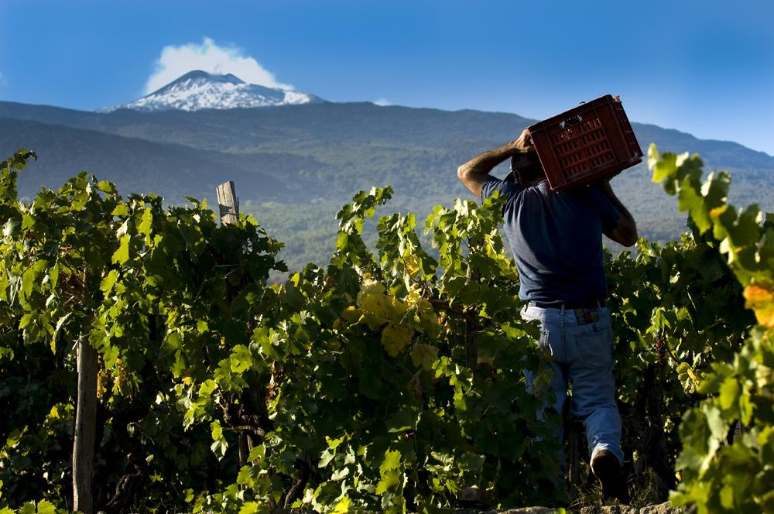
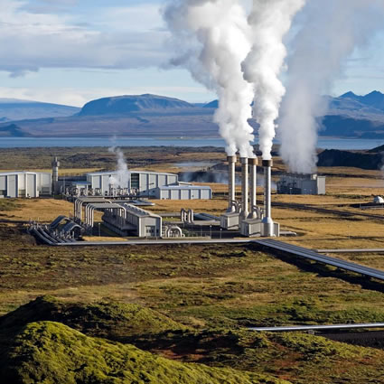
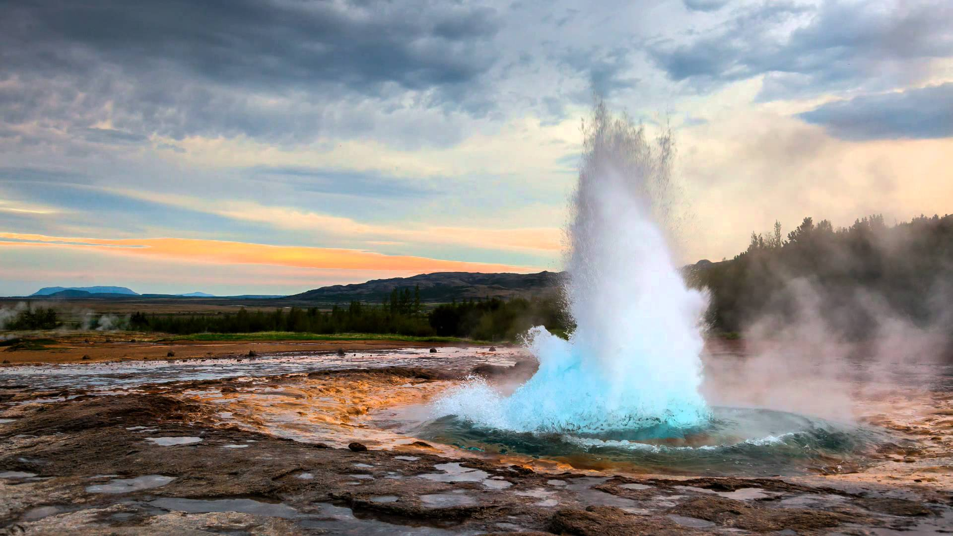
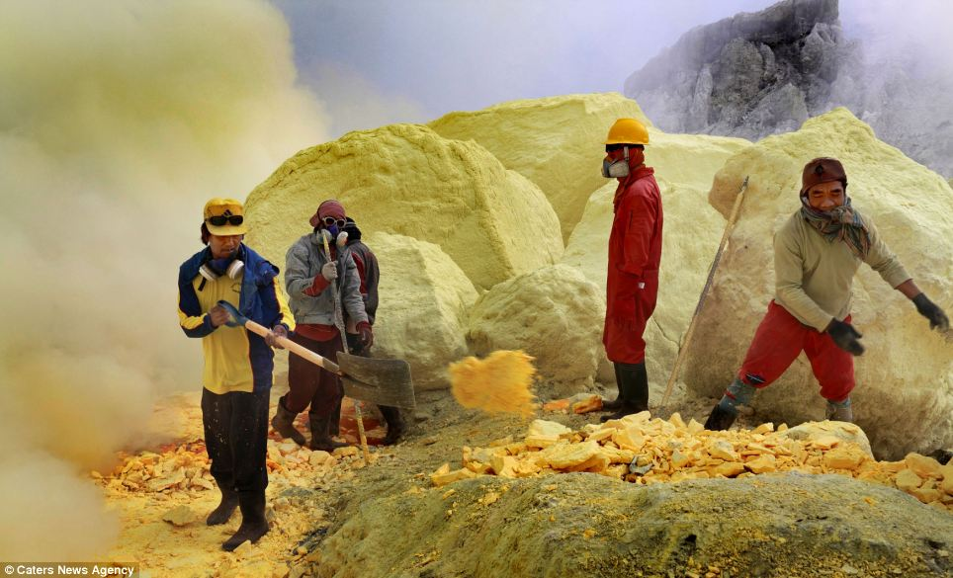
Social and economic reasons
why people continue to live in areas affected by volcanoes

Slide 10
Save your image on JPG format . Click on current slide only.

Slide 11
Upload image

Slide 12
Save

Slide 13
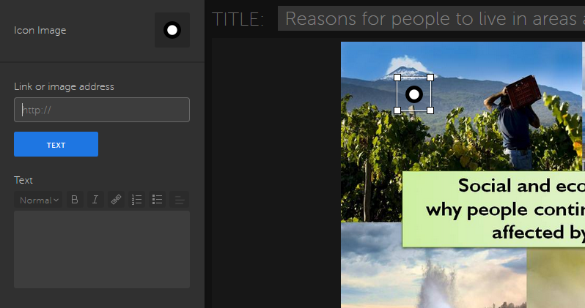
Add a title. Click where you want to add a tag which is going to be text.

Slide 14
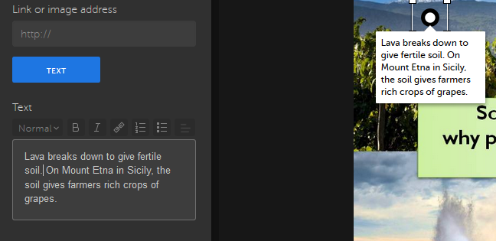
Save-bottom right. The following slide shows you how your image will appear once you have saved it.

Slide 15
Go over the image your first tag is. A circle appears. Put the arrow in the circle. The annotations appears.

Slide 16
Final steps
At least one of the tags must be a video.
Find one video which shows one of the reasons e.g. sulphur mining in Indonesia .
Copy the link.
Go back to your image on thinglink. Click on edit on the right. Click to add a tag on the image.

Slide 17
Paste you link. Your video must appear on your image. Delete the text from the video and add your own text. E.g. Valuable materials. For instance, sulphur is mined around volcano vents.
Save

Slide 18
Click on the circle. The new text appears below the video.

Slide 19
Click on this box to access my image with two tags. Don’t use the same images and video!
Once you have completed this activity, copy the link on top of your page and send it to my school email. Don’t forget to add your class and name to your email.

