Slide 1
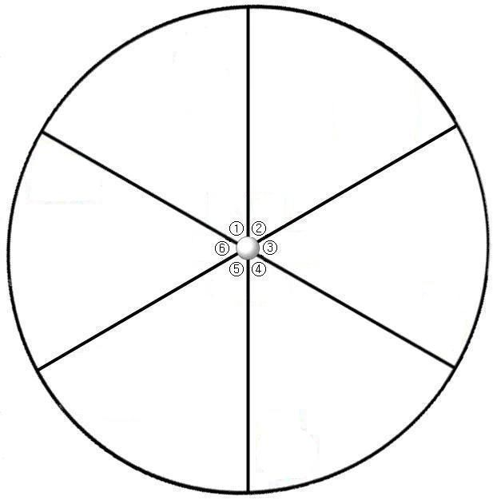
Act it out
Find a synonym
What does it remind you of?
Use it in a sentence.
Spell it out
Explain the definition

