Slide 1
CREATIVE TEACHING and LEARNING ERASMUS+
Lisbon, Portugal – 26-30 April, 2017
Augmented Reality
Stanimira Valcheva
history teacher
SU “Ekzarh Antim I” - Kazanlak, Bulgaria

Slide 2
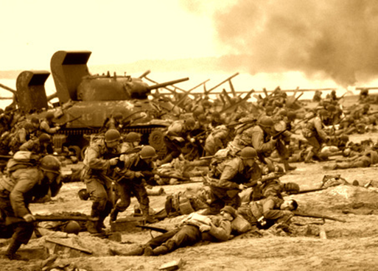
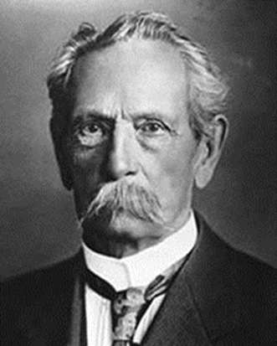
These are some of the Auras I’ve made for my history classes…

Slide 3
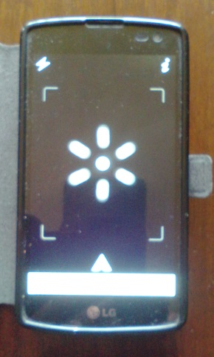
TO SEE AN AURA YOU NEED ….
To install Aurasma on your phone ….
When you click on the icon probably you will see this…
…. That’s the MENU…

Slide 4
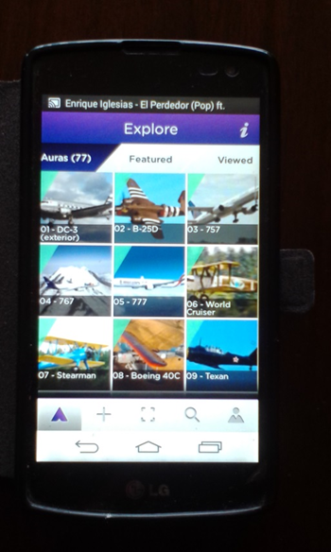
.…touch it and you’ll see this…
….go to search….

Slide 5
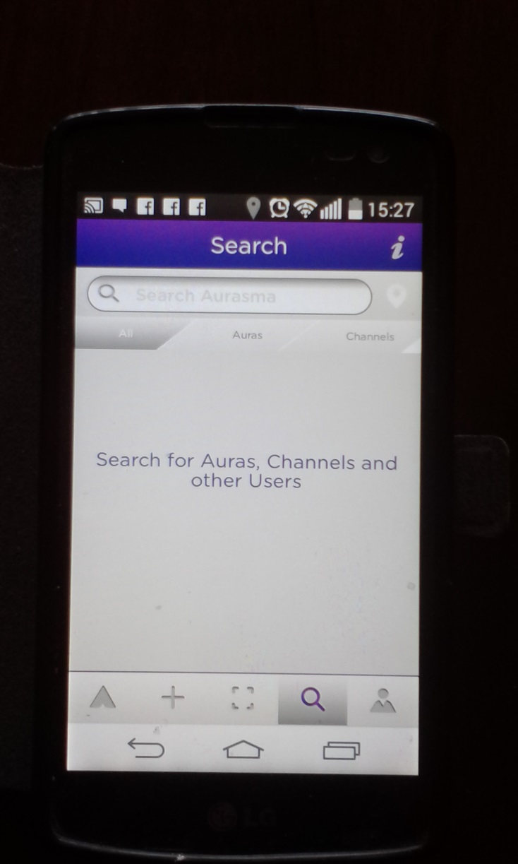
go to CHANNELS…

Slide 6
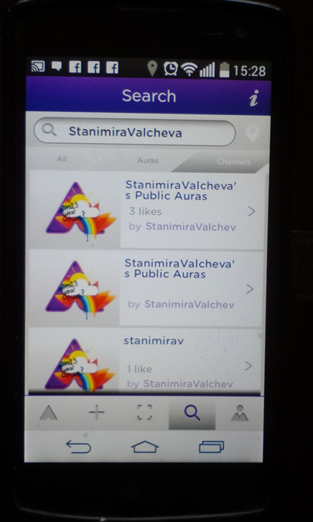
type the name of the channel you need….
….for example : StanimiraValcheva

Slide 7
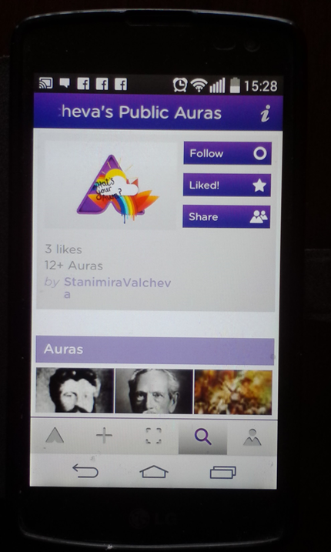
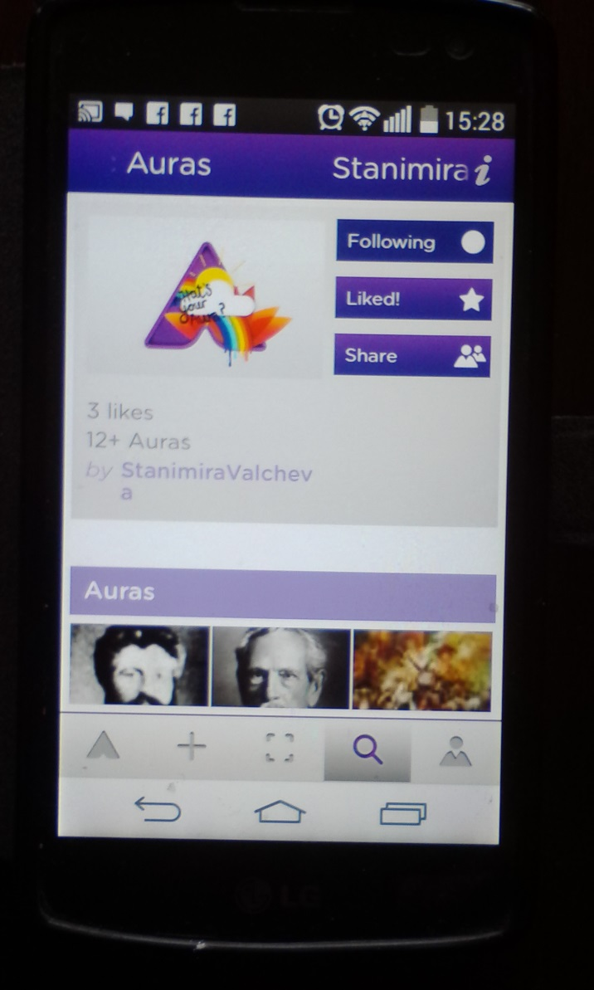
…you have to FOLLOW that channel….
now when you
are following this
channel you can see
all the public Auras
created by me…

Slide 8
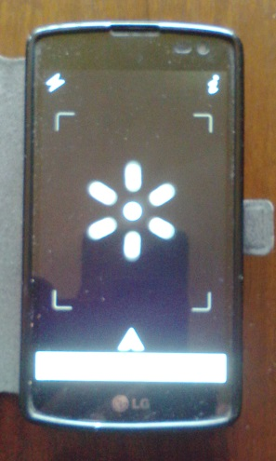
scan the photo using this icon and…..
….see what’s hidden in it…

Slide 9
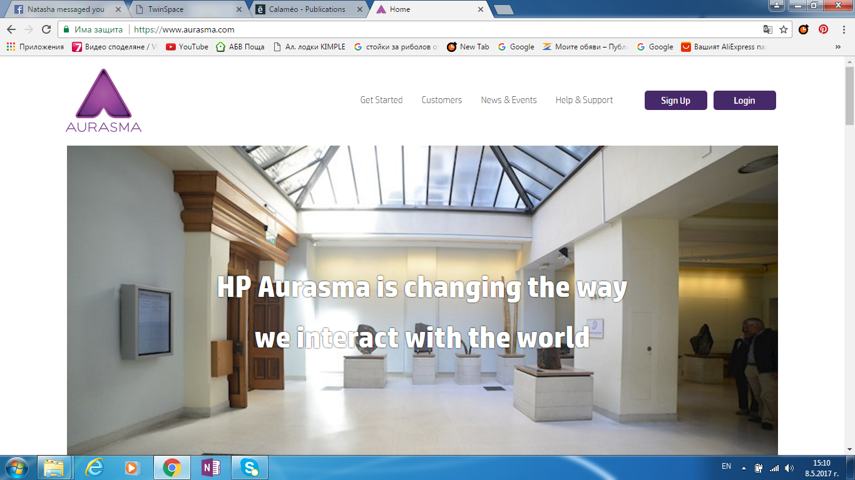
TO CREATE YOUR OWN AURA YOU NEED TO ….
Go to https://studio.aurasma.com and Sign up
go to Assets….

Slide 10
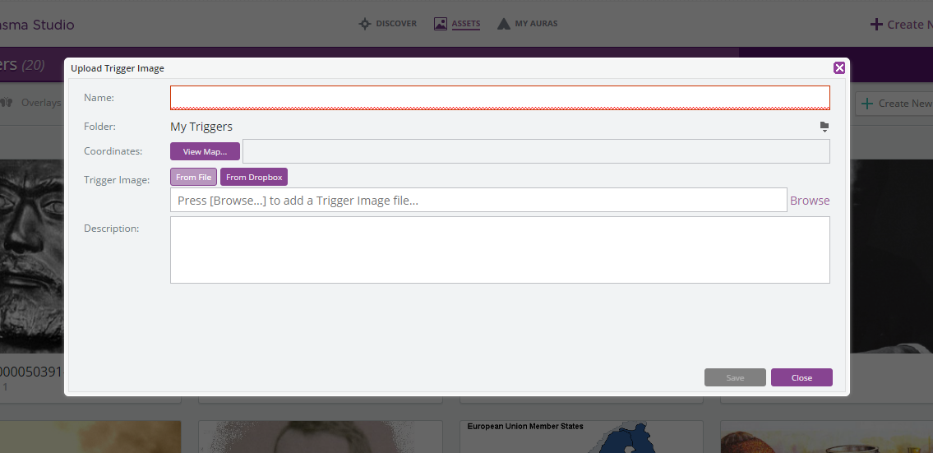
Create New Trigger
/that’s an image file/
Browse…..and Save…

Slide 11
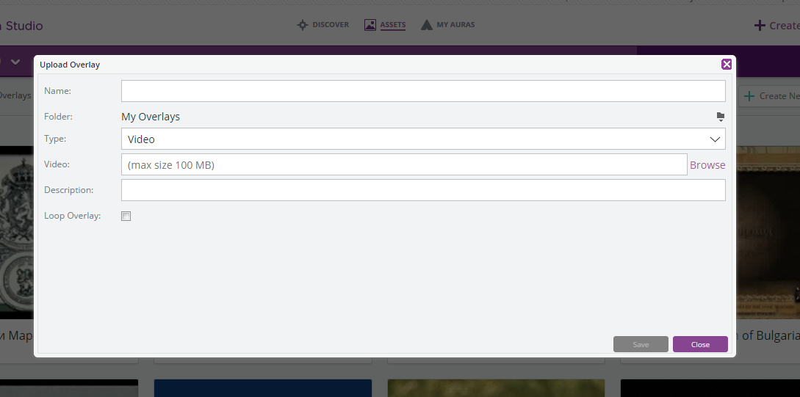
Go to Overlays
Create New Overlay
/that has to be a
Video file/
Browse….
…and … Save

Slide 12
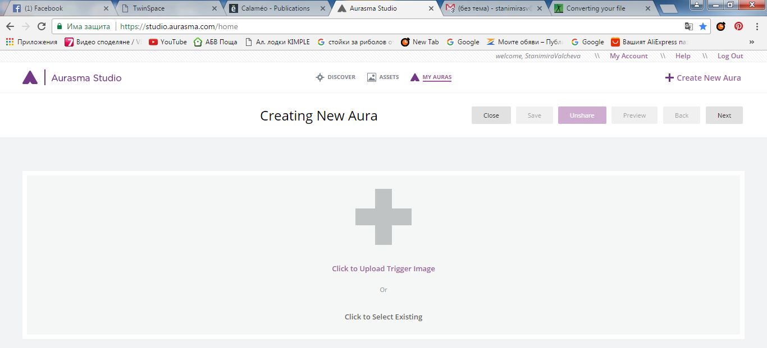
Creating New Aura
1. Create New Aura
3.Next
2.Select Existing Trigger

Slide 13
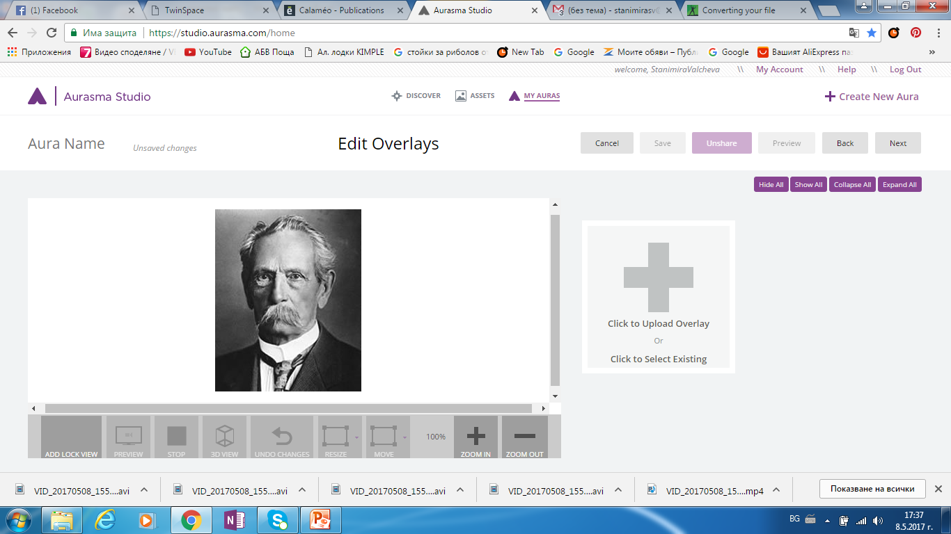
5. Next
4. Select Existing Overlay

Slide 14
SAVE your Aura….make sure that it is SHARED….
If you SHARE the Aura it will be visible for other people…it will be PUBLIC Aura
If you UNSHARE your Aura it will be visible only for you…it will be PRIVATE Aura

Slide 15
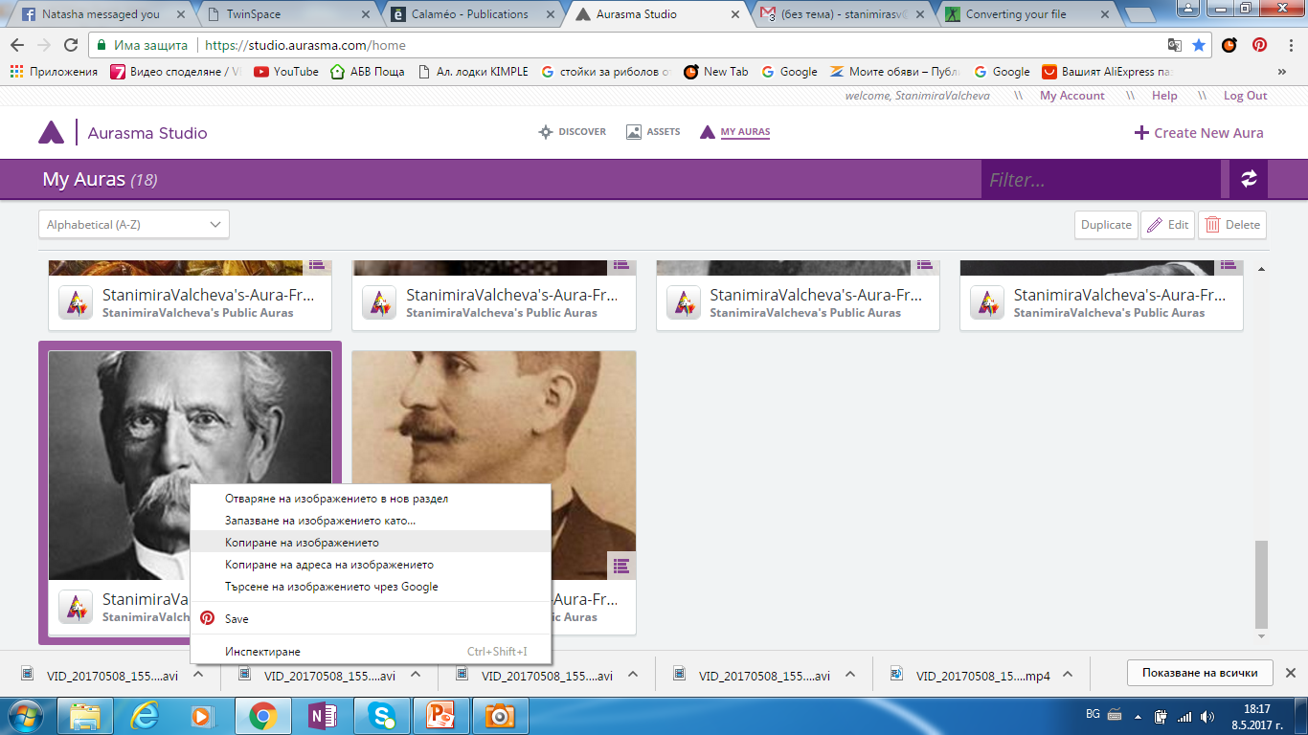
Your Aura is in My Auras
Click with right button on it….COPY the image…and PASTE it on a Word Document…
…and you are ready…..scan the picture with your phone using Aurasma …and that’s it!!!

