Slide 1
10 fingers typing
Creative Teaching and Learning
for EVERYONE
Miroslav Kostov,
SU Ekzarh Antim I , Kazanlak, Bulgaria

Slide 2
You have seen them,
whether in films or in real life, these keyboard masters who type faster than you can read.
They look so cool, don’t they?
The good news: everyone can learn to type this way.
And looking like a computer expert is the least reward you get from that.

Slide 3
OTHER benefits
Your fingers will get tired much slower and you’ll be able to type longer periods of time on the keyboard. The reason: “work” is divided in 10 instead on 2 or 4 fingers. As consequence of this the fingers cross much less distance.
And because the work is divided among more “units”, the speed also gets up. It’s not that at the beginning but once your fingers learn the positions of the keys, the more you type, the faster you become.
You don’t need to look at the keyboard and to shake your head up and down like heavy metalist.

Slide 4
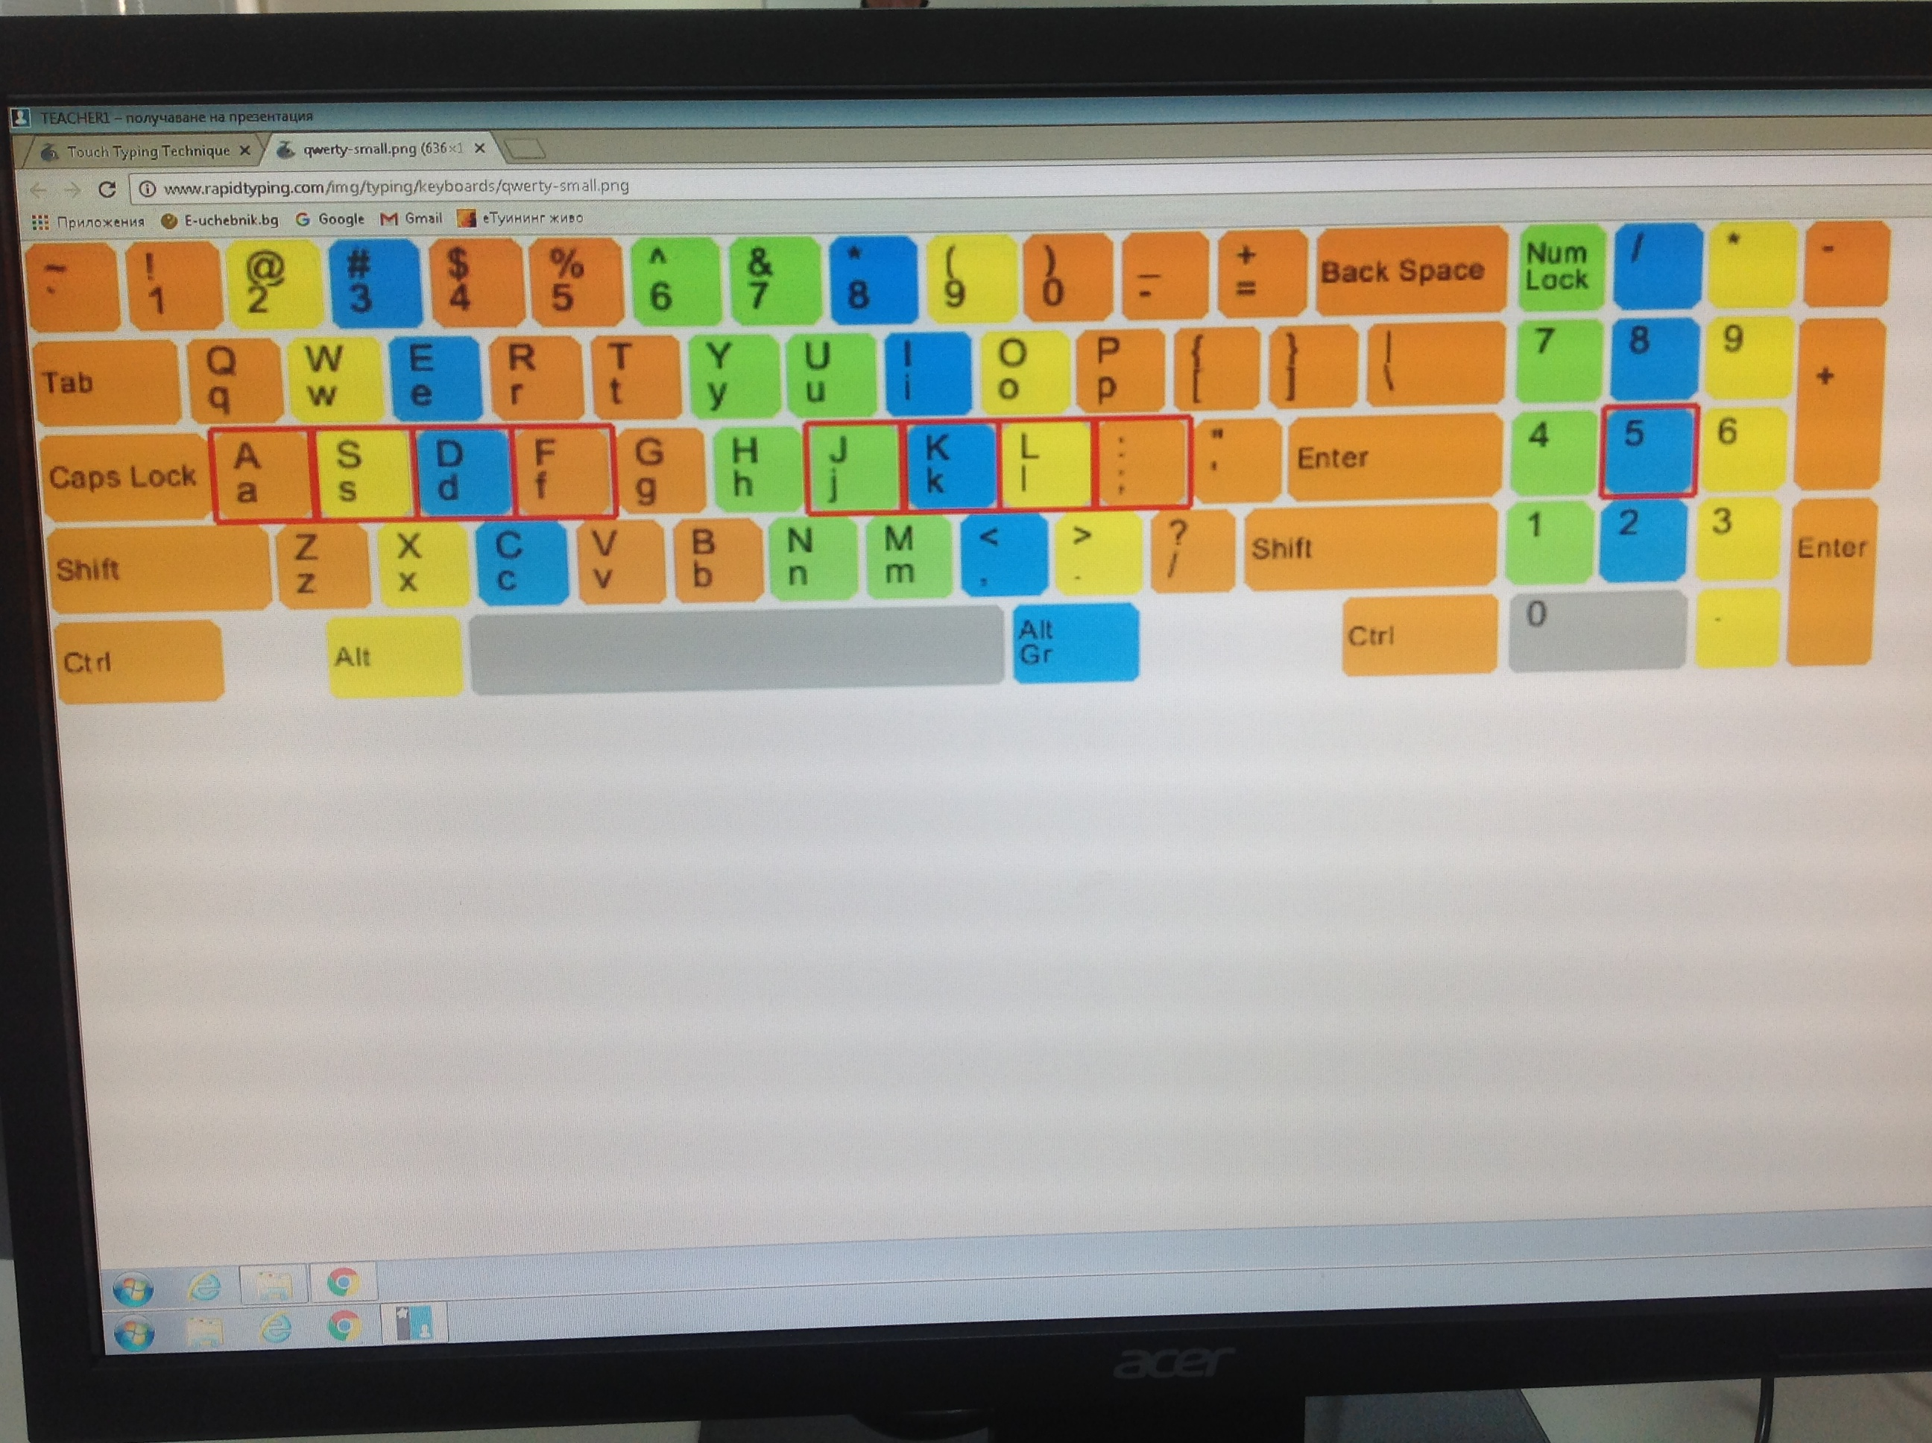

Slide 5
What do you need
Computer and Internet (the easy part).
Desire, perseverance and practice (the difficult part).
MUCH OF PRACTICE (another difficult part).
LET’S START MAKING THE STEPS

Slide 6
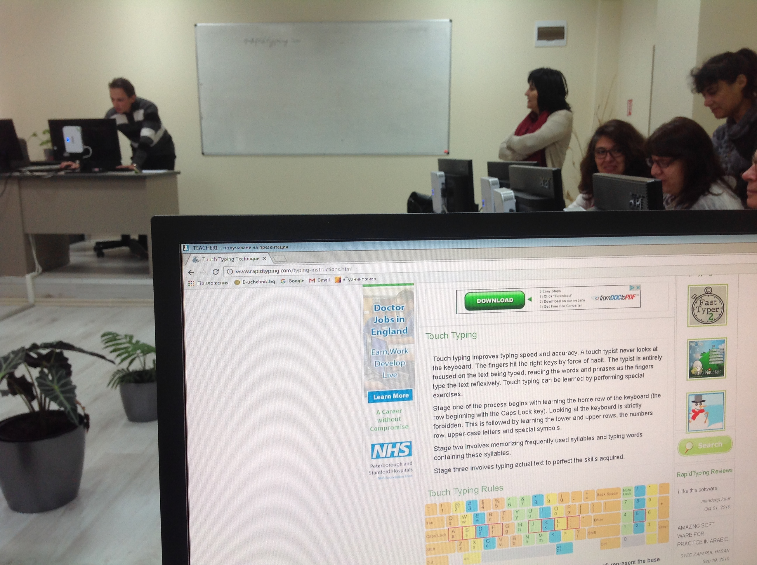

Slide 7
Step 1
Look carefully at the keyboard of your desktop computer or laptop and find the keys for letter “F” and “J”.
Do they differ somehow from the others?
If you don’t see it, try to feel it. Put and slide your fingers over the surface of these keys. The reason for their little roughness is:
These are the places where your index fingers usually stay on. You have to be able to find them without looking at the keyboard.

Slide 8
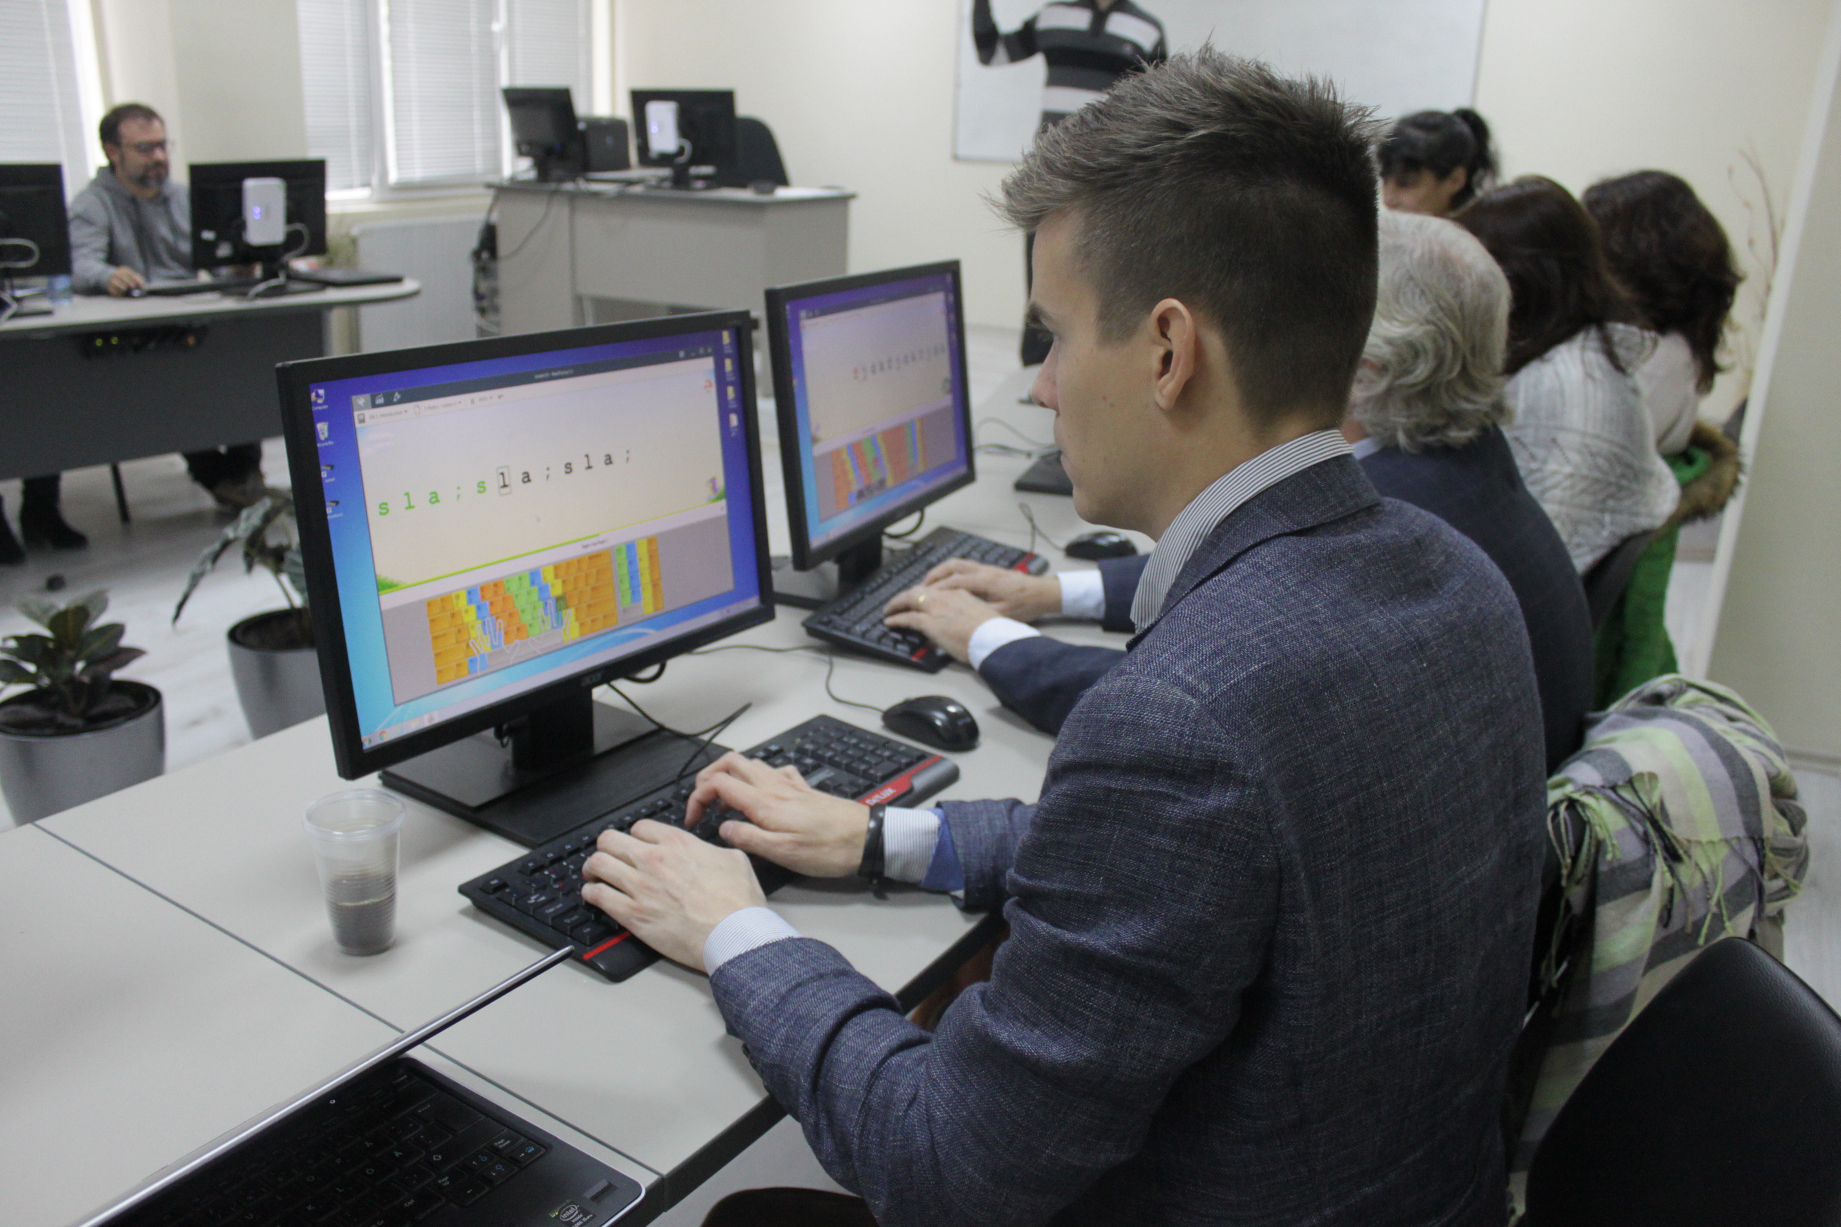

Slide 9
Step 2
First, put your left index finger on “F” (without pressing it) and your right index finger on “J”. You have to touch the keys by the tips of the fingers.
Close your eyes. Put your hands behind your back.
Find the “F” and “J” with your eyes closed and place your index fingers there.
Then repeat the above two bullets.

Slide 10
Step 3
Look at the picture below and place your fingers on the adjacent keys: left pinky on “A”, left ring finger on “S”, left middle on “D”, …, right pinky on “;”. You need to bend some of the fingers to make them all lay above the keys.
Looking at the picture on the screen press “a”, then “s”, then “d”, “f”, “g”, “h”, “j”, “k”, “l”, and “;” . Repeat that a few times.

Slide 11
Step 4
Raise your hands up. Put them again on the right places. The different colours of the keys on the picture form the areas for every finger.
Repeat the task above a few times. Then try to execute it with your eyes closed. These are the base positions of your fingers. Remember them!

Slide 12
Step 5
For typing a whole message in capital letters you switch the CAPS LOCK. But for single capital letters it’s supposed to use the Shift keys.
A standart keyboard have left Shift key and right Shift key (one for the left pinky and one for the right pinky). Find them on the keyboard.

Slide 13
Step 6
In order to type a capital letter, which is pressed by some of your left fingers, you use the right Shift. For example, to type a capital “D”, press and hold the right Shift (by the right pinky) and press “D” using the left middle finger.
When you need to type a capital letter, which is pressed by some of your right fingers, you press and hold the left Shift using the left pinky.
Try to type a few times F and J – capital until you start doing it without looking at the keyboard.

Slide 14
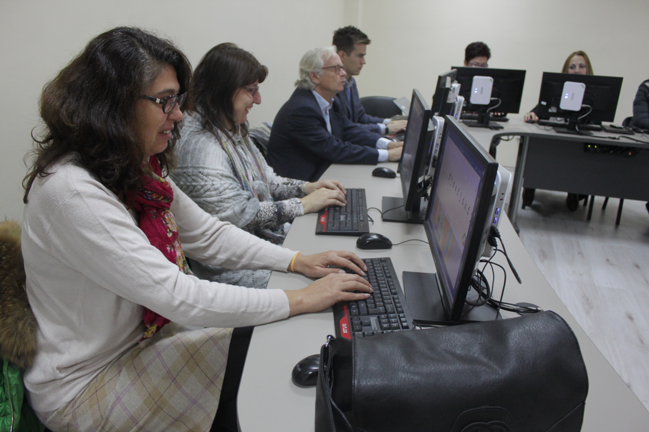

Slide 15
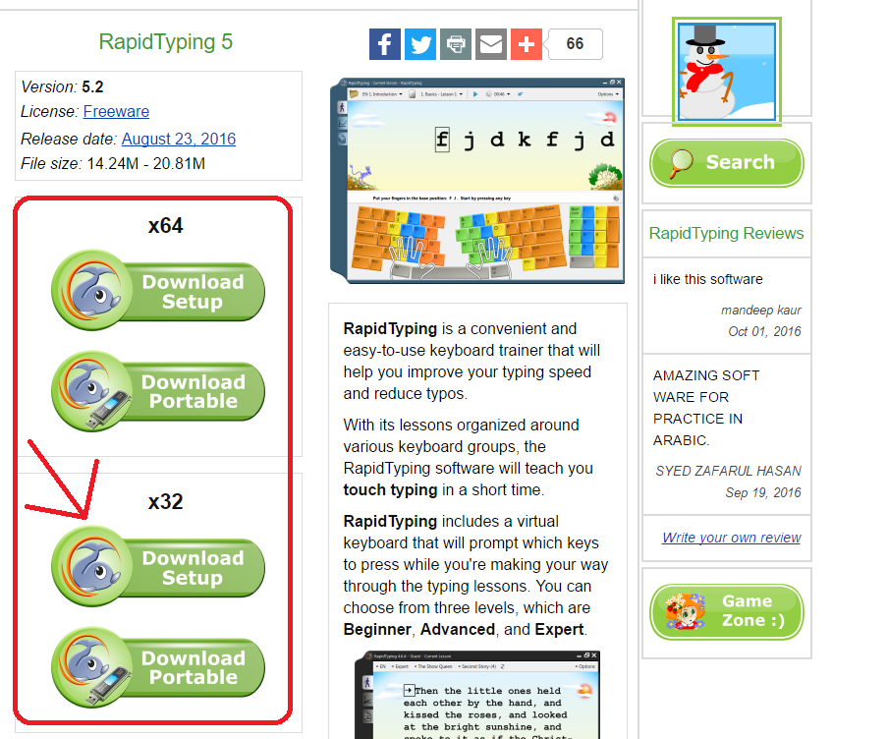
Step 7
Now go http://www.rapidtyping.com/downloads.html, download and install the appropriate version of RapidTyping 5 for your computer. If you don’t know which one is it, install Download Setup x32.
Start the program for the first time and set the valid settings for your system. If you don’t know which are they, just leave the default ones.

Slide 16
Step 8
Choose “EN 1. Introduction” and “1. Basics – Lesson 1” as shown on the right picture.
Repeat every lesson at least 4-5 times and be in NO harry. It is only important to press the right key using the right finger and make 100% accuracy.

Slide 17
Step 9, 10…
When necessary to move your finger in order to press a key on a different line, move only that finger and return it to its base/usual position after that.
Practice not that long periods of time, but regularly - if possible, every day!
Not necessary to do all the lessons:
Perform “EN 1. Introduction” , Lessons 1.1 to 1.9
Perform “EN 1. Introduction” , Lessons 2.1 to 2.4 and lessons 2.7 to 2.9
Perform “EN 2. Beginner” , Lessons 1.1 to 1.9
Perform “EN 2. Beginner” , Lessons 2.1 to 2.4 and lessons 2.7 to 2.9
Then you can leave the program and just apply what you’ve learned in your daily computer use. Or complete the course with “EN 3. Experienced”, “EN 4. Advanced” and “EN 5. Testing”
!!!It will be very hard and tedious at the beginning as the habit will try to make you return to your previous style of typing. The most important is to NEVER do that until the 10 fingers style becomes natural for you.

Slide 18
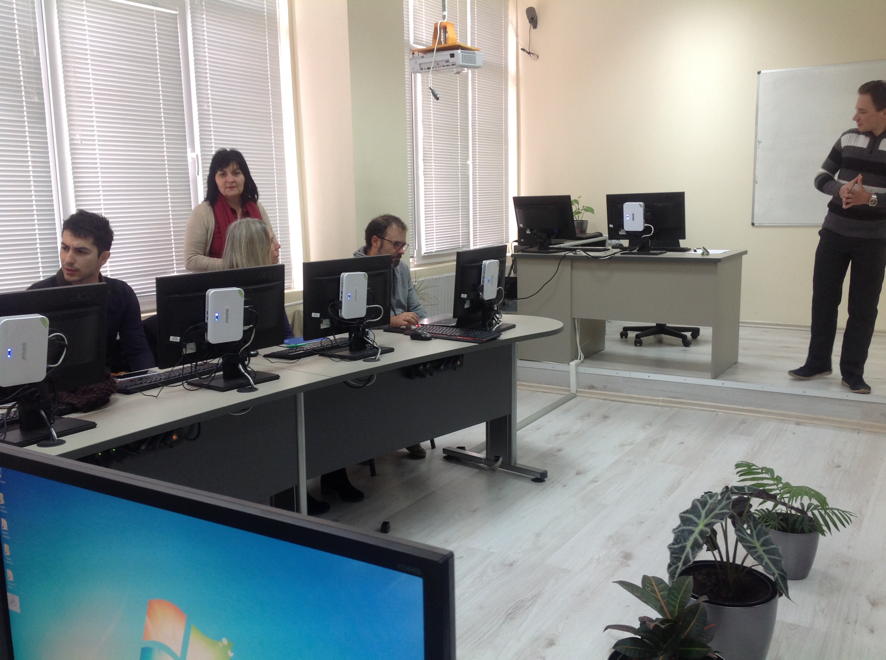

Slide 19
The workshop was presented during
the First Transnational meeting
in October 2016 held in SU Ekzarh Antim I,
Kazanlak, Bulgaria

Slide 20
References
ALL PICTURES in the presentation are screenshots of the RapidTyping software.
THIS SOFTWARE is downloaded from http://www.rapidtyping.com/
Tools for testing:
https://10fastfingers.com/typing-test/english
http://rapidtyping.com/online-typing-games/fast-typer-2.html
You may also be interested about DVORAK keyboard layout:
http://www.dvorak-keyboard.com/

