Slide 1
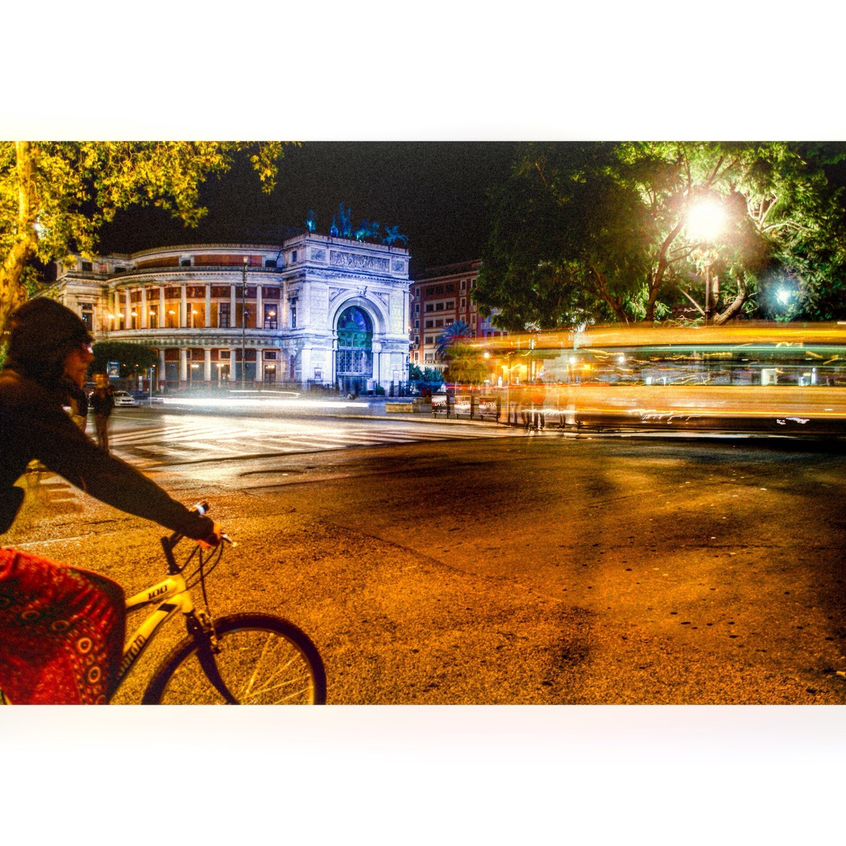
In my life..
I have seen asounding views,
I have heard sounds coming from the trees,
I have touched every animal,
I have smelled unforgettable flowers perfumes,
I have tasted particular cakes on the tables,
I have done whatever to pass on something about my life to you.

